Slide 1
Unit Testing with JUnit

Slide 2
Unit Testing
What is unit testing?
Breaking up our application into very small pieces, units, and testing them individually to make sure it is doing what we expect it to do
When should we be unit testing?
Always!
If we have a bug in the application we can fix it and write a test to make sure any new changes to the code won’t have the same bug reappear

Slide 3
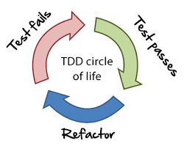
Unit Testing
New Code
Once a developer adds more code, they need to write unit tests for the new code to ensure it is working properly
The tests can actually be written first
TDD - Test Driven Development
Refactoring
Allows for code refactoring at a later date and test to make sure everything is still running smoothly or quickly find what tests fail
What is a test case?
A test case is a set of conditions or variables under which a tester will determine whether an application is working correctly
Once we break up our code into a unit we can come up with test cases that will determine if the unit is working correctly

Slide 4
JUnit
What is JUnit?
JUnit is an open source framework that has been designed for the purpose of writing and running tests in the Java programming language.
JUnit helps us to code and test both during the development.
JUnit provides also a graphical user interface (GUI) which makes it possible to write and test source code quickly and easily. JUnit shows test progress in a bar that is green if testing is going fine and it turns red when a test fails.

Slide 5
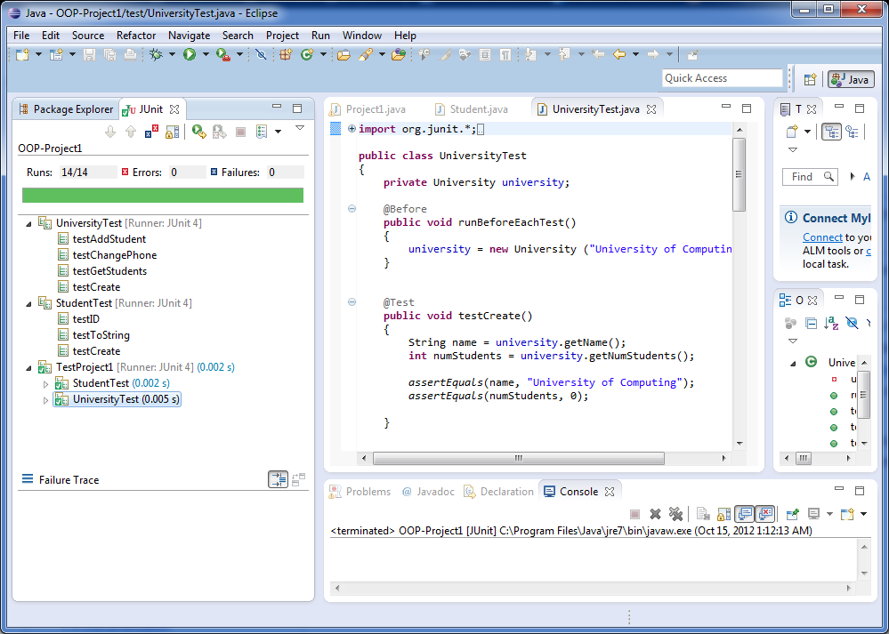
JUnit Interface

Slide 6
Unit Testing with JUnit
Junit uses annotations @, such as:
@Test – specifies a method as a test to run
@Before - Run before @Test
@After – Run after @Test
@BeforeClass – Run once before any of the test methods in the class
@AfterClass – Run once after all the tests in the class have been run
JUnit comes with assert methods that be used to evaluate a test
assertsEquals(“Message upon fail”, expectValue, actualValue);
Tests should be create independently and not fail because another test failed
The order in which the tests run shouldn’t cause a test to fail

Slide 7
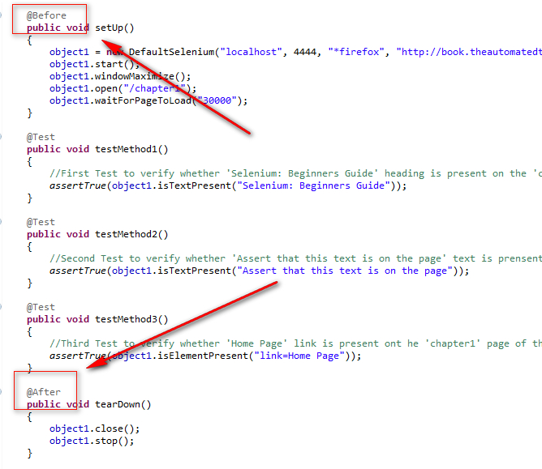
JUnit Annotations @

