Slide 1
Working With Relational Database Management Systems
Using: PostgreSQL

Slide 2
Database System Types
Online Transaction Processing(OLTP)
What is it?
Updates to database are instant
Normalized to 3NF
Data updates are kept as short as possible
High number of Indexes – faster speed

Slide 3
Database System Types (cont.)
Online Analytic Processing(OLAP)
Static data, infrequent updates
No normalization, few indexes
Also know as “Data Warehouses”

Slide 4
Intro to PostgreSQL
Relational Database Management System
What is it?
Database – container for objects that store data and retrieve data in a safe and secure manner
Tables – where the data is stored, contain one or more columns
Columns – provides a definition of each single item of information, that builds up to a table definition. Each has it’s own data type.
Rows – also called records, define a single unit of information

Slide 5
Database Design
Important points to think about or do when designing a DB:
What kind of data will the database be storing?
Gathering info from the business users
Organizing info into logical units
Employees have common properties such as Name, Address, SSN, DateOfHire, Salary, etc.
What kind of relationships exist between units
One employee will receive multiple paychecks, which have their own distinct properties.

Slide 6
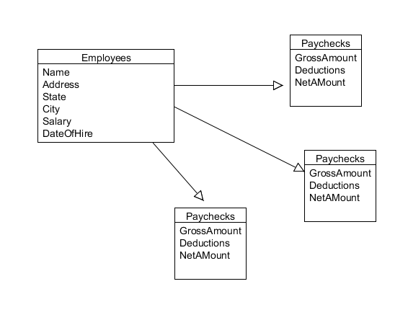
Database Design(cont.)
What are some other tables we could add?

Slide 7
Relationships
Now that we have discussed DB design, let’s take a look at tables and their relationships with other tables
A relationship in a RDBMS such as SQL Server is a logical link between two tables.
Relationships are established through the use of keys
Keys are a way identifying a record or row in a table:
Primary keys – a column, or columns, which serve as the unique identifiers of a row and can not be null.
Foreign key – references primary key in another table. Does not need to be unique

Slide 8
1:n Relationship
A one to many relationship(1:n) is established by using a PK in a table, and referencing that PK in another table as a FK.
Think about it: One unique employee(unique), must be a present employee(not null) can receive many paychecks. However, a paycheck can only be sent to one specific, present employee.
A 1:n relationship is very common in a Database
Other 1:n relationships:
Customer to Orders
Dept to employees

Slide 9
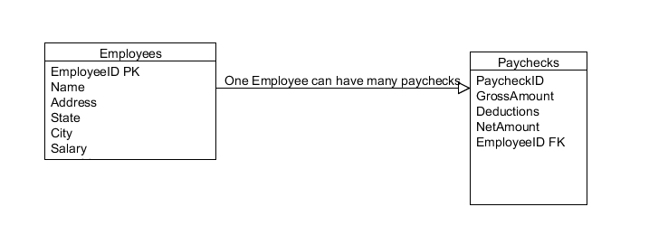
1:n Relationship
Employees contains PK –unique, not null
Paychecks contains the EmployeeID FK, does not need to be unique

Slide 10
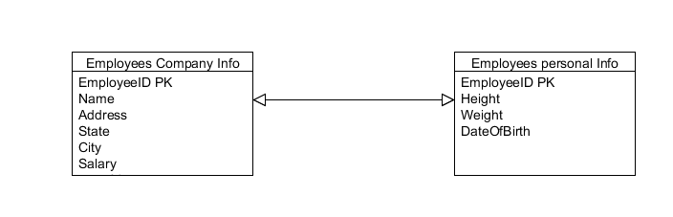
1:1 Relationship
Not very common unless splitting large table into smaller tables
Generally can use if certain columns in a table are rarely used

Slide 11
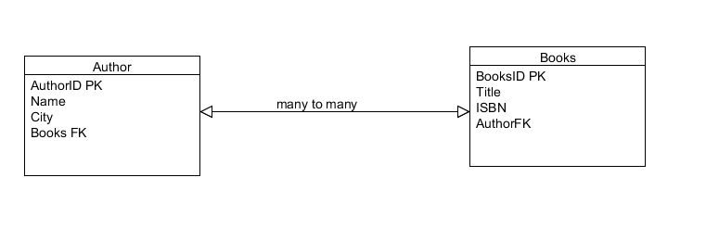
n:n Relationship
Possible, however most DBA’s will break a many to many relationship into two 1:n relationships
The tables will use a junction table to enforce efficiency in the design

Slide 12
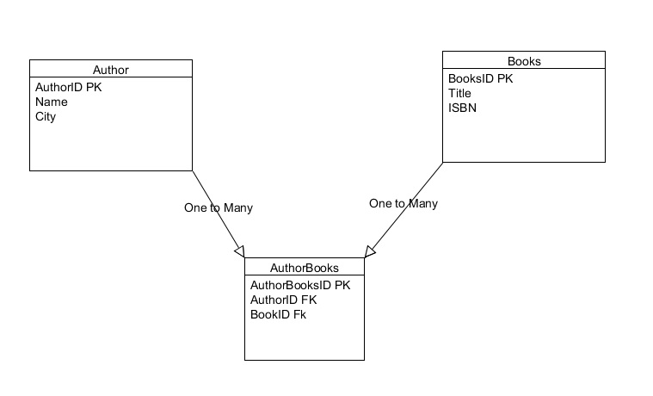
n:n Relationship(cont.)
A junction table will increase efficiency

Slide 13
Normalization
Minimize data redundancy, reduce duplicate data
Tables should be atomic(granular) in nature
Only store information related to that table
Each table should have their own unique identifier

Slide 14
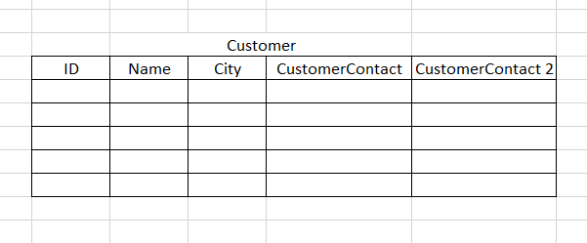
1NF
Table should be atomic in nature, meaning break up columns into granular values.
Example, name column can be broken up to FirstName and LastName
Address column can be broken up to Street, City, State, and Zip
How can we make this table conform to the 1NF?

Slide 15
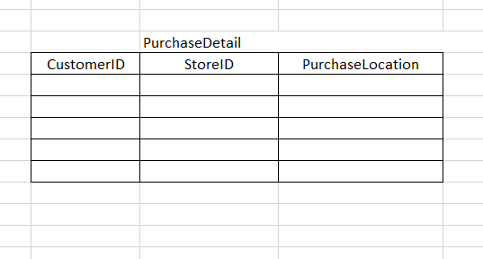
2NF
Any non-key field should be dependent on entire primary key
Must satisfy 1NF to qualify for 2NF
A table that is in 1st normal form and contains only a single key as the primary key is automatically in 2nd normal form.
Composite Key
PurchaseLocation is not dependent on entire PK

Slide 16
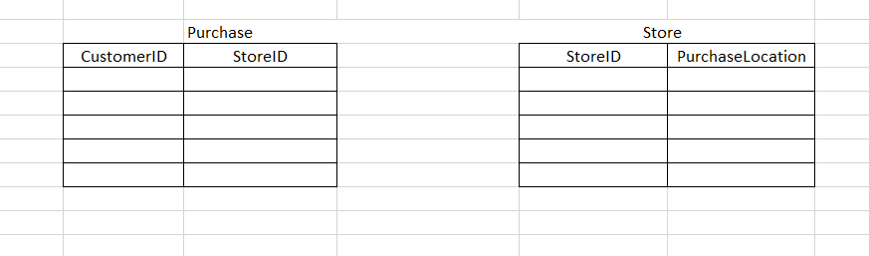
2NF
Breaking up the table will get rid of non-dependencies

Slide 17
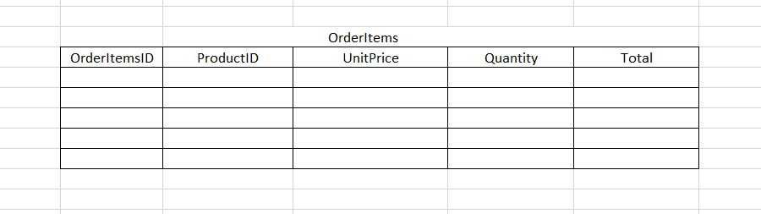
3NF
No non-key should be dependent on another non-key field
Table should comply and satisfy rules of 1NF and 2NF
Total does not make sense since it depends on UnitPrice and Quantity. You could have an illogical value added

Slide 18
Denormalization
Adding redundancy and duplication
Normalized data takes less space, but may require a join predicate to construct the desired result set, takes longer to read(query) data
Denormalized data is replicated in several places. It then takes more space, but the result set of a query takes less times
this improves reading data (because data is readily available), but updating data becomes more costly (because you need to update the replicated data).

Slide 19
Constraints
Constraints let you define the way the Database Engine automatically enforces the integrity of a database. Constraints define rules regarding the values allowed in columns and are the standard mechanism for enforcing integrity
The classes of constraints are:
UNIQUE
NOT NULL
CHECK
PK
FK – Referential Integrity

Slide 20
Check
Check constraint requires data entered into a column to fit a Boolean expression.
CREATE TABLE grades (
id SERIAL PRIMARY KEY,
student_id INTEGER REFERENCES students(id),
assignment_id INTEGER REFERENCES assignments(id),
grade FLOAT CHECK (grade >= 0 AND grade <= 100)
);

Slide 21
NOT NULL
The NOT NULL constraint designates that a column will not allow a NULL value.
CREATE TABLE grades (
id SERIAL PRIMARY KEY,
student_id INTEGER REFERENCES students(id) NOT NULL,
assignment_id INTEGER REFERENCES assignments(id) NOT NULL,
grade FLOAT CHECK (grade >= 0 AND grade <= 100)
);

Slide 22
UNIQUE
A unique constraint on a column requires that values entered into this column must be unique to the column.
Unique constraints can be applied to multiple columns to designate that the included columns combined data must be unique as a whole.
CREATE TABLE names_i_like (
id SERIAL PRIMARY KEY,
name VARCHAR(20) UNIQUE
);
CREATE TABLE names_for_animals (
id SERIAL PRIMARY KEY,
animal VARCHAR(20),
name VARCHAR(20),
UNIQUE(animal, name)
);

Slide 23
PRIMARY KEY
A primary key serves as a unique identifier for a row of data.
Primary keys are implicitly UNIQUE and NOT NULL.
A tables primary key can be formed from multiple columns as a composite primary key.
CREATE TABLE my_keys (
id SERIAL PRIMARY KEY);
CREATE TABLE my_composite_keys (
id integer,
other_id SERIAL,
PRIMARY KEY(id, other_id)
);

Slide 24
FOREIGN KEY
The foreign key constraint defines that a column value references a row in another table (or potentially the same table).
A foreign key column must reference a valid row in the other table or otherwise be null. This helps to enforce referential integrity.
CREATE TABLE table_a (
id SERIAL PRIMARY KEY
);
CREATE TABLE table_b (
id SERIAL PRIMARY KEY,
table_a_ref INTEGER REFERENCES table_a(id)
);

Slide 25
ON DELETE
The ON DELETE clause allows the definition of behavior following the deletion of a referenced row. This stop data from being orphaned and maintain referential integrity.
NO ACTION – No action follows the deletion of referenced rows. Warning: This will likely result in orphaned data and the loss of referential integrity.
RESTRICT – prevents deletion of rows which are being referenced by other rows
CASCADE – Upon deletion of a referenced row, delete referencing rows.
SET NULL – Upon deletion set referencing columns to null. Warning: This will likely result in orphaned data.
SET DEFAULT – Upon deletion set referencing columns to a define default value. Warning: This will likely result in orphaned data.

Slide 26
PostgreSQL
In this course will be working primarily with PostgreSQL 10
We will use pgAdmin as a development and testing environment

Slide 27
Building a sample Database
Now we can try to build our own database and normalize it to the 3NF
Think about real world objects, what data types your attributes will be, what keys you will need, and what kind of relationships you will set up
Remember to Normalize your tables!

Slide 28
Structured Query Language
Structured Query Language (SQL) is used to communicate with a database.
According to ANSI (American National Standards Institute), it is the standard language for relational database management systems.
SQL statements are used to perform tasks such as update data on a database, or retrieve data from a database.
Common relational database management systems that use SQL are: Oracle, Sybase, Microsoft SQL Server, DB2, etc.

Slide 29
Working with SQL Statements
Data Definition Language (DDL)
DDL statements are used to build and modify the structure of your tables and other objects in the database. When you execute a DDL statement, it takes effect immediately.
CREATE TABLE <table name> (
<attribute name 1> <data type 1>,
<attribute name 2> <data type 2>);
ALTER TABLE <table name>
ADD PRIMARY KEY <attribute name 1>;
DROP TABLE <table name>

Slide 30
SQL Statements
Data Manipulation Language
Used for inserting, deleting and updating data in a database Performing read-only queries of data is also considered a component of DML.
Examples of DML are:
INSERT, UPDATE, DELETE
Data Query Language
Used for querying data
SELECT

Slide 31
Practice with DDL
In SSMS select new query and use the DDL statements to create a new DB and a table with no PK
Use the ALTER statement to add a PK constraint
Use the DROP statement to delete the table

Slide 32
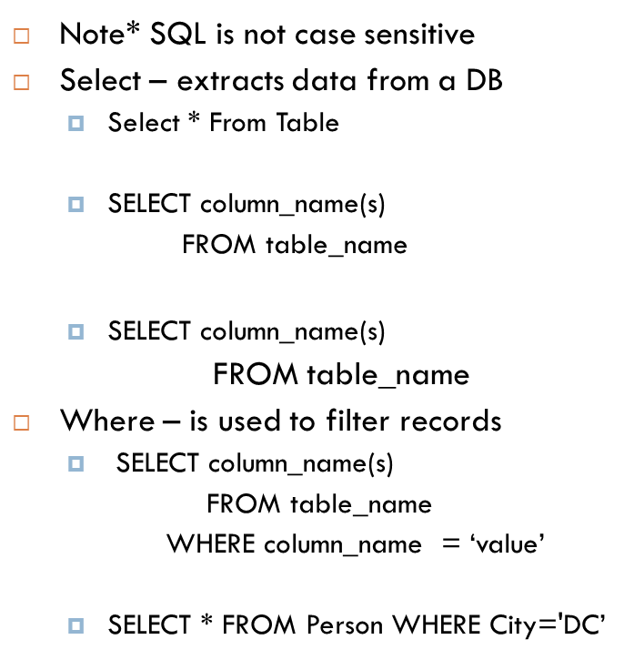
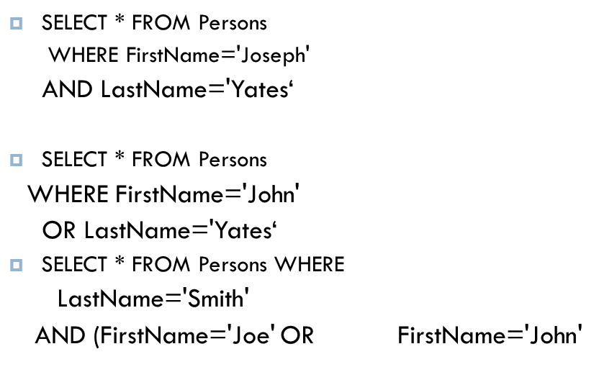
SELECT Statement

Slide 33
Order By
Order By – used to sort the result-set by a specified column
SELECT column_name(s) FROM table_name ORDER BY column_name(s) ASC|DESC
Select * From Persons
Order By LastName

Slide 34
INSERT INTO Statement
Insert Into – used to insert a new row into a table
INSERT INTO table_name VALUES (value1, value2, value3,...)
INSERT INTO table_name (column1, column2, column3,...) VALUES (value1, value2, value3,...)
Inserting multiple rows in a single statement
INSERT INTO table_name (column1, column2, column3,…)
VALUES (value1, value2, value3,…), (value1, value2, value3,…)…;

Slide 35
UPDATE
Update – used to update records in a table
UPDATE table_name SET column1=value, column2=value2,... WHERE some_column=some_value
*be careful when using update, make sure to specify a where clause or your entire table will be updated
UPDATE Persons SET Address='55 Fairfax Blvd', City='Fairfax' WHERE LastName='Mike' AND FirstName=’Joseph’

Slide 36
LIKE
The LIKE operator is used to list all rows in a table whose column values match a specified pattern. It is useful when you want to search rows to match a specific pattern, or when you do not know the entire value. For this purpose we use a wildcard character '%'.
SELECT first_name, last_name FROM customer WHERE first_name LIKE 'S%';
“%” signifies multiple characters and “_” specifies single character.

Slide 37
BETWEEN Operator
The operator BETWEEN and AND, are used to compare data for a range of values.
SELECT first_name, last_name, age FROM student_details WHERE age BETWEEN 10 AND 15;

Slide 38
IN Operator
The IN operator is used when you want to compare a column with more than one value. It is similar to an OR condition.
SELECT first_name, last_name, subject FROM student_details WHERE subject IN ('Math', 'Science');
NOTE: The data used to compare is case sensitive

Slide 39
DELETE Statement
Delete – used to delete records in a table
DELETE FROM table_name WHERE some_column=some_value
DELETE * FROM table_name

Slide 40
SQL Functions
Aggregate functions
COUNT(), MAX(), MIN(), AVG(), SUM()
SQL Functions
NOW(), NOW()::date, current_user
String Functions
UPPER(), LENGTH()

Slide 41
Advantages to Stored Procedures
Security: Users can execute a stored procedure without needing to execute any of the statements directly. Therefore, a stored procedure can provide advanced database functionality for users who wouldn't normally have access to these tasks, but this functionality is made available in a tightly controlled way.
Faster execution: Stored procedures are parsed and optimized as soon as they are created and the stored procedure is stored in memory. This means that it will execute a lot faster than sending many lines of SQL code from your application to the SQL Server. Doing that requires SQL Server to compile and optimize your SQL code every time it runs.
Reduced network traffic: If you send many lines of SQL code over the network to your SQL Server, this will have an impact on network performance. This is especially true if you have hundreds of lines of SQL code and/or you have lots of activity in your application. Running the code on the SQL Server (as a stored procedure) eliminates the need to send this code over the network.
Reusable: You can write a stored procedure once, then call it from multiple places in your application

Slide 42
Transactions
Think about a banking system
Move money from checking into savings
First you need to subtract from checking then add to savings
Both events must occur for transaction to succeed
ACID properties
Atomic – must all happen or none occur
Consistent – can not violate any integrity rules, the database is left in a stable state at the end of the transaction
Isolated – data is locked, system can not access that data
Durable – robust data, survivability, data endures
Implicit vs Explicit

Slide 43
Triggers
Specialized stored procedure that executes on a DML or DDL statement
DML trigger – enforces business rules
Insert trigger
Update trigger
Delete trigger
FOR/AFTER trigger
After underlying data is modified
Can not be used in views
INSTEAD OF trigger
Runs in place of DML statement
Ex. “Insert”

Slide 44
Joins
With joins you can retrieve data from two or more tables based on logical relationships between the tables
a join condition defines the way two tables are related in a query by specifying the column from each table to be used for the join. A typical join condition specifies a foreign key from one table and its associated key in the other table usually a PK.
joins are typically performed in the FROM clause of a table or view for the SELECT, INSERT...SELECT, SELECT...INTO, UPDATE and DELETE statements

Slide 45
Inner Join
Inner join returns only those records/rows that match/exists in both the tables.
--Companies and contacts with where we ship their items.
select CompanyName, ContactName, ContactTitle, ShipAddress, ShipCity
from Customers c inner join Orders o
on c.CustomerID = o.CustomerID
-- What categories products fall into and their description
select ProductName, UnitPrice, CategoryName, Description
from Products p inner join Categories c
on p.CategoryID = c.CategoryID

Slide 46
Right Outer Join
The RIGHT JOIN keyword returns all the rows from the right table, even if there are no matches in the left table. If there are no columns matching in the left table, it returns NULL values.
--Employees processing orders and when they were shipped.
select e.FirstName, e.LastName, o.OrderDate, o.ShippedDate
from Employees e right join Orders o
on e.EmployeeID = o.EmployeeID

Slide 47
Left Outer Join
The LEFT JOIN keyword returns all rows from the left table, even if there are no matches in the right table If there are no columns matching in the right table, it returns NULL values.
select e.FirstName, e.LastName, o.ShipName
from Employees e left join Orders o
on e.EmployeeID = o.EmployeeID
Select c.CompanyName, c.ContactName, o.ShippedDate, o.Freight
from Customers c left join Orders o
on c.CustomerID = o.CustomerID
where o.Freight > 5

Slide 48
Full Outer Join
Based on the two tables specified in the join clause, all data is returned from both tables regardless of matching data
-- Products we sell and where/who we get them from.
select ProductName, UnitPrice, CompanyName, ContactName
from Products p full outer join Suppliers s
on p.SupplierID = s.SupplierID
where UnitPrice > 10

Slide 49
Cross Join
Cross join is a Cartesian join means Cartesian product of both the tables. This join does not need any condition to join two tables. This join returns records/rows that are multiplication of record number from both the tables means each row on left table will related to each row of right table

Slide 50
Self Join
Self join is used to retrieve the records having some relation or similarity with other records in the same table
Assume we have an employee table, one of the columns in the same table contains the ID of a manager, who is also an employee for the same company. This way, all the employees and their managers are present in the same table. If we want to find the manager of a particular employee, we need to use a self join.
Note - Self Joins are not actually their own type of joins they are Outer, Inner, or Cross joins.

Slide 51
Self Joins
SELECT e1.Name EmployeeName, e2.name AS ManagerName
FROM Employee e1 INNER JOIN Employee e2 ON e1.ManagerID = e2.EmployeeID
SELECT e1.Name EmployeeName, ISNULL(e2.name, 'Top Manager') AS ManagerName
FROM Employee e1
LEFT JOIN Employee e2
ON e1.ManagerID = e2.EmployeeID
Checks 1st parameter for Null, true returns 2nd
Outer and Inner are performed as “Self Joins”

Slide 52
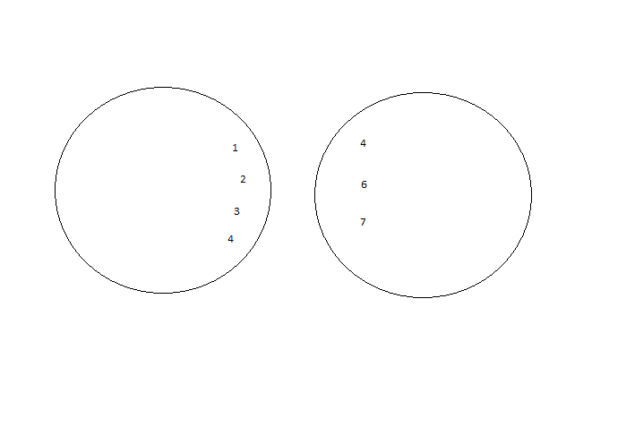
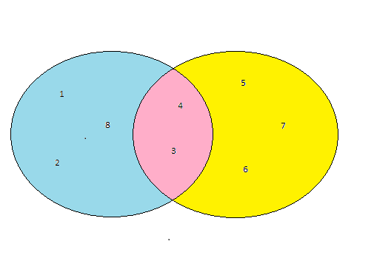


Joins still confusing?
Full Outer Join
Left Join
Inner
Right Join
Cross Join
Left
Right

Slide 53
UNION vs UNION ALL
UNION
The UNION command is used to select related information from two tables, much like the JOIN command. However, when using the UNION command all selected columns need to be of the same data type. With UNION, only distinct values are selected.
UNION ALL
The UNION ALL command is equal to the UNION command, except that UNION ALL selects all values.
The difference between Union and Union all is that Union all will not eliminate duplicate rows, instead it just pulls all rows from all tables fitting your query and combines them into a table.
A UNION statement effectively does a SELECT DISTINCT on the results set. If you know that all the records returned are unique from your union, use UNION ALL instead, it gives faster results.

Slide 54
Views
views can be thought of as either a virtual table or a stored query. The data accessible through a view is not stored in the database as a distinct object. What is stored in the database is a SELECT statement. The result set of the SELECT statement forms the virtual table returned by the view
Virtual tables are used when security is a concern and can span multiple tables using joins
Restrict a user to specific rows in a table.
Ex. allow an employee to see only the rows recording his or her work in a labor-tracking table.
Restrict a user to specific columns.
Ex. allow employees who do not work in payroll to see the name, office, work phone, and department columns in an employee table, but do not allow them to see any columns with salary information or personal information.
Join columns from multiple tables so that they look like a single table.
Aggregate information instead of supplying details.
Ex. present the sum of a column, or the maximum or minimum value from a column

Slide 55
Views(cont.)
If we wanted to create a view that would encapsulate the details of an employee who had all their personal information, like salary and SSN, we could use a view. Then if an end user needed to access the info of an employee, like name or work number, they could so through a view
CREATE VIEW EmployeeInfo
AS
SELECT FirstName, LastName, WorkNumber
FROM Employees
Then you could use a SELECT statement to query the View
Select * from EmployeeInfo

Slide 56
Indexes
The most important route to high performance in a SQL Server database is the index. Indexes speed up the querying process by providing swift access to rows in the data tables, similarly to the way a book’s index helps you find information quickly within that book.
Indexes are created on columns in tables or views. The index provides a fast way to look up data based on the values within those columns. For example, if you create an index on the primary key and then search for a row of data based on one of the primary key values, SQL Server first finds that value in the index, and then uses the index to quickly locate the entire row of data. Without the index, a table scan would have to be performed in order to locate the row, which can have a significant effect on performance.
Data is arranged by SQL Server in the form of extents and pages. Each extent is of size 64 KB, having 8 pages of 8KB sizes. An extent may have data from multiple or same table, but each page holds data from a single table only
What is a B-tree?

Slide 57
Indexes(cont.)
A table is nothing but a collection of record sets; by default, rows are stored in the form of heaps unless a clustered index has been defined on the table, in which case, record sets are sorted and stored on the clustered index. The heap’s structure is a simple arrangement where the inserted record is stored in the next available space on the table page
Heaps are good at storing data, however heaps are inefficient when a large amount of reads are being performed
Indexes are arranged in the form of a B-Tree where the leaf node holds the data or a pointer to the data. Since the stored data is in a sorted order, indexes precisely know which record is sitting where. Hence an index optimizes and enhances the data retrieval immensely
Every time there is a DML (insert/update/delete) fired on an indexed table, SQL Server updates the index to be able to identify the record. Hence if there are more indexes, it’s liable that the DMLs will take a longer time to execute

Slide 58
Indexes(cont.)
Clustered Index
clustered index will be created on a table by default the moment a primary key is created on the table
A table can only have one CI
key-value pair in the clustered index has the index key and the actual data value
If a table has no clustered index, its data rows are stored in an unordered structure called a heap.
Non-Clustered Index
Nonclustered indexes have a structure separate from the data rows. A nonclustered index contains the nonclustered index key values and each key value entry has a pointer to the data row that contains the key value.
The pointer from an index row in a nonclustered index to a data row is called a row locator. The structure of the row locator depends on whether the data pages are stored in a heap or a clustered table. For a heap, a row locator is a pointer to the row. For a clustered table, the row locator is the clustered index key

Slide 59
SQL Server Administration
SQL Profiler is a tool provided by SQL Server for DBA’s/Developers to analyze queries
a rich interface to create and manage traces and analyze and replay trace results
events are saved in a trace file that can later be analyzed or used to replay a specific series of steps when trying to diagnose a problem.
Backup/Restore
Use a .bak file to restore a database to SQL Server, also can create a .bak file from a database
Use a .mdf file to attach an existing database to SQL Server

Slide 60
Agenda
Introduction
Types of Languages
DDL and DML
Constraints
Select Statements
Clauses
Joins

Slide 61
Introduction
Structured Query Language (SQL) is used to communicate with a database.
According to ANSI (American National Standards Institute), it is the standard language for relational database management systems.
SQL statements are used to perform tasks such as update data on a database, or retrieve data from a database.
Common relational database management systems that use SQL are: Oracle, Sybase, Microsoft SQL Server, DB2, etc.

Slide 62
Types of Languages
DDL – Data Definition Language
create, alter and drop
DML – Data Manipulation Language
insert, update and delete
DQL – Data Query Language
select
TCL – Transaction Control Language
commit, rollback and savepoint

Slide 63
DDL
Data Definition Language (DDL) statements are used to define the database structure or schema.
CREATE
to create objects in the database like Table
ALTER
alters the structure of the database table
DROP
delete objects like table from the database

Slide 64
Tables
A relational database system contains one or more objects called tables.
The data or information for the database are stored in these tables.
Tables are uniquely identified by their names and are comprised of columns and rows.
Columns contain the column name, data type, and any other attributes for the column.
Rows contain the records or data for the columns.

Slide 65
Constraints
SQL constraints are rules that you define which data values are valid while doing INSERT, UPDATE, and DELETE operations.
When constraints are in place, SQL engine rejects all the transactions that break the rules therefore constraints help you enforce the integrity of data automatically.
SQL provides five types of constraints
PRIMARY KEY
NOT NULL
UNIQUE
FOREIGN KEY
CHECK

Slide 66
Constraints
Primary key
This constraint defines a column or combination of columns which uniquely identifies each row in the table.
Foreign key or Referential Integrity
This constraint identifies any column referencing the PRIMARY KEY in another table. It establishes a relationship between two columns in the same table or between different tables.
Not Null
This constraint ensures all rows in the table contain a definite value for the column which is specified as not null. Which means a null value is not allowed.

Slide 67
Constraints
Unique key
This constraint ensures that a column or a group of columns in each row have a distinct value. A column(s) can have a null value but the values cannot be duplicated.
Check
This constraint defines a business rule on a column. All the rows must satisfy this rule. The constraint can be applied for a single column or a group of columns.

Slide 68
DML
Data Manipulation Language (DML) statements are used for managing data within schema objects.
INSERT
insert data into a table
UPDATE
updates existing data within a table
DELETE
deletes specific or all records from a table

Slide 69
Insert statement
The insert statement is used to insert or add a row of data into the table.
To insert records into a table, enter the key words insert into followed by the table name, followed by the keyword values, followed by the list of values enclosed in parenthesis.
Strings should be enclosed in single quotes, and numbers should not.
insert into "tablename" (first_column,...last_column) values (first_value,...last_value);

Slide 70
Update statement
The update statement is used to update or change records that match a specified criteria.
This is accomplished by carefully constructing a where clause.
update "tablename" set "columnname" = "newvalue" [,"nextcolumn" = "newvalue2"...] where "columnname" OPERATOR "value" [and|or "column" OPERATOR "value"];

Slide 71
Delete statement
The delete statement is used to delete records or rows from the table.
delete from "tablename" where "columnname" OPERATOR "value" [and|or "column" OPERATOR "value"];
To delete an entire record/row from a table, enter "delete from" followed by the table name, followed by the where clause which contains the conditions to delete. If you leave off the where clause, all records will be deleted.

Slide 72
Drop table
The drop table command is used to delete a table and all rows in the table.
To delete an entire table including all of its rows, issue the drop table command followed by the tablename.
drop table is different from deleting all of the records in the table. Deleting all of the records in the table leaves the table including column and constraint information.
Dropping the table removes the table definition as well as all of its rows.
drop table "tablename"

Slide 73
TCL
Transaction control statements manage changes made by DML statements.
A transaction is a set of SQL statements which is treated as a Single Unit. i.e. all the statements should execute successfully or none.
COMMIT
Make changes done in transaction permanent.
ROLLBACK
Revert the state of database to the last commit point.
SAVEPOINT
Use to specify a point in transaction to which later you can rollback.

Slide 74
Select statement
The select statement is used to query the database and retrieve selected data that match the criteria that you specify.
You can select as many column names that you'd like, or you can use a "*" to select all columns.
The table name that follows the keyword from specifies the table that will be queried to retrieve the desired results.
The where clause (optional) specifies which data values or rows will be returned or displayed, based on the criteria described after the keyword where.
select "column1" [,"column2",etc] from "tablename" [where "condition"];

Slide 75
Select statement
Conditional selection used in where clause
= | Equal
> | Greater than
< | Less than
>= | Greater than or equal
<= | Less than or equal
<> | Not equal to

Slide 76
Aggregate functions
MIN | returns the smallest value in a given column
MAX | returns the largest value in a given column
SUM | returns the sum of the numeric values in a given column
AVG | returns the average value of a given column
COUNT | returns the total number of values in a given column
COUNT(*) | returns the number of rows in a table

Slide 77
Where Clause
The WHERE Clause is used when you want to retrieve specific information from a table excluding other irrelevant data.
The condition provided in the WHERE clause filters the rows retrieved from the table and gives only those rows which is expected.
select "column1" [,"column2",etc] from "tablename" [where "condition"];
WHERE clause can be used along with SELECT, DELETE, UPDATE statements.

Slide 78
Group by clause
The GROUP BY clause will gather all of the rows together that contain data in the specified column(s) and will allow aggregate functions to be performed on the one or more columns.
SELECT column1, SUM(column2) FROM "list-of-tables" GROUP BY "column-list";

Slide 79
Having clause
The HAVING clause allows you to specify conditions on the rows for each group - in other words, which rows should be selected will be based on the conditions you specify.
The HAVING clause should follow the GROUP BY clause if you are going to use it.
SELECT column1, SUM(column2) FROM "list-of-tables" GROUP BY "column-list" HAVING "condition";

Slide 80
Order by clause
ORDER BY is an optional clause which will allow you to display the results of your query in a sorted order (either ascending order or descending order) based on the columns that you specify to order by.
If you would like to order based on multiple columns, you must separate the columns with commas.
SELECT column1, SUM(column2) FROM "list-of-tables" ORDER BY "column-list" [ASC | DESC];

Slide 81
Like
The LIKE operator is used to list all rows in a table whose column values match a specified pattern. It is useful when you want to search rows to match a specific pattern, or when you do not know the entire value. For this purpose we use a wildcard character '%'.
SELECT first_name, last_name FROM customer WHERE first_name LIKE 'S%';
“%” signifies multiple characters and “_” specifies single character.

Slide 82
Between
The operator BETWEEN and AND, are used to compare data for a range of values.
SELECT first_name, last_name, age FROM student_details WHERE age BETWEEN 10 AND 15;

Slide 83
In
The IN operator is used when you want to compare a column with more than one value. It is similar to an OR condition.
SELECT first_name, last_name, subject FROM student_details WHERE subject IN ('Maths', 'Science');
NOTE: The data used to compare is case sensitive.

Slide 84
Sequence
A sequence is a user-defined schema bound object that generates a sequence of numeric values according to the specification with which the sequence was created.
CREATE SEQUENCE seqname [ INCREMENT increment ] [ MINVALUE minvalue ] [ MAXVALUE maxvalue ] [ START start ]

Slide 85
Joins
It is one of the most beneficial features of SQL & relational database systems - the "Join".
The "Join" makes relational database systems "relational".
Joins allow you to link data from two or more tables together into a single query result--from one single SELECT statement.
A "Join" can be recognized in a SQL SELECT statement if it has more than one table after the FROM keyword.
SELECT "list-of-columns" FROM table1,table2 WHERE "search-condition(s)"

Slide 86
Joins
Equi joins
It is a simple sql join condition which uses the equal sign as the comparison operator. Two types of equi joins are SQL Outer join and SQL Inner join.
Inner Join
All the rows returned by the sql query satisfy the sql join condition specified.
Outer Join
This sql join returns all rows from both tables which satisfy the join condition along with rows which do not satisfy the join condition from one of the tables.
Non equi joins
It is a sql join condition which makes use of some comparison operator other than the equal sign like >, <, >=, <=

Slide 87
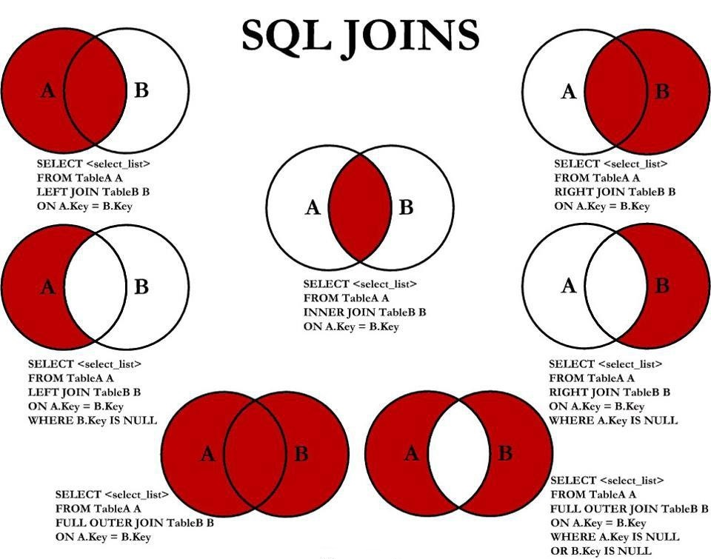

Slide 88
PL/SQL

Slide 89
Introduction
PL/SQL stands for Procedural Language extension of SQL.
PL/SQL is a combination of SQL along with the procedural features of programming languages.
PL/SQL is used for defining Procedures & Functions
PL/SQL is also used for Cursors and Triggers

Slide 90
Stored Procedures
A stored procedure is a named PL/SQL block which performs one or more specific task. This is similar to a procedure in other programming languages.
We can pass parameters to procedures in two ways.
IN-parameters: Parameters taken as arguments
OUT-parameters: Parameters giving values back.
CREATE [OR REPLACE] PROCEDURE proc_name [list of parameters] IS Declaration section BEGIN Execution section END; /

Slide 91
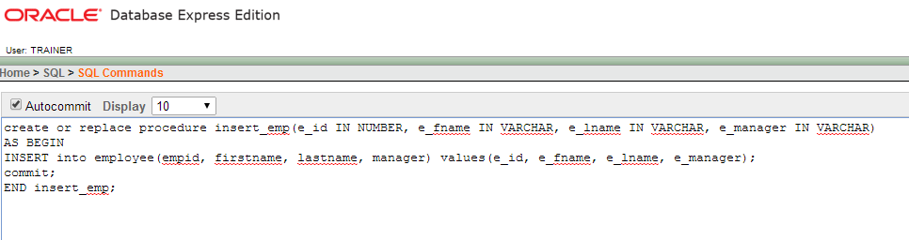
Creating a Stored Procedure in Oracle 10g XE

Slide 92
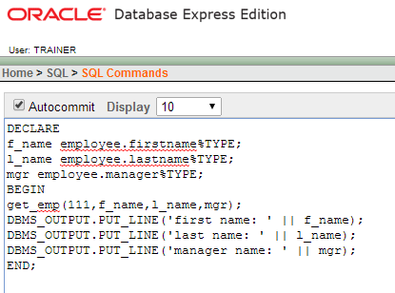
Calling a Stored Procedure in Oracle 10g XE

Slide 93
Functions
A function is a named PL/SQL Block which is similar to a procedure. The major difference between a procedure and a function is, a function must always return a value, but a procedure may or may not return a value.
CREATE [OR REPLACE] FUNCTION function_name [parameters] RETURN return_datatype IS Declaration_section BEGIN Execution_section Return return_variable; END; /

Slide 94
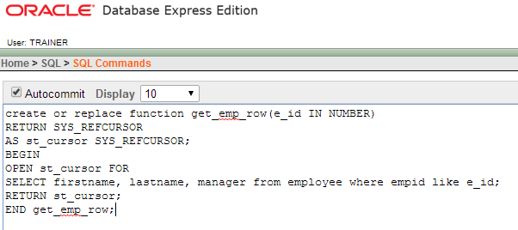
Creating a Function in Oracle 10g XE

Slide 95
Other PL/SQL Blocks
Cursor
A cursor is a temporary work area created in the system memory when a SQL statement is executed. A cursor contains information on a select statement and the rows of data accessed by it.
Trigger
A trigger is a PL/SQL block structure which is fired when a DML statements like Insert, Delete, Update is executed on a database table. A trigger is triggered automatically when an associated DML statement executes.
Row level trigger
An event is triggered for each row updated, inserted or deleted.
Statement level trigger
An event is triggered for each sql statement executed.

Slide 96
End

