Slide 1

Multithreading

Slide 2
Topics
Multithreading
Lifecycle of a Thread
Priorities
Creating a Thread
Runnable interface VS Thread Class
Thread methods
Synchronization
Deadlock

Slide 3
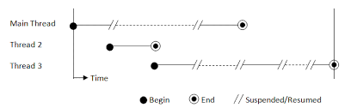
Multithreading
A multithreaded program can have two or more threads running concurrently
Each thread can have its own task
Program becomes optimized and runs faster
OS divides processing time not just with applications but between threads as well

Slide 4
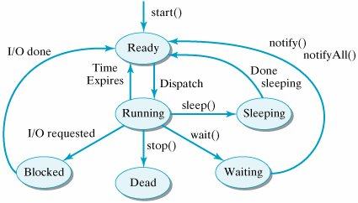
Lifecycle of a Thread
New: A thread’s lifecycle begins. Stays in this state until the program starts the thread.
Runnable: After the thread starts, its in the runnable state.
Waiting: Waits for other threads to complete the task. Will go back to runnable state only when the other thread signals it to continue executing.
Timed Waiting: A thread can be in a waiting state for a specified interval time. It goes back to the runnable state after the time has expired.
Terminated: A thread that completes the task is terminated.

Slide 5
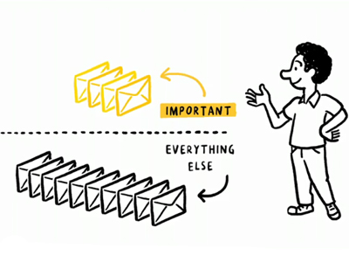
Priorities
Threads can be configured with a priority number which signifies which order threads are to be run in (Range is 1 – 10).
MIN_PRIORITY (typically a 1)
NORM_PRIORITY (defaults to 5)
MAX_PRIORITY (typically a 10)

Slide 6
Creating a Thread
Create a class that implements the Runnable interface
Implement the run() method
Pass an object of it into the Thread constructor
Call the start() method
Create a class that extends the Thread class
Override the run() method
Create an object of the class
Call the start() method
Thread | Runnable
When you want to override other Thread utility methods | When you want to extend another class

Slide 7
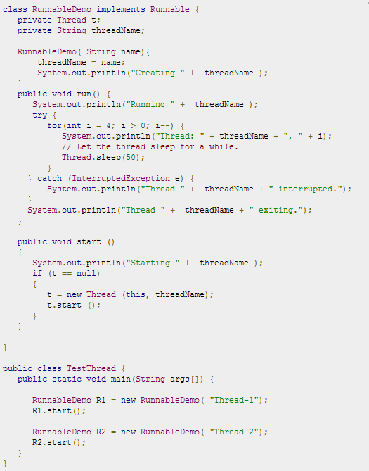
Implementing Runnable

Slide 8
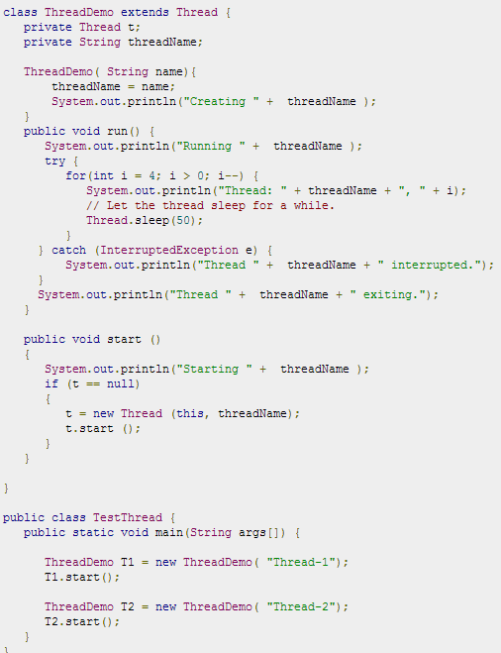
Extending Thread

Slide 9
Thread Methods
Non Static methods
public void start()
public void run()
public final void setName(String name)
public final void setPriority(int priority)
public final void setDaemon(boolean on)
public final void join(long millisecond)
public void interrupt()
public final boolean isAlive()

Slide 10
Thread Methods
Static method
public static void yield()
public static void sleep(long milliseconds)
public static boolean holdsLock(Object x)
public static Thread currentThread()
public static void dumpStack()

Slide 11
Thread Methods
Object methods that threads can use
notify()
notifyAll()
wait()

Slide 12

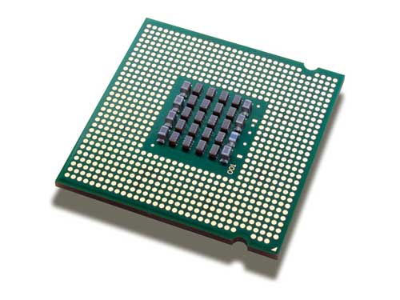
Synchronization
Problem: When two or more threads are trying to access a method or process, a race condition may occur. If one thread is writing data to a file, the other thread may overwrite that data which may cause issues in the program.
Solution: synchronize the action of multiple threads and make sure that only one thread can access the resource at a given point in time. This is implemented using a concept called monitors. Each object in Java is associated with a monitor, which a thread can lock or unlock. Only one thread at a time may hold a lock on a monitor.
The Java programming language provides a very handy way of creating threads and synchronizing their task by using synchronized blocks. You keep shared resources within this block.

Slide 13
Deadlock
Occurs due to resource locking
Thread ‘A’ locks resource ‘1’
Thread ‘B’ locks resource ‘2’
Thread ‘A’ requests resource ‘2’
Thread ‘B’ requests resource ‘1’
Neither thread can continue!
Each holds locks on resources the other needs
Release your lock, man!!
I don’t know you man… you release your lock first!

Slide 14
Review
Multithreading
Lifecycle of a Thread
Priorities
Creating a Thread
Runnable interface VS Thread Class
Thread methods
Synchronization
Deadlock

Slide 15
Assignment
Write a program that creates a thread using either a Runnable interface or Thread class. Have it call a method which prints out numbers from 1 to 10. Hint: Loop the thread.
Write a program which demonstrates synchronization between two threads. Print out the duration a thread has to wait till the prior one has completed. Loop the threads 5 times each.
Review deadlock information in your book or online.

