Slide 1

Canadian Election Study Analysis
By Wei Chen, Jason Hilberdink, John Janzen, Kani Koliji, and Abdul Mahmood Sayedi

Slide 2

Large-Scale Study conducted before and after 2019 Federal Election
Measures Canadians’ preferences on wide range of political issues
37,822 respondents
Stephenson, Laura B; Harell, Allison; Rubenson, Daniel; Loewen, Peter John, 2020, "2019 Canadian Election Study - Online Survey", https://doi.org/10.7910/DVN/DUS88V, Harvard Dataverse, V1

Slide 3
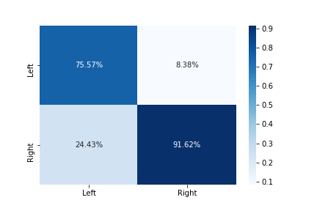
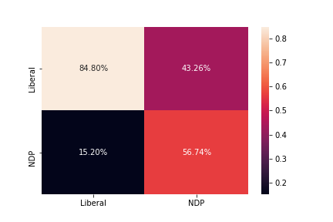
Machine Learning Results

Slide 4
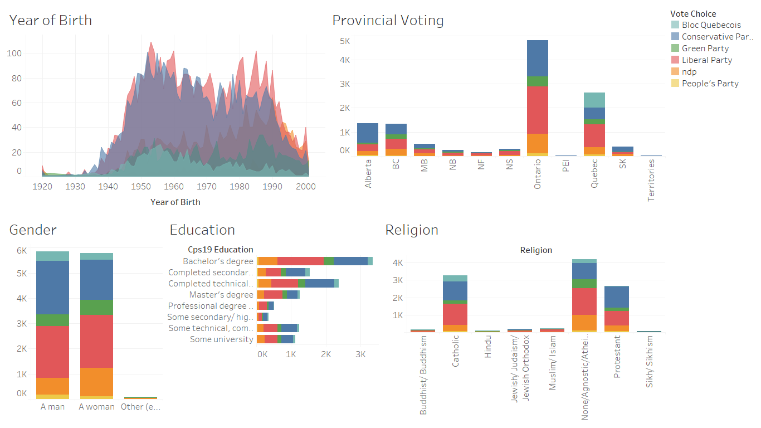

Slide 5
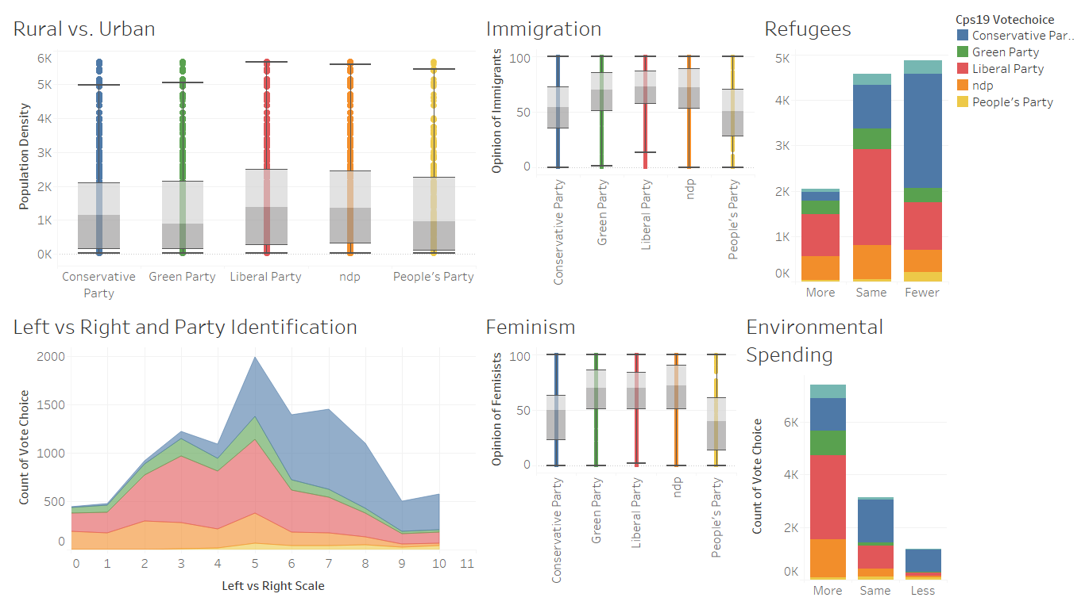

Slide 6
