Slide 1
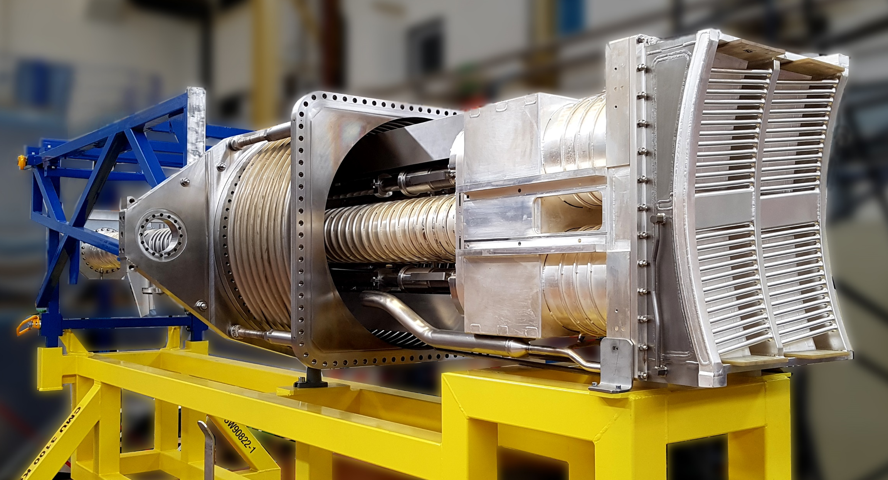
2.2 t
0.65 m
4.1 m
0.55 m

Slide 2
C_{top}
Transmission line
Z_{L}
Z_{T}
Source
Feedthrough
30 Ω
Z₀₁
Z₀₂
2 quarter-wave impedance transformers
Z_{L}
C_{bot}
Service-
stub

Slide 3
WEST ICRH Antenna Electrical Circuit
WEST ICRH antenna circuit
V₃
C₃
Front face
top
P_{fwd}, P_{ref}
port2
Z_{T}
feedthrough
Transmission line
Z₀₂
Z₀₁
30 Ω
Port 2
port4
2 quarter lines impedance transformer
V₄
C₄
bot
Service
stub
Right side
V₁
C₁
top
P_{fwd}, P_{ref}
port1
Z_{T}
feedthrough
Transmission line
Z₀₂
Z₀₁
30 Ω
Port 1
port3
2 quarter lines impedance transformer
V₂
C₂
bot
Service
stub
TOPICA, Petra-M, Full-wave models
Lumped circuit, from full-wave model
Left side
Full-wave models

Slide 4
WEST ICRH Antenna Electrical Circuit
WEST ICRH antenna circuit
C₁
V₁
P_{fwd}, P_{ref}
top
Front face
Gen 1
Transmission line
feedthrough
Z_{T}
Port 1
30 Ω
Z₀₁
Z₀₂
Port 1
Port 3
2 quarter lines impedance transformer
Service
stub
C₂
bot
V₂
Left side
C₃
V₃
P_{fwd}, P_{ref}
top
Gen 2
Transmission line
feedthrough
Z_{T}
Port 2
30 Ω
Z₀₁
Z₀₂
Port 2
Port 4
2 quarter lines impedance transformer
Service
stub
C₄
bot
V₄
TOPICA, Petra-M, Full-wave models
Lumped elements circuit from full-wave model
Right side
Full-wave models

Slide 5
WEST ICRH Antenna Electrical Circuit
WEST ICRH antenna circuit
C₁
V₁
P_{fwd}, P_{ref}
top
Front face
Gen 1
Transmission line
feedthrough
Z_{T}
30 Ω
Z₀₁
Z₀₂
Port 1
2 quarter lines impedance transformer
Service
stub
C₂
bot
V₂
Left side
C₃
V₃
P_{fwd}, P_{ref}
top
Gen 2
Transmission line
feedthrough
Z_{T}
30 Ω
Z₀₁
Z₀₂
Port 2
2 quarter lines impedance transformer
Service
stub
C₄
bot
V₄
TOPICA, Petra-M, Full-wave models
Lumped elements circuit from full-wave model
Right side
Full-wave models

Slide 6
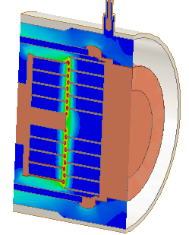
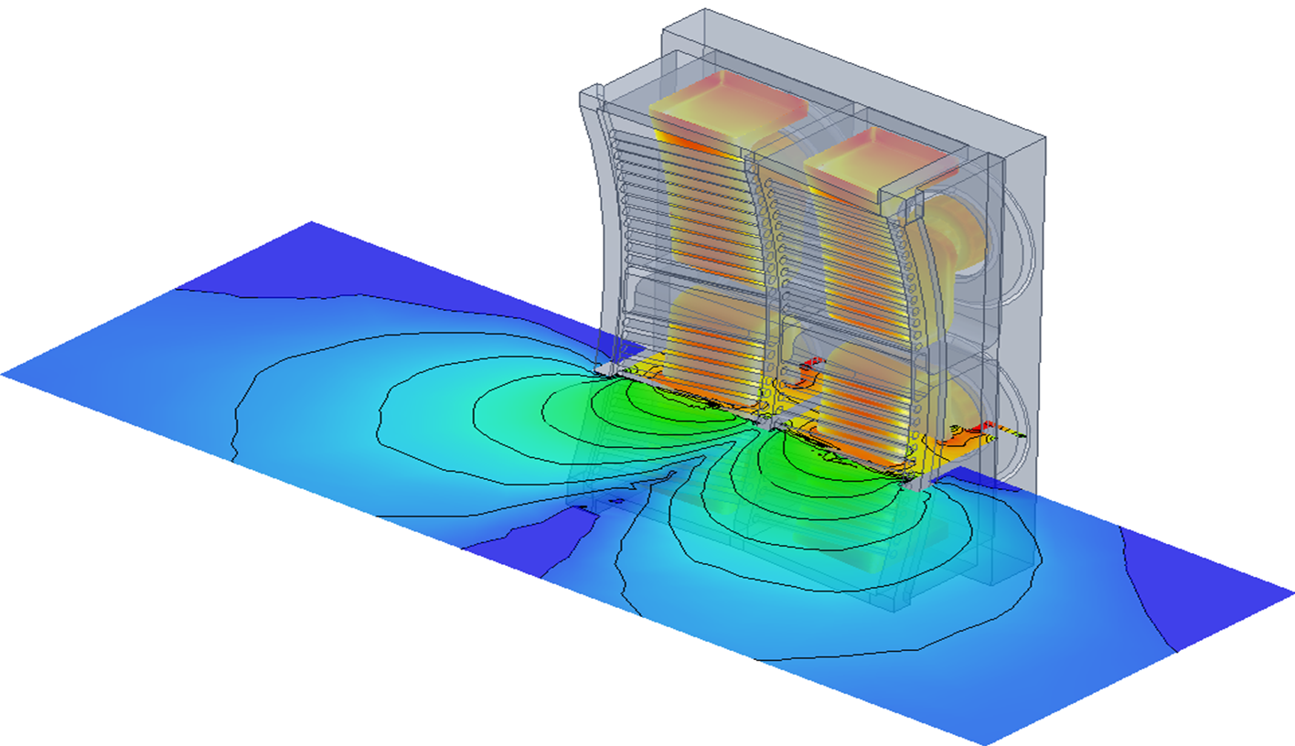
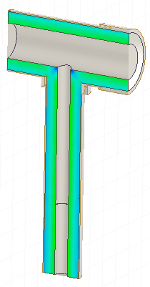
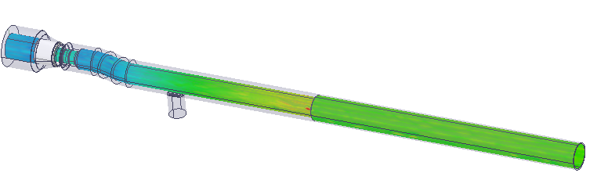
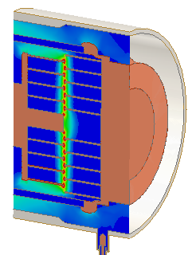
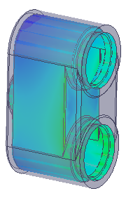
WEST ICRH Antenna Electrical Circuit
WEST ICRH antenna circuit
top
C₁
V₁
P_{fwd}, P_{ref}
Transmission line
feedthrough
Front face
Z_{T}
30 Ω
Z₀₁
Z₀₂
Gen 1
2 quarter lines impedance transformer
Service
stub
C₂
V₂
bot
Left side
top
C₃
V₃
P_{fwd}, P_{ref}
Transmission line
feedthrough
Z_{T}
30 Ω
Z₀₁
Z₀₂
Gen 2
2 quarter lines impedance transformer
Service
stub
C₄
V₄
TOPICA, Petra-M, Full-wave models
bot
Lumped circuit, from full-wave model
Right side
Full-wave models

Slide 7
WEST ICRH Antenna Electrical Circuit
WEST ICRH antenna circuit
P_{fwd}, P_{ref}
feedthrough
2 quarter lines impedance transformer
V₁
Gen 1
Service
stub
P_{fwd}, P_{ref}
Gen 2
V₃
V₂
V₄

Slide 8
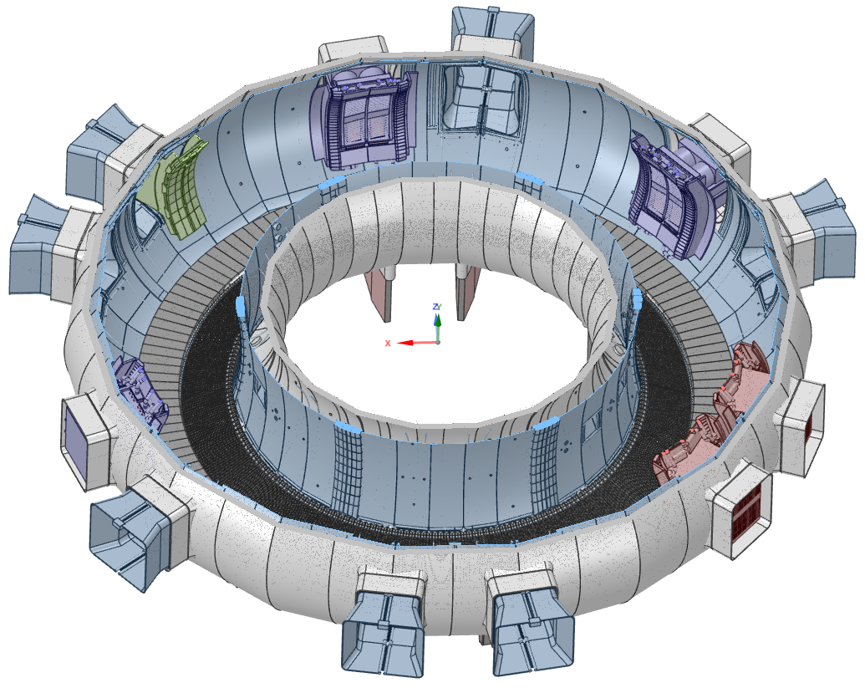
ICRH Q2
Antenna Protection Limiter (APL)
ICRH Q1
LH2 (PAM)
ICRH Q4
LH1 (FAM)

Slide 9
