Slide 1

RF Network Analysis of the WEST ICRH Antenna with the Open-Source Python scikit-rf Package
Julien Hillairet
RFPPC 2019

Slide 2
Summary
Modern science is founded on reproducing experiments
Closed-source codes lead to an obvious reproducibility problem. Research tools should ideally be open.
Scikit-rf is an open-source Python package developed for RF/Microwave engineering
Flexible and scalable library for network analysis and calibration
Naturally compatible with the rich and modern scientific Python ecosystem, Jupyter notebooks and on-line virtualizations services
Used to simulate the WEST ICRH antennas.
Open-source and reproducible work-flow adds confidence in the fact that future staff could use and extend it

Slide 3
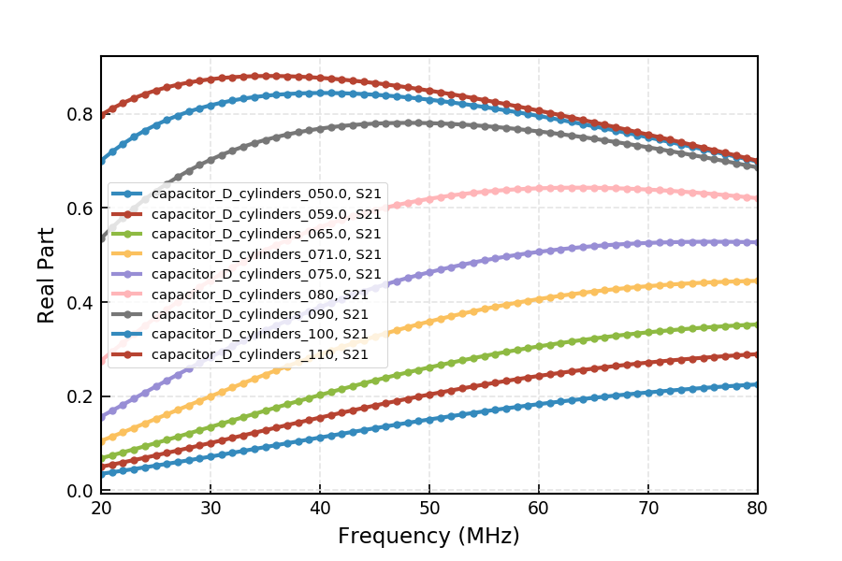
WEST Antenna Matching Capacitors
From full-wave model [1] of the capacitor at various positions
Importing all .sNp files and plot Re[S₂₁] for a subset of the frequency band:
import skrf as rf
capas_set = rf.NetworkSet.from_dir('S_Matrices/Antenna/Capacitor')
capas_set['20-80 MHz'].plot_s_re(m=1, n=0) # Indexing starts at 0 in Python
[1] data from W.Helou’s PhD, 2018

Slide 4
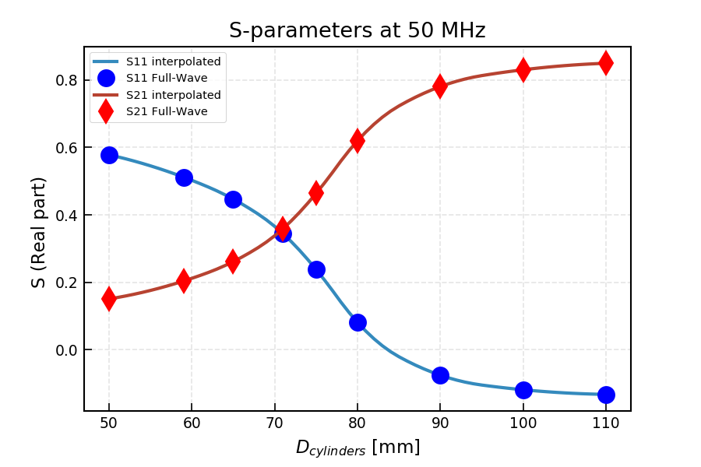
Interpolating new networks
Creating a new network interpolated from full-wave variations:
ntw = capas_set.interpolate_from_network(D_cylinders, new_value)
Repeating for other
new_value

Slide 5
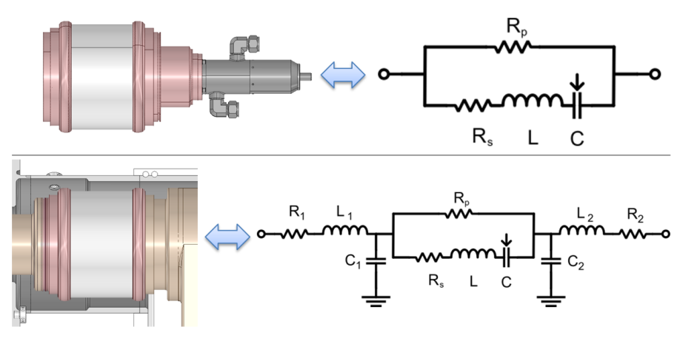
Creating equivalent lumped model
Modelling the fact that capacitor is surrounded by outer conductor
def eq_capa(C, freq, z0, R, L, R1, C1, L1): # neglecting R_p
line = rf.media.DefinedGammaZ0(frequency=freq, z0=z0)
pre = line.resistor(R1) ** line.inductor(L1) ** line.shunt_capacitor(C1)
cap = line.resistor(R) ** line.inductor(L) ** line.capacitor(C)
post= line.shunt_capacitor(C1) ** line.resistor(R1) ** line.inductor(L1)
return pre ** cap ** post # ** is the connection operator in scikit-rf

Slide 6

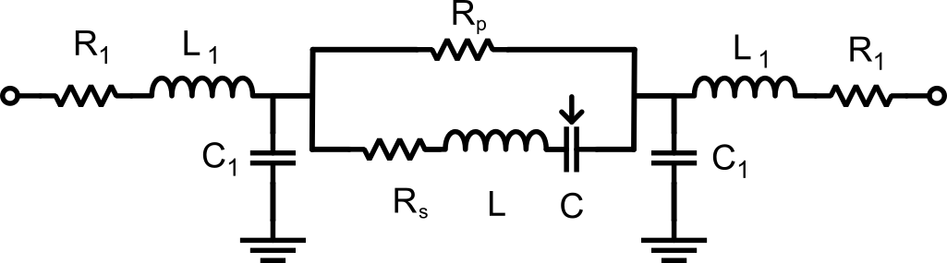
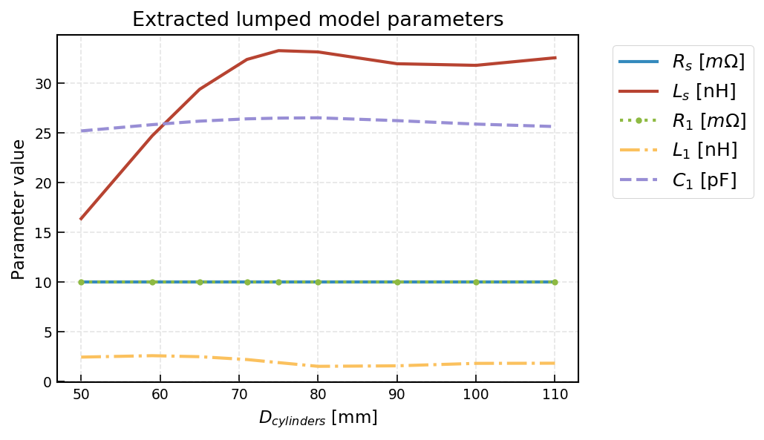


Model Parameter Extraction
Assuming R₁=R₂, L₁=L₂, C₁=C₂
Model Parameters are extracted using standard scipy.optimize package
Minimum bound (arbitrary) imposed for resistance values
Parameters almost constant except L_{s}

Slide 7
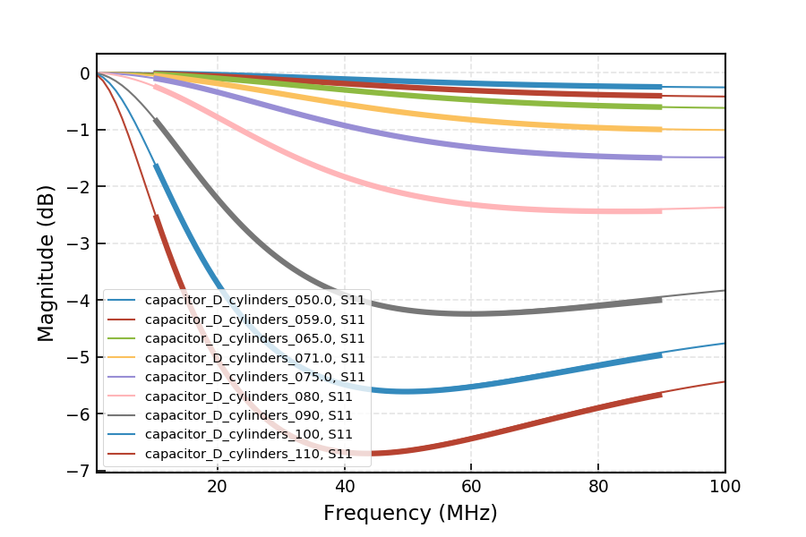
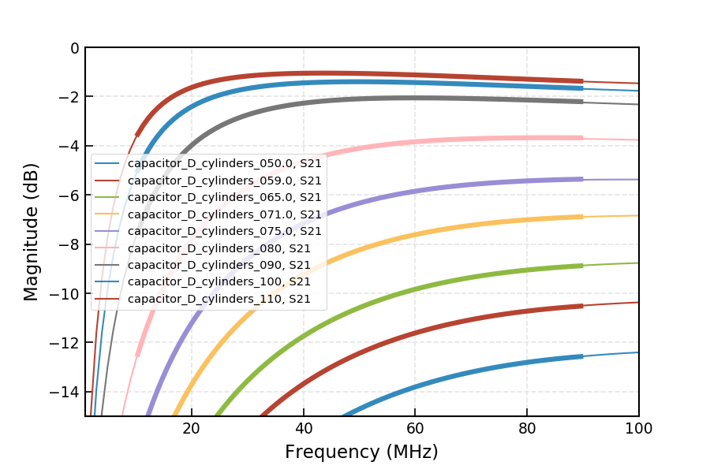
Benchmark models
Equivalent lumped model fits well full-wave calculations
Works even for low capacitance (in non-linear region)
Error with full-wave reference < - 40 dB for all configurations

Slide 8
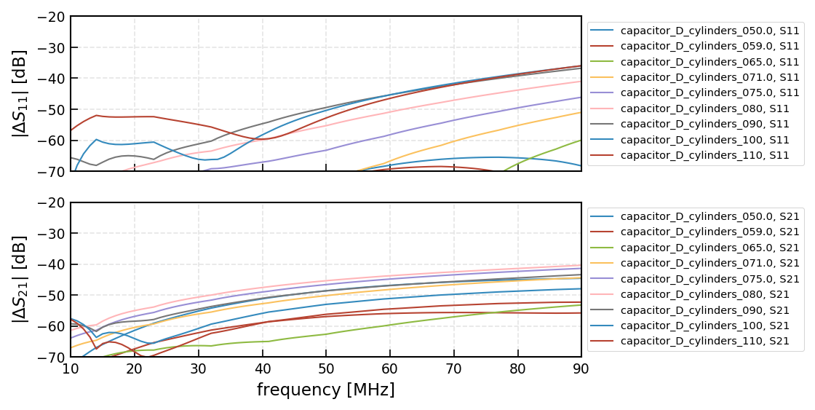
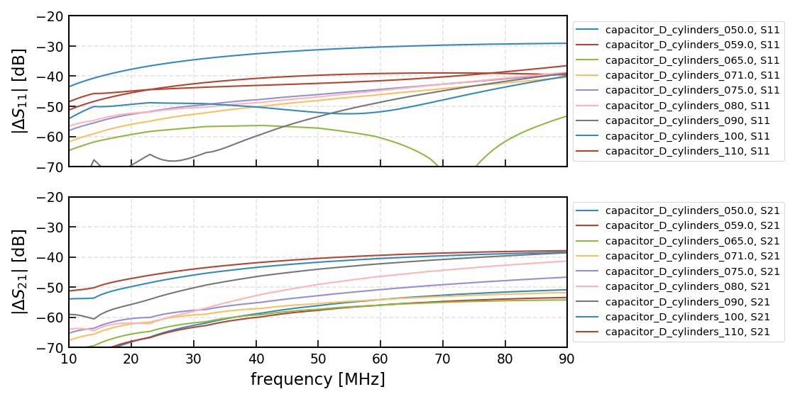
Lumped Parameter Parameters
Specific R_{s}, L_{s}, R₁, C₁, L₁
Fixing the model parameters increases the error by ~10 dB on S₁₁
Especially for low capacitance values
But still < -30dB
S₂₁ error still <-40dB
Unique R_{s}, L_{s}, R₁, C₁, L₁

Slide 9
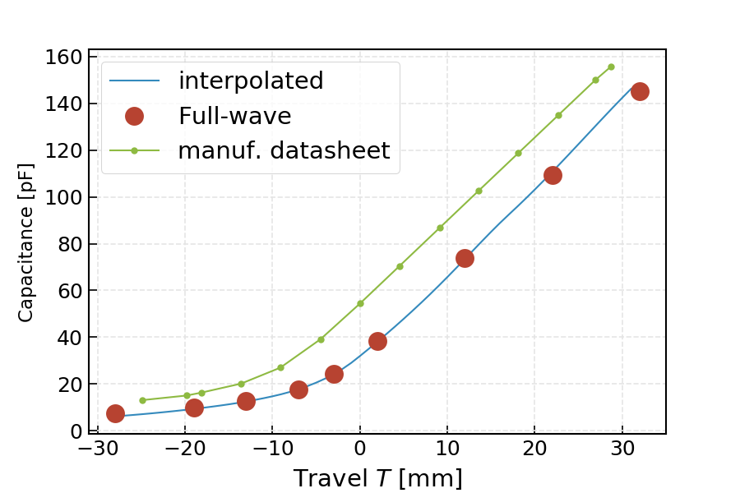
WEST Capacitor Modeling with scikit-rf
Two possible numerical approaches for control
Interpolate directly s-parameters from full-wave simulations:
The control parameter is related to a geometrical distance between the capacitor electrodes
Use equivalent lumped model (adjusted from full-wave)
The control parameter is then the capacitance C of the assembly (which differs from the capacitance given by the manufacturer).

Slide 10
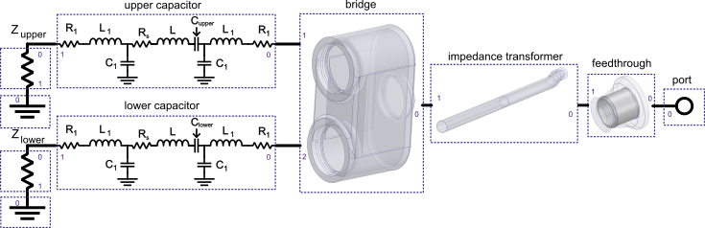
Building Circuits: ½ WEST ICRH antenna example
Scikit-rf allows building RF circuits from individual networks
connections = [
[(port1, 0), (window, 0)],
[(window, 1), (impedance_transformer, 0)],
[(impedance_transformer, 1), (bridge, 0)],
[(bridge, 1), (capa_upper, 0)],
[(bridge, 2), (capa_lower, 0)],
[(capa_upper, 1), (load_upper, 0)],
[(capa_lower, 1), (load_lower, 0)],
[(load_upper, 1), (ground_upper, 0)],
[(load_lower, 1), (ground_lower, 0)]
]
return rf.Circuit(connections)
Resulting Network is calculated for all frequencies (vectorized)
S-parameters are given for both Internal (at connections) and external (at ports)

Slide 11

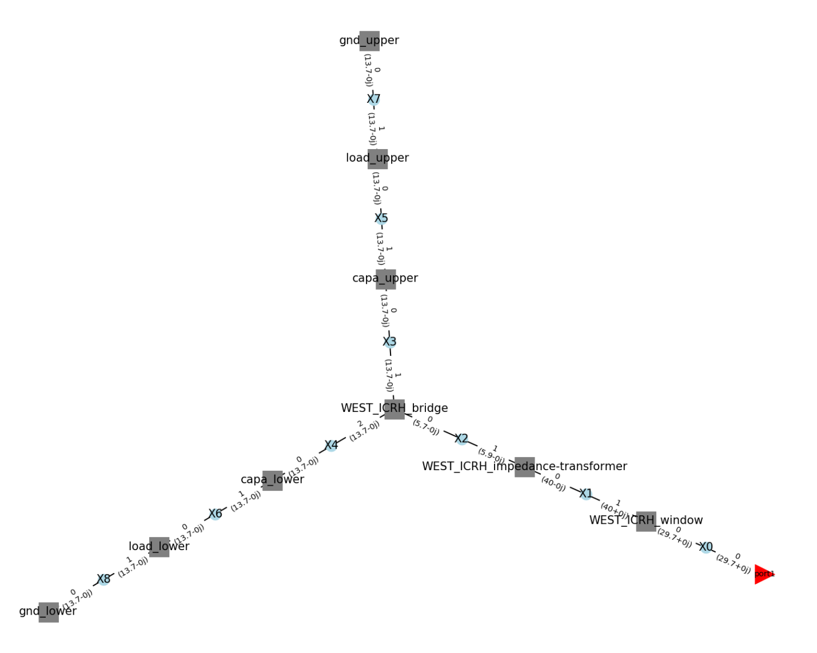
Building Circuits: ½ WEST ICRH antenna example
Scikit-rf Circuit includes circuit’s graph visualization
Previous Example leads to:
Visualize each network port and char.imp.
Convenient for checking mistakes

Slide 12
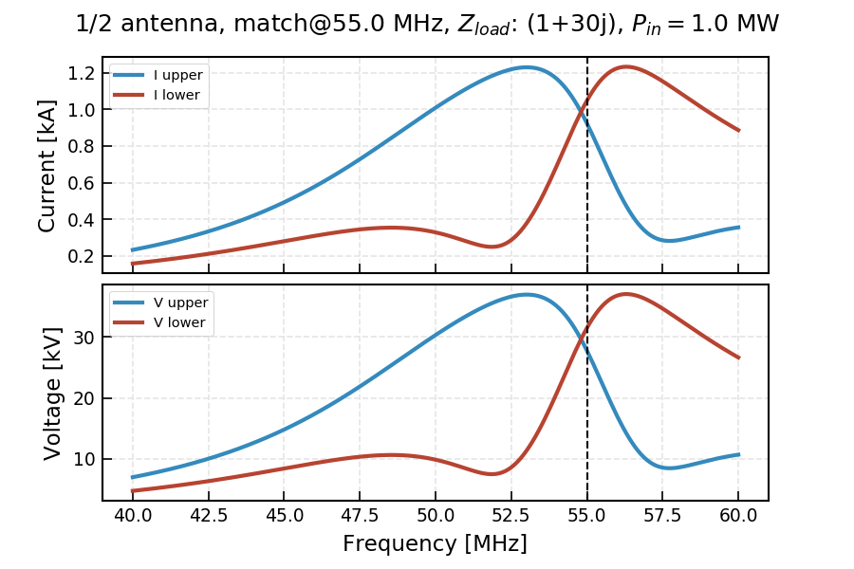
Building Circuits: ½ WEST ICRH antenna example
S-parameters accessible at connections → voltage and currents for a given excitation

Slide 13
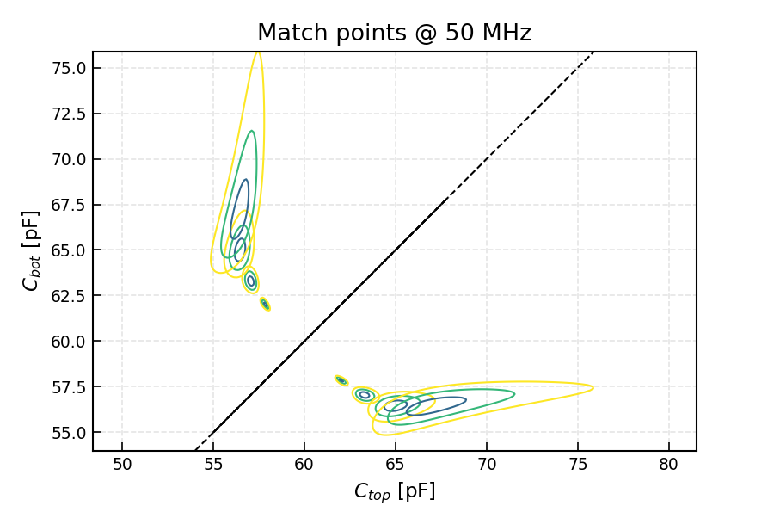
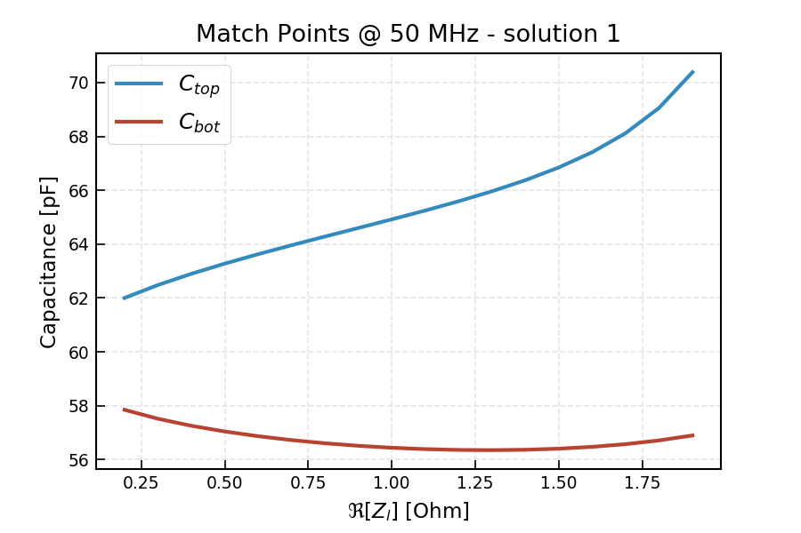
Building Circuits: ½ WEST ICRH antenna example
Match Points Map for various loading cases: VSWR (C_{top}, C_{bot})
1.5+30j
0.5+30j
0.2+30j
1.0+30j

Slide 14
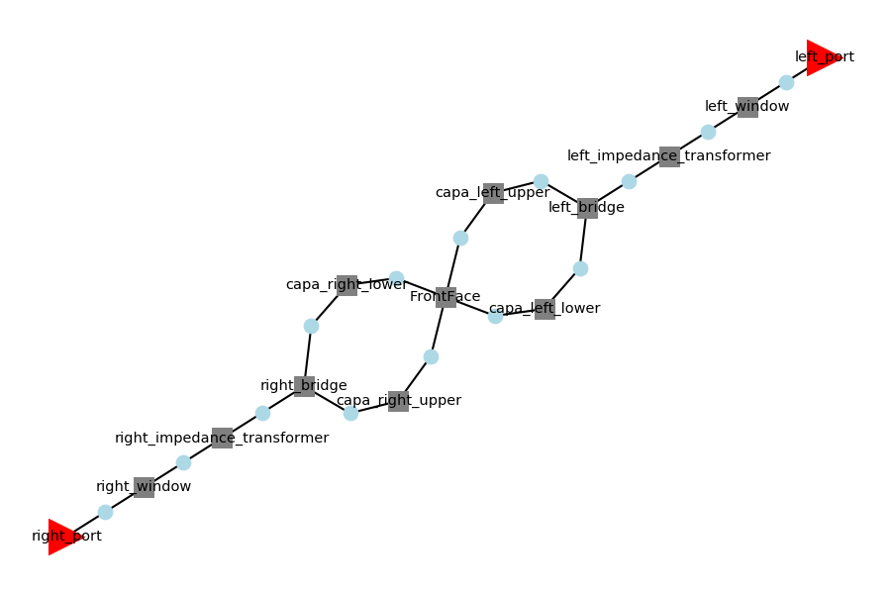
Example: full WEST ICRH antenna
connections = [
# left conjugate T
[(left_port, 0), (left_window, 0)],
[(left_window, 1), (left_impedance_transformer, 0)],
[(left_impedance_transformer, 1), (left_bridge, 0)],
[(left_bridge, 1), (capa_left_upper, 0)],
[(left_bridge, 2), (capa_left_lower, 0)],
# right conjugate T
[(right_port, 0), (right_window, 0)],
[(right_window, 1), (right_impedance_transformer, 0)],
[(right_impedance_transformer, 1), (right_bridge, 0)],
[(right_bridge, 1), (capa_right_upper, 0)],
[(right_bridge, 2), (capa_right_lower, 0)],
# front face
[(capa_left_upper, 1), (front_face, 0)],
[(capa_left_lower, 1), (front_face, 2)],
[(capa_right_upper, 1), (front_face, 1)],
[(capa_right_lower, 1), (front_face, 3)],
]
circuit = rf.Circuit(connections)

Slide 15
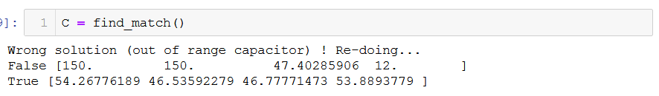
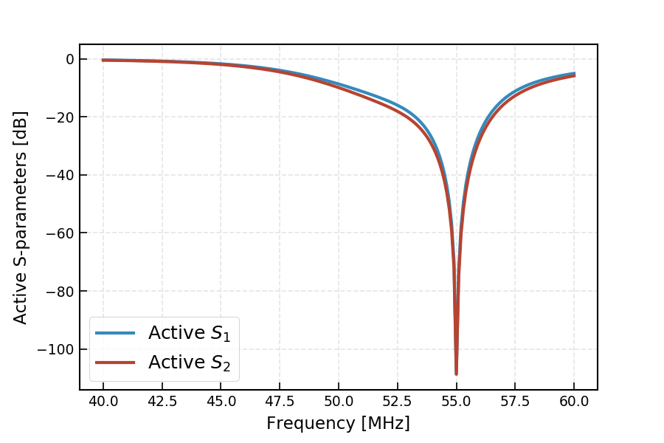
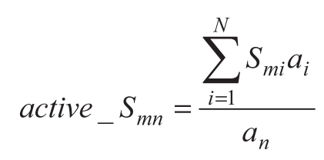
WEST ICRH Matching
Using the scipy optimization framework, the 4 capacitances can be deduced to match the antenna for a given loading

Slide 16
Scikit-rf functionalities
ntw
Stiching Networks
Combines two networks that cover different frequency into a single network
Arithmetic Operations
Element-wise operations on s-parameters
Ex: Phase difference
Comparison operators (==)
Interpolation, resampling
ntw1
ntw2
f
ntw = stich(ntw1, ntw2)
ntw = ntw1 + ntw2
ntw = ntw1 – ntw2
ntw = ntw1 * ntw2
ntw = ntw1 / ntw2
Scikit-rf documentation

Slide 17
Scikit-rf functionalities
Cascading Networks
Effect of mismatched port impedances taken into account
Deembedding Networks
ntw
ntw1
ntw2
ntw = ntw1 ** ntw2
ntw
ntw1
ntw2
ntw1 = ntw ** ntw2.inv
Scikit-rf documentation

