Slide 1




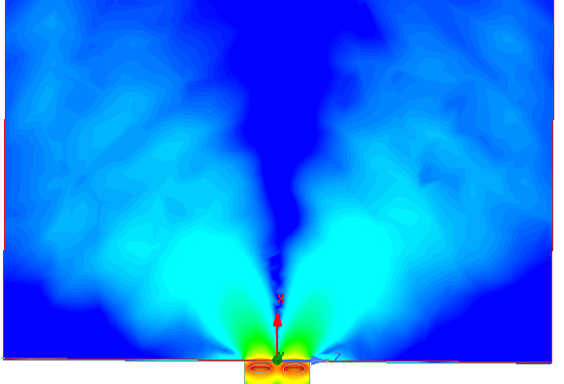
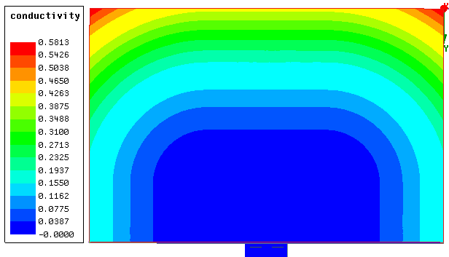
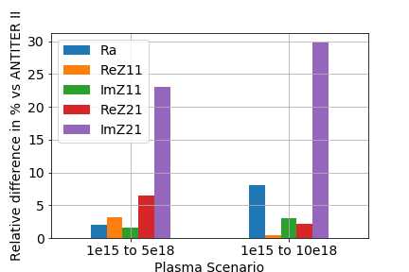
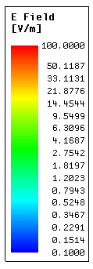
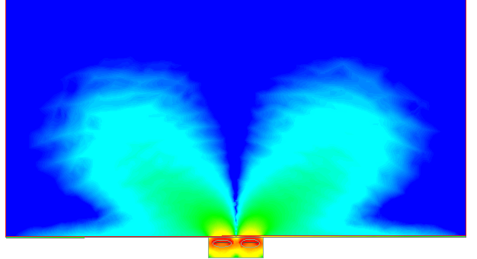
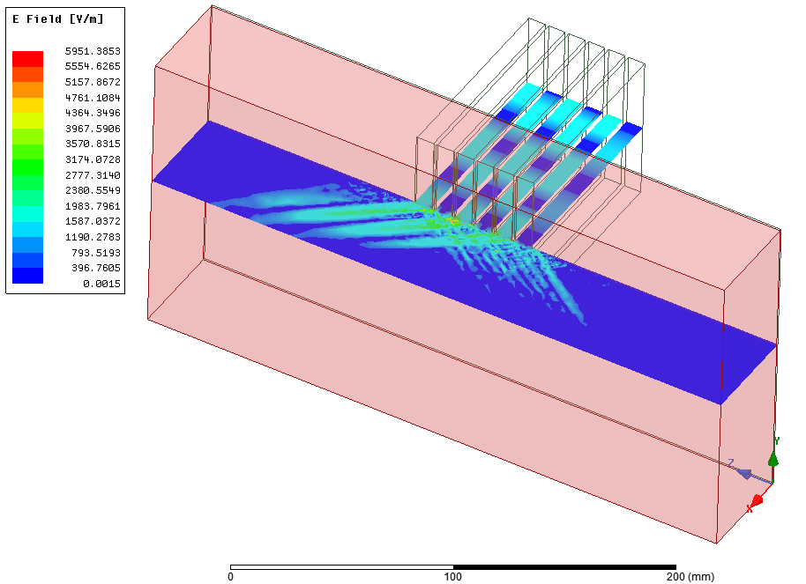
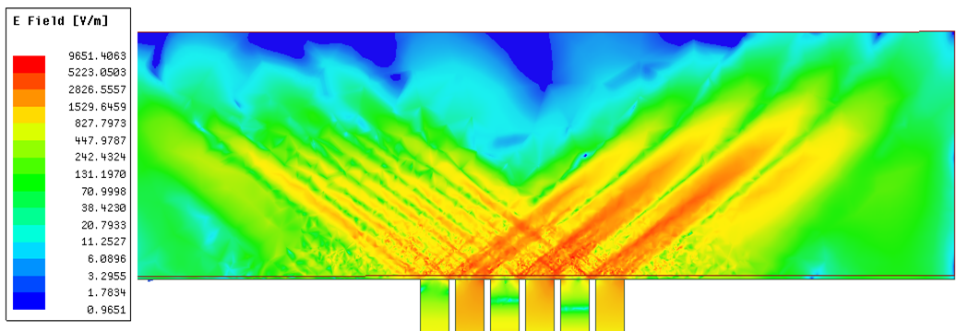
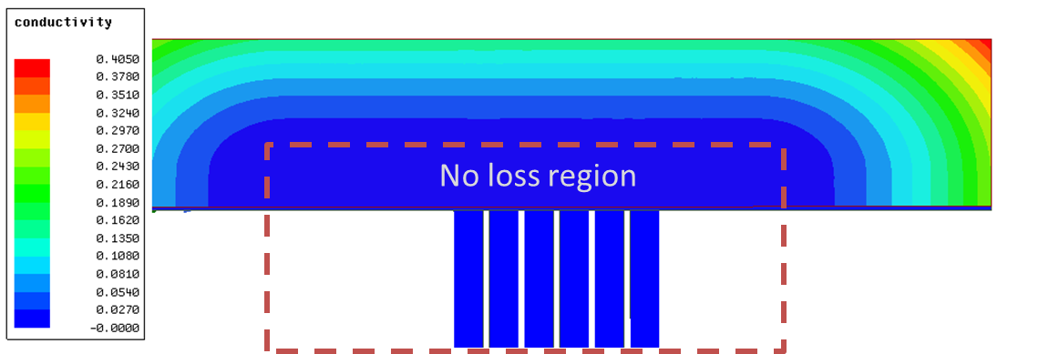
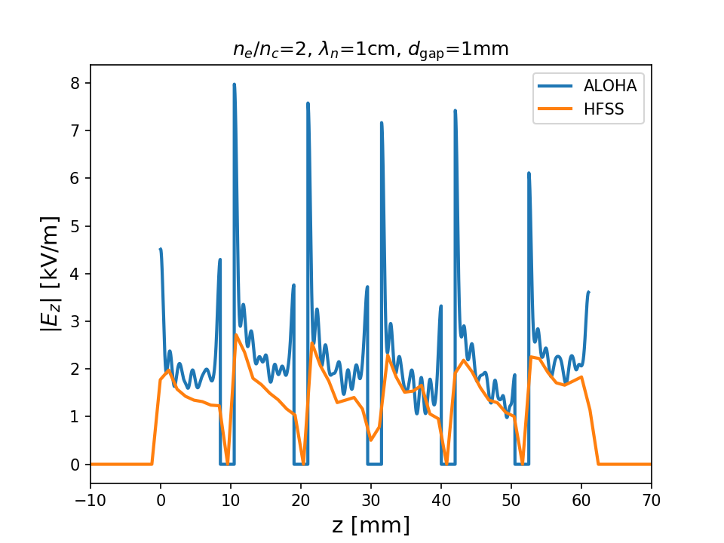
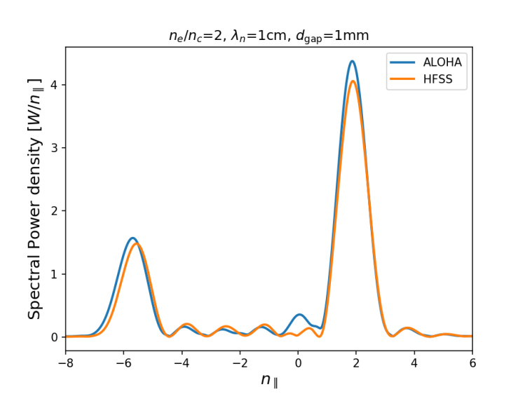
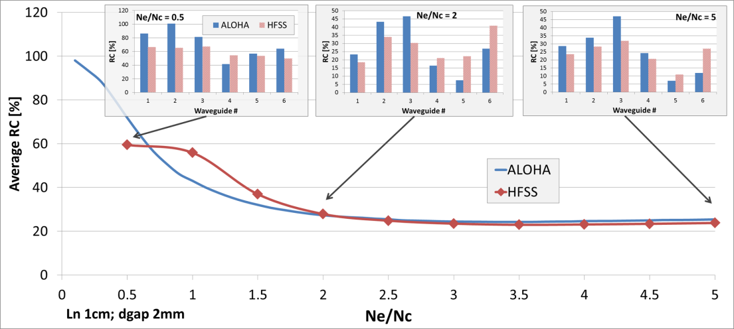

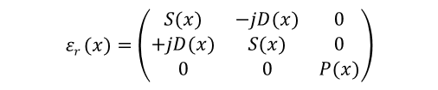


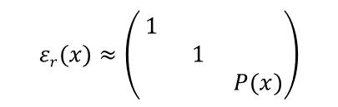

Ion Cyclotron and Lower Hybrid Cold Magnetized Plasma Modelling in ANSYS HFSS
1
2
3
J.Hillairet¹, R.Ragona², L.Colas¹, W.Helou¹, F.Bocquet³
Summary
ANSYS HFSS allows using inhomogeneous (tabulated or analytical) and anisotropic media
Can be used to model ICRF and LHRF coupling to tokamak edge cold plasma
Default absorbing boundary conditions (radiation or PML) are not compatible with anisotropic dielectric tensors, so Ad hoc conditions must be defined manually
Antenna S/Z-parameters have been successfully benchmarked with the codes ANTITER II and ALOHA
ANSYS HFSS can be used to model 3D antenna-wave coupling problems to tokamak edge plasma.
$$εr (x)=\left(\begin{matrix}S(x) & −jD(x) & 0 \\ +jD(x) & S(x) & 0 \\ 0 & 0 & P(x)\end{matrix}\right)$$
Ion Cyclotron Resonance Frequency (2 straps, dipole phasing, 50 MHz)
In ICRH range of plasma parameters, P(x) values are >10⁴ → Leads to large computing resources (mesh & memory).
Using a equivalent dielectric K_{D}(x)=S - D as proposed in [A.Messiaen, R.Weynants, PPCF 53 (2011)] is a good/faster workaround for S-parameters evaluation.
Inhomogeneous cold plasma or equivalent dielectric have been benchmarked with ANTITER II.
Near-field pattern with cold-plasma is different from equivalent-dielectric
Good agreement obtained on antenna Z-parameters
n_{e}
30 cm
n_{e1}
n_{e0}
x_{plasma}
Quadratic conductivity increase
0
x_{core}
x
Equivalent dielectric + rad. BC
|E|
Cold-plasma + Ad hoc BC
x
No loss region
Cut-off layer
Lower Hybrid Current Drive (6 rect. waveguides, 90° phasing, 3.7 GHz)
In the LH range of plasma parameters, plasma-facing dielectric tensor ε_{r} can be approximated by a diagonal tensor, with P < 0 if electron density n_{e} is higher than the cut-off density n_{c}.
$$εr(x)≈\left(\begin{matrix}1 & & \\ & 1 & \\ & & P(x)\end{matrix}\right)$$
$$P(x)≈1−\frac{ne(x)}{nc}$$
$$nc=\frac{ε0meω2}{e2}$$
Inhomogeneous losses have been added to dump wave power
|E|
Quadratic conductivity increase
Results have been compared with the ALOHA code
E-field
Spectrum
Reflection coefficients

