Slide 1
WEST C4 Campaign Status of ICRH Commissioning
WEST Progress Meeting 25/07/2019

Slide 2
(Rapid) Summary of ICRH Results during WEST C3
ICRH System
Q1 and Q2 antennas installed in WEST and operated on plasma
Generators and CODAC commissioned and operated
Real-time capacitor matching commissioned and operated (mostly Q2)
Arc safety interlocks validated
Performances on C3 plasma
Antenna Coupling increased (0.3 → 1 Ohm)
1 MW/antenna and 1.4 MW with 2 antennas…
… but 50 to 100% of the ICRH power radiated
The coupling picture is still incomplete
Difference between Q1 and Q2 antennas not fully explained in C3b (partly from ant.position).
Complete new calibration of antenna acquisition chain during shutdown
Verification and correction of antenna radial locations
→ To be checked again during C4
Many correlations in database → need dedicated experiments
Experiments in C4 to guide WEST Phase 2:
Relevant of fueling (and pumping) scheme
Relevance of ICRH antenna front face coating?
Cf TF Meeting 04/04/2019

Slide 3

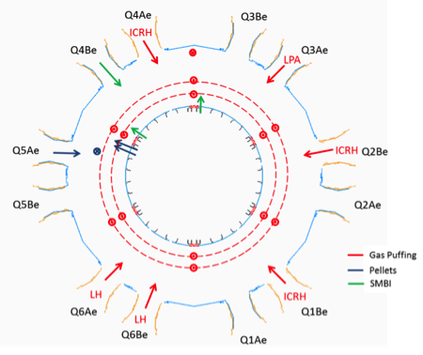
Non-exhaustive list of the work performed during WEST S3 shutdown
The third antenna (Q4) installed
Cabling made few years ago during WEST had to be repaired
Q1 and Q2
New access footbridge: required full un-cabling and re-cabling
All Antennas
New and more precise power and phase calibrations performed for all antennas
Antennas lower bumpers receded to avoid LH fast electron interception
Antenna radial location strokes checked and revisited (WOI 6.5)
Replacement of antenna internal pumping vacuum gauges
Duration Limitations due to water cooling problems solved
Local Gas Injection
New configuration (as seen from plasma):
Q1B: Right side
Q2B: Left side
Q4: Right side

Slide 4
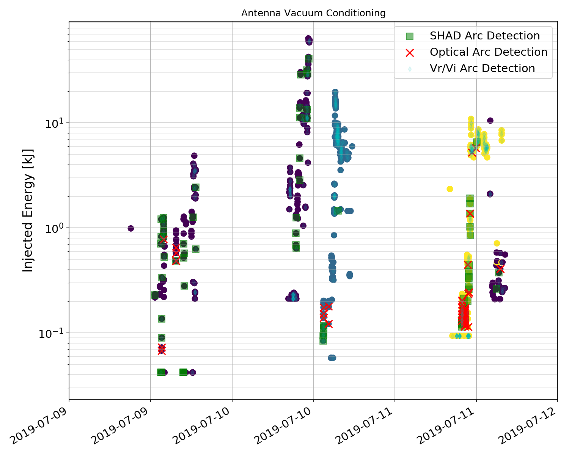
WEST C4 - ICRH Vacuum Conditioning
4 days of vacuum conditioning
Target ~27 kV during ~ 2 s
(nominal max. voltage)
Required ~ 1 day/antenna
(when w/o problem)
Each side separately
Then both sides together
Faster if no plasma in //
precise antenna tuning in vacuum is modified after each plasma discharge
All arc detection systems validated for all antennas
Q1
Q4
Q2

Slide 5
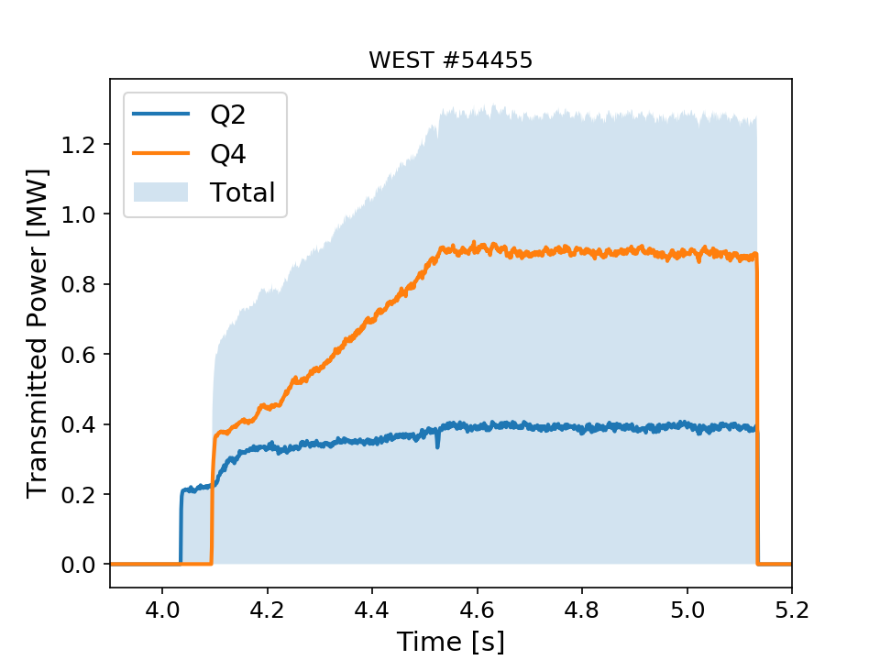
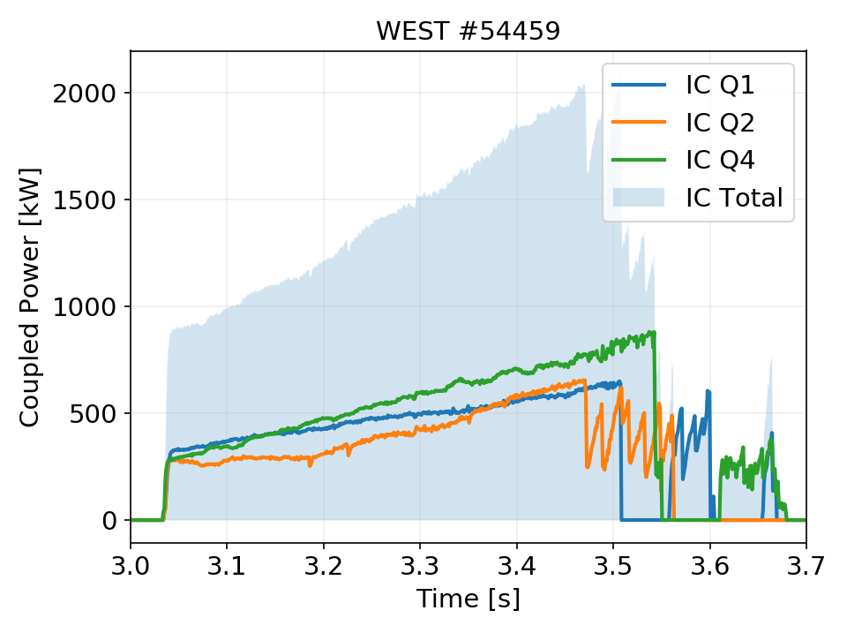
WEST C4 - ICRH Commissioning Summary
Voltage probe V1 on Q1 identified as out of order (broken cable/connector inside the antenna)
Many problems fixed:
Cabling repairs
Hydraulic systems (Q4, Q2) (not totally finished today)
RF plant maintenances and repairs
CODAC, Fast Acquisition
Start one new antenna on plasma (Q4)
Now the full set of 3 ICRH antennas on plasma !
1.3 MW total cleanly coupled (with 2 antennas)
2 MW total 3 antennas (then plasma detachment)
Higher power/duration possible, to be continued… (was restricted that day by the loss of impurity interlock)

Slide 6
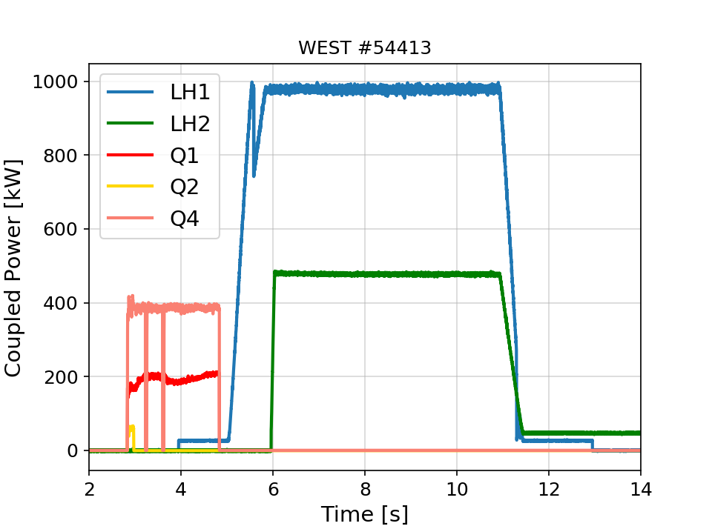
1st WEST plasmas with the full set of RF Heating Systems
(Mostly) Separated time slots during commissioning
To combine powers, requires now working on scenarios to:
Optimize antenna radial locations wrt. plasma
Optimize plasma fueling (local injections)
Dedicated experiments to actualize WEST Operating Instructions (outdated with Tore Supra config)…

Slide 7
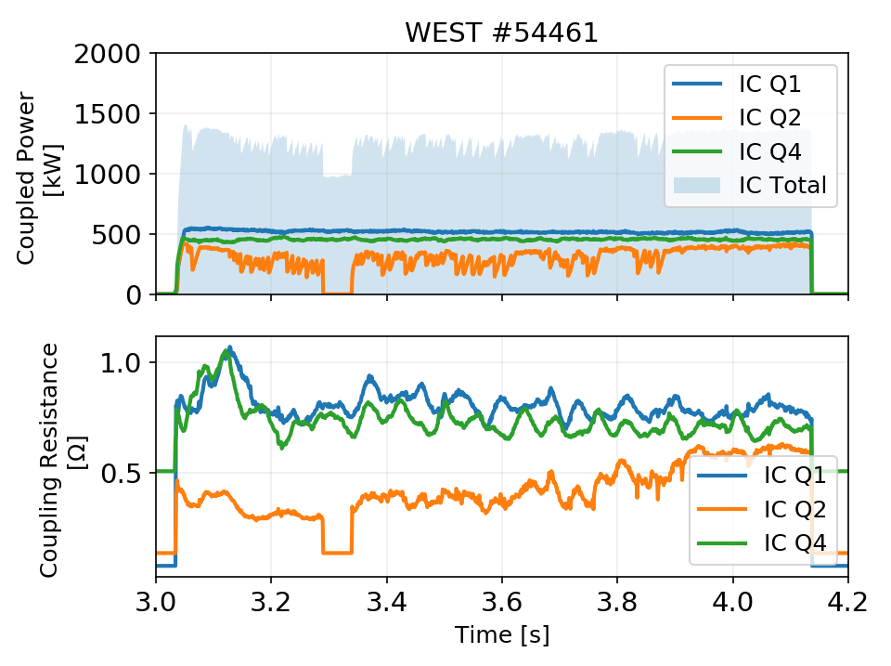
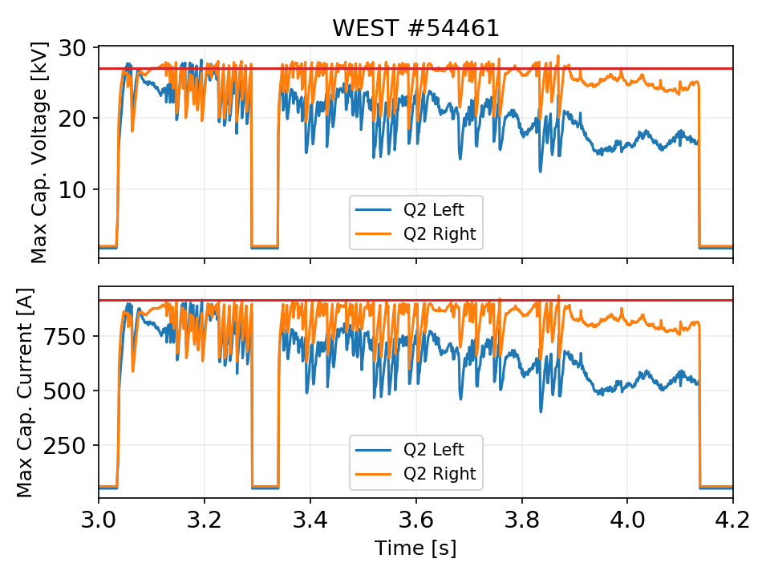
Commissioning confirms that Q2 coupling is (still) different from Q1 and Q4
Antenna located at same radius
Same plasma condition
Same forward power request (500 kW or 300 kW)
Lower coupling resistance on Q2 → max. currents and voltages reached → limits forward power
➔work in progress: assess impact of antennas on each others

Slide 8
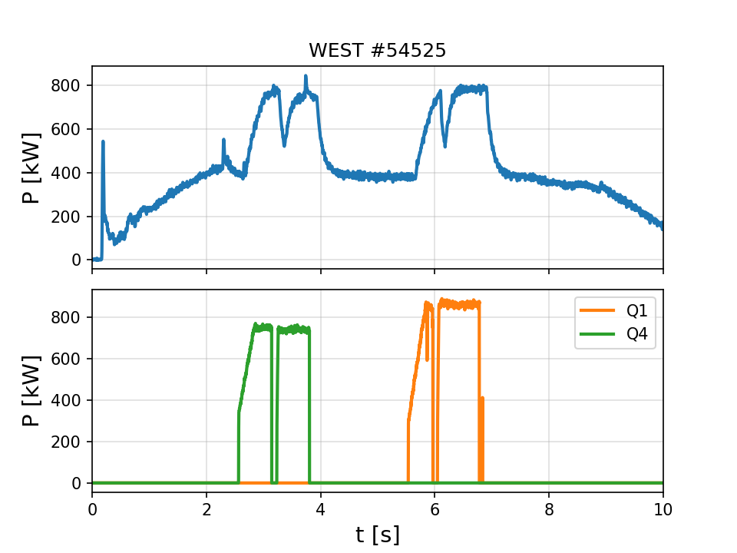
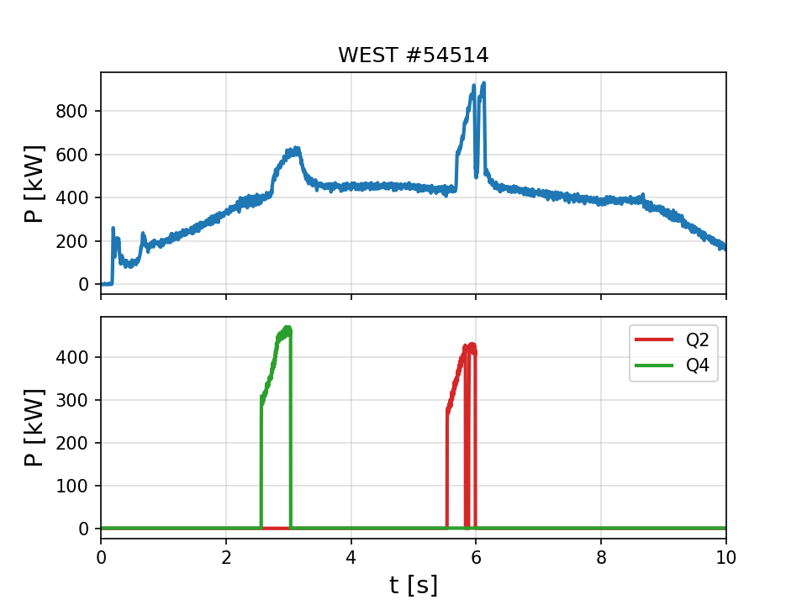
Commissioning shows that Q2 has different effects on plasma than Q1 and Q2
~50%
~50%
~40%
~100%
Indirect (2 by 2) comparison (yet) on 2 shots: with similar power coupled b/w antennas
→ Total radiated power larger with Q2 than Q1 or Q4
Despite good Q2 RF configuration: matching, toroidal phasing confirmed to ~180° (dipole)
Surface state differences ? (Visual Inspections during shutdown showed darkened straps)
➔ Work in progress…

Slide 9

Remaining work (at 27/07/19)
Minority Specie Control
Will use a calibrated gas bottle D/H (90/10%) → should be done next week (administrative delays…)
Vacuum Interlock Improvement
Allows antennas to restart if pressure inside antenna is OK again → Done. Tested OK on #54525
Automatic Phase Control
To be validated before PCS can control antenna phasing (important for impurity prod assessment) → tbd
Automatic Matching
Validated during C3b on Q2, remains for Q1 and Q4→ validated on Q4 on #54540 and Q1 on #54544
Reduce antenna cross-talk → On going since 24/07
Local Fueling
1st part of dedicated experiments performed on 24/07/19 → analysis in progress
Increase power !
2 MW achieved with 2 antennas (Q1 & Q4) in few shots, 1.6 MW with Q4 → continue on 25/07

Slide 10
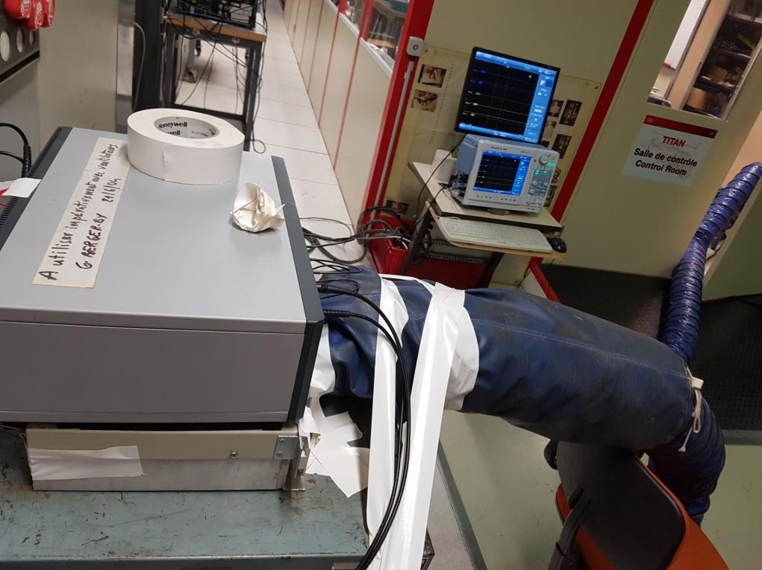
Unexpected Problem: Heat Wave…
Electronics gets hot at RF plant (38°C)
SHAD Arc Detection system on a generator suspected to trigger false alarms on Q1
IC RF Plant control room (air conditionned)
Pump
SHAD Arc Detection System

