Slide 1
Analyse des chocs semaine 36
J.Hillairet

Slide 2
Mardi 3/09

Slide 3
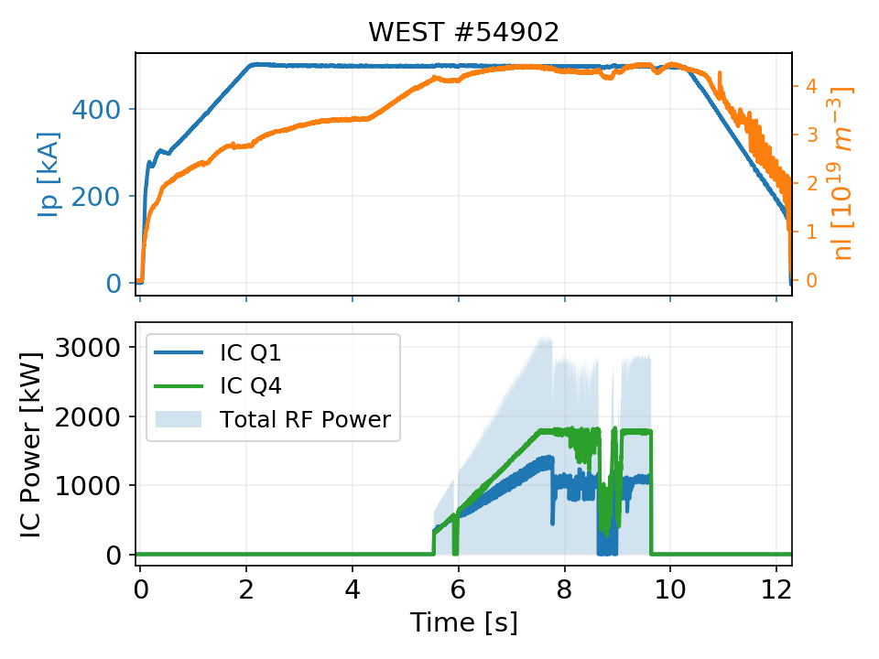
#54902
USN plasma, 500 kA
3 MW coupled with 2 antennas
« crashes » linked to reduced plasma density in front of the antennas

Slide 4
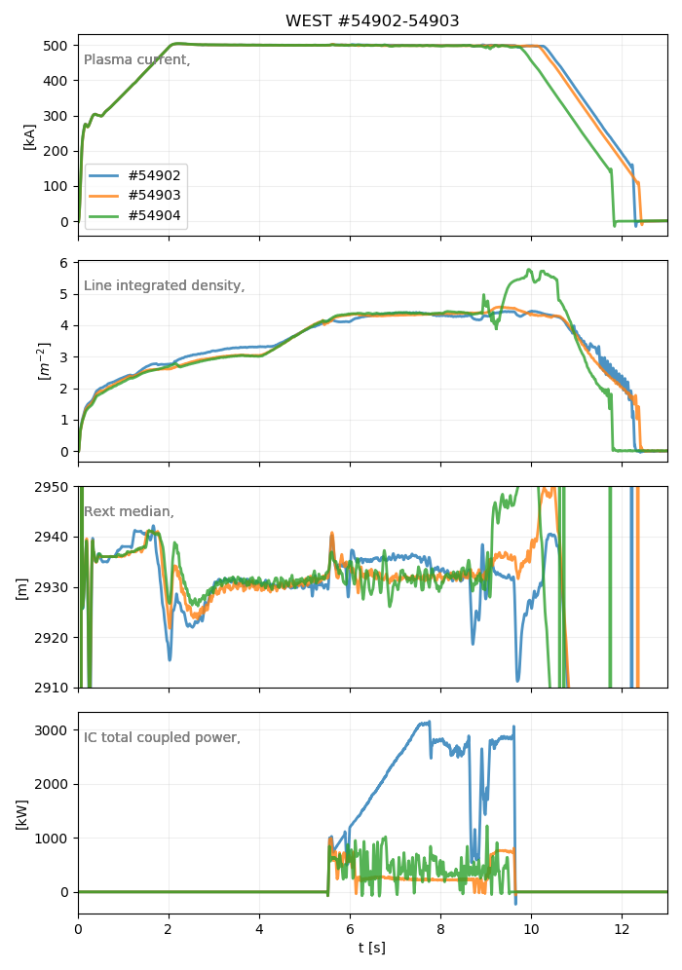
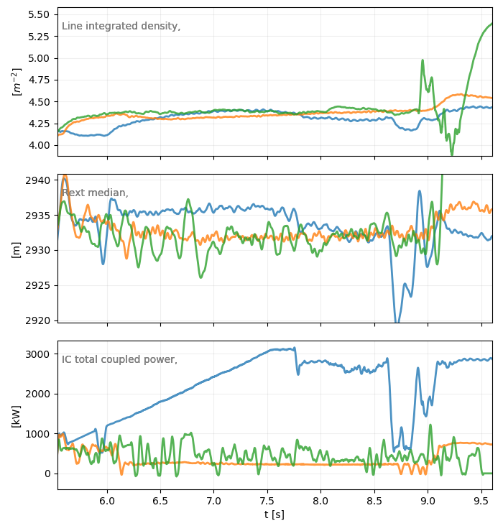
WEST #54902 (USN) vs #54903/54904 (LSN)
2 consecutive pulses, where only poloidal current have been inversed.
~5mm

Slide 5
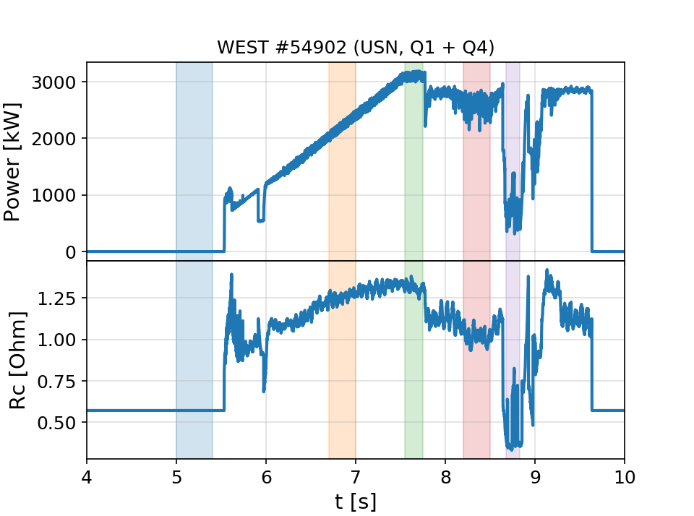
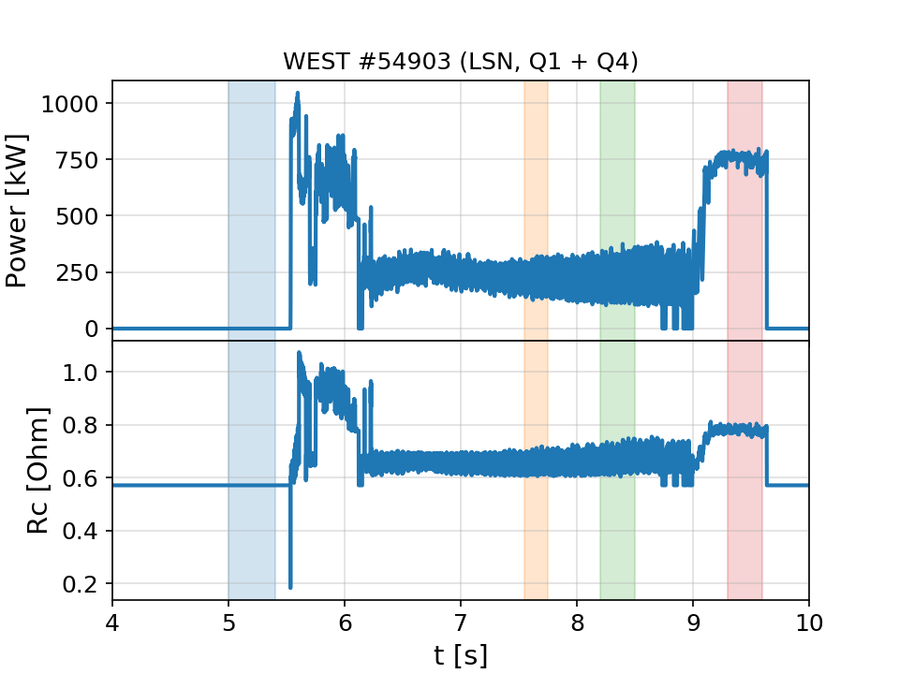
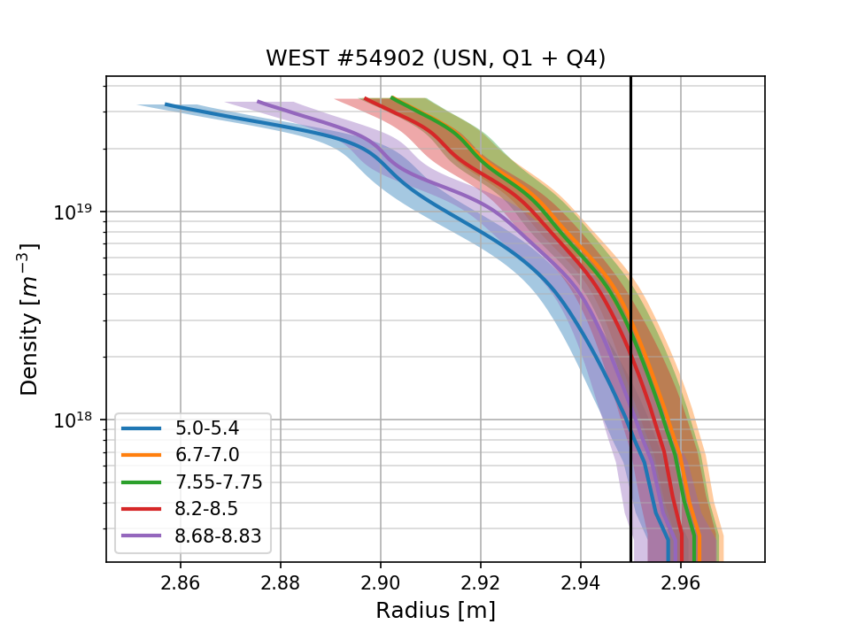
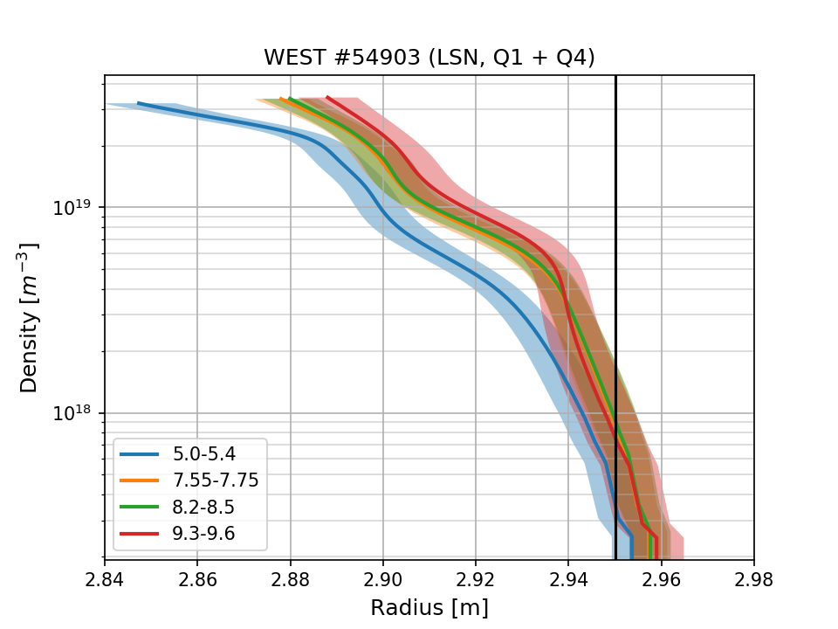
WEST #54902 (USN) vs #54903 (LSN)

Slide 6
Radial position differences between 54902/USN and 54903/LSN?
FEEQS gives similar values for UROG/EROG/LROG (R.NOUAILLETAS)
Larger differences with NICE model (~cm) (M.Goniche)

Slide 7
Vendredi 7/09

Slide 8
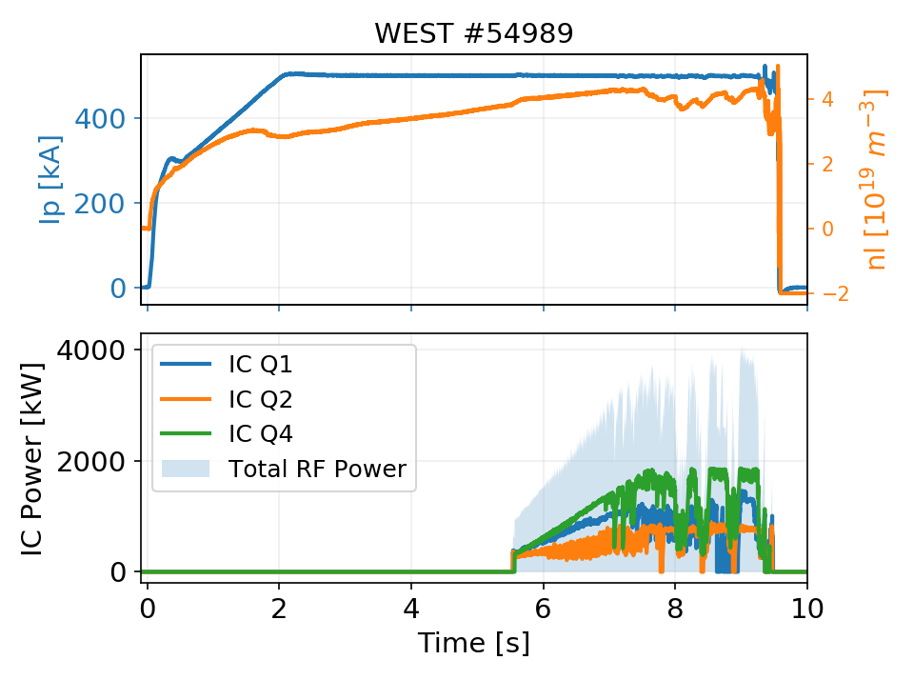
54989
4 MW reached with 3 antennas
NB: Do not use SICHPTOT signa, gives wrong values. Use Σ_{i} SICHPQi (problem solved on 10/09/2019

