Slide 1
Status of the ICRH System in WEST C4 (preliminary)
WEST Task Force Meeting – 26/09/2019
J.Hillairet, P.Mollard, G.Lombard, F.Durand, L.Colas, J-M.Bernard

Slide 2
Main C4 Results
(so far!)

Slide 3
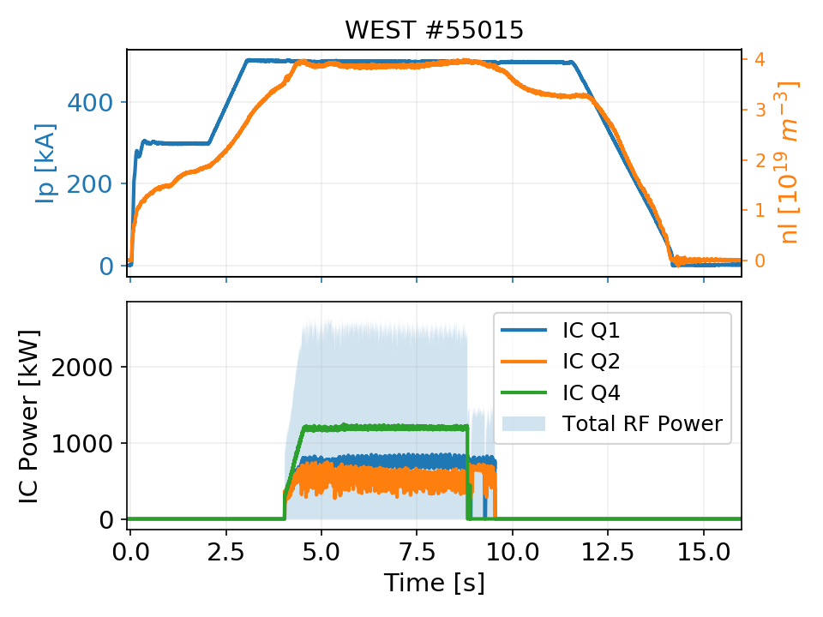
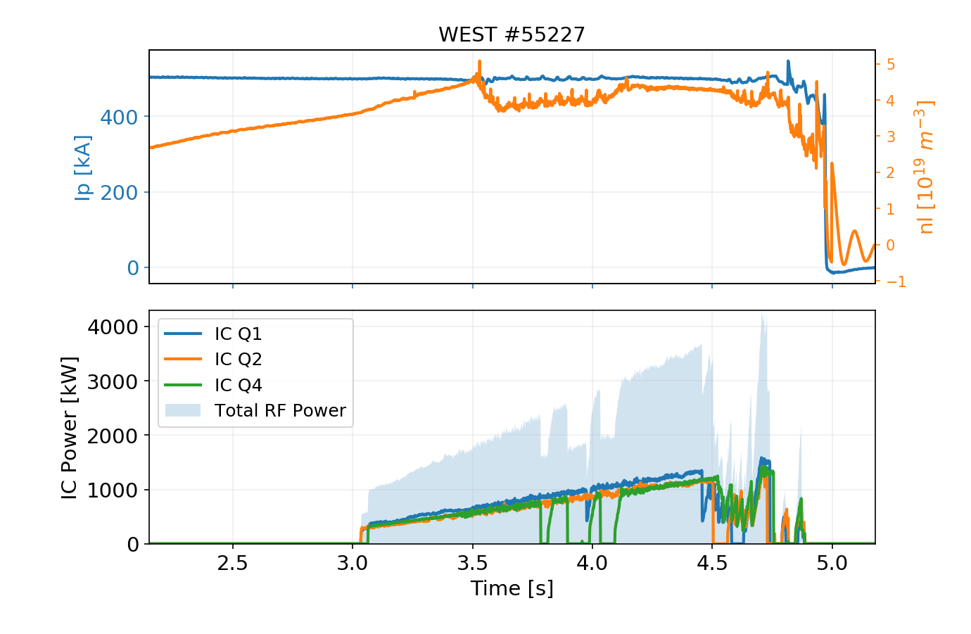
WEST C4 Statistics (preliminary)
Main C4 Results (so far)
RF plant reliable due to good maintenance during shutdown
All three antennas operational simultaneously on plasma few times 3 MW/few seconds, 4.2 MW peak.

Slide 4
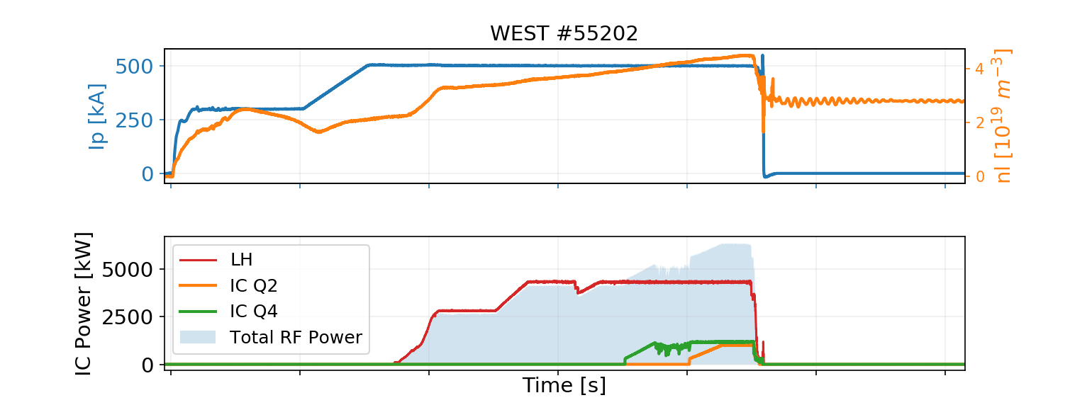
WEST C4 Statistics (preliminary)
Main C4 Results (so far)
RF plant reliable due to good maintenance during shutdown
All three antennas operational simultaneously on plasma few times 3 MW/few seconds, 4.2 MW peak.
Up to 2.4 MW (2 antennas) in // with LH (but impurity problem limits duration)

Slide 5
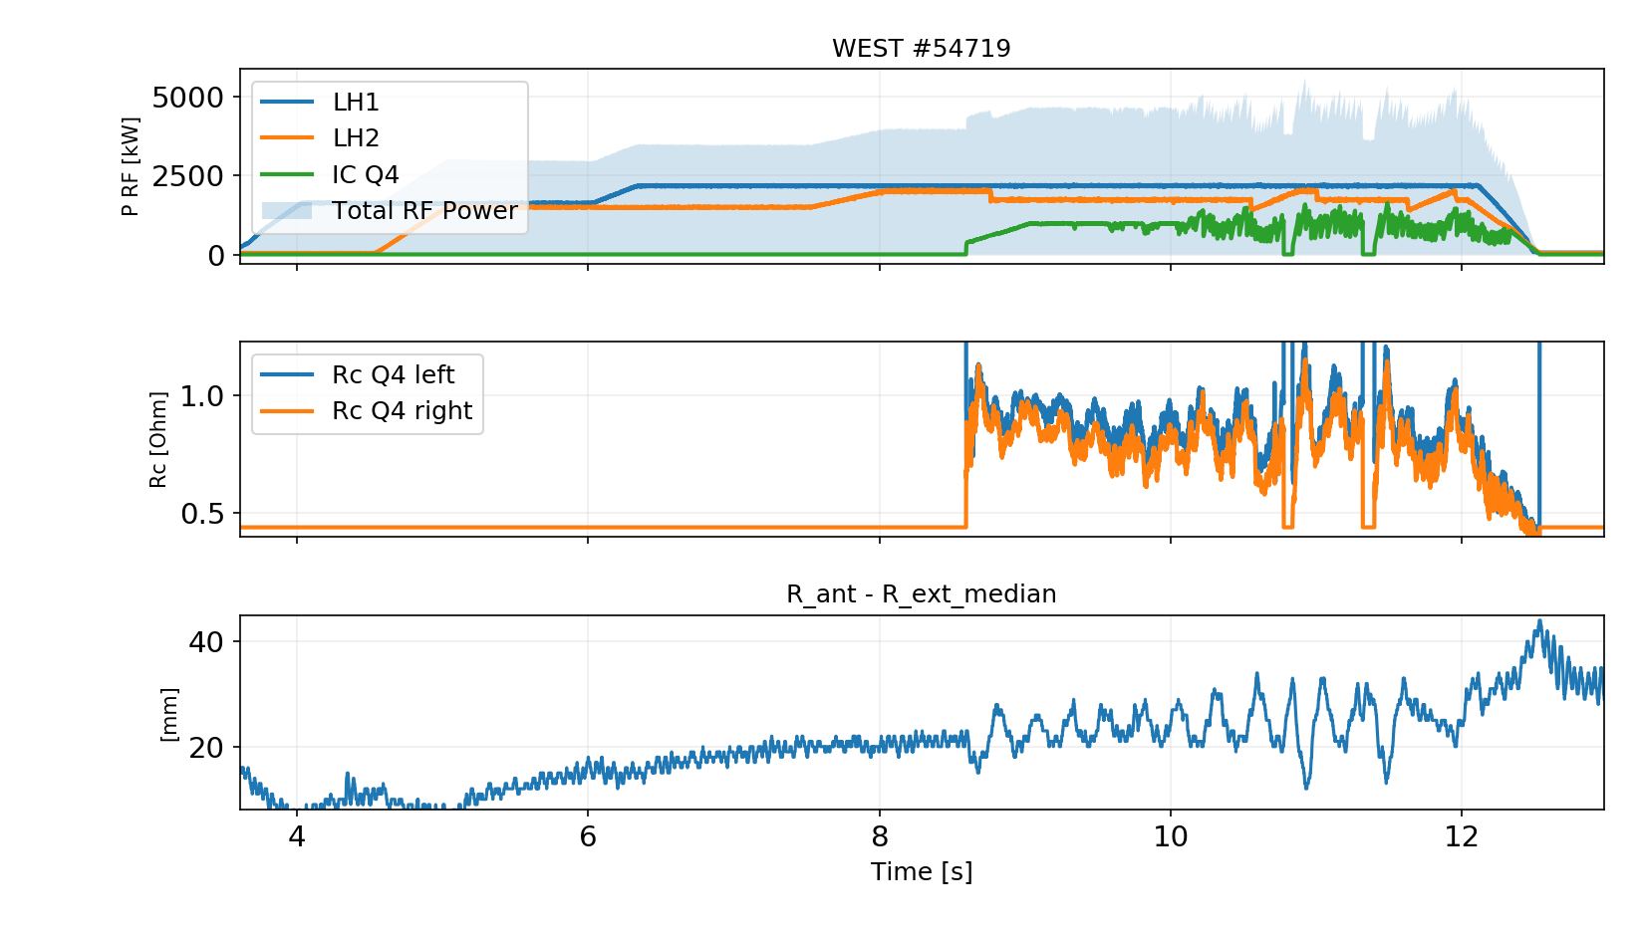
WEST C4 Statistics (preliminary)
Main C4 Results (so far)
RF plant reliable due to good maintenance during shutdown
All three antennas operational simultaneously on plasma few times 3 MW/few seconds, 4.2 MW peak.
Up to 2.4 MW (2 antennas) in // with LH (but impurity problem limits duration)
Load resilience confirmed

Slide 6
WEST C4 Statistics (preliminary)
Main C4 Results (so far)
RF plant reliable due to good maintenance during shutdown
All three antennas operational simultaneously on plasma few times 3 MW/few seconds, 4.2 MW peak.
Up to 2.4 MW (2 antennas) in // with LH (but impurity problem limits duration)
Load resilience confirmed
Incidents:
Regular maintenance performed on plant
Delay on Q4 startup due to cabling defects
Few problems with the hydraulic system (cylinders, position encoder) → All solved during maintenance
One voltage probe out of order on Q1 (cable?) →Investigations during S4
One capacitor of Q2 can’t move since its servopack is out of order. Obsolete component, bought online second hand. → Full update of the servomotors and control systems during S4

Slide 7
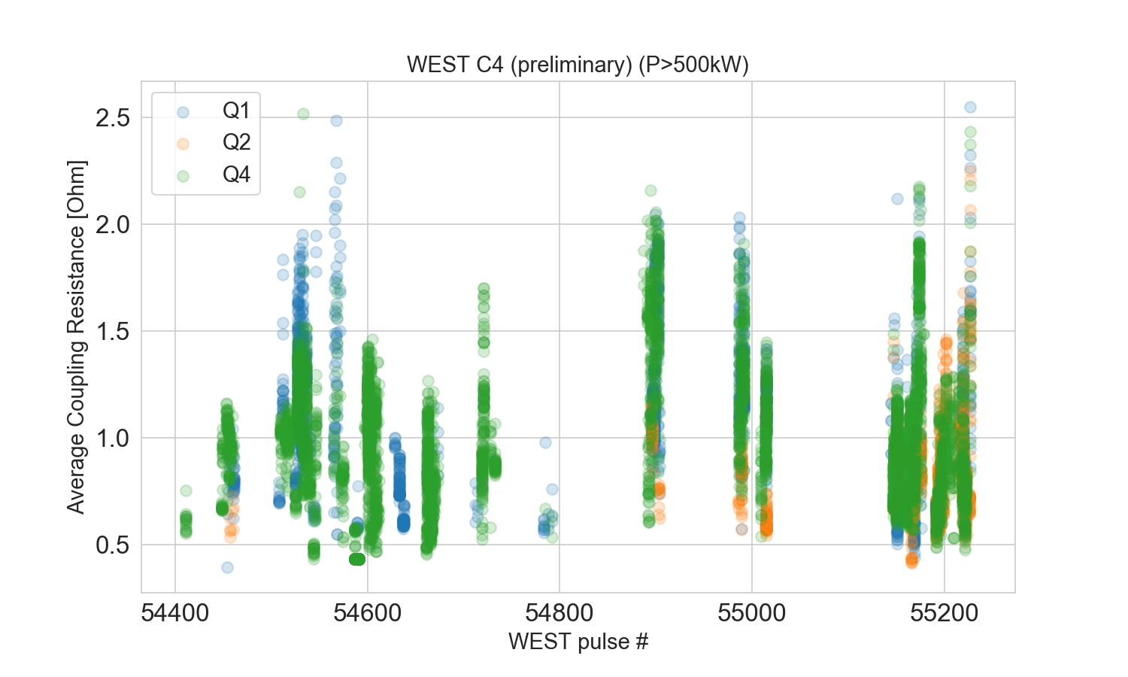
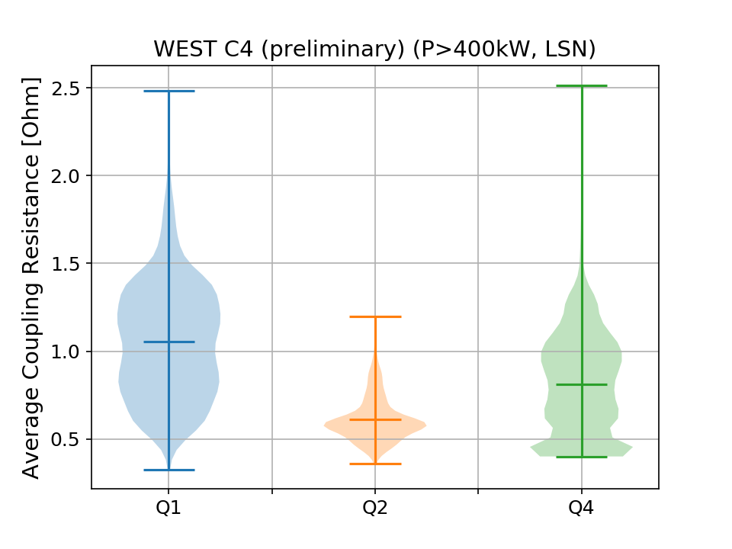
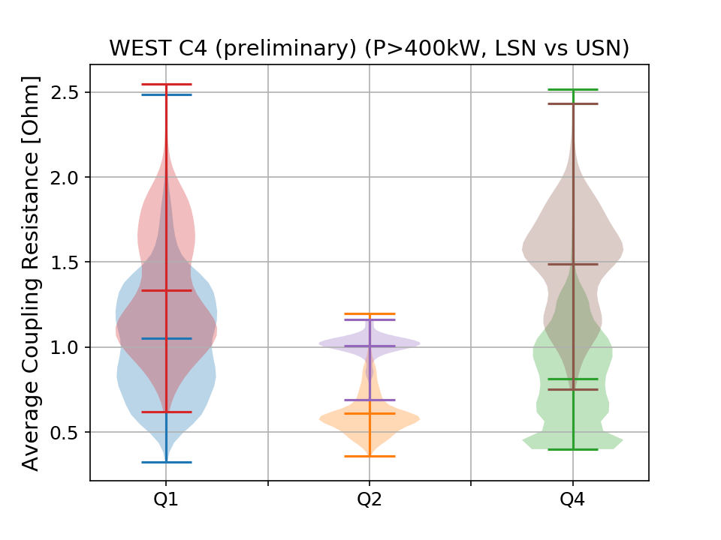
ICRF Coupling during C4 (preliminary)
Still clear difference with Q2
Average coupling resistance for WEST C4 is
between 0.8 -1.0 Ω for Q1 and Q4
Closer to 0.6 for Q2
Clear difference between LSN and USN plasmas for all antennas
Plasma control

Slide 8
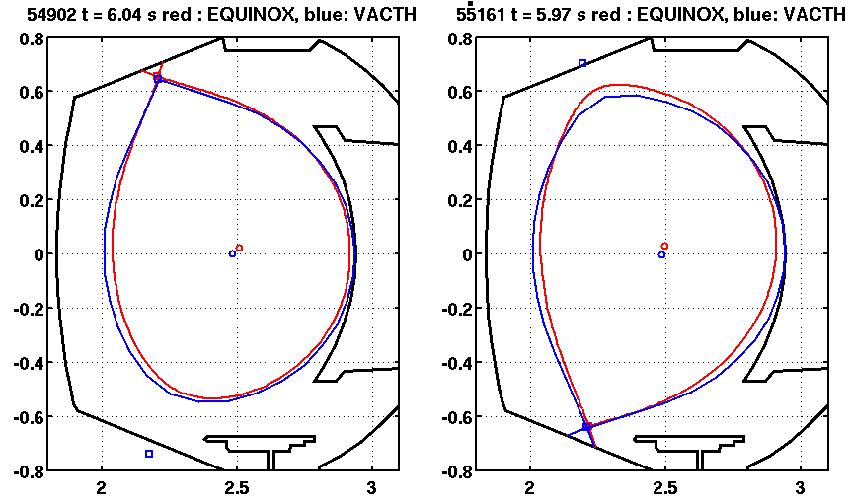
Higher Coupling found in USN Uncertainties on plasma frontier
Comparison btw VACTH and EQUINOX equilibrium (500kA/3.6T plasmas)
In USN, difference on Rext is of the order of 15mm
In LSN, difference on Rext can reach 40 to 60 mm…
→ Would explain coupling difference measured btw LSN and USN?
Conclusion: probably margin for coupling improvements in C5
From N. FEDORCZAK and Jorge MORALES

Slide 9
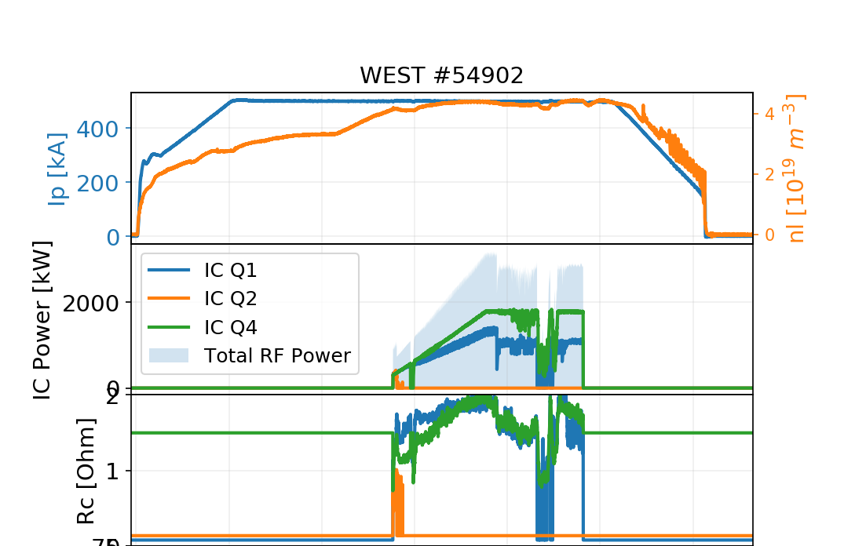
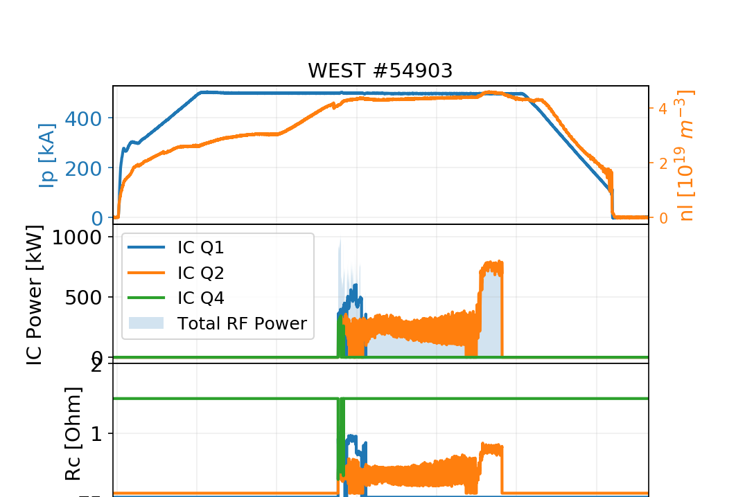
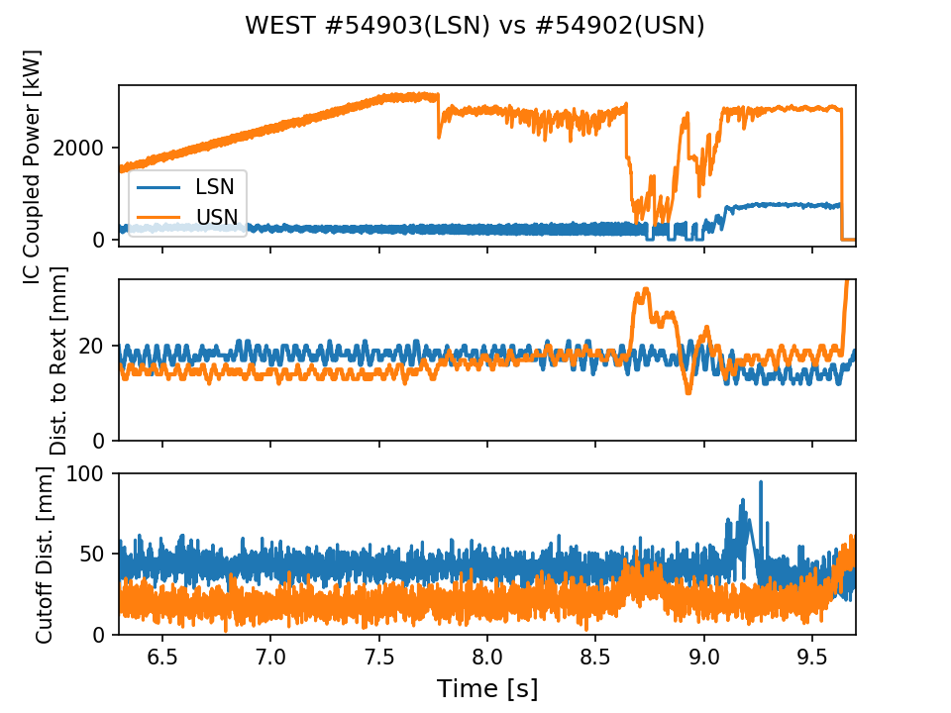
Higher Coupling found in USN Distance to cut-off density is lower in USN
# 54902 (USN) vs 54903 (LSN): 500 kA, nl 4.10¹⁹ m⁻³
1.5 Ω
0.5 Ω
18 vs 14 mm
R_{ext} is (supposed to be) similar
43 vs 19 mm
Cut-off distance is different : ~ 20 mm (from reflectometry)

Slide 10
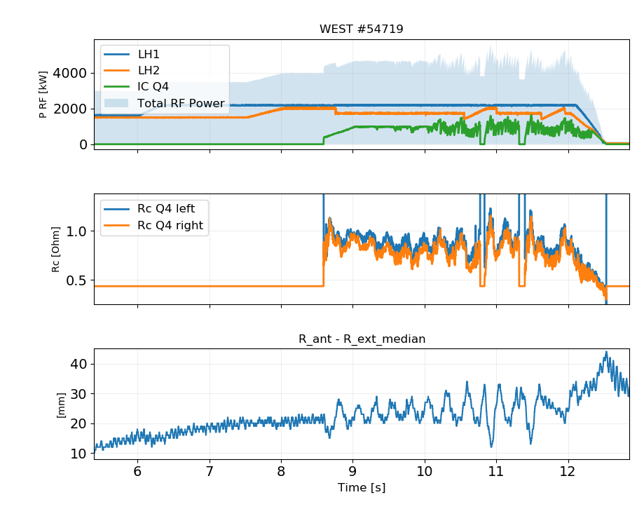
Radial position drifts with time ex: #54719
Plasma LCFS moves away from the antennas
Coupling resistances drop
Leads to power regulation and/or trips
Corrections in progress (week 38)
>10 mm shift toward HFS

Slide 11
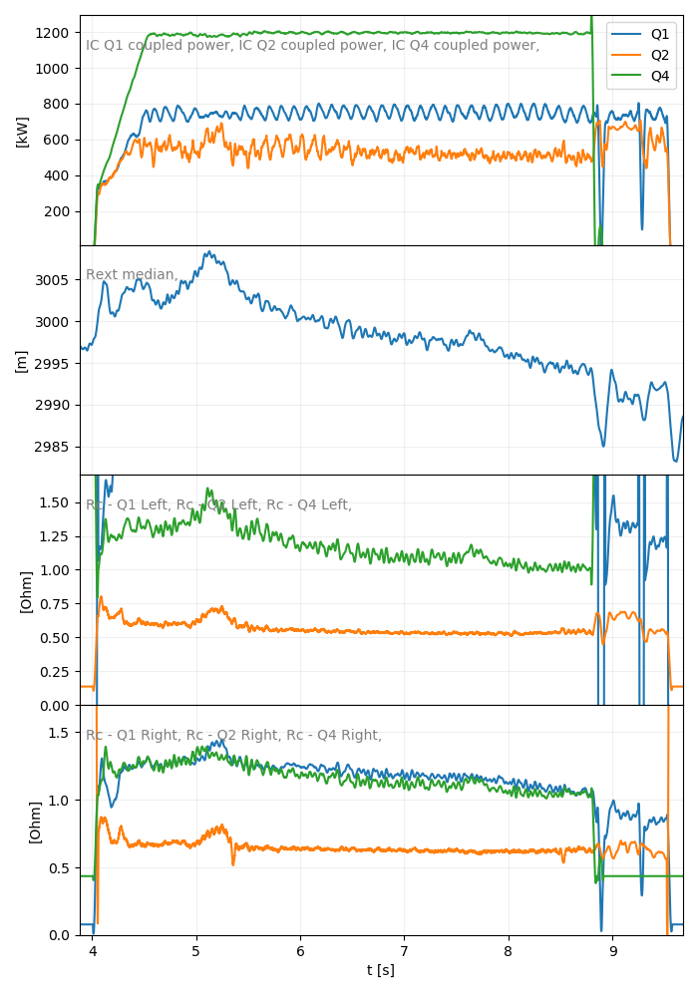
Radial position drifts with time ex: #55015
Plasma LCFS moves away from the antennas
Coupling resistances drop
Leads to power regulation and/or trips
Corrections in progress (week 38)
-14mm

Slide 12
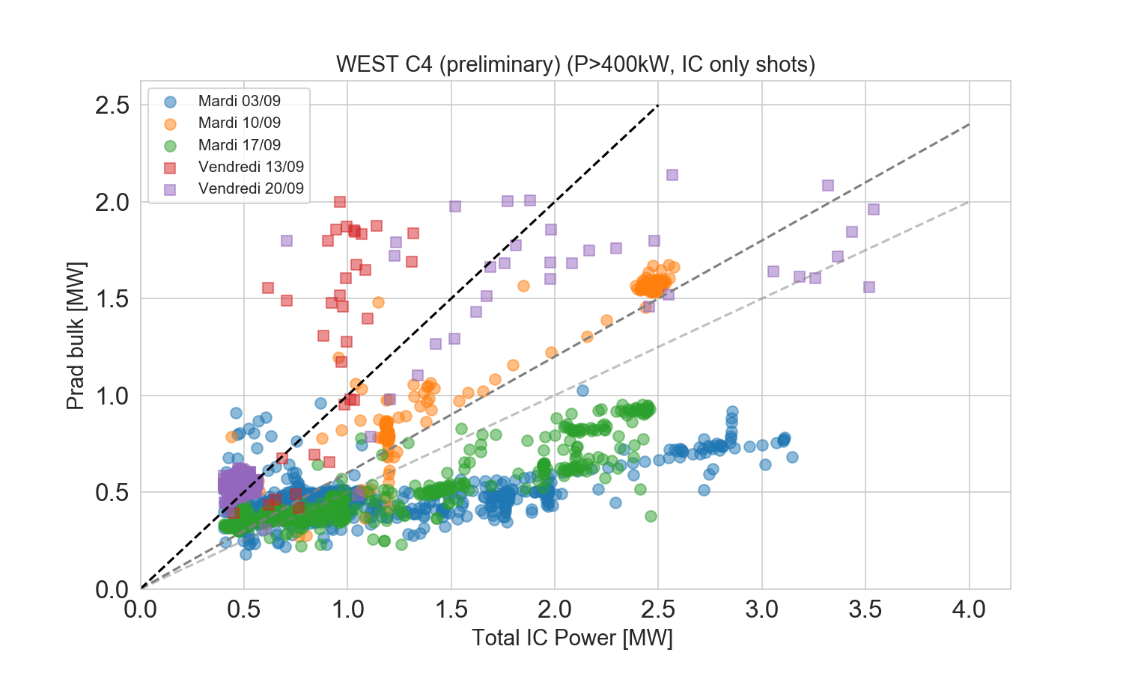
Boronization helps reducing radiated fraction
Borononization performed on Mondays
IC sessions on Tuesday and Friday evenings: some data to be compared
Caveat: results heavily depend on antennas phasing, but anyway, a clear tendency appears
f_{rad}=100%
f_{rad}=60%
Phase tests
f_{rad}=50%

Slide 13
Q2 Coupling Resistance
Will the mystery come to an end?

Slide 14
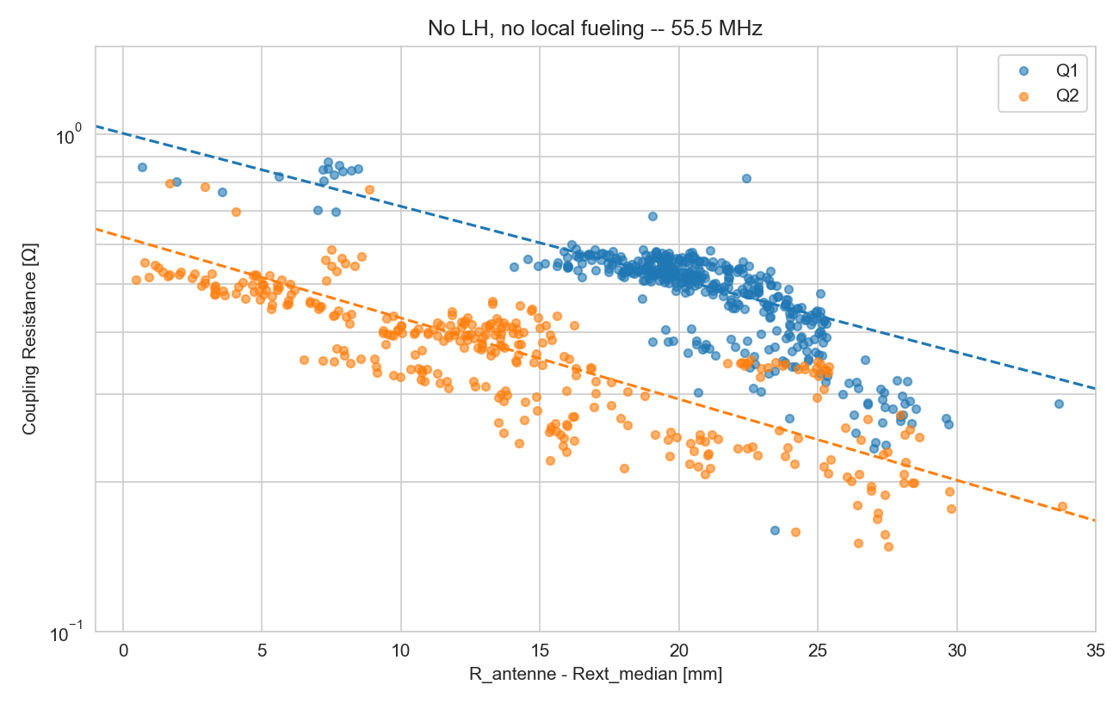
Q2 Coupling Resistance
Q2 coupling resistance has been found different from Q1 during the C3 campaign
Coupling resistance is deduced from voltages and power measurements
→ Power measurements recalibrated during S3, still difference clearly remains.
In C4, the coupling of Q1 and Q4 has been found equivalent.
→ seems to indicate a peculiarity of Q2
Conclusion: difference in Q2 voltage probe calibration as most probable explanation
C3b: Rc vs distance antenna/LCFS
Such behaviour could be explained by a dist. diff. to LCFS ~ 10-15 mm
→ Can’t be explained by mechanical differences (cf. measures), since:
- strap/FS distance is 30.5 mm (-1.6/ +2.2)
⁻ Antenna radial positions checked during S3

Slide 15
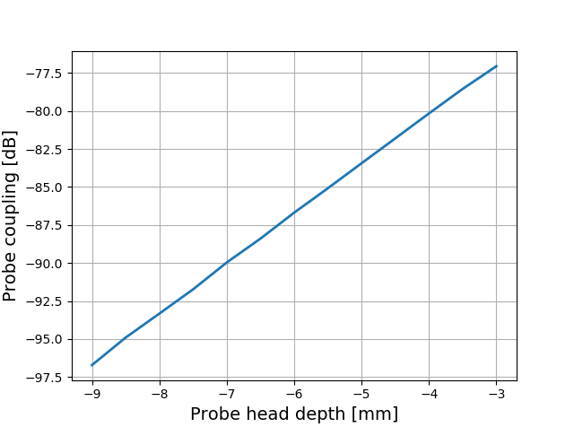
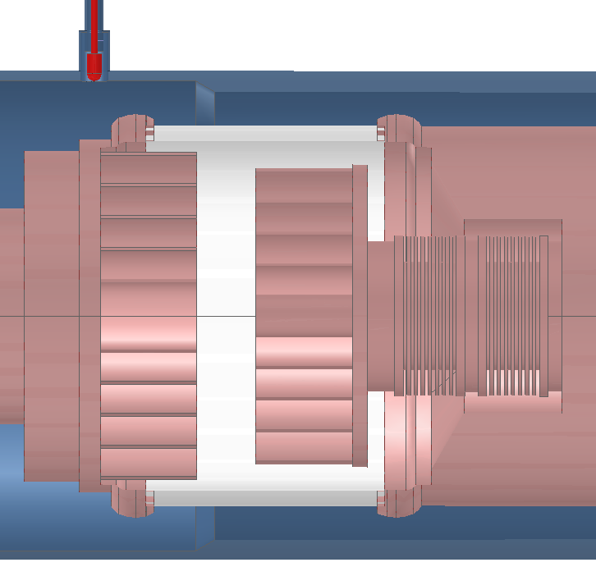
WEST Antenna voltage probe calibration procedure
Probes are calibrated at low frequency (~1 MHz)
Calibration data are then extrapolated to nominal frequencies (48 to 63 MHz)
Probe coupling is *very* sensitive to its depth in its port
Probe head depth
~ 3.3 dB/mm from modelling & measurements
0
Q2 was the first antenna to be assembled and calibrated
Probes have been disassembled then reinstalled *after* the calibration (for welding access) → mechanical error between 1st and 2nd assembly?

Slide 16
How Q2 voltage probe calibration should be modified to match Q1 and Q4?
From reproducible shots from Friday 13/09
Voltages averaged btw Q2 and Q4
Caveat: VSWR not exactly identical (some frozen capacitor positions at that time)
 | V_{Q2} | V_{Q4} | V_{Q2}/V_{Q4}
Left Upper | 15 | 11.95 | 1.25
Left Bottom | 19.9 | 16.1 | 1.23
Right Upper | 16.7 | 12.3 | 1.35
Right Lower | 13.9 | 16.5 | 0.84
V_{Q2} ~ 1.25 x V_{Q4} for 3 probes
NB: 20log₁₀(1.25) = 1.94 dB
Proposed correction until end of C4: -1.94 dB for 3 probes
Equivalent to a positioning error ~ 0.6 mm (credible)
Additional investigations during next shutdown

Slide 17
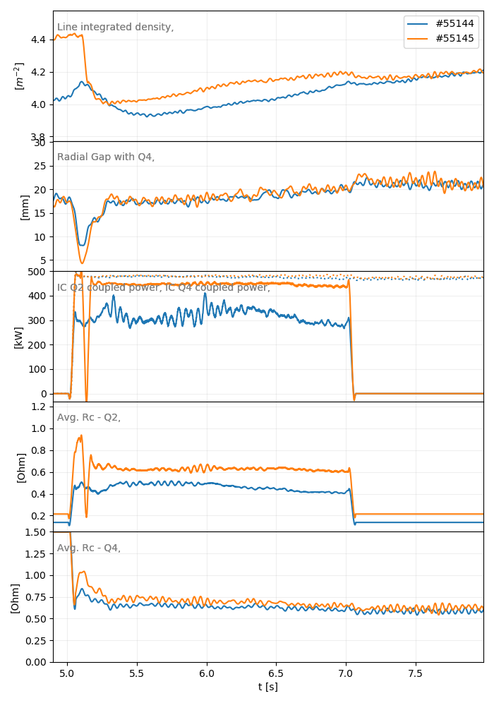
Test of the proposed modification
#55144 vs #55145
→ Q2 Rc increase (consequence of reduced voltages) → No more power regulation and power ~ Q4
Risks: If the cause of voltage differences between Q2 and other antennas is different than a pure calibration problem, it may increase capacitor voltages and currents to:
27 kV x 1.25 = 33.8 kV
915 A x 1.25 = 1143.8 A
Risk considered acceptable until the end of C4

Slide 18
Toroidal Phase Control

Slide 19
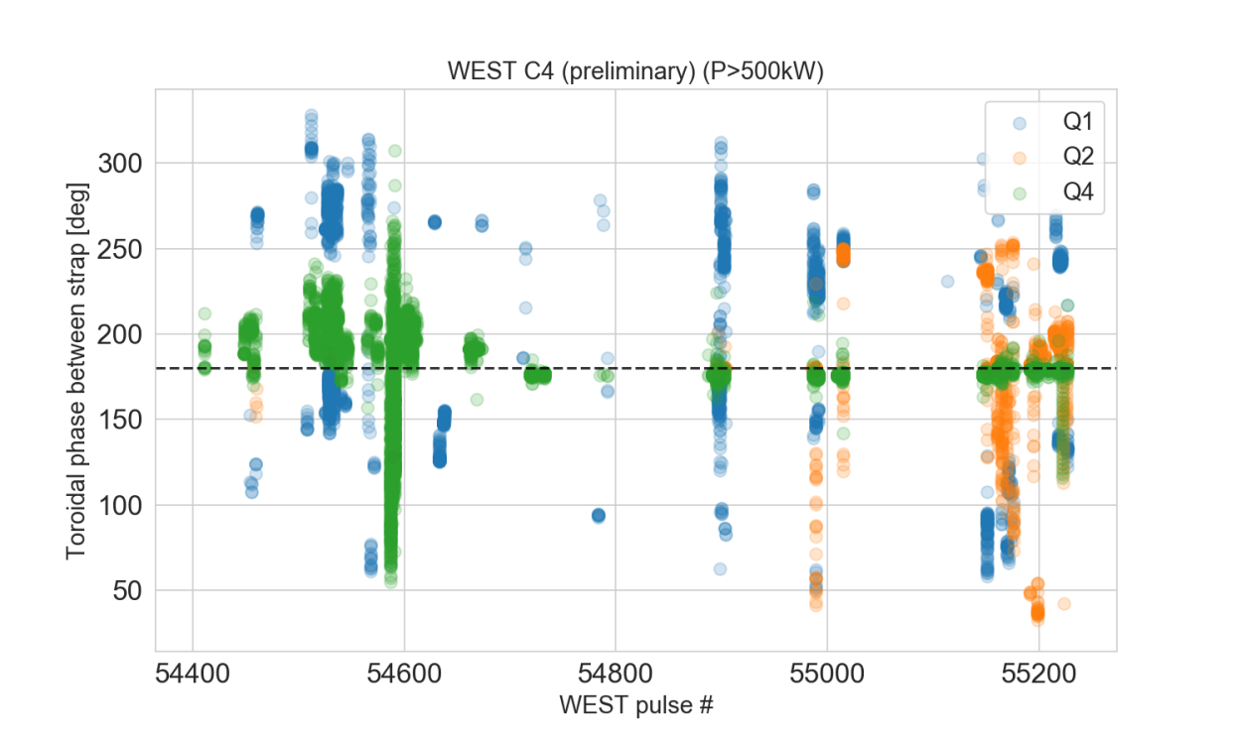
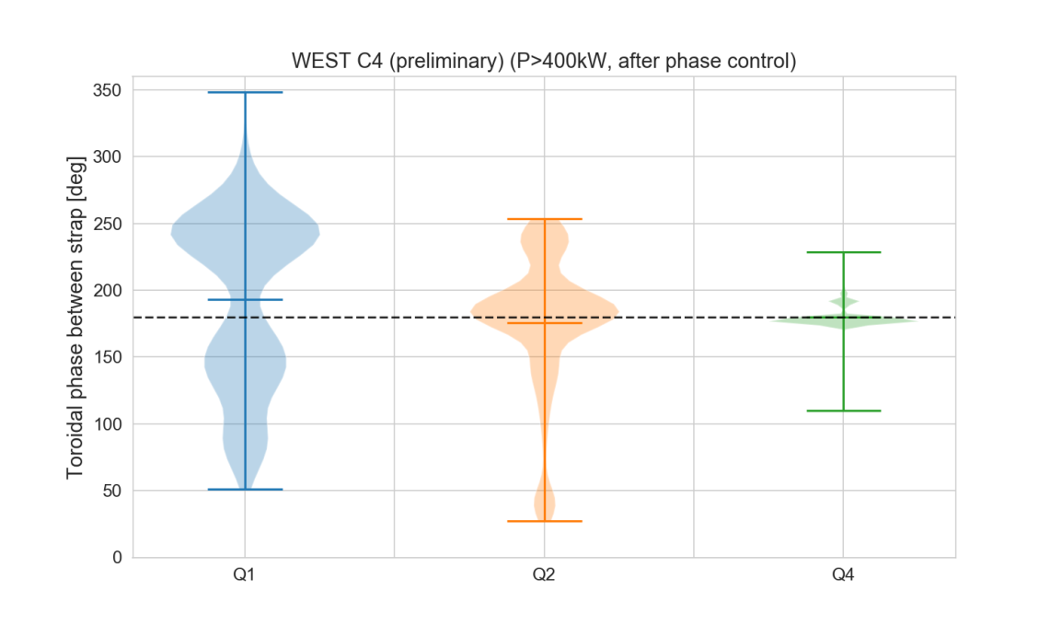
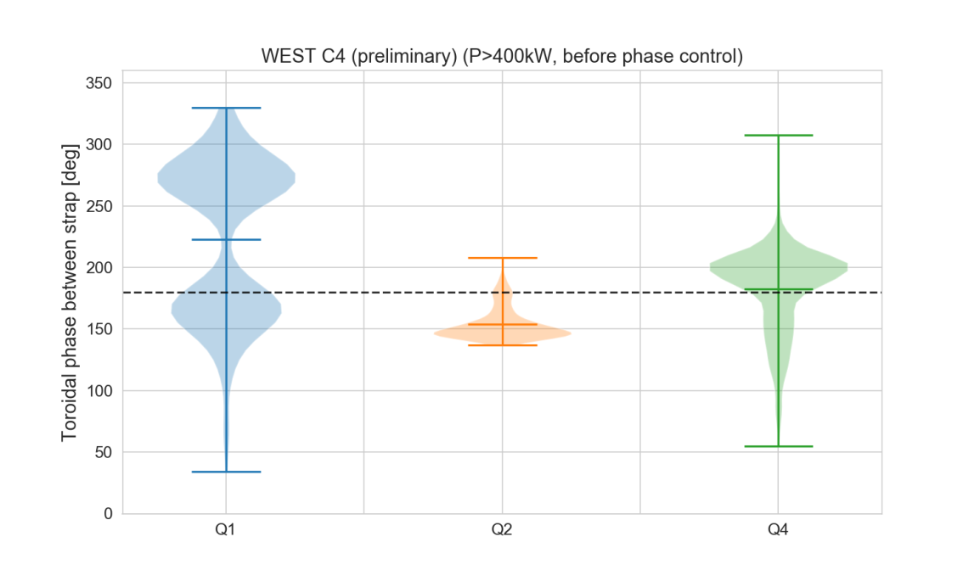
WEST Antenna Toroidal Phase Automatic Regulation
Phase control started since #54626 (but not on all antennas/at the same time)
OK for Q4 (quite resilient)
Better control for Q2 (but get easily distracted)
Does not work on Q1 yet
Conclusions:
Still margin for improvements (for sure).
Investigations ongoing. Need to update hardware (tbc).

Slide 20
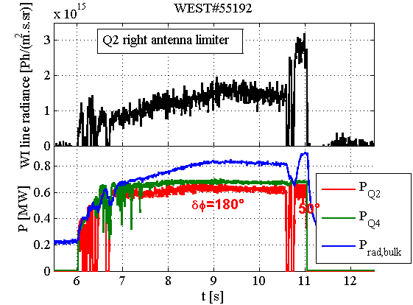
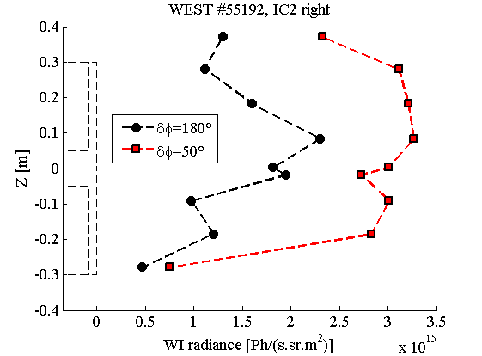
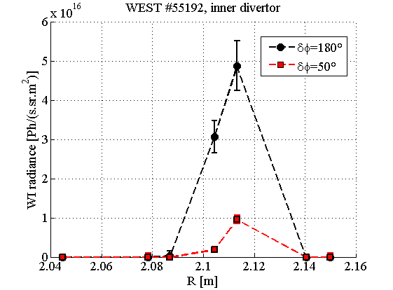
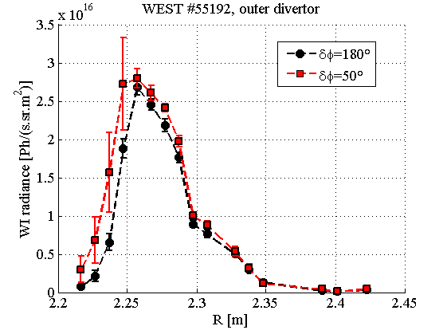
Impurity production vs phase WEST #55192
Failure in Q2 phase control leads to:
Radiated power increase
WI radiance increase on lateral limiters but not on divertor
From L.Colas

Slide 21
IC and LH
Status: from « it’s complicated » to « it's getting better and better »

Slide 22
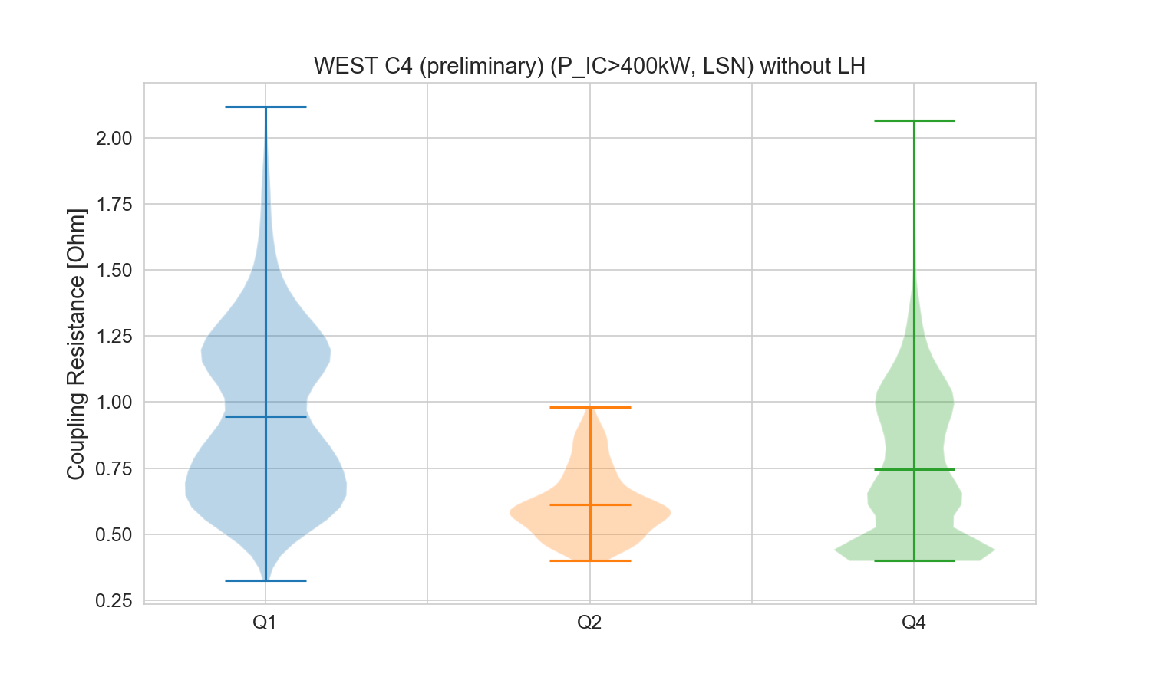
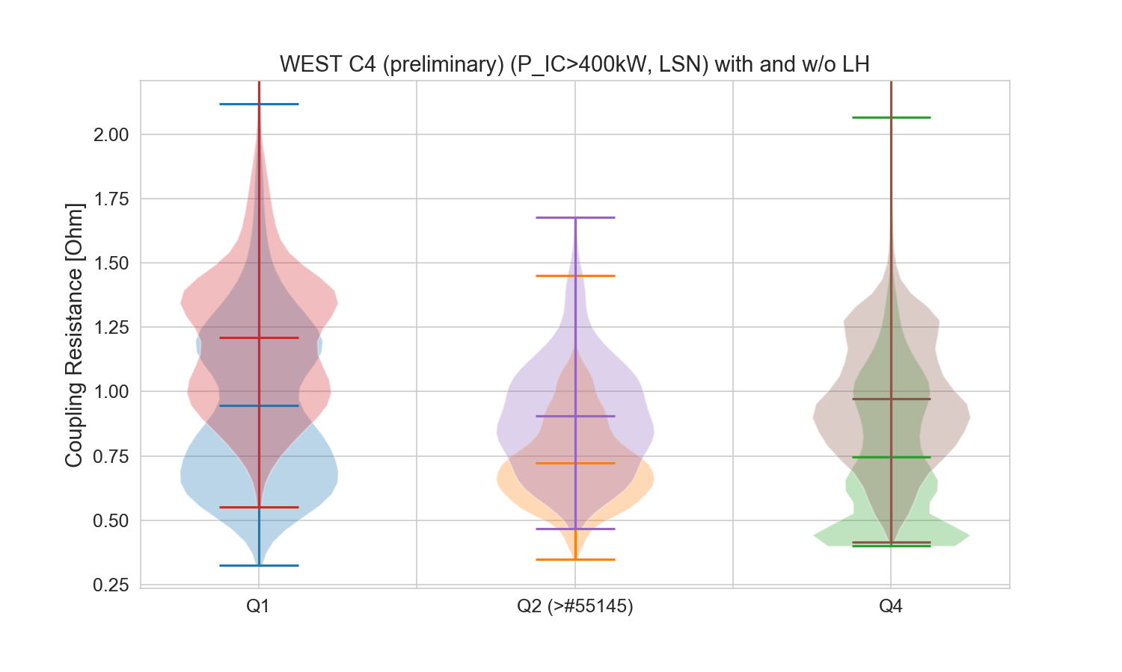
Effect of LH on IC Coupling Resistance
LH power increases the Rc average by ~0.25 ohm
But important dispersion: sometime opposite effects measured
Database biased: few shot with LH and Q2

Slide 23
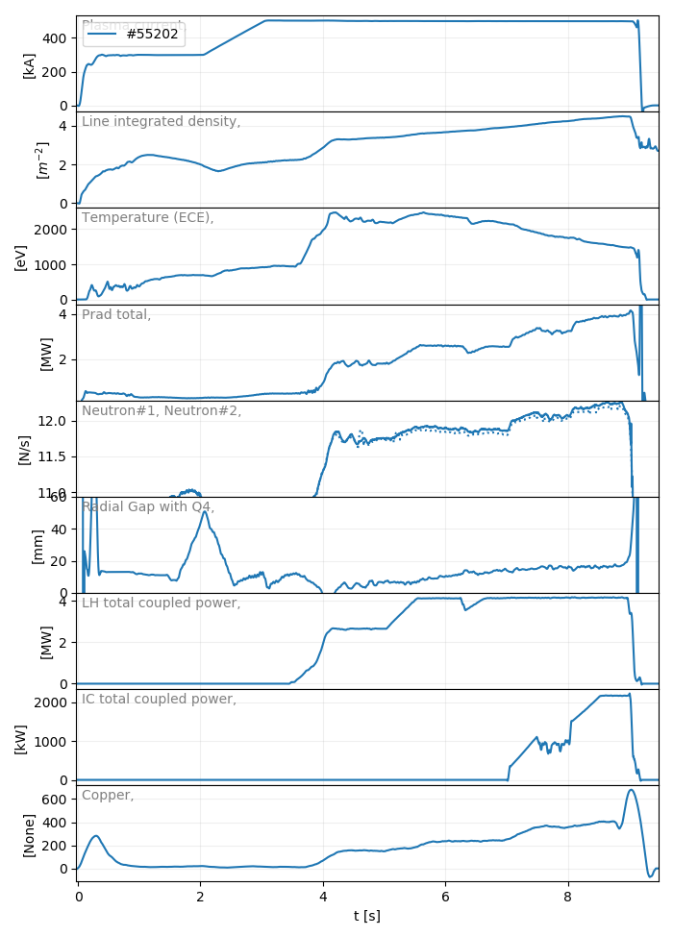
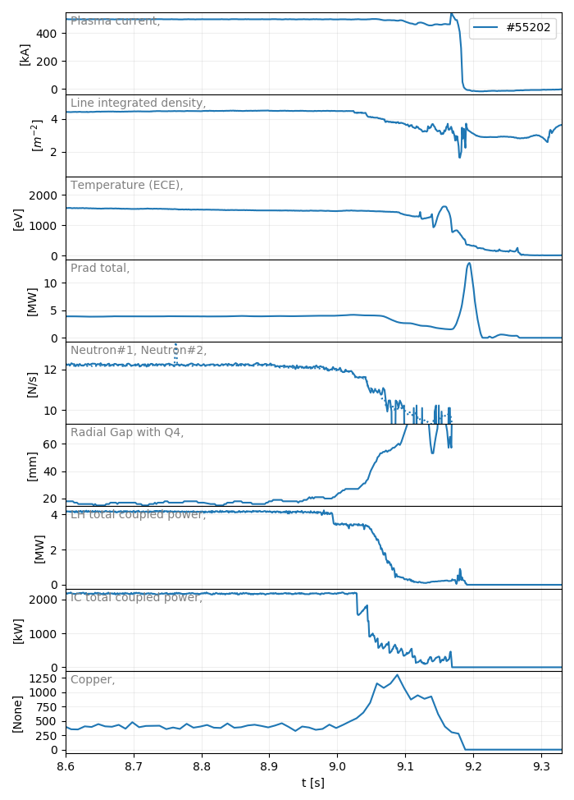
Copper Impurities (only?) currently limiting the High Confinement Scenario
49% of LH radiated
61% of IC radiated
4.2MW LH
2.2 MW IC

Slide 24
(Preliminary) Summary

Slide 25
Status of the ICRH System during C4 (preliminary) summary
All 3 ICRH antennas available on plasma
IC power alone on specific scenarios :
4.2 MW peak achieved on USN plasma
Coupling different in 500kA USN vs LSN. Investigations ongoing.
H-mode scenario:
Low density and coupling resistance, meaning ~1 MW/ant
Max so far: 2.2 MW IC with 2 antennas in // with 4.2 MW LH
Toroidal phase control progress, but still work to do to make it reliable

