Slide 1
WEST C5 Figures
12/2020
J.Hillairet

Slide 2
Commissioning

Slide 3
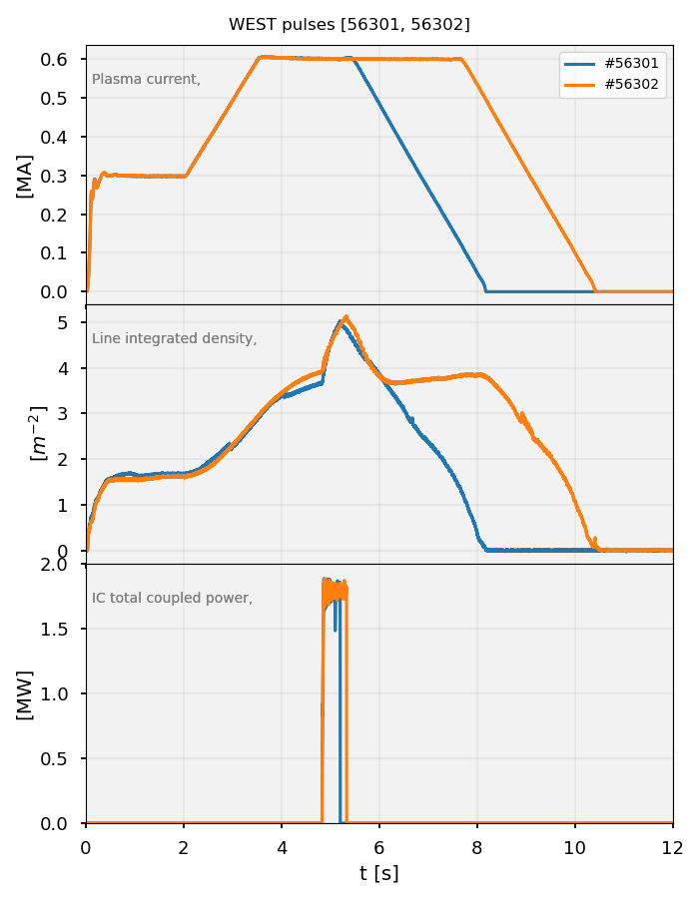
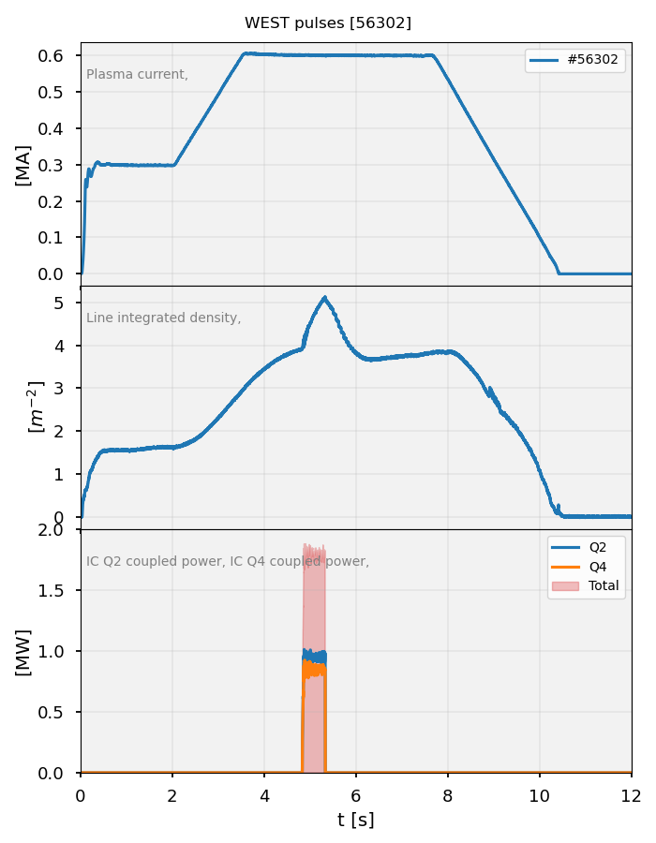
56301 & 56302 : 2 x 1 MW Q2 and Q4
10/12/2020
Q2 and Q4 on plasma
~1 MW / antenna target reached
Q1 was not available due to HVPS B3 not available
Caveats
Hydrogen fraction between 20 to 40%
Density (& P_{rad}) increases during IC
→ limits IC power duration (to avoid density limit)
Copper impurity level rises during IC (bad absorption?), cf next slide
Phase active control not working yet on Q2 (but OK for Q4)
Hot spots on Q2 central region (next slides)

Slide 4
56301 & 56302 : 2 x 1 MW Q2 and Q4
Hot Spots Observed on Q2
TODO

Slide 5
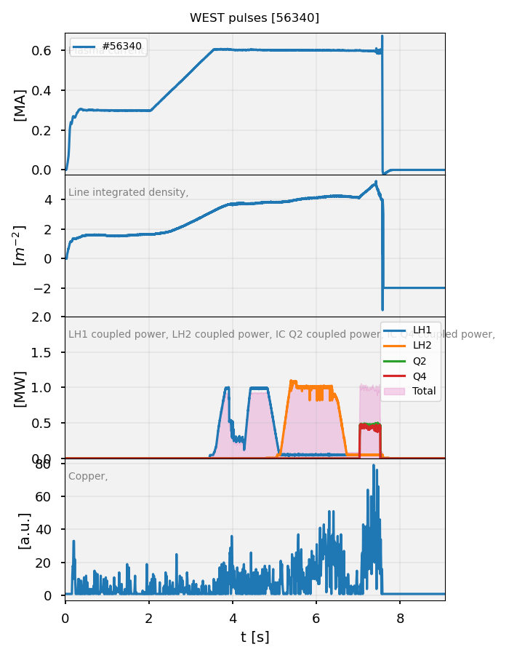
56339 & 56340: 2x0,5 MW IC and LH power before
11/12/2020
Q2 hard-fixed phase to 180°, Q4 phase control to 180°
Disruptions during IC power
Copper impurity signal larger during IC than LH

Slide 6
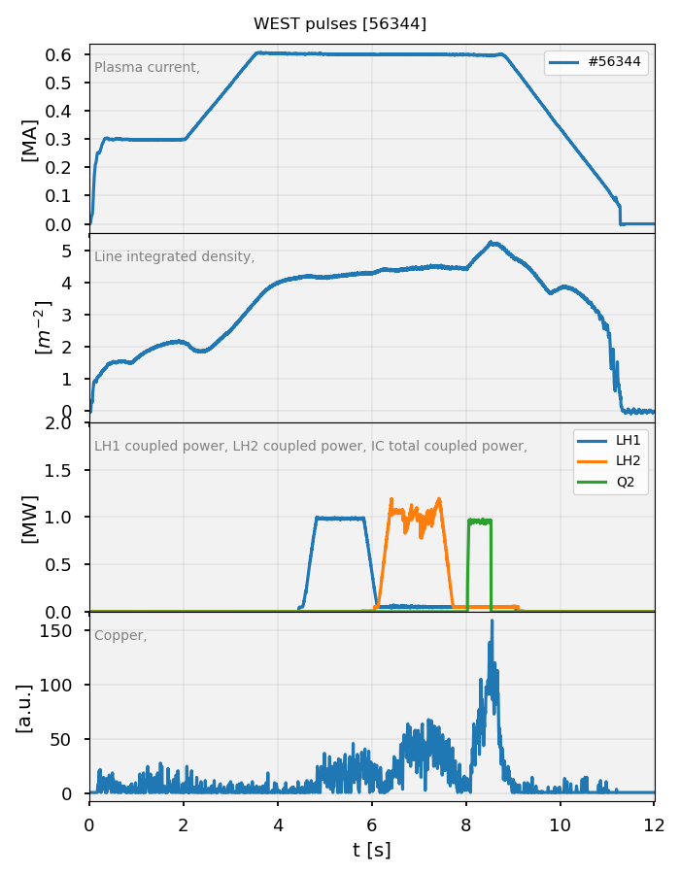
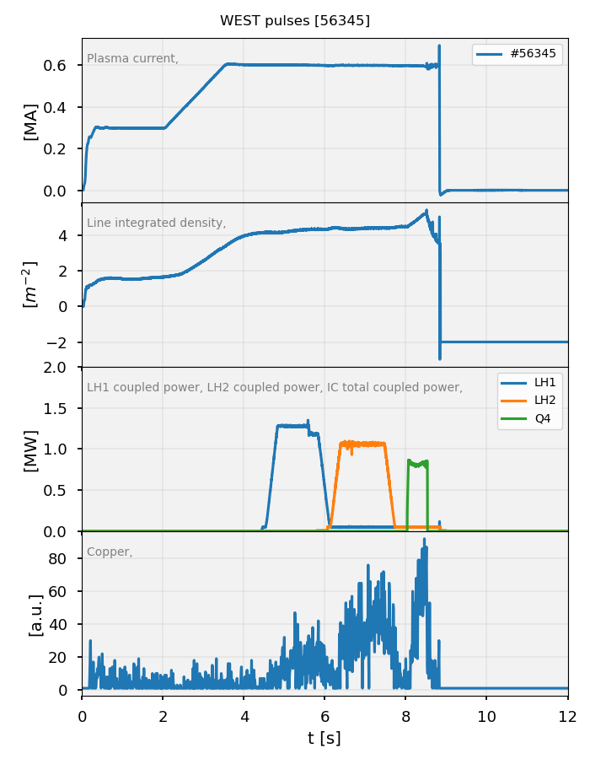
56344 & 56345 : 1 MW Q2 & Q4
11/12/2020
Q2 hard-fixed phase to 180°, Q4 phase control to 180°
Previously, firing 2x0,5 MW with both Q2 and Q4 led to disruptions (MHD?)
So tried with 1 MW single antenna.
Better, but MHD still triggered
Copper impurity signal larger during IC than LH
much higher with Q2 than Q4 (→line connexion with LH??)
MHD triggered

Slide 7
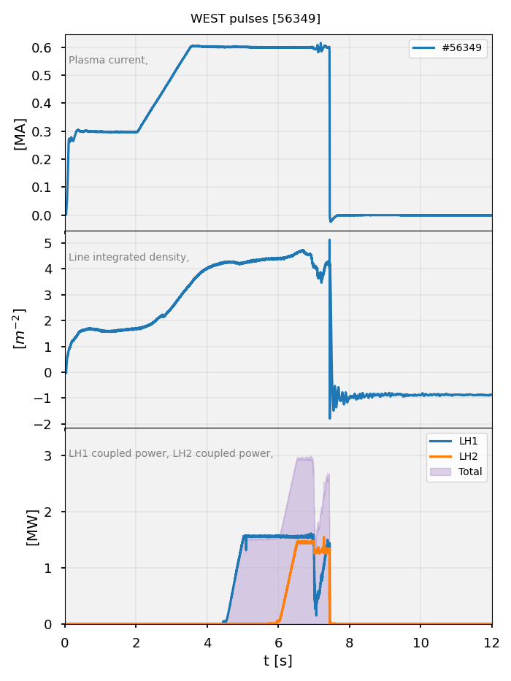
56349: LH1 & LH2 up to 3MW combined

Slide 8
EUROfusion session 18/12/2020

Slide 9
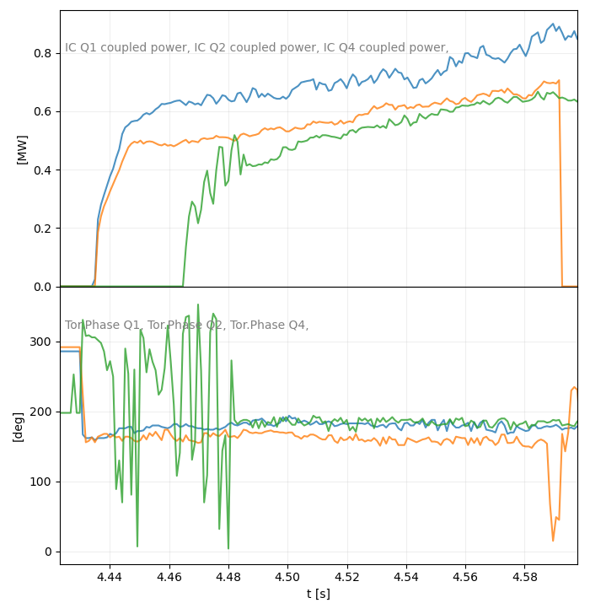
56
Correction du bug sur la consigne de phase dans le CODAC
La regulation de phase fonctionne sur les 3 antennes
Reste des problems de cross-talks entre antenne → Patrick met en place la possibilité de désactiver le Pr/Pi au générateur (pas de discrimination de fréquence) → validé le lendemain.

Slide 10
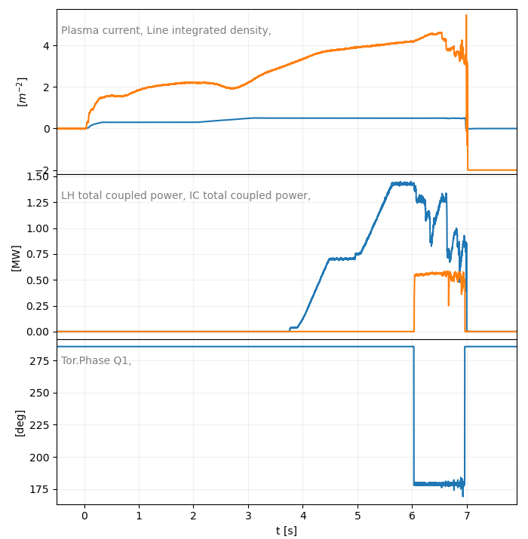
56480: LH + Q1
Phase Q1 proper
LH trips pendant Q1

Slide 11
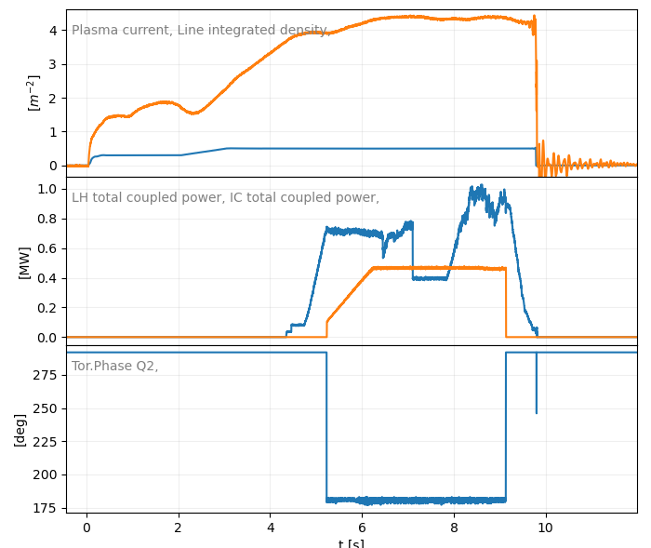
56485: LH + Q2
Phase Q2 proper
LH trips pendant Q2

Slide 12
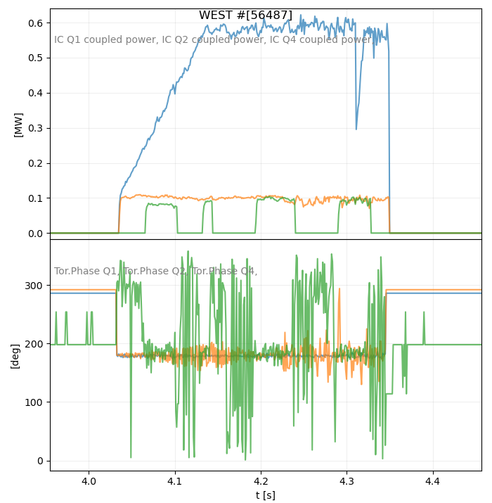
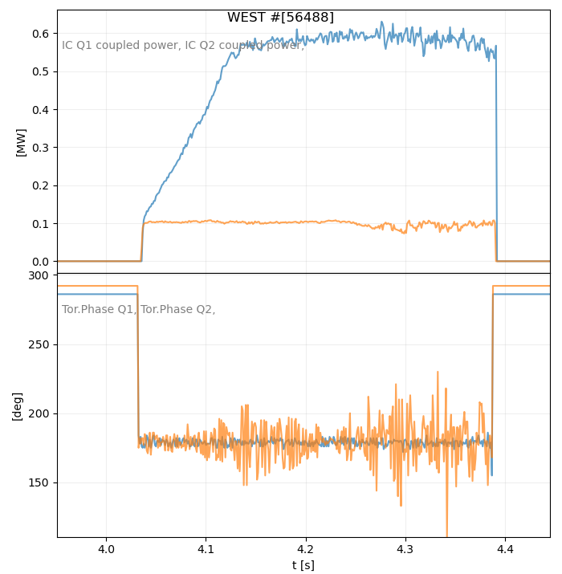
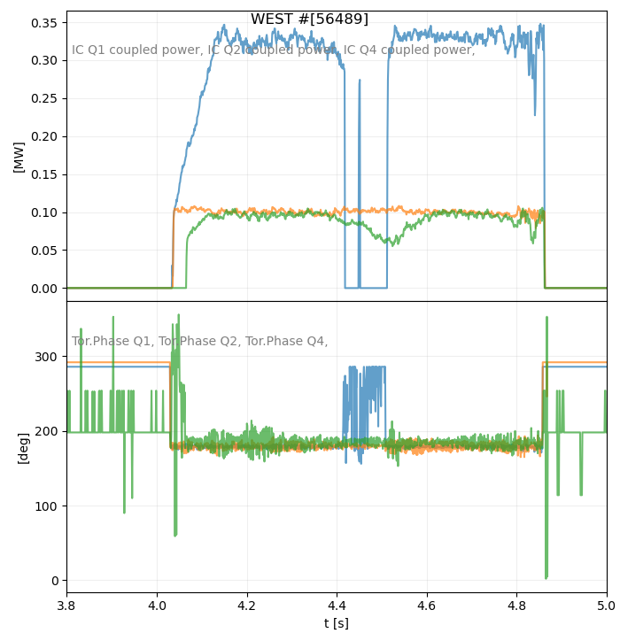
56487-56489 : ICRH Antennas Toggling (tentative)
In these 3 pulses, the Pr/Pi interlock was desactivated at generator side.
But plasmas disrupt during before toggling to the next antenna.

Slide 13
Evolution du rapport isotopique

Slide 14
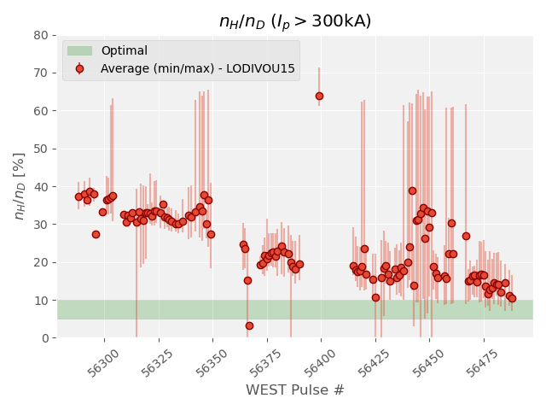
Evolution du rapport isotopique du 10/12 au 18/12/2020

Slide 15
Evolution Impuretés

Slide 16
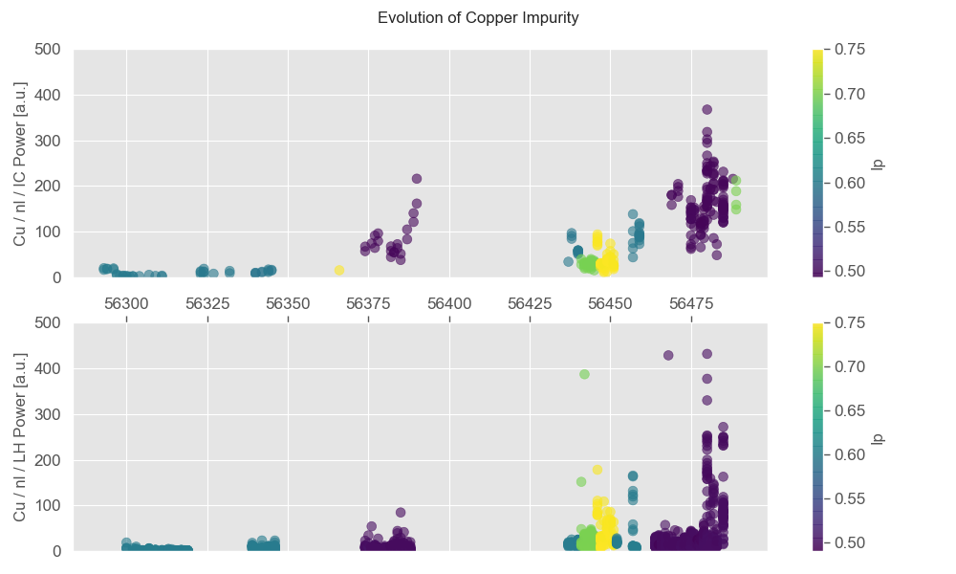
Evolution du signal Cu (SCU19) du 10/12 au 18/12
L’amplitude du signal augmente sensiblement le 17 et 18/12/20
D’autant plus avec IC

Slide 17
Evolution Cu vs MHD (GMHD_D1%2)

