Slide 1
WEST ICRH Antenna Circuit Model
Last update 22/09/2020
J.Hillairet

Slide 2
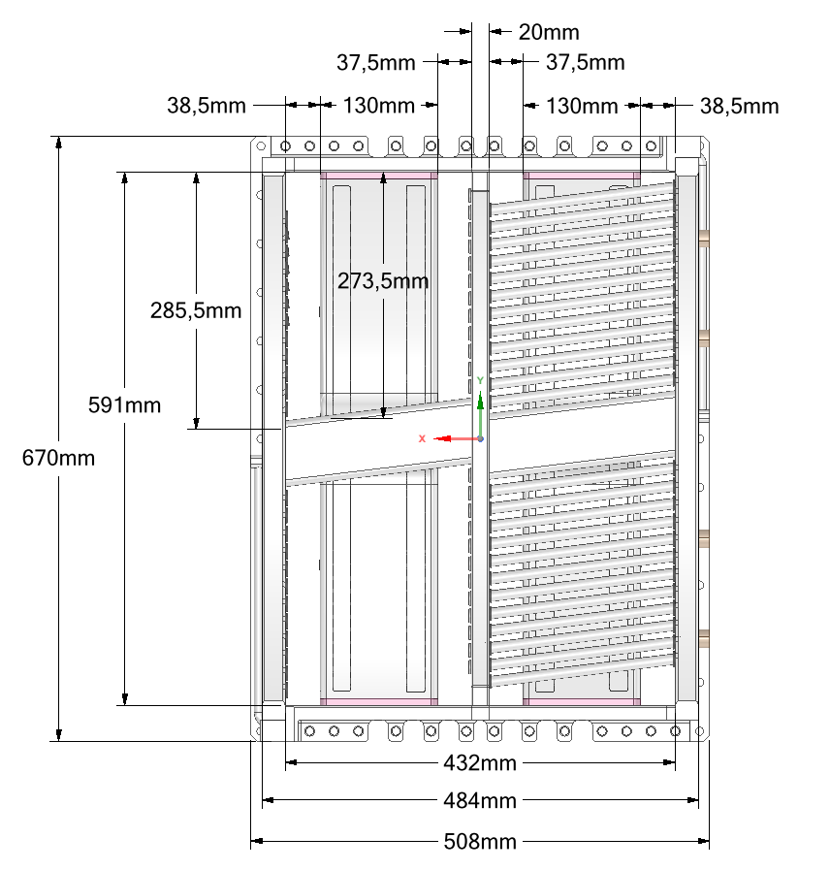
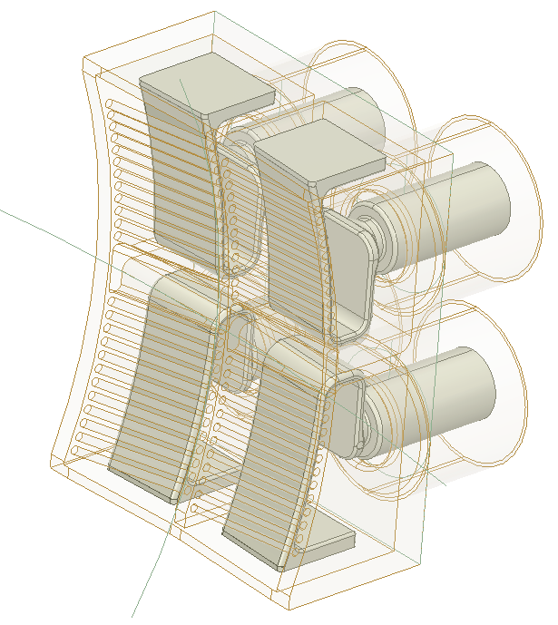
WEST ICRH Antenna Front Face Main Dimension
RF Model
Right side
Port 2
Port 1
Port 4
Left side
Port 3
Warning: port indexing differs from voltage probe and capacitor indexing

Slide 3
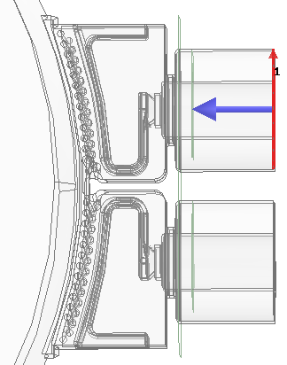
WEST ICRH Antenna Front Face Port Properties
Port plane of reference is located at 30,6 mm from and 49,6 mm from antenna box
In the illustrated model, 150mm are added and de-embbeded
49.6
150
30.6
D_{int}/D_{out} = 102/222 → Z₀ = 46.646 Ω

Slide 4
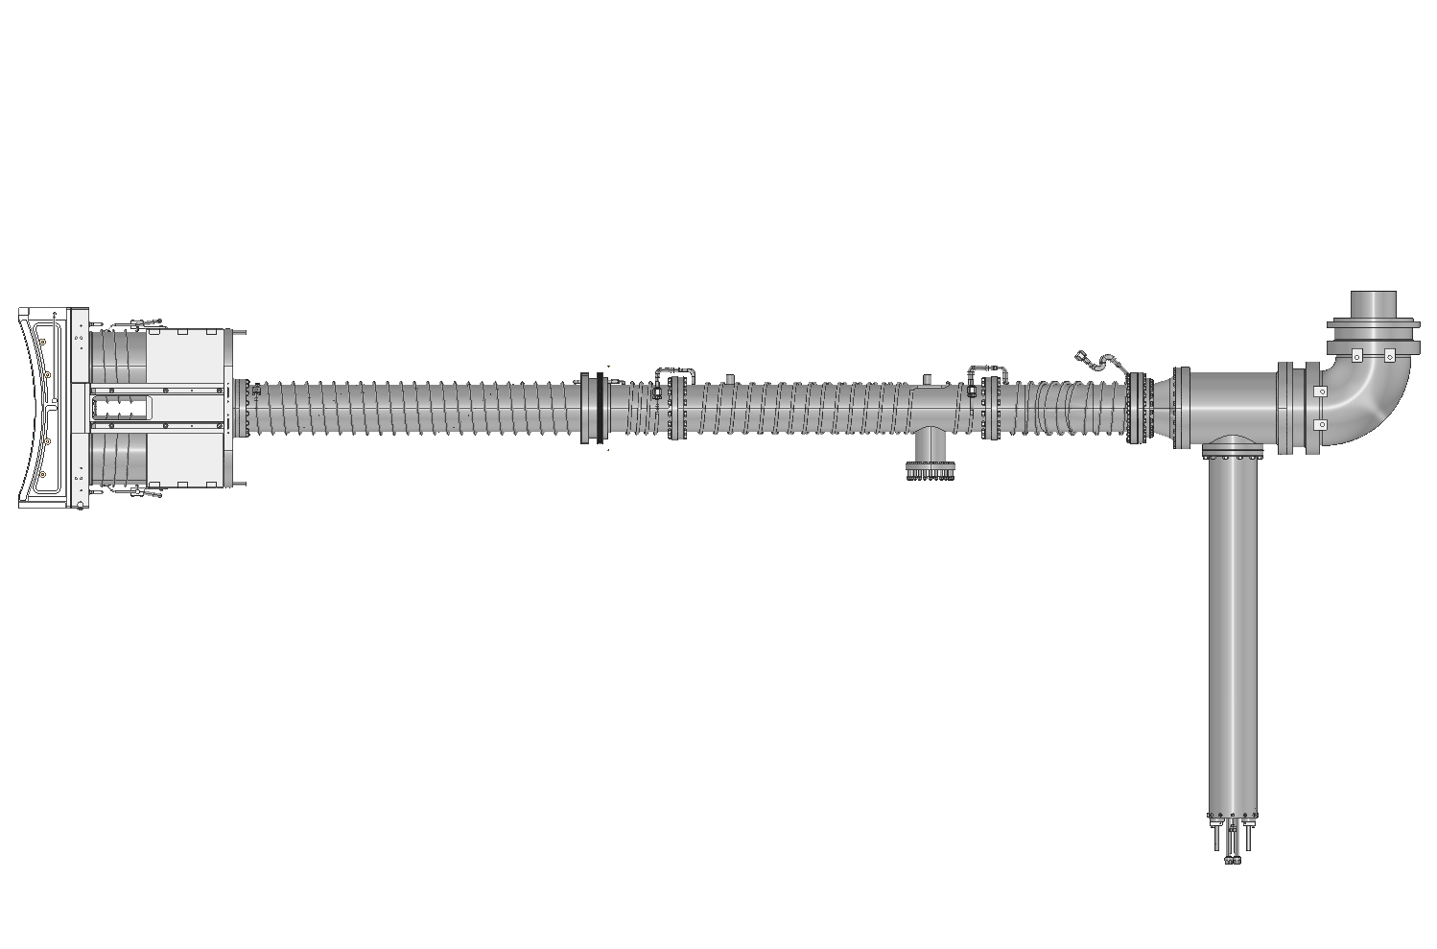
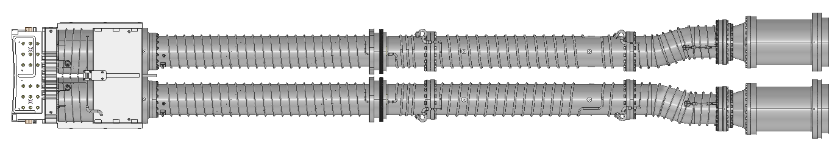
Antenna Elements (side views)
Capacitor (top) (x2)
Feeder
30 Ohm
Bridge (x2)
Impedance Transformer + window (x2)
Antenna
front-face
Capacitor (bottom) (x2)
Service
Stub
x2

Slide 5
WEST ICRH Antenna Circuit Model – ANSYS Circuit/HFSS Model
Bridge
(left)
Imp Transf+Win
(left)
Front-face
V1, I1
C1
V2, I2
C2
V3, I3
C3
Bridge
(right)
C4
V4, I4
Imp Transf+Win
(right)

Slide 7
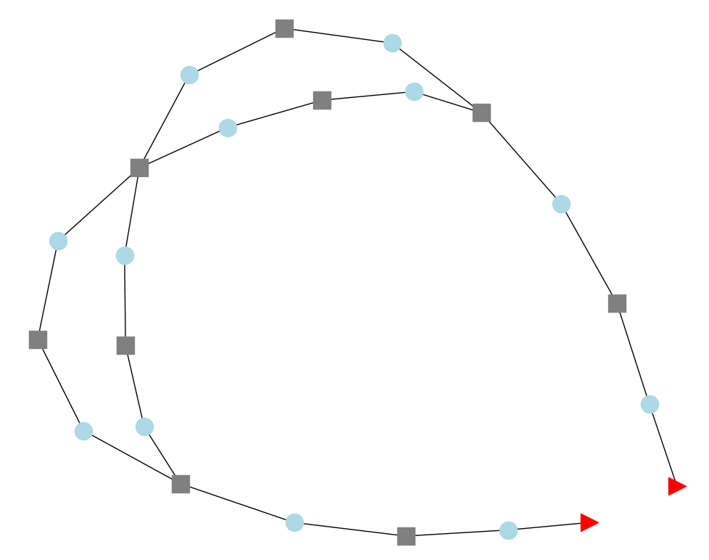
WEST ICRH Antenna Circuit Model - Python skrf Circuit Model
V3, I3
NB: service stubs are also included but not illustrated here
C3
(Right) Bridge
2
Antenna (4 ports)
Right side
C4
4
V1, I1
1
3
V4, I4
Imp Transf
+window
V2, I2
C1
C2
Imp Transf
+window
Port Right
Left side
(Left) Bridge
Port Left

Slide 8
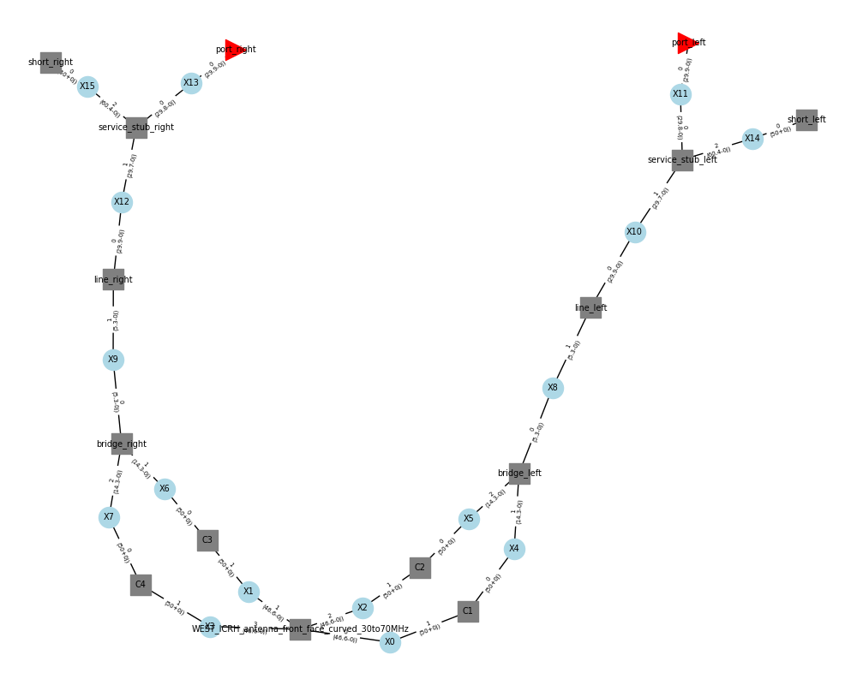
WEST ICRH Antenna Circuit Model - Python skrf Circuit Model
Right side
Left side
Port Left
Port Right
Service stub & short
Service stub & short
Imp Transf
+window
Imp Transf
+window
(Right) Bridge
(Left) Bridge
C3
C2
V3, I3
V2, I2
2
3
C4
4
C1
V1, I1
V4, I4
Antenna (4 ports)
1

Slide 9
WEST ICRH Antenna Circuit Model - Python skrf Circuit Model
Right side
Left side
Port Left
Port Right
Service stub & short
Service stub & short
Imp Transf
+window
Imp Transf
+window
(Right) Bridge
(Left) Bridge
C3
C2
V3, I3
V2, I2
2
3
C4
4
C1
V1, I1
V4, I4
Antenna (4 ports)
1

Slide 10
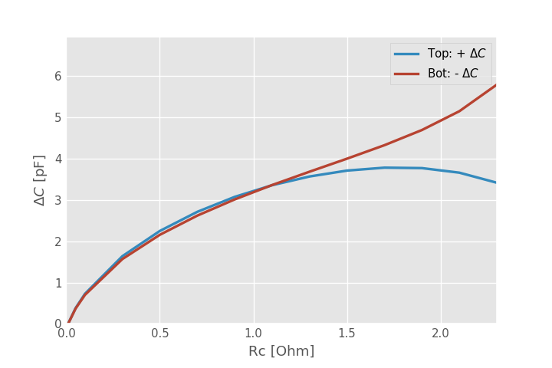
Ideal front-face model
Front-face
Port 1
Solution on vacuum
Port 2
Port 3
Port 4
Z_{s}=R_{c}+X_{s}
As the coupling resistance increase, the ideal capacitances set for match change.
This figure displays how much capacitance but be added (removed) to top (bottom) capacitors respectively.

Slide 11
WEST Antenna Matching

Slide 12
(Virtual) Experiment Description
Assumed: one antenna working at f₀
Antenna RF excitation
Excitation left side: P_{in},
Excitation right side: P_{in} x exp(j∆φ), with ∆φ in [0, 180°]
Dipole: ∆φ=180°
Monopole: ∆φ=0°
Antenna Matching Method (manual procedure)
Match left side (right side detuned) -> gives C1 and C2
Match right side (left side detuned) -> gives C3 and C4
2 solutions can be found for each sides : solution “1”: C_{top} > C_{bottom}, solution “2”: C_{top} < C_{bottom}
Setup antenna to (C1, C2, C3, C4) with same solution on both sides:
Optimum frequency to operate in dipole is f=f₀ + ∆f, where ∆f ~ 0.2 MHz (∆f = ∆f (f₀))
Optimum frequency to operate in monopole is f=f₀ - ∆f, where ∆f ~ 0.2 MHz (∆f = ∆f (f₀))

Slide 13
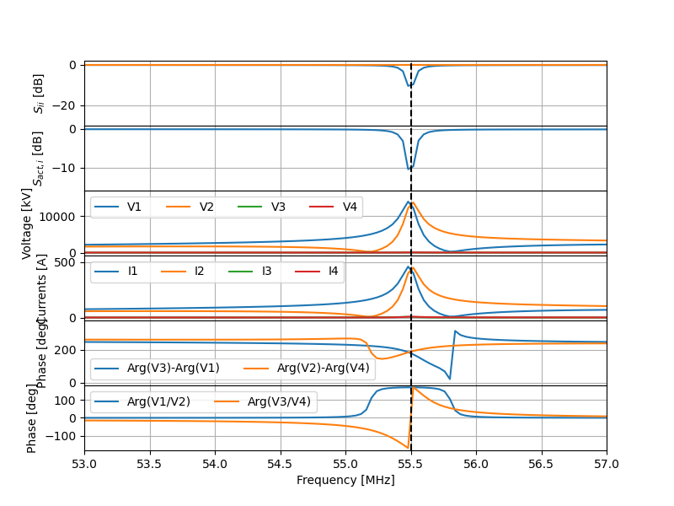
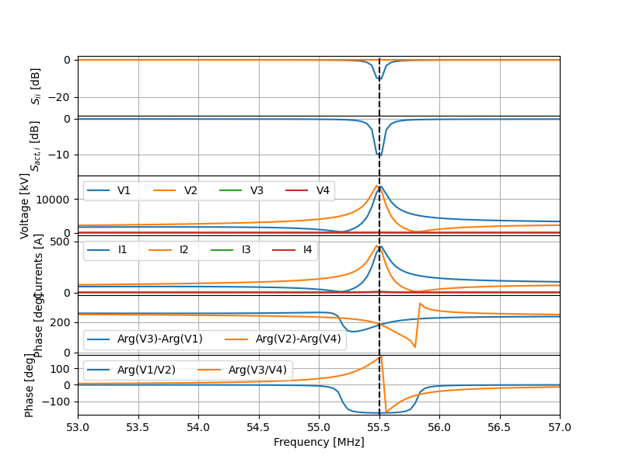
Left side matched (right side unmatched)
Solution 1 (C_{top} > C_{bot})
Solution 2 (C_{top} < C_{bot})

Slide 14
Plasma S-Matrix Measurement

Slide 15
S^{p}
1
S^{mL}
a_{L}
2
b_{L}
3
S^{mR}
a_{R}
4
b_{R}
Smes
S^{ant}

