Slide 1

scikit-rf: an open-source Python package for RF network simulation, analysis and calibration
The scikit-rf team https://github.com/scikit-rf/scikit-rf/graphs/contributors
http://scikit-rf.org/

Slide 2
RF Engineering Typical Problems
Reading VNA Touchstone Files (.sNp)
2-ports, 4-ports or 8-ports: different formatting!
Extract and Plot Network Parameters
What is the formula to convert S to Z?
Compare, Combine Networks
Incertitude of a Series of Measurements?
Cascading or Deembedding
Calibration
Problem with Calibration = Unusable Measurements!
Tiered Calibration (Ex: 2-port measured with a 1-port setup)
I don’t have the license for the XXX software/toolbox!
©INGRAM PUBLISHING
Etc…

Slide 3
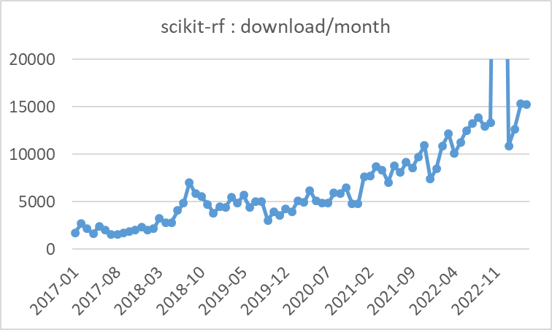
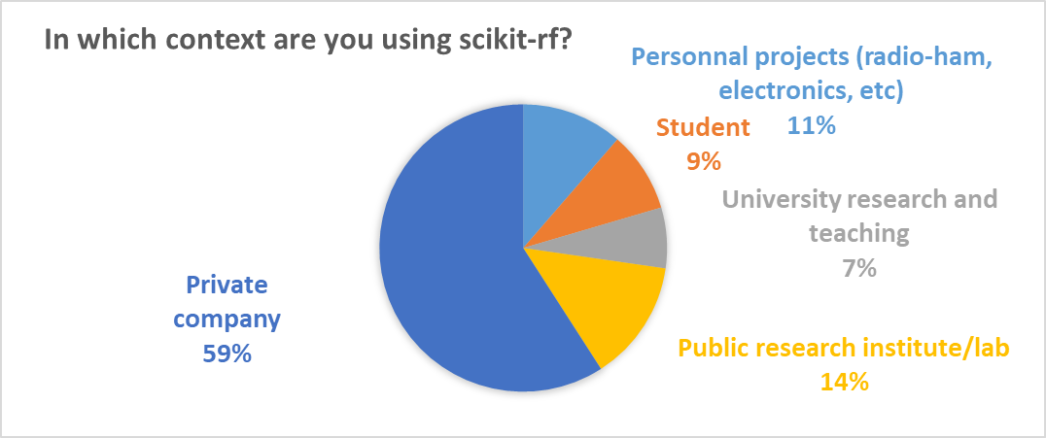
scikit-rf: an open-source package for RF engineering
A modern, object-oriented library for network analysis and calibration
Designed to make RF/microwave engineering both robust and approachable
Created in 2009 by Alex Arsenovic and continually developed since
By more than 70 volunteers on GitHub (https://github.com/scikit-rf/scikit-rf), used in > 170 projects
Distributed with BSD open-source license: benefits to the needs of private industry and gov. contracts
>23 000 lines of code, estimated 6 years of effort (and counting)
Used by several companies, universities and research groups in the world

Slide 4
Introduction to scikit-rf
The Network Class

Slide 5
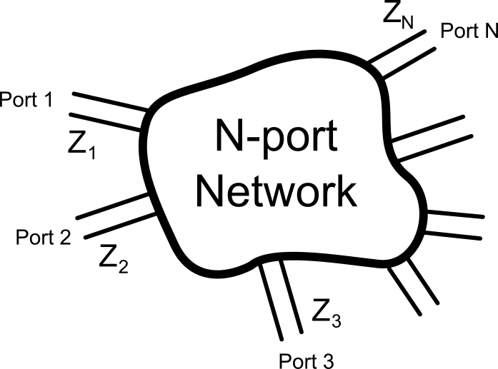
Network : the scikit-rf base class
Any RF Network is fully described by its S-parameters
Represented in scikit-rf with a Network object
Created Manually from S-parameters (or Z, Y, etc.)
Or imported from a Touchstone file (.sNp)
>>> import skrf
>>> ring_slot = skrf.Network('data/ring slot.s2p')
The Short Description of a Network object gives
The number of port(s),
The frequency range and number of points of the network parameters,
The Characteristic impedances of its ports (which can be frequency-dependant) :
>>> print(ring_slot)
2-Port Network: 'ring slot', 75.0-110.0 GHz, 201 pts, z0=[50.+0.j 50.+0.j]

Slide 6
Network : the scikit-rf base class
Network parameters and associated projections are easily accessible
For example, for the most used ones:
>>> ring_slot.frequency # frequency band properties
>>> ring_slot.z0 # ports characteristic impedances
>>> ring_slot.s # S-parameters. Dimension is (nb_f x nb_port x nb_port)
>>> ring_slot.z # Z-parameters. Dimension is (nb_f x nb_port x nb_port)
Also available: .y, .a (ABCD), .t (transfer), .h (hybrid)
Several Available Projections: complex, real, imag, magnitude, dB, phase (rad/deg) :
>>> ring_slot.s_db # S-parameters magnitude in dB
>>> ring_slot.z_deg # Z-parameters phase in degree
Extract Data for Sub-Frequency Bands, using frequency indices… or using « natural » language:
>>> ring_slot[100:200]
2-Port Network: 'ring slot', 92.5-109.825 GHz, 100 pts, z0=[50.+0.j 50.+0.j]
>>> ring_slot['80-100GHz']
2-Port Network: 'ring slot', 80.075-100.025 GHz, 115 pts, z0=[50.+0.j 50.+0.j]

Slide 7
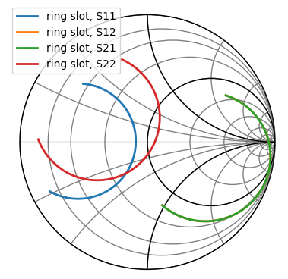
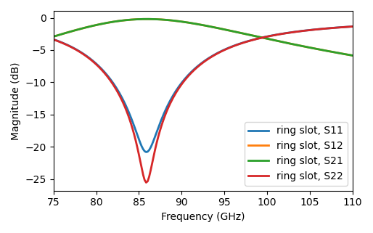
Graphical Representations
>>> ring_slot.plot_s_db()
>>> ring_slot.plot_s_smith()

Slide 8
Building RF Circuits

Slide 9
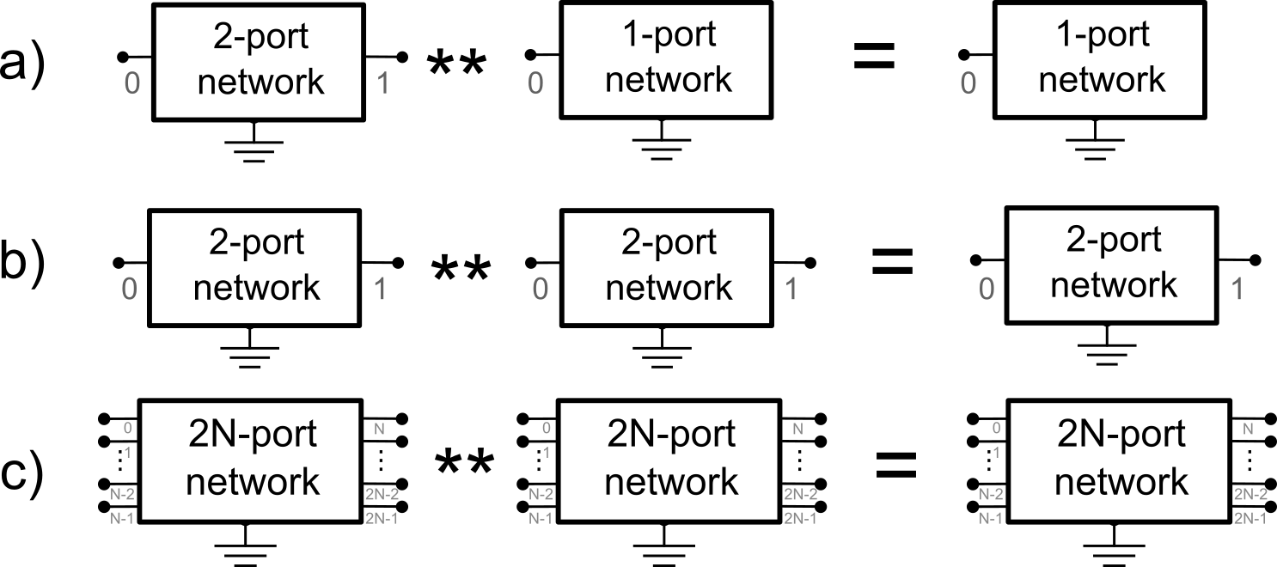
Cascading Networks
scikit-rf allows to connect N-ports Networks easily
Cascading between two Networks is performed using the ** Python Operator
Cascade of a 2-port with a 1-port
Cascade of two 2-port
Cascade of two 2N-port

Slide 10
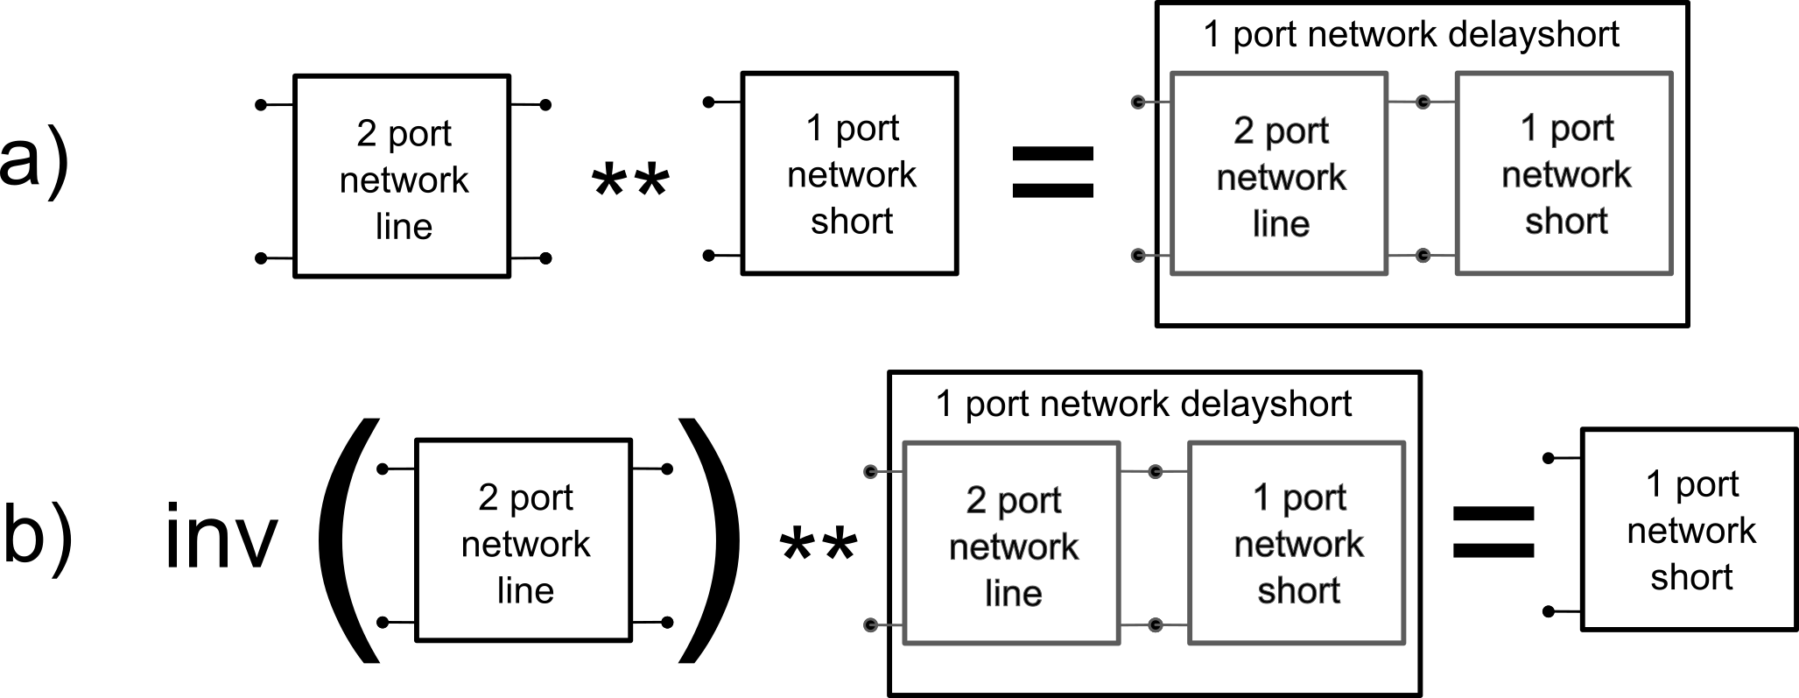
Cascading and Simple Deembedding
Cascade of a transmission line with a short-circuit:
>>> short = skrf.data.wr2p2_short # WR2.2 (1-port, 330-500 GHz) short
>>> line = skrf.data.wr2p2_line # WR2.2 (2-port, 330-500 GHz) line
>>> delayshort = line ** short
Deembedding of a Network of known S-parameters
>>> short_2 = line.inv ** delayshort # deembedding

Slide 11
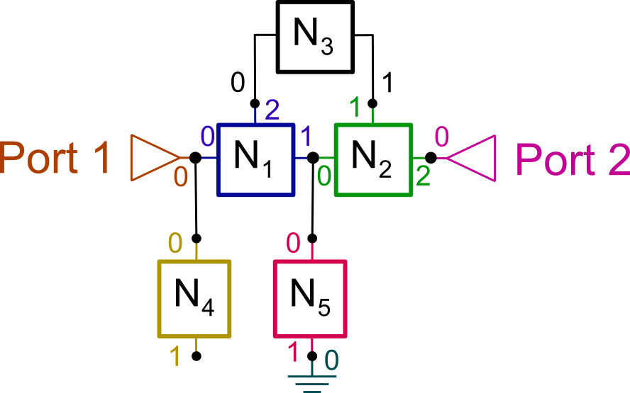
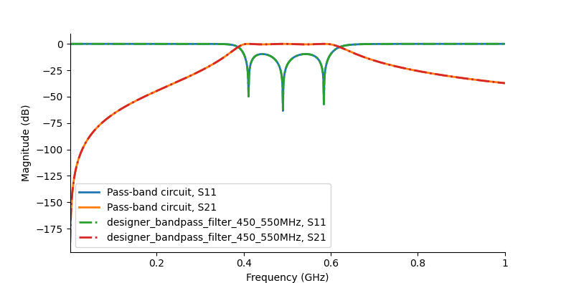
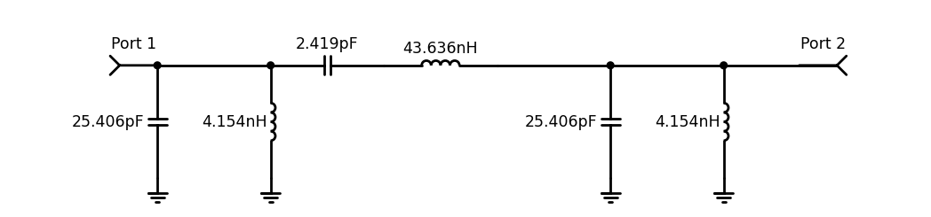
scikit-rf can be used to build advanced Circuits
N-ports Circuit Creation
From the assembly of several Networks
Calculation of S-parameters (at ports or internally), V/I at nodes

Slide 12
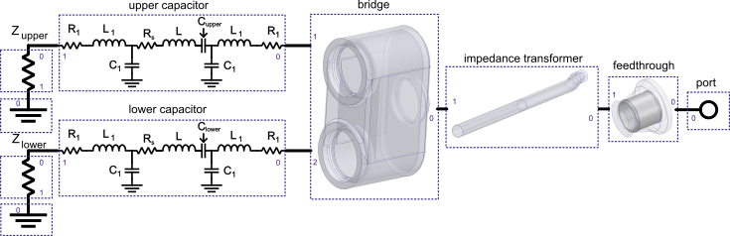
Another Example of Advanced Circuit
Combination of Lumped Components and Full-Wave Results
Touchstone
from HFSS
Touchstone
from HFSS
Touchstone
from HFSS
Hillairet, J. RF network analysis of the WEST ICRH antenna with the open-source python scikit-RF package. AIP Conference Proceedings 2254, 070010 (2020).

Slide 13
Time Domain Analysis

Slide 14
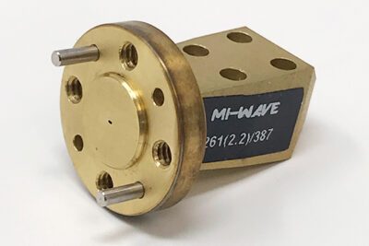
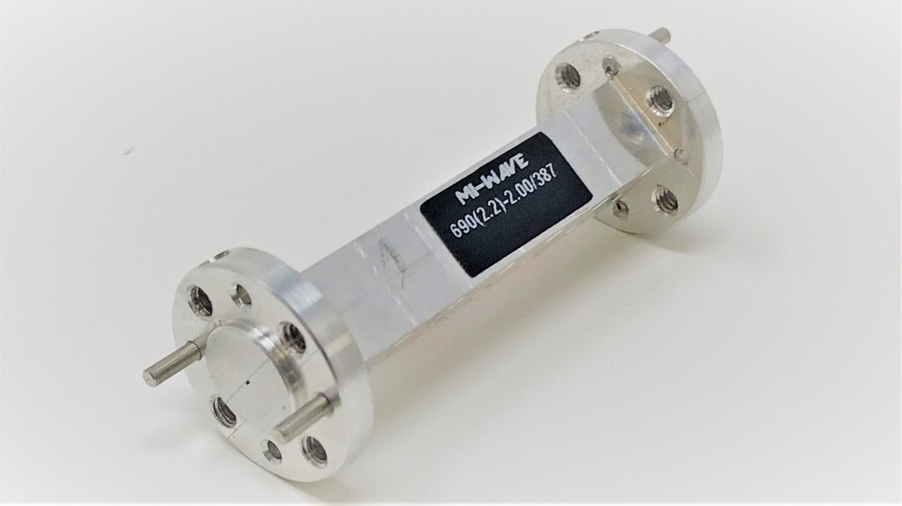
Time Domain and Gating
Suppression of parasitic reflections
Waveguide alignment can be problematic at very high frequency (>100 GHz)
Generate parasitic reflection
S-parameters are measured in the frequency domain, but can be analyzed in time domain
Parasitic phenomenon can be suppressed by filtering the time response (time-gating)
0.022” x 0.011”
(0.56 x 0.28 mm)
WR-2.2/UG-387 325 – 500 GHz Gain Horn Antennas and straight waveguide (© MI-WAVE)
Notes:
CNC milling offers ±2.5−μm tolerances at best

Slide 15
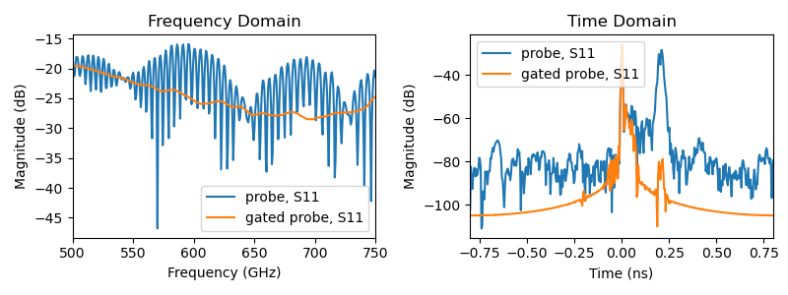
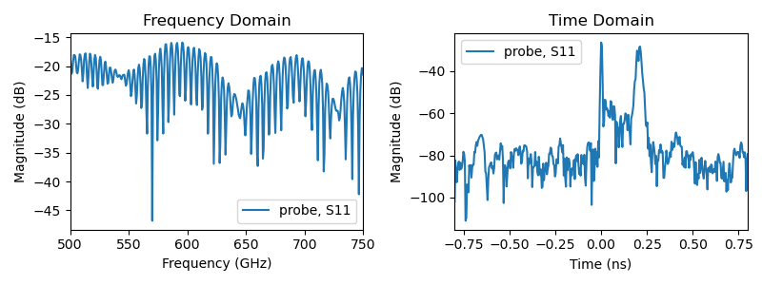
Time Domain and Gating
Suppression of parasitic reflections
Example: isolation of a particular response in a signal affected by multi-reflections
>>> probe = skrf.Network('probe.s2p') # CPW probe @ 500-750 GHz
>>> s11 = probe.s11
>>> s11_gated = s11.time_gate(center=0, span=.2)# gate 1st largest reflec

Slide 16
Measurement Sets and Statistics

Slide 17
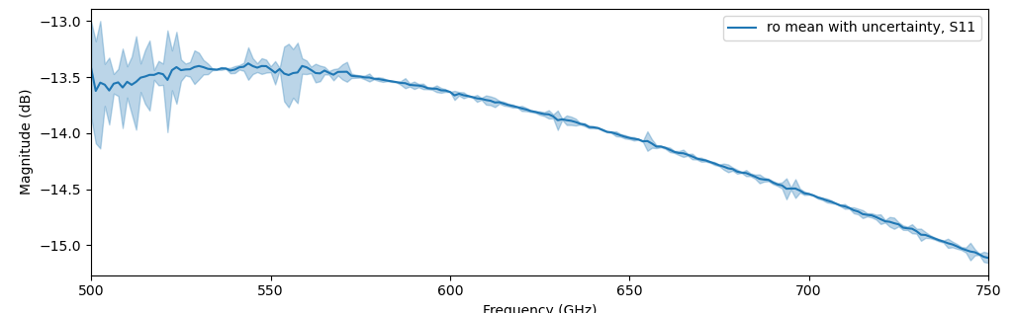
NetworkSet: A Set of Measurements/Networks
scikit-rf eases series of measurements analysis with the NetworkSet class
Reading multiple .sNp files at once
Deduce statistical properties (mean, standard-deviation, covariance, etc.)
>>> from skrf.data import ro_1, ro_2, ro_3 # ex of 3 consecutives measurements
>>> ntwk_list = skrf.NetworkSet([ro_1, ro_2, ro_3])
>>> ntwk_list.plot_uncertainty_bounds_s_db() # 3-sigma uncertainty

Slide 18
NetworkSet: Named Parameters and Interpolation
scikit-rf can read data set files such as CITI (.cti) or GMDIF (.mdif)
Content of these files is converted into a NetworkSet
Includes all the defined named parameters (ex: V=0, 5, 10; A=1)
Get data subset from named parameters
Ex: all measurements made for V = [0 to 10] and A = 1
Interpolation of data set
Interpolation of network parameters for a data set
Ex: Interpolation of S-parameters for intermediate values of V
NetworkSet
NetworkSet
V=0, A=1
Network
sel
V=0, A=1
Network
V=5, A=1
Network
V=5, A=1
Network
V=10, A=1
Network
V=10, A=1
Network
V=2, A=2
Network
interp
V=2.6, A=2
Network
V=4, A=2
Network

Slide 19
Calibration, Deembedding

Slide 20
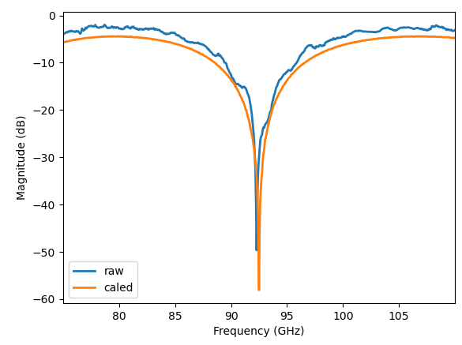
Off-Line Calibration in scikit-rf
« Off-line » calibration: flexibility and raw data preservation
Several calibration algorithms are available
1-port (SOL, SDDL, PHN, etc.)
2-port (SOLT, (multiline) TRL, Unknown-Thru, LRM, LRRM, 8, 12 ou 16-terms generic models, etc.)
Example: 2-port TRL calibration:
>>> measured = [T,R,L]
>>> trl = TRL(measured)
>>> dut_corrected = trl.apply_cal(dut_raw)
Notes:
o measure the switch terms manually, you can define custom traces as ratio’s of receivers and save the data to touchstone files. Assume ports are labeled 1 and 2, and incident waves are a’s and reflected waves are b’s. Then, the
forward switch term == a2/b2 with source port 1
reverse switch term == a1/b1 with source port 2

Slide 21
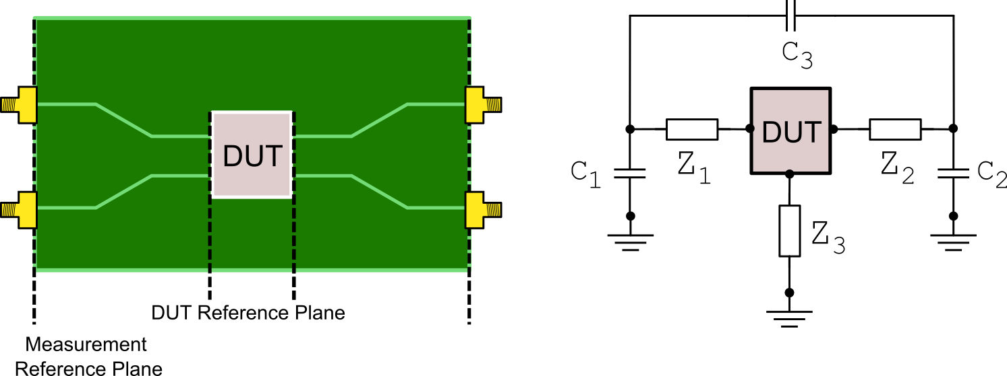
Deembedding
Deembedding: removing the effects a test fixture can have on a DUT
raw_dut

Slide 22
Deembedding
Deembedding: removing the effects a test fixture can have on a DUT
OpenShort Deembedding: remove the DUT and measure the fixture with 2 dummy setups:
>>> dm = OpenShort(dummy_open=open_nw, dummy_short=short_nw)
>>> dut = dm.deembed(raw_dut)
open_nw
short_nw

Slide 23
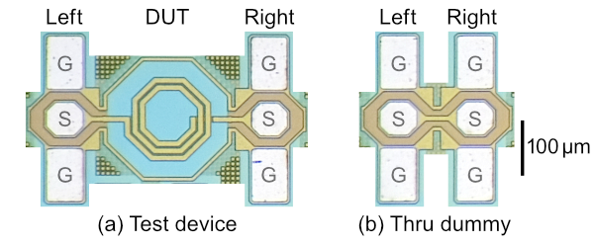
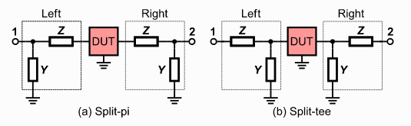
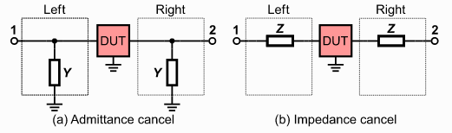
Deembedding
Deembedding: removing the effects a test fixture can have on a DUT
At frequencies >10 GHz, fringe capacitance and the parasitic inductance cause errors
Several methods using a through (thru) dummy are implemented in scikit-rf:
Split-Pi, Split-Tee, Admittance-Cancel (Mangan’s method), Impedance-Cancel

Slide 24
Summary

Slide 25
scikit-rf: an open-source package for RF engineering
A modern, object-oriented Python package for network analysis and calibration
Designed to make RF/microwave engineering both robust and approachable (and free!)
Eases reading/writing RF data files (Touchstone, CITI, GMDIF, …)
Eases graphical representations
dB, amplitude, phase, Smith chart, incertitude, etc.
S-parameters Transformations
Conversions (Z, Y, ABCD, etc.),
Frequency subset, concatenations, sub-network,
Interpolations between frequency points or sets of data
Time Domain, Gating
Off-Line Calibration and deembedding
1-port or 2-port (SOL(T), SDDL, TRL, LR(R)M, etc.)
Advanced Deembedding methods
But Also!
SPICE circuit modelling (vector fitting)
Direct communication with VNAs
Mixed-mode conversions
Transmission Line modelling
Etc…
Acknowledgments
The project would not exist without the several benevolent contributors!

Slide 26
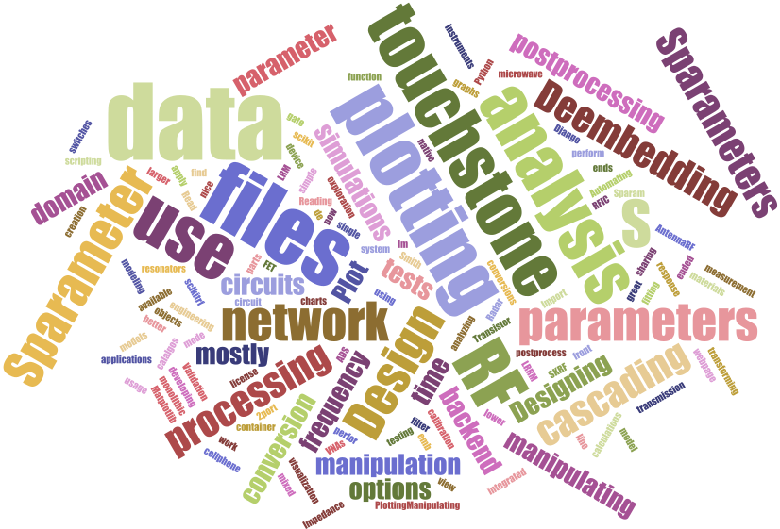

Questions or comments?
Website and Documentation
http://scikit-rf.org/
Ask the Community
Email: scikit-rf mailing List: http://groups.google.com/group/scikit-rf
Chat: scikit-rf have channels on both Slack and Matrix
Contributing to the scikit-rf project
There is multiple ways to contribute to an open-source project like scikit-rf!
Sponsoring the project
Contributing to the code
Contributing to the documentation

Slide 27
Acknowledgments
scikit-rf would not be possible without the feedback, bug fixes, and new features contributed by its user community.
The complete list of contributors can be seen here:
https://github.com/scikit-rf/scikit-rf/graphs/contributors
A.Arsenovic, J.Hillairet, J.Anderson et al., "scikit-rf: An Open Source Python Package for Microwave Network Creation, Analysis, and Calibration [Speaker’s Corner]," in IEEE Microwave Magazine, vol. 23, no. 1, pp. 98-105, Jan. 2022, doi: 10.1109/MMM.2021.3117139.
https://ieeexplore.ieee.org/document/9632487

Slide 28
Spare Slides

Slide 29
scikit-rf: Installation
If you have installed Python, you can install scikit-rf from:
pip (PyPi):
python -m pip install scikit-rf
conda (Anaconda):
conda install -c conda-forge scikit-rf

Slide 30
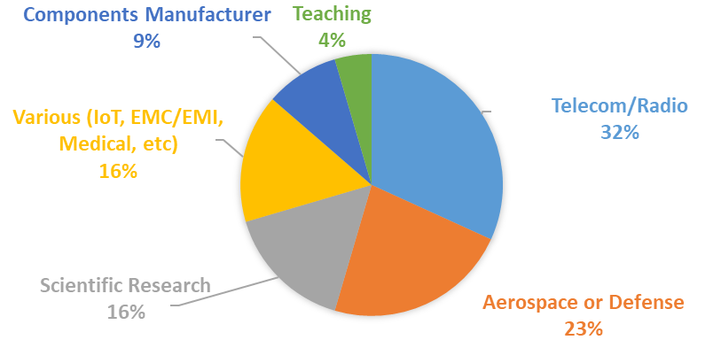
Main application domains of scikit-rf (2021 survey)

