Slide 1
Contested Dice Pool Probabilities
Tom Hills
Graduate Student
EECS Department of University of Tennessee
CS594: Evidence Engineering
Dr. Audris Mockus
05/05/2022
Notes:
Alright then.
Good afternoon everyone.
Today I will be talking to you about one of my personal projects which I’ll call “Contested Dice Pool Probabilities”. Don’t worry, that name will make more sense shortly. The reasons I picked this topic are
It’s a fundamental/central mechanic for a computer RPG game I’m developing as a hobby/passion project,
It’s purely derived from mathematical and programming concepts (which is always a good thing in my book),
and it’s a nice demonstration of Dr. Mockus’s generosity in allowing me to receive credit for this topic.

Slide 2
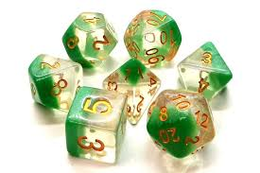
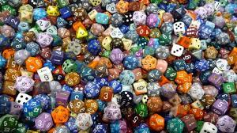
Contested dice pool
Die value >= “success number” == 1 success.
Character 1 rolls s1 successes, Character 2 rolls s2 successes.
s1 > s2: Character 1 wins with s1 – s2 net successes, and vice versa for Character 2.
s1 == s2: Contest is a tie. No ground gained by either character.
Net Successes:
1 == minor, 2 == moderate, 3 == serious, 4 == severe,
5 == critical, 6+ == maximal
Die Value >= “reroll number == 1 success + 1 reroll (“reroll number” >= “success number”)
Notes:
So, what do I mean by “contested dice pool”?
A dice pool is, as the name suggests, a number of dice that a character would roll to achieve some goal. Now, the contested part means that a character would roll their dice pool against an opposing dice pool which is rolled separately. With both pools rolled, the results of each are then compared and a winner is determined by the more successful roll.
In my game, the mechanics for contested dice pool rolls work like this, assuming Character 1 opposes Character 2, and vice versa:
Character 1 would roll his/her dice pool, where the quantity of dice is determined by character statistics and other factors, against a “success number” determined by some situational factor (for example, in melee combat, weapons have their own success numbers that wielding characters would roll against). For each die that rolls equal to or greater than the “success number”, Character 1 would gain a success. Let’s call the number of successes that Character 1 rolls, s1.
Character 2 would then do the same against their own personal “success number” and count the resulting successes. Let’s call this quantity, s2.
These success quantities would then be compared where the character with the most successes wins the contest. Additionally, the winning character would have his “win” qualified by how many more successes they received over their opponent. If s1 was greater than s2, then Character 1 would win the contest with a qualified win of s1 – s2 net successes. The second bullet on the slide gives a good breakdown of the possible scenarios.
So, a net success of 1 would be considered a minor win, a net of 2 would be moderate, 3 would be serious, 4 severe, 5 critical, and 6+ would be maximal (i.e., the best possible win qualification).
As an aside: I adopted the terms minor, moderate, etc from the “Injury Severity Score” system, which is one of the most widely used injury scoring systems in medical trauma literature. These terms naturally make sense for combat and other injury inducing endeavors, but I apply these terms more generally to any opposed roll, whether it’s hacking into a computer system guarded by AI, picking a lock with active anti-theft functionality, etc.
And finally, just to make things more ridiculous, I added a mechanic inspired by the Shadowrun Tabletop RPG: exploding dice. By exploding, I just mean dice can potentially be rerolled indefinitely provided they continue to be equal to or greater than an assigned “reroll number”. It’s important to note that if a die qualifies to be rerolled, then it also counts as a success as well since the “reroll number” must be equal to or greater than the “success number”. Any successes produced by exploding dice are in addition to the successes acquired in the initial roll.

Slide 3

Binomial Probability Distribution And Dice Pools
Binomial Probability Distribution Function:
n = number of trials (e.g., dice in pool)
x = total number of successes (i.e., pass or fail)
p = probability of success for individual trial
q = probability of failure for individual trial (i.e., 1 - p)
Success Probability: p = 1 – q = 1 – (successNum - 1)/maxDieValue
Kinds of die in a dice pool:
Full die: 100 sided, and make up the whole number portion of the dice pool.
Fractional die: sides vary depending on the fractional component of the dice pool
EXAMPLE: Dice pool == 5.69 has 5x 100-sided die and 1 die with 69 sides.
5.35
5
6
Notes:
So now, let’s shift our focus to probability. Fortunately for me, rolling dice with a given success number for each die fits perfectly with the binomial probability distribution function shown in the slide. The reason this is so, is because matching or exceeding a success number directly translates into a pass or fail scenario, and each die acts as it’s own independent trial.
In the formula, we have
n equal to the number of trials or dice in the pool,
x equals the total number of successes where a success is having the die value equal or exceed the success number,
p is the probability of success, and
q is the probability of failure, or 1 - p.
In the 2nd bullet, you can see the general form of the success probability where “successNum” is obviously the success number, and “maxDieValue” is the maximum number that can be rolled on a selected die, which translates into the number of sides on the die. Note that you must subtract 1 from the “successNum” since a success occurs if your die value is equal, not just greater than (see purple highlight). This seems like a good time to mention that there are two kinds of die in my game:
Full die, which are die with 100 sides and will be determined by the whole number portion of the dice pool, and
Fractional die, which as the name suggests, will be determined by the fractional portion of the dice pool.
So, for example, let’s say a character’s attributes and skills give him/her a dice pool of 5.69. The whole number, 5, means they’d roll five 100-sided dice, and the fraction .69 means they’d roll 1 die with 69 sides. Now, since success and reroll numbers can technically range from 1 to 100 (though below 50 makes getting a success pretty trivial, even for small dice pools) this means that the full dice will always be rolled, but the fractional die may or may not be rolled, depending on whether it’s value exceeds the success number or not. So, if the success number were 70, then in our example, only five 100-sided dice would be rolled. However, if the success number were 65, then the fractional die would also be rolled with the full dice since it’s possible for the die to succeed now. (PAUSE) Sooo, I know it may seem odd for some of you to introduce something like fractional dice into the dice pool system, but I believe it not only adds innovation since I’ve never seen anyone do this, but it also adds a good amount of graduality to the gameplay since skills have ranks and partial progress in between. If you look at my fantastic illustration at the bottom of the slide, you can get the idea pretty easily. The blue represents the progress that a character has made in going from rank 5 to 6 in a skill. Since he/she is 35% of the way to rank 6, they get the fraction .35 added to their dice pool, giving a total of 5.35. But that’s only if the dice pool were based off of one skill. In my system, dice pool rolls will also have attribute contributions as well. So, if you have an attribute of 4.40 and a skill of 5.35 which are both needed equally in a contested roll, then this would give you a dice pool of 4.40 + 5.35 = 9.75. If our success number were 70, then neither attribute or skill alone would have allowed a fractional roll. But combined, we now get an additional die with an 8% chance [1 – (69)/75] of getting another success beyond what our full dice can provide. Not great, but not bad either.

Slide 4
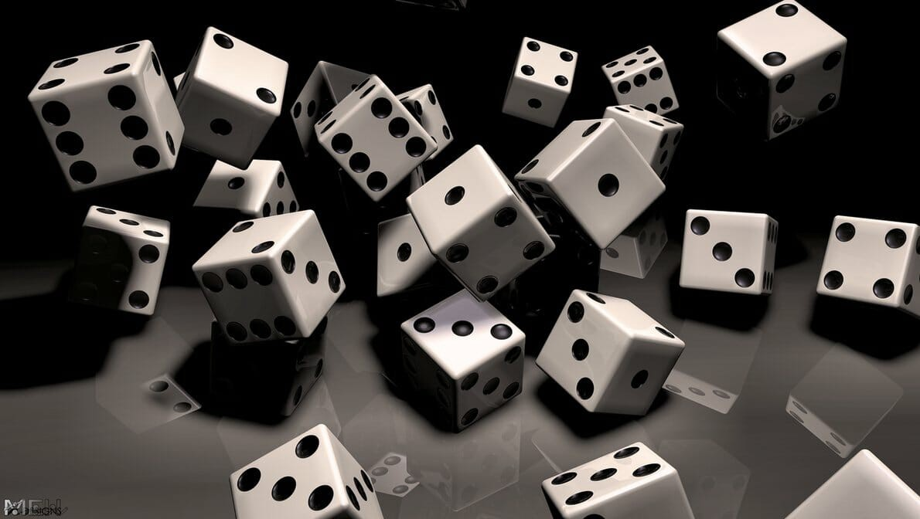
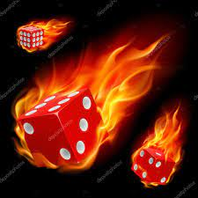
Experiment
Experiments
Relies on the Law of Large Numbers
Uses pseudo random number generator to build dice pool rolls for contest and record results.
Do this a billion or more times!!!
Notes:
Now, with that out of the way, let’s move on to my experiments and the mathematical formulations I tried to form from those experimental results. For brevity sake, I’ll refer to those mathematical formulation endeavors as “theory”, and the experiments as… uh, experiments.
So, let’s get started:
First off, my experiments rely on the Law of Large Numbers from probability theory, which states that “as the number of identically distributed, randomly generated variables increases, their sample mean (or average) approaches their theoretical mean.” This is great because it means that if I find a way to perform a contested roll between two dice pools many, many times and record the outcomes, I’ll start to hone in on the “true theoretical value” of the probabilities for success of one pool over the other!
And of course, with computers, this can easily be done using a random number generator which I’ll be using in the game anyway, so it’s perfect. Basically what my code does is build a dice pool for one character taking into account whether the fractional die comes into play or not, and then do the same for the opponent. I then process each dice pool against their associated success and reroll numbers. If a die rolls over the assigned reroll number, it gets rolled again continually until it’s goes below the reroll number adding any additional successes along the way. Once all dice pool rolls are finished, I compare successes and record statistics such as wins, loses, ties, and even track the counts of successes and net successes for each character. I’ll show you some sample output here in a bit to help illustrate what I mean.
And I perform this contested roll a billion or more times updating variables as I go which turns out to be plenty to hone in on the theoretical values up to roughly 4 decimal places.
So now, I’ll show you output for a particular contested roll.
(
SHOW:
pc, 5, 0, 70, 101
npc, 4, 80, 70, 101
NOTE: Before class, produce both the ‘experimental’ and ‘theory’ version of the above scenario. This scenario is both a good example of
experimental and theory portions.
)

Slide 5


Theory: Without Rerolls
Started with not allowing dice to be rerolled at all.
Used excel to craft solution before coding.
Everything written in C#
It worked from the start! Yay!
Notes:
Now onto the theory portion. To start, I focused my efforts on scenarios without rerolls (either limited or unlimited). This was accomplished in my code by setting the reroll number to 101 which would always fail since 100 is a die’s maximum value. This way, I didn’t have to deal with setting Booleans and whatnot. But before I could even code up a solution, I needed to know what the solution was. To do this, I used excel spreadsheets to test binomial combinations until I found results that matched my experimental findings. Fortunately, I honed in on the correct “no reroll” solution right away. Oh, and also, everything was coded in C#, btw.
So, I believe the best way to get the idea across is to show you my spreadsheet, and then show a sample of program output to hopefully convince you that it works:
(
Show the “No Rerolls” excel sheet, and then show/compare Theory vs. Experimental for:
pc, 5, 0, 70, 101
npc, 4, 80, 70, 101
)

Slide 6


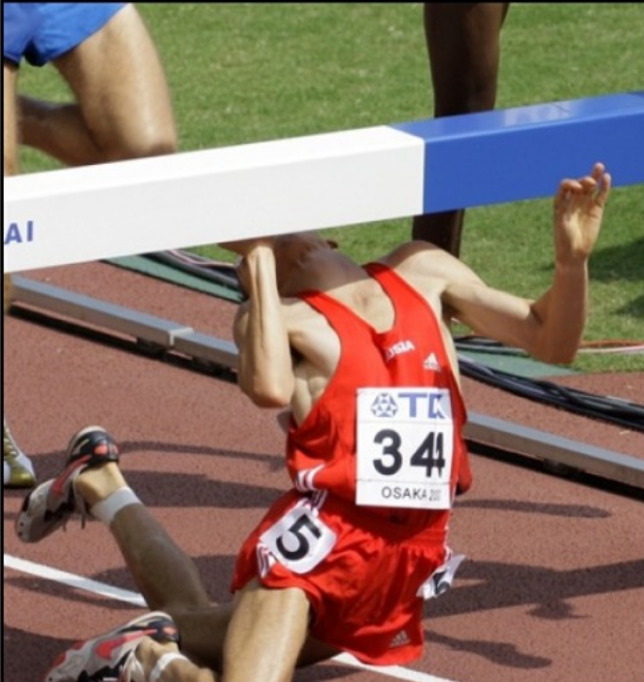
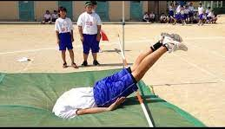
Theory: With Rerolls
Moved on to allowing UNLIMITED rerolls.
Used excel to craft solution before coding.
Everything written in C#
Solution FAILED!!
Notes:
And now, I must talk about the dreaded rerolls, or more specifically: unlimited rerolls.
Again, it’s best that I just go straight to the excel sheet and show you what my initial so-called solution was:
(
Show and explain “rerollNum<SN, NO Reroll failure” sheet.
NOTE: Just talk through how you arrived at recursion solution, and leave it at that
)

Slide 7

Theory: Where to go from here?!?
Next Steps:
Run experiments where PC and NPC have same stats, except one rerolls and the other doesn’t.
Observe distribution differences and identify any trends/patterns between ‘NO REROLL’ and ‘REROLL’ outcomes.
Vary “success numbers” and “reroll numbers” for fixed dice pool, and observe changes from previous trends/patterns
This assumes varying the size of the dice pool won’t help in finding a solution… probably true…
Suspicion: ‘REROLL’ probabilities are still binomially distributed, and may have parameters that are derivable from ‘NO REROLL’ counterparts.
Notes:
Just talk about possible ways to use experimental data to find trends between “NO REROLL” and “REROLL” scenarios
(
Show the “No Rerolls” excel sheet, and then show/compare Theory vs. Experimental (SUCCESS CNTS, not NET!!) for:
pc, 5, 0, 70, 90
npc, 5, 0, 70, 101
pc, 5, 0, 70, 70
npc, 5, 0, 70, 101
pc, 5, 0, 50, 70
npc, 5, 0, 50, 101
)

Slide 8
Let’s Play “Ask a question”
Questions?!?!?
Comments?!?!?
…anyone...
Notes:
Ok.
Well, that’s it.
Thank you for your attention, or at least pretending to do so. I appreciate it.
Are there any questions?

