Slide 1
Data Driven Generative Accelerator Model Ph.D. Candidate: Xinyu Ren Research Advisor: Prof. Tor Raubenheimer

Slide 2
Content
1. Background and Motivation
1.1 SASE FEL and Simulation
1.2 Surrogate Modeling
2. Generative Algorithms: Generative Adversarial Networks
2.1 Wasserstein GAN
2.2 Conditional GAN
2.3 Complex GAN
3. Datasets and Results Demonstration
3.1 XTCAV Image
3.2 Temporal Power Profile
4. Statistical Testing of Power Profiles
5. Future work

Slide 3


1. Background and Motivation
Free Electron Laser (FEL):
Accelerated electron cluster travel through periodic dipole magnet lattice and radiate x-ray around resonant wavelength
Undulator
N
S
N
S
N
S
N
S
N
S
N
S
X-ray Pulse
Accelerated electrons
S
N
S
N
S
N
S
N
S
N
S
N
Dumped electrons
Self-amplified Spontaneous Emission (SASE):
Without using reflecting mirror or seeding, SASE FEL process initialize from the fluctuations of electron beam density and exponential amplify such shot noise.
Resonant Condition:

Slide 4
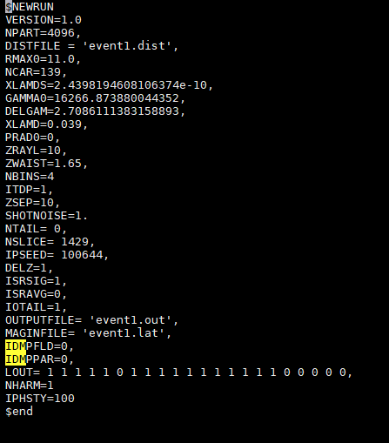
1. Background and Motivation
There are many simulation software of FEL process.
One of reliable (comparable to experiment) 3D FEL simulation is Genesis:
Input File
Part. File
Part. File
Genesis
X-ray File
Lattice File
Each shot takes approximately half hour to simulate → Difficult for data analysis or virtual machine
Can we develop a surrogate model, which reproduce Genesis output efficiently and reliably

Slide 5

1. Background and Motivation
Reconsider: what is Genesis mathematically?
“randomly” mapping from setting conditions to x-ray profiles under a specific electron beam:
Is it possible for generative neural networks (→efficiency) to be such a surrogate model?
Input:
0D (energy, taper parameter),
1D (energy center along beam),
2D (long. phase space),
Genesis Surrogate Model
Output:
Significant x-ray information

Slide 6

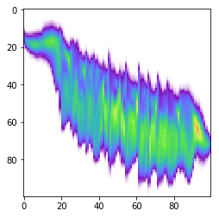
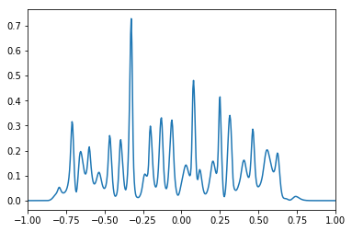
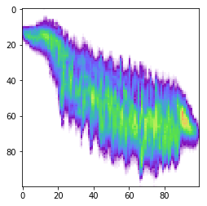
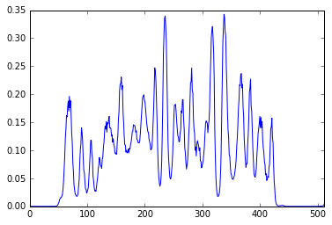
2. Generative Algorithms: Generative Adversarial Networks
Generative Adversarial Networks (GANs): a pair of neural networks play min-max games
Simulation
E
P
t
t
Real data
Discriminator
Real/Fake
E
P
Identify data is real or fake
Seeds
Generator
t
Produce data close to real
t
Fake data

Slide 7

2. Generative Algorithms: Generative Adversarial Networks
GAN structure evolutions:
Vanilla GAN
Instead of heavy fully connected layers, use convolutional neural network structures:
1. Use convolutional layers for discriminator and convolutional transpose layers for generator
2. Remove fully connected layers and pooling layers.
3. Use LeakyReLU activation for discriminator and ReLU activation for generator
Deep Convolutional GAN
Instead of KL divergence, use Wasserstein distance to estimate the difference of real/fake distributions
1. Use a linear activation function for discriminator output layer
2. Use Wasserstein loss to train the model
3. Constrain discriminator model weights to a limited range
Wasserstein GAN

Slide 8
2. Generative Algorithms: Generative Adversarial Networks
Name | Generator | Discriminator
Input Feature | Random Seed | X-ray from R/F pool
Basic Layer | Convolutional Transpose | Convolutional
Activation | ReLU | LeakyReLU
Output Label | Fake x-ray | Real/Fake
Loss Function | W Loss | W Loss
Optimizer | RMSprop | RMSprop
Training | x1 | x5

Slide 9

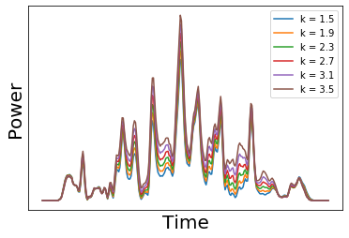
2. Generative Algorithms: Conditioning
In addition to randomly generate data for a specific beam configuration. We implement conditional GAN (cGAN), providing a tuning knob
For example, generate a group of number → Generate a group of five
Generate a group of power profile + under specific undulator K
Network
Implement
Merge conditional inputs to both generator and discriminator
Knobs could be undulator K, taper, energy, chirp and combination of them

Slide 10



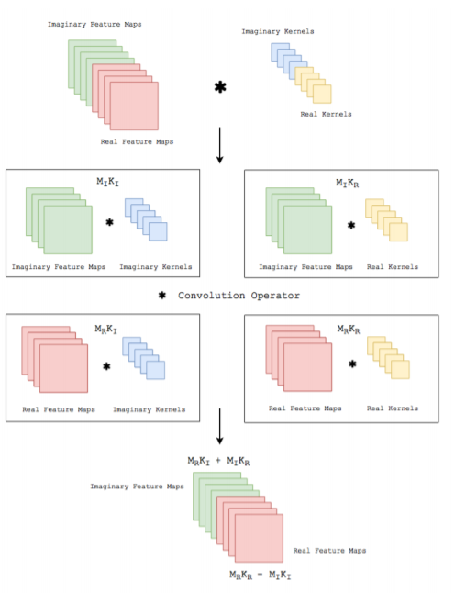
2. Generative Algorithms: Complexing
X-ray is represented as a complex field
Thus, we might want the neural network is compatible with complex number. Two points are useful:
For complex weight matrix W and feature vector h:
Split-Joint-Split model
Initial Seed
The complex matrix multiplication should be:
Initial Power
Initial Phase
Merge Layers
Sharing Layers
Split Power
Split Phase
Generating Layers

Slide 11
3. Datasets and Results Demonstration
For simulating enough training data, we should collect electron beams and undulator setup.
Two different pipeline:
1. Experiment line
Designed for various configurations
Input File
Dumped from XTCAV (longitudinal phase space)
Part. File
Genesis
Dumped from archive logbook
Lattice File
2. Simulation line
Designed for various configurations
Input File
Generated from upstream simulation (elegant)
Part. File
Genesis
Write by following experimental setup
Lattice File

Slide 12
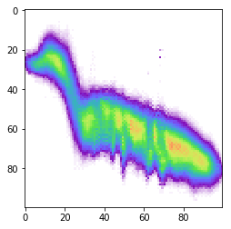
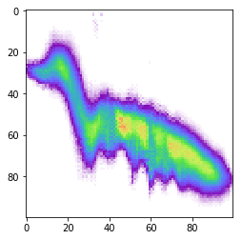
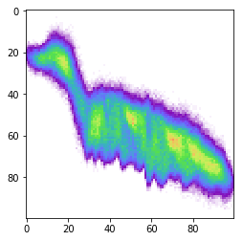
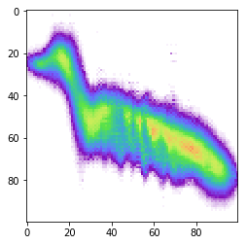
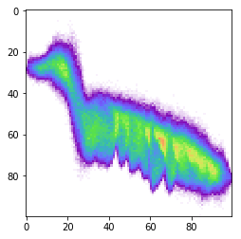
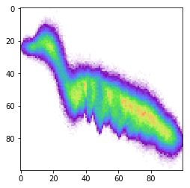
3. Datasets and Results Demonstration
Training Dataset:
Dump beam from experiment;
Dump taper function from archive;
Simulate 1000 events with particle file

Slide 13
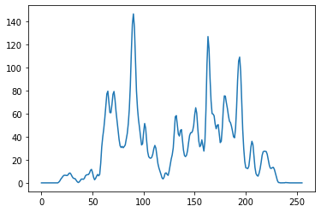
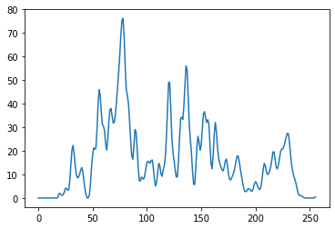
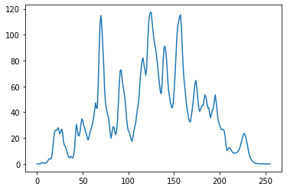
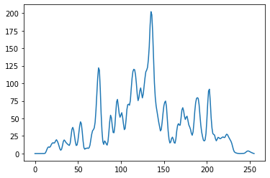
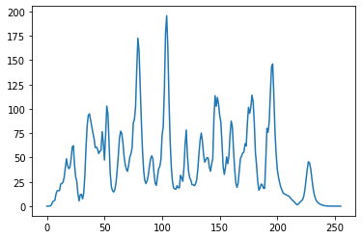
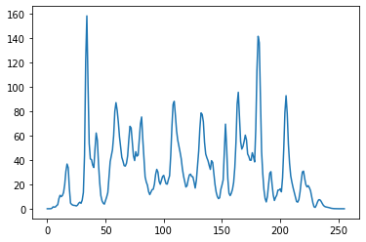
3. Datasets and Results Demonstration
Training Dataset (3000 events):
Collect beam from elegant and randomly choose conditions
(1) Electron energy jitter -10%-10%
(2) Undulator K 1.5-3.5
(3) Taper decay 0-3%
Power
Power
Power
Time
Time
Time
Power
Power
Power
Time
Time
Time

Slide 14

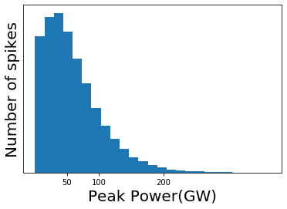
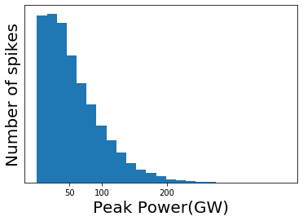
4. Statistical Testing of Power Profiles
In addition to converged loss function and look-good results. It is important to estimate power profiles from physical perspective.
SASE FEL is a random physical process, so we could estimate several statistical properties of generated power profiles.
Single spike power distribution → negative exponential
Real
Fake

Slide 15


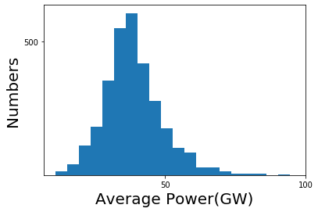
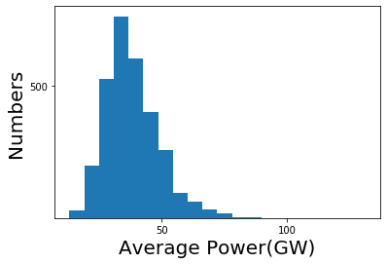
4. Statistical Testing of Power Profiles
For the whole power profiles, we integrate the power profile to get total energy, which follows Gamma distribution:
,where M is the number of modes:
Real
Fake

Slide 16

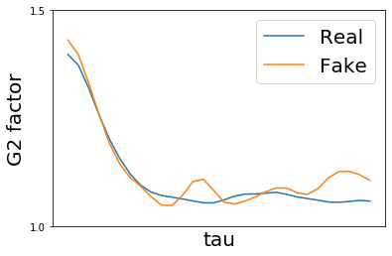
4. Statistical Testing of Power Profiles
G2 factor is the second-order temporal correlation function, estimating the correlation between t and tau:
Another usage of G2: using the mean-square-error MSE(G2_{real},G2_{fake}) as additional loss function and feedback it during training generator.

Slide 17
5. Future Work
Applying GAN on the real machine:
(1) Improving algorithms for meeting different user requirements
(2) Integrate into start-to-end surrogate models for experiments
(3) Select target applications and do detailed experiment design
→ useful beam configurations and significant operational mode
Data Analysis
Surrogate Model
Pre-tuning
Error Detection

Slide 18
Thank you for listening~
References:
[1] The Physics of Free Electron Laser. E. L. Saldin and et.al.
[2] Synchrotron Radiation and Free-Electron Lasers. Zhirong Huang and et.al.
[3] Generative Adversarial Networks, Ian Goodfellow and et.al.
[4] Wasserstein GAN, Martin Arjovsky and et.al.
[5] Unsupervised Representation Learning with Deep Convolutional Generative Adversarial Networks, Alec Radford and et.al., arXiv:1511.06434
[6] Temporal power reconstruction for an x-ray free-electron laser using convolutional neural networks, Xinyu Ren and et.al.

