Slide 1
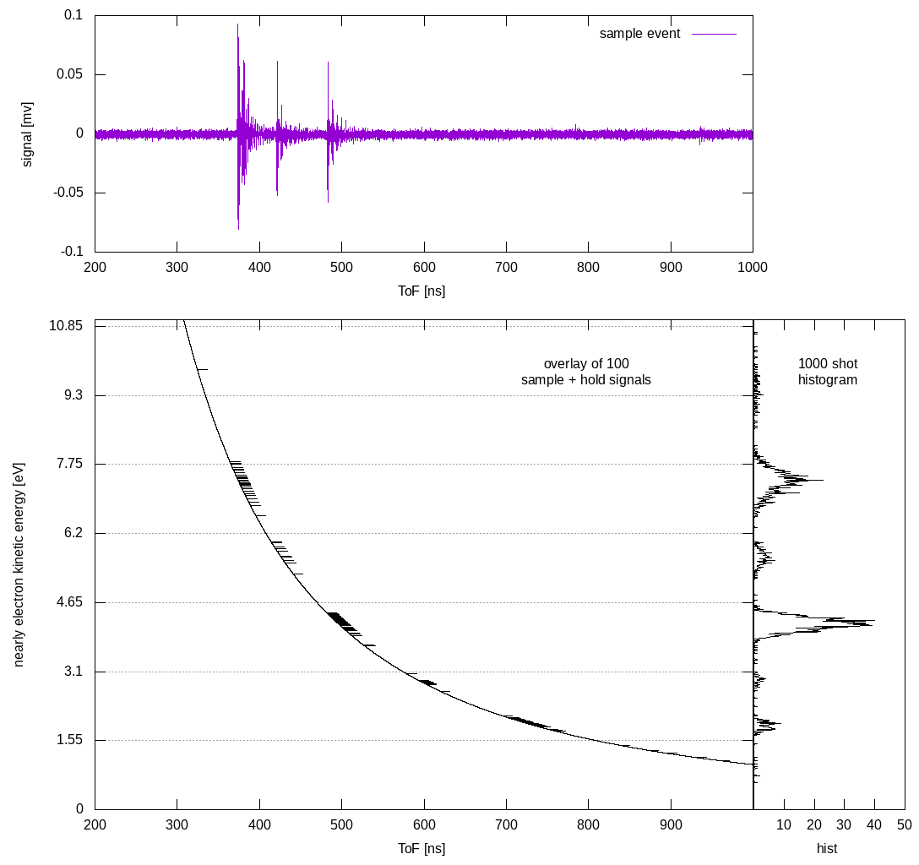

Ultrafast artificial intelligence at the Edge
Scientific Achievement
Analog signal processing that directly feeds sub-20 microsecond latency machine learned identification of desirable x-ray SASE sub-structure.
Significance and Impact
Analog signal processing transforms detector signal to ideal ML-model input.
FPGA-based inference neural network for autonomous decisions with 20 microsecond latency.
Research Details
Initial test with surrogate HHG laser source and newly designed electron Time-of-Flight (ToF) spectrometer
Analog signal processing that transforms raw Micro-channel plate (MCP) signals directly into the representation needed for the neural network.
Shallow neural network for on-the-fly decision making that uses the 16-fold angular array of electron ToF spectrometers
FPGA-based identification of the number of sub-spikes in SASE XFEL shots with decision times below 20 microseconds.
Next Steps
Use 8-fold differential retardation to simulate angular streaking results.
Measure linear streaking in PULSE lab with analog pre-processing circuit and on-digitizer FPGA neural network.
Incorporate recently measured wave forms to benchmark inference fidelity in both over- and under-sampling regimes.
Improve the “confusion matrix” for increasing numbers of SASE sub-spikes.
Non-linear Time-to-analog conversion logic. The top panel shows a few-hit single shot, central demonstrates the non-linear voltage ramp used for the “sample and hold”, and the right panel the resulting histogram.
Work was funded by DOE-BES – Scientific User Facilities under FWP 100498 with personnel support provided by LCLS Experimental Facilities FWP 10074.
Notes:
HL Type: User___, Staff___, User & Staff___
1-2 paragraph description of highlight
Insert a ~ 200 word description of the highlight here.
Collaborating Institutions
Funding Overview Section (check all relevant sources)
BES Funding: MSED___, CSGB___, EFRC___, SUFD___
SC Funding: ASCR___, BES___, BER___, FES___, HEP___, NP___, WDTS___, SBIR___, etc.
Other Funding: DOD___, DOE___, NIH___, NSF___, etc.
Funding details for all sources:
Publication/ press releases/ related links:
<number>

