Slide 1
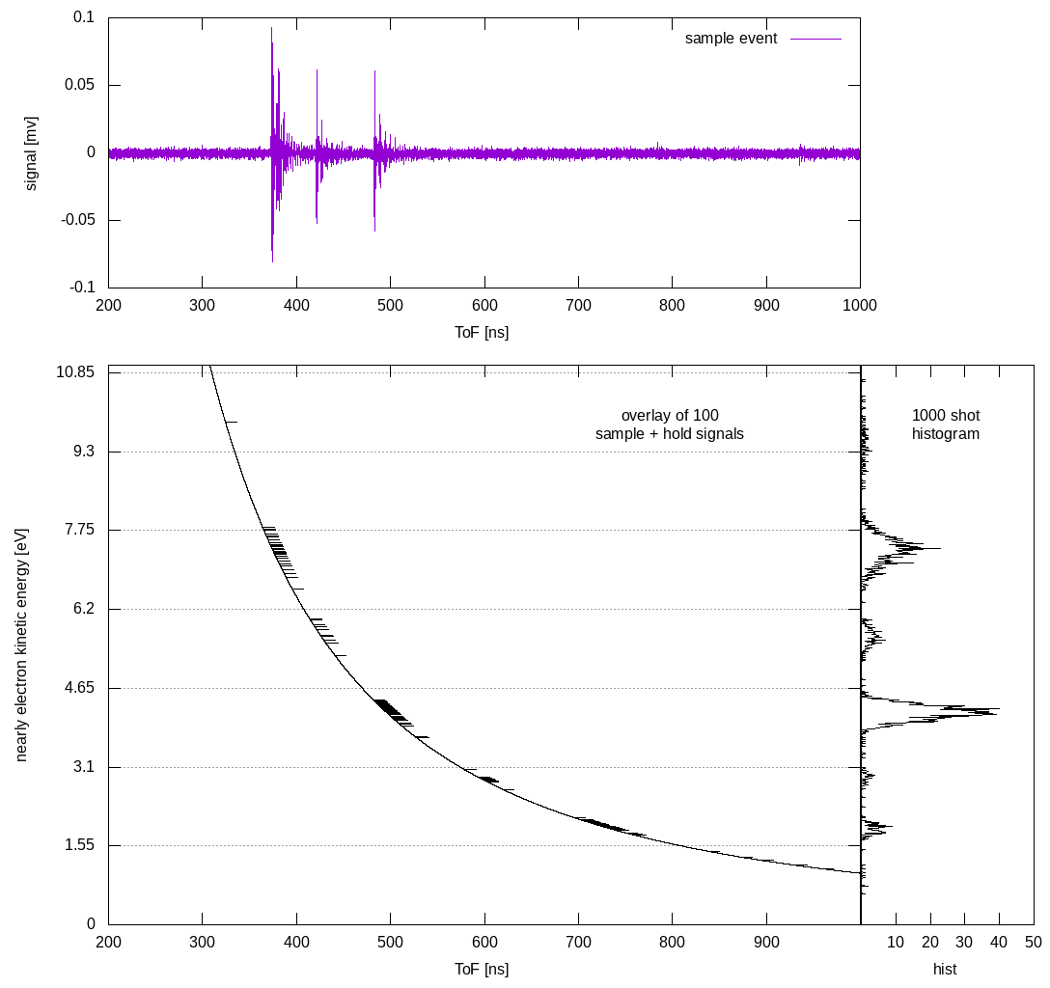

Analog pre-processing for down-stream ML models
Scientific Achievement
Non-linear time-to-analog conversion for direct production of “featurized” wave forms for EdgeML based electron spectroscopy
Significance and Impact
Identified analog electronics logic for pre-processing of electron Time-of-Flight wave forms that alleviates need for high digitizer bandwidth and sampling.
Research Details
Initial test, using surrogate HHG laser source with prototype electron spectrometer (CookieBox)
Developed analysis chain using analog pre-processing that feeds a non-linear Time-to-Analog converter for transforming raw wave forms directly into the representation needed by the down-stream FPGA-based inference engine.
Next steps: Use known HHG spectra with 8-fold differential retardation to simulate angular streaking results. Install prototype detectors into dual sided streaking geometry in PULSE lab and measure linear streaking with analog pre-processing circuit and on-digitizer logic.
HHG based electron spectra transformed from Time-of-Flight to nearly energy domain using derivative amplifier and software non-linear TAC logic. The top panel shows a few-hit single shot, central demonstrates the non-linear voltage ramp used for the “sample and hold”, and the right panel the resulting histogram.
Work was performed at PULSE HHG laser lab by a combination of PULSE and LCLS scientists supporting the CookieBox project.
Notes:
HL Type: User___, Staff___, User & Staff___
1-2 paragraph description of highlight
Insert a ~ 200 word description of the highlight here.
Collaborating Institutions
Funding Overview Section (check all relevant sources)
BES Funding: MSED___, CSGB___, EFRC___, SUFD___
SC Funding: ASCR___, BES___, BER___, FES___, HEP___, NP___, WDTS___, SBIR___, etc.
Other Funding: DOD___, DOE___, NIH___, NSF___, etc.
Funding details for all sources:
Publication/ press releases/ related links:
<number>

Slide 2
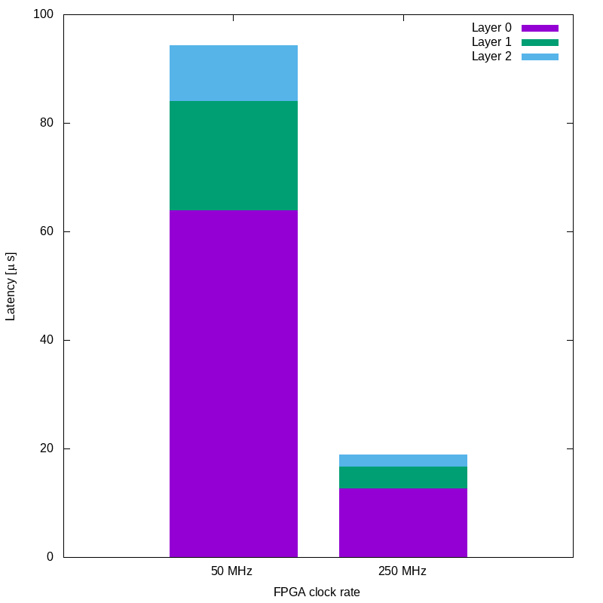
Autonomous data routing and veto decisions at rate
Scientific Achievement
Ultra-low latency inference engine for identifying desirable x-ray shots based on SASE sub-structure
Significance and Impact
Initial demonstration of ultra-low latency FPGA-based inference for autonomous decisions in data routing and veto; compatible with as few as 20 event buffer depth.
Research Details
Shallow Neural Network model for Level-0 on-the-fly decision making based on the 16-fold angular array of electron spectrometers (CookieBox)
Correctly identifies single spike versus two spike versus 3 or 4 spike SASE shots with inference latency in the 10 microsecond range for 250MHz clock FPGA.
Next steps: Incorporate recently measured wave forms in both over- and under-sampling regimes. Improve the “purity” of the output confusion matrix for higher number of sub-spikes
SASE sub-structure inference neural network for to infer the fate of streaming data, on the fly, using the CookieBox detector. Neural Network layers by color, 3 layer fully connected neural network, for two representative FPGA clock frequencies.
Work was performed at the LCLS with the help of TID with close integration into L2SI data systems efforts.
Notes:
HL Type: User___, Staff___, User & Staff___
1-2 paragraph description of highlight
Insert a ~ 200 word description of the highlight here.
Collaborating Institutions
Funding Overview Section (check all relevant sources)
BES Funding: MSED___, CSGB___, EFRC___, SUFD___
SC Funding: ASCR___, BES___, BER___, FES___, HEP___, NP___, WDTS___, SBIR___, etc.
Other Funding: DOD___, DOE___, NIH___, NSF___, etc.
Funding details for all sources:
Publication/ press releases/ related links:
<number>

