Slide 1
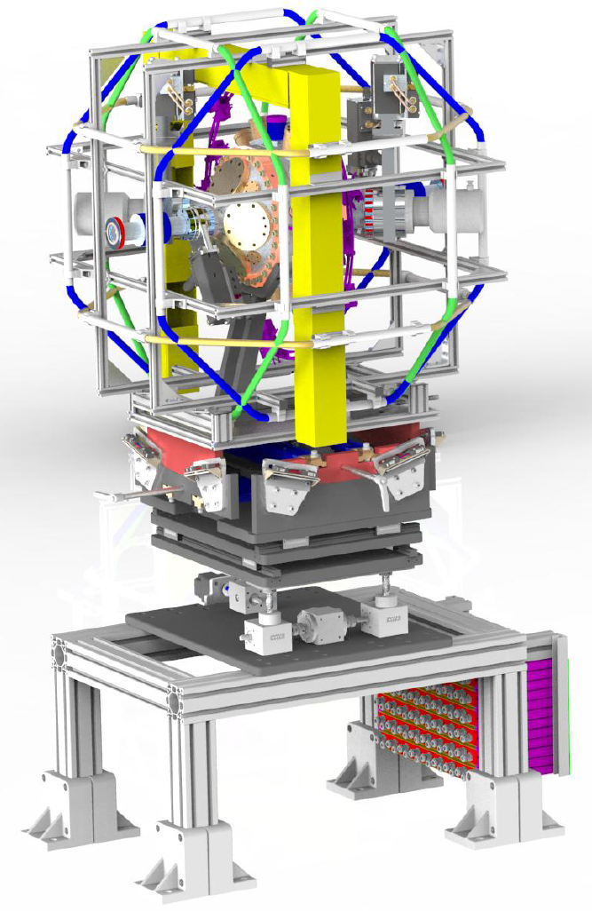
Non-invasive and pulse-resolved polarization diagnostics
Joakim Laksman
X-ray Photon Diagnostics (XPD)

Slide 2
Acknowledgements
European XFEL: XPD
Jan Grünert
Marc Planas
Florian Dietrich
Jia Liu
Theophilos Maltezopoulos
Wolfgang Freund
Torben Falk
Sonay Sayar
European XFEL: SQS
Marcus Ilchen
DESY: PETRA III: P04
Jens Viefhaus
Jens Buck
Leif Glaser
Frank Scholz
Gregor Hartmann
European XFEL science support groups : VAC, CAS, AE, ITDM, EET
DESY : Transport, Survey&Alignment
Laksman et al., J. Synchrotron Rad., Accepted Manuscript, (2019)

Slide 3
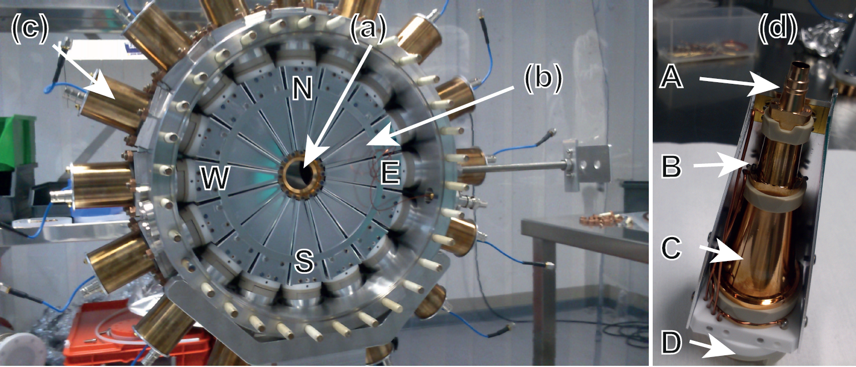
Photo-Electron Spectrometer Overview
16 eTOF spectrometers perpendicular to X-ray beam.
TOF spectra → Photon energy
Angular distribution → Polarization
Gas targets
N₂
Ne
Kr
Xe
X-ray pulse ionizes gas in extraction region.
Photo electrons hit the 16 MCP based detectors which gives time-of-flight spectra on digitizers
Helmholtz-coil & Magnetometer
Movement of entire system with six degrees of freedom.

Slide 4
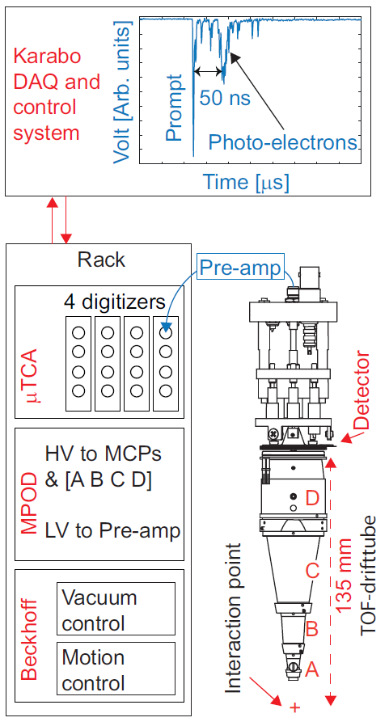
Measurements at SASE3

Slide 5
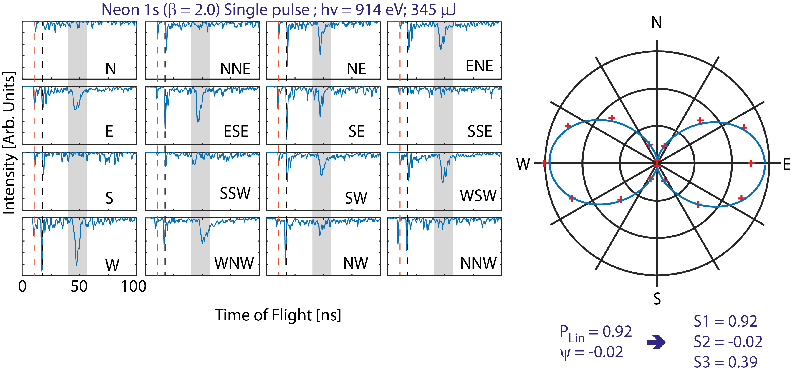
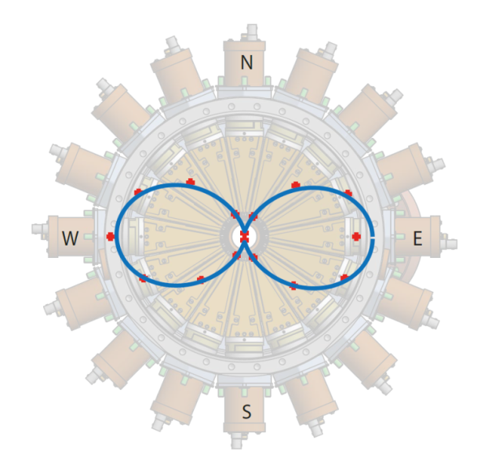
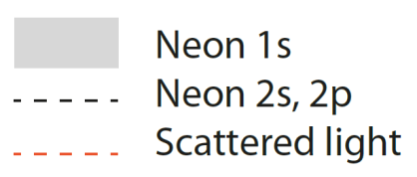
Spectra provides two types of information
TOF → Kinetic energy → Photon energy
Angular distribution → Polarization

Slide 6
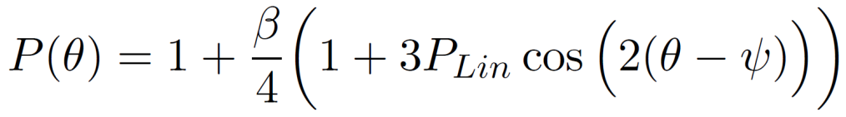
Polarization
P_{Lin} = 0.96 ± 0.03
ψ = 0.02 ± 0.03 [rad]
Fitting procedure provides us with polarization.
Future afterburner will produce circular polarization
Polarization important for many experiments at end-station
For every pulse we collect 16 TOF spectrums in all directions.
Spectra provides two types of information
TOF → Kinetic energy → Photon energy
Angular distribution → Polarization

Slide 7
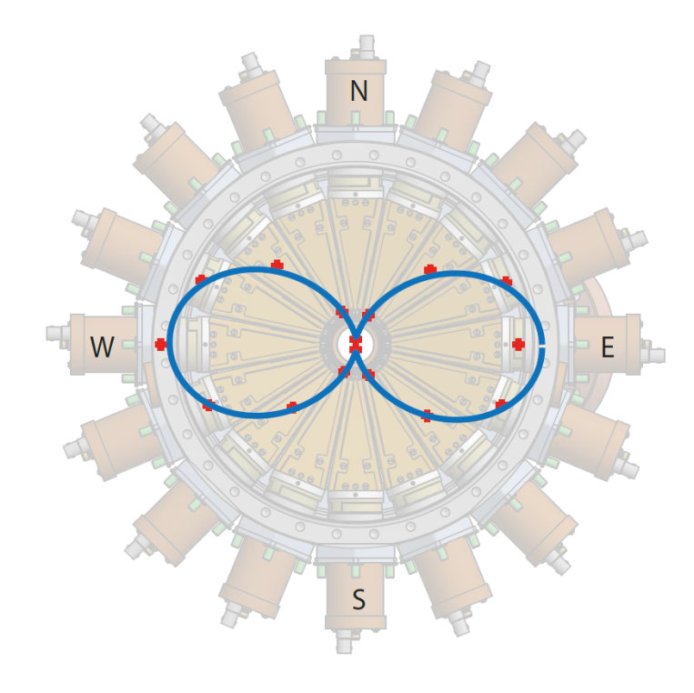
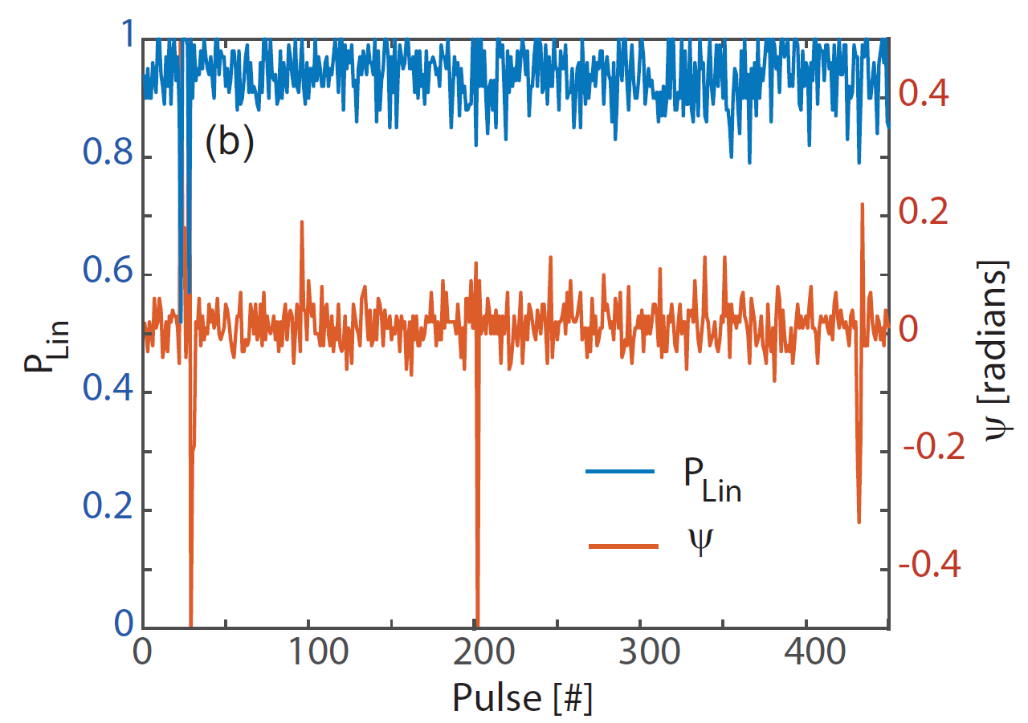
Polarization
Compare to multilayer based polarimeter
Advantages
Pulse resolved
Non-invasive
Dis-advantages
Only linear information
Cannot distinguish between un-polarized or right / left polarization
Unreliable pulse triggers Veto-signal
Instrument does not store data for that pulse
Saves storage space on server

Slide 8
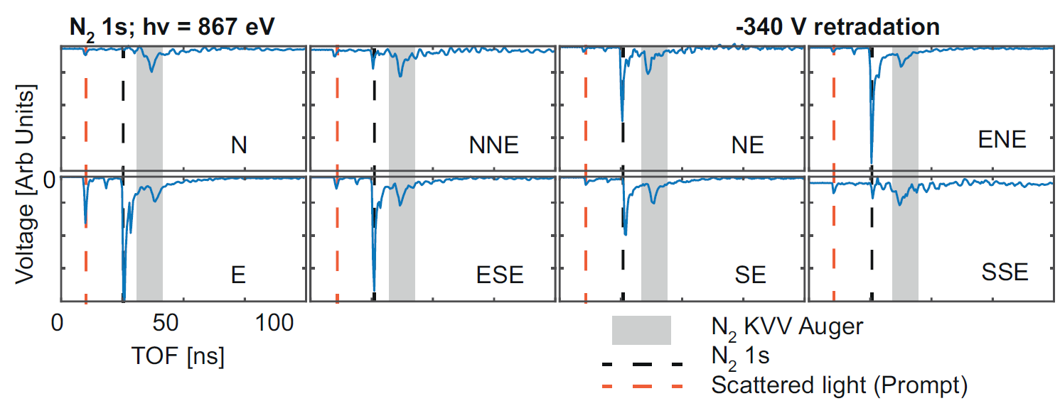
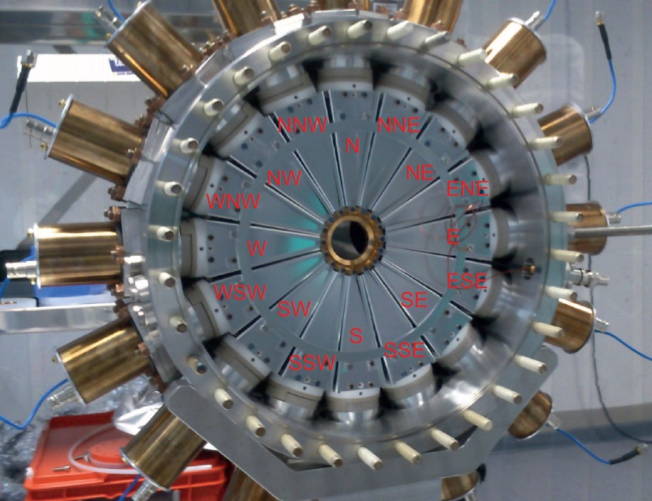
N₂ KVV Auger line for normalizing detector efficiency.

Slide 9
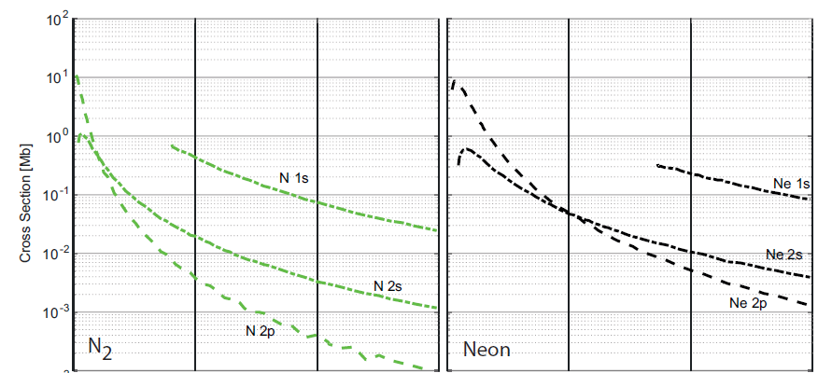
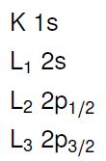

Select suitable
target gas:
Cross Section
Neon
Orbital BE [eV]
Criteria
High cross section (but still avoid space charge)
Anisotroy parameter β far from 0
Kinetic energy as low as possible
J. J. YEH and I. LINDAU, AT. DATA NUCL. DATA 32 (1985)

Slide 10
Status:
In principle operational:
All hardware is installed in tunnel.
Software enables us to acquire and analyse data.
Spectrometer has been calibrated: TOF can be converted to Photon-energy. Angular distribution can be converted to Polarization.
Ongoing work and outlook:
Only collect raw data trace which is storage consuming and requires post-analysis.
PES data source cannot be included in experimental end-stations.
In collaboration with CAS and AE we are developing MDL-Device to convert huge data trace to relevant parameters in real time:
Spectral distribution
Polarization
Purpose of data:
Data must be stored in .h5 files together with user experiments.
Continuously available to operators for tuning undulator gap and variable polarization.

Slide 11
Status:
In principle operational:
All hardware is installed in tunnel.
Software enables us to acquire and analyse data.
Spectrometer has been calibrated: TOF can be converted to Photon-energy. Angular distribution can be converted to Polarization.
Ongoing work and outlook:
Only collect raw data trace which is storage consuming and requires post-analysis.
PES data source cannot be included in experimental end-stations.
In collaboration with CAS and AE we are developing MDL-Device to convert huge data trace to relevant parameters in real time:
Spectral distribution
Polarization
Purpose of data:
Data must be stored in .h5 files together with user experiments.
Continuously available to operators for tuning undulator gap and variable polarization.
Thank you very much for your attention!

Slide 12
