Slide 1
ACTS
Concept Design

Slide 2









Full Stack
Client
Server
DB
Requests :
- Move Cart1 to Loc1 -
Positions
Commands
Status
RTLS
Mobile Robots
Carts

Slide 3
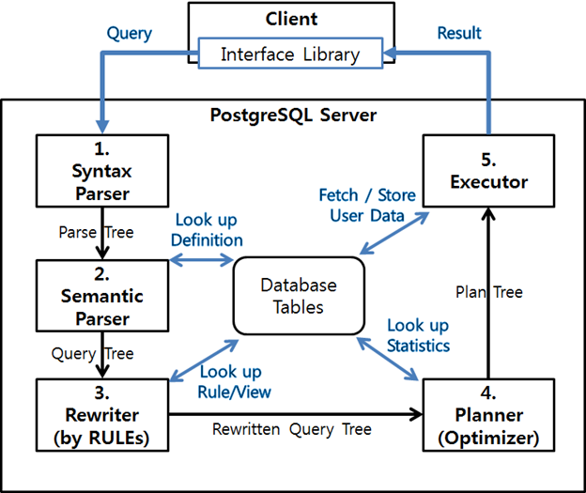
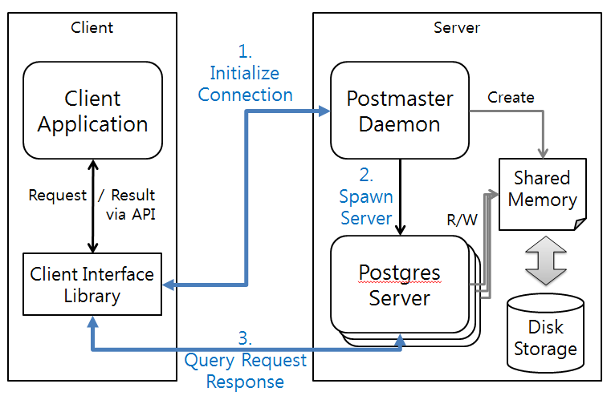
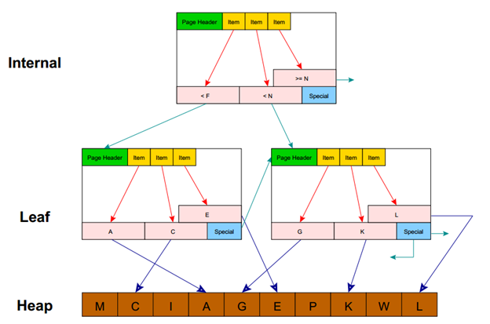
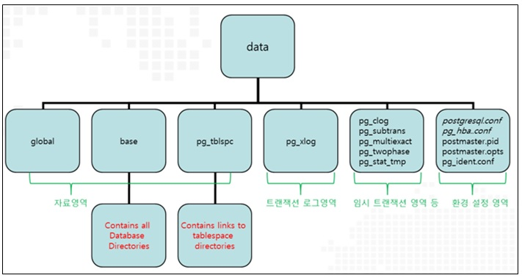
DB

Slide 4
Page 1
Top Bar
Side bar
Map
Robots
Carts
robots
carts
latest Jobs

Slide 5
Page 2

Slide 6
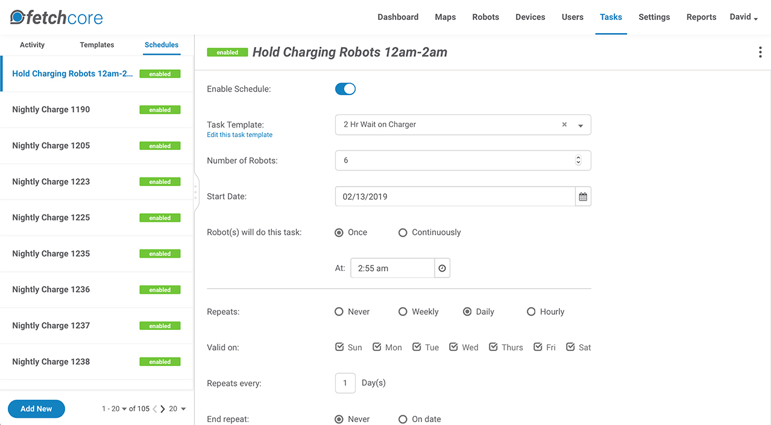
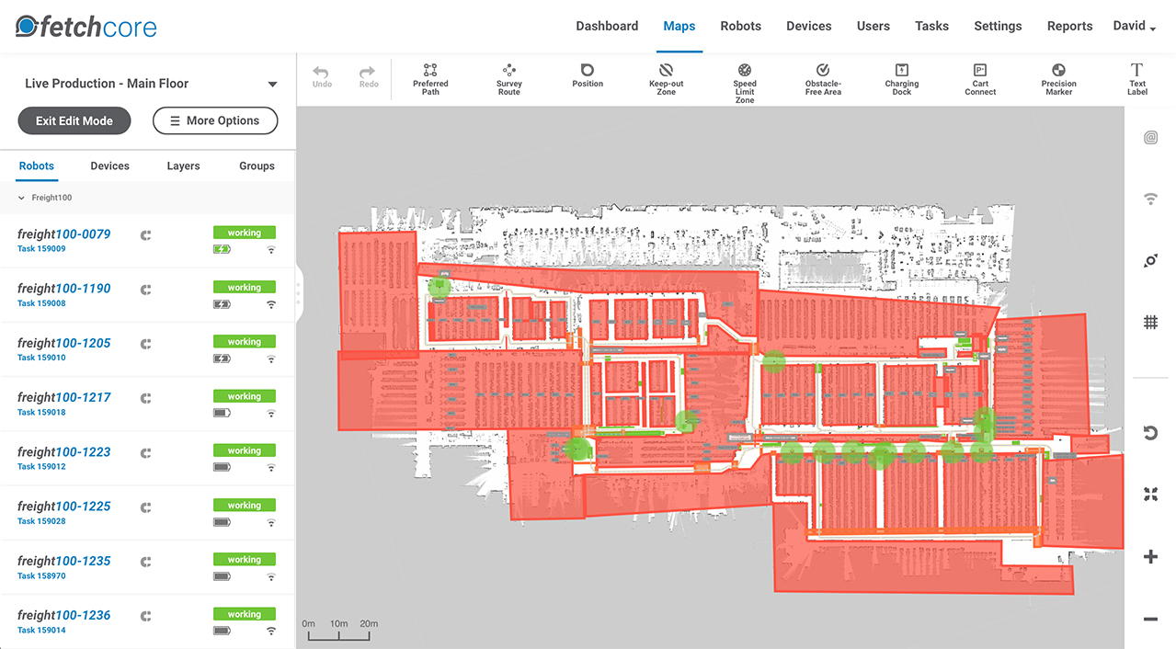
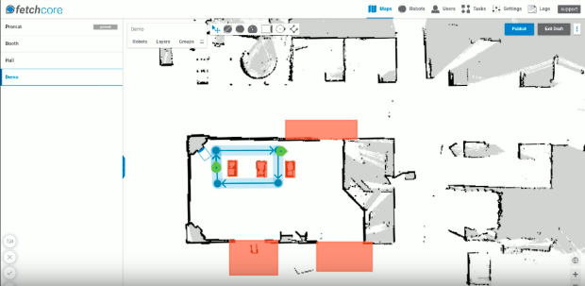
Page

Slide 7
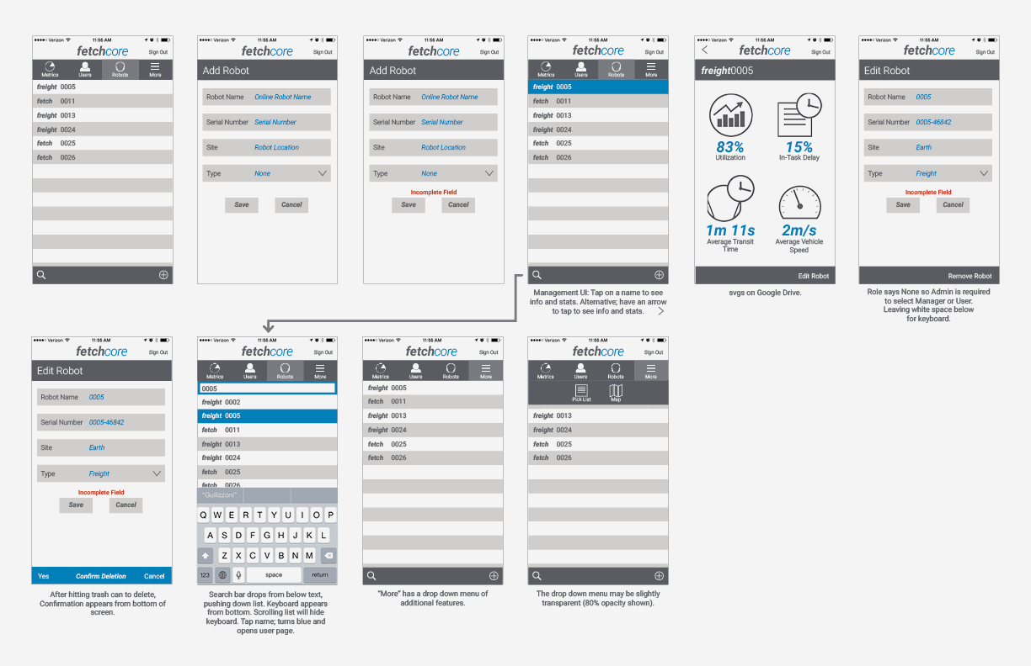
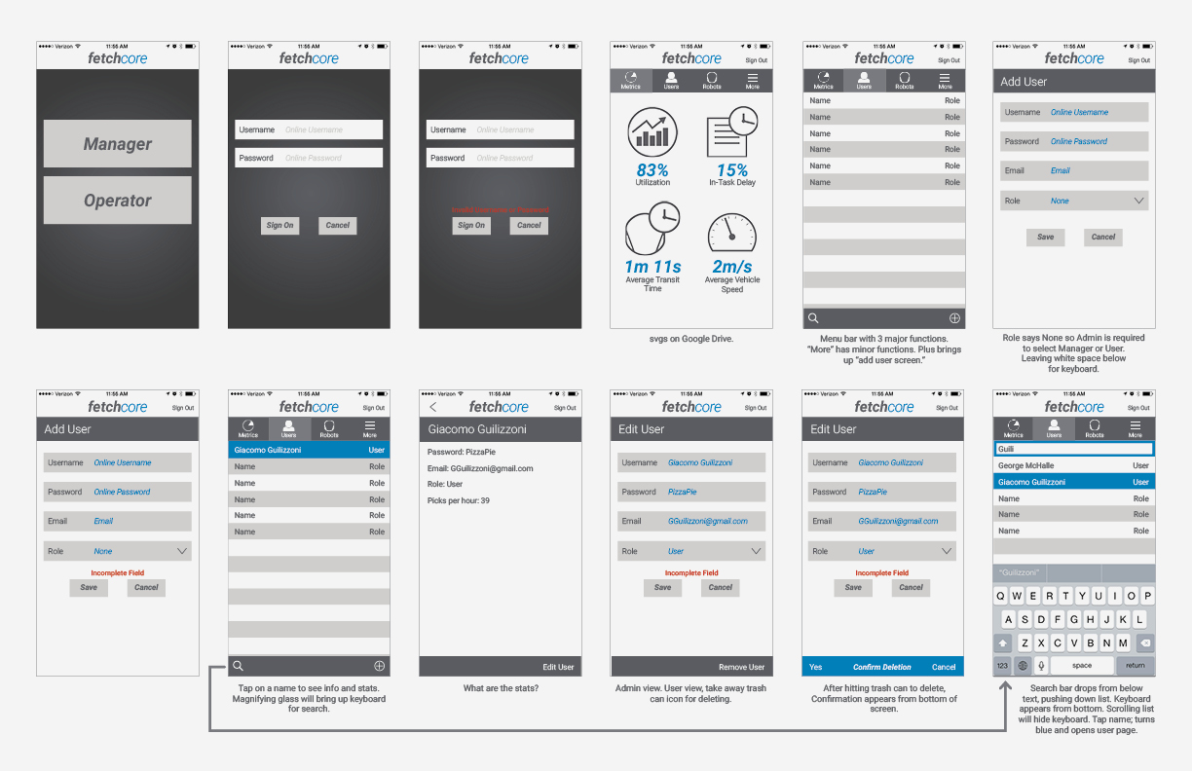
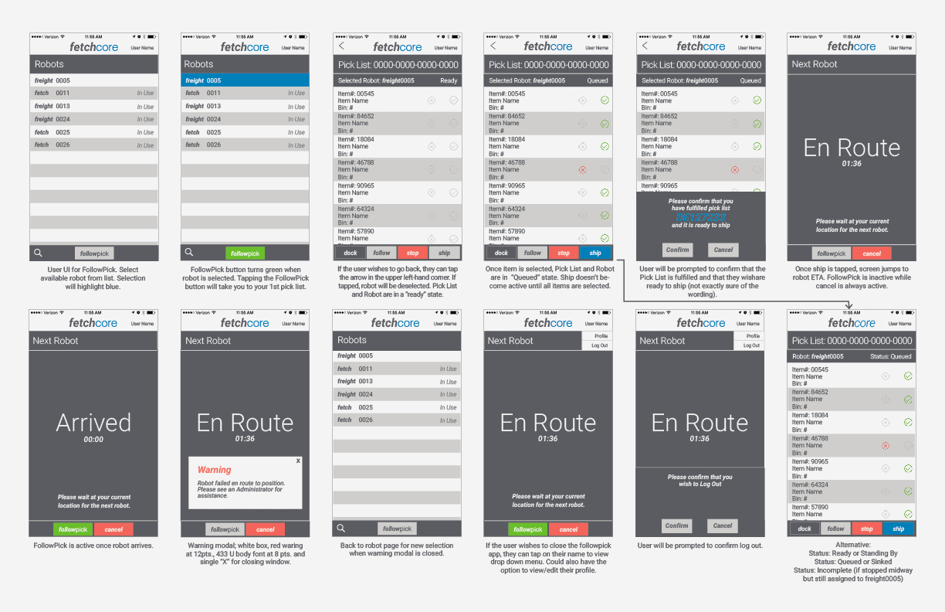
Page

Slide 8
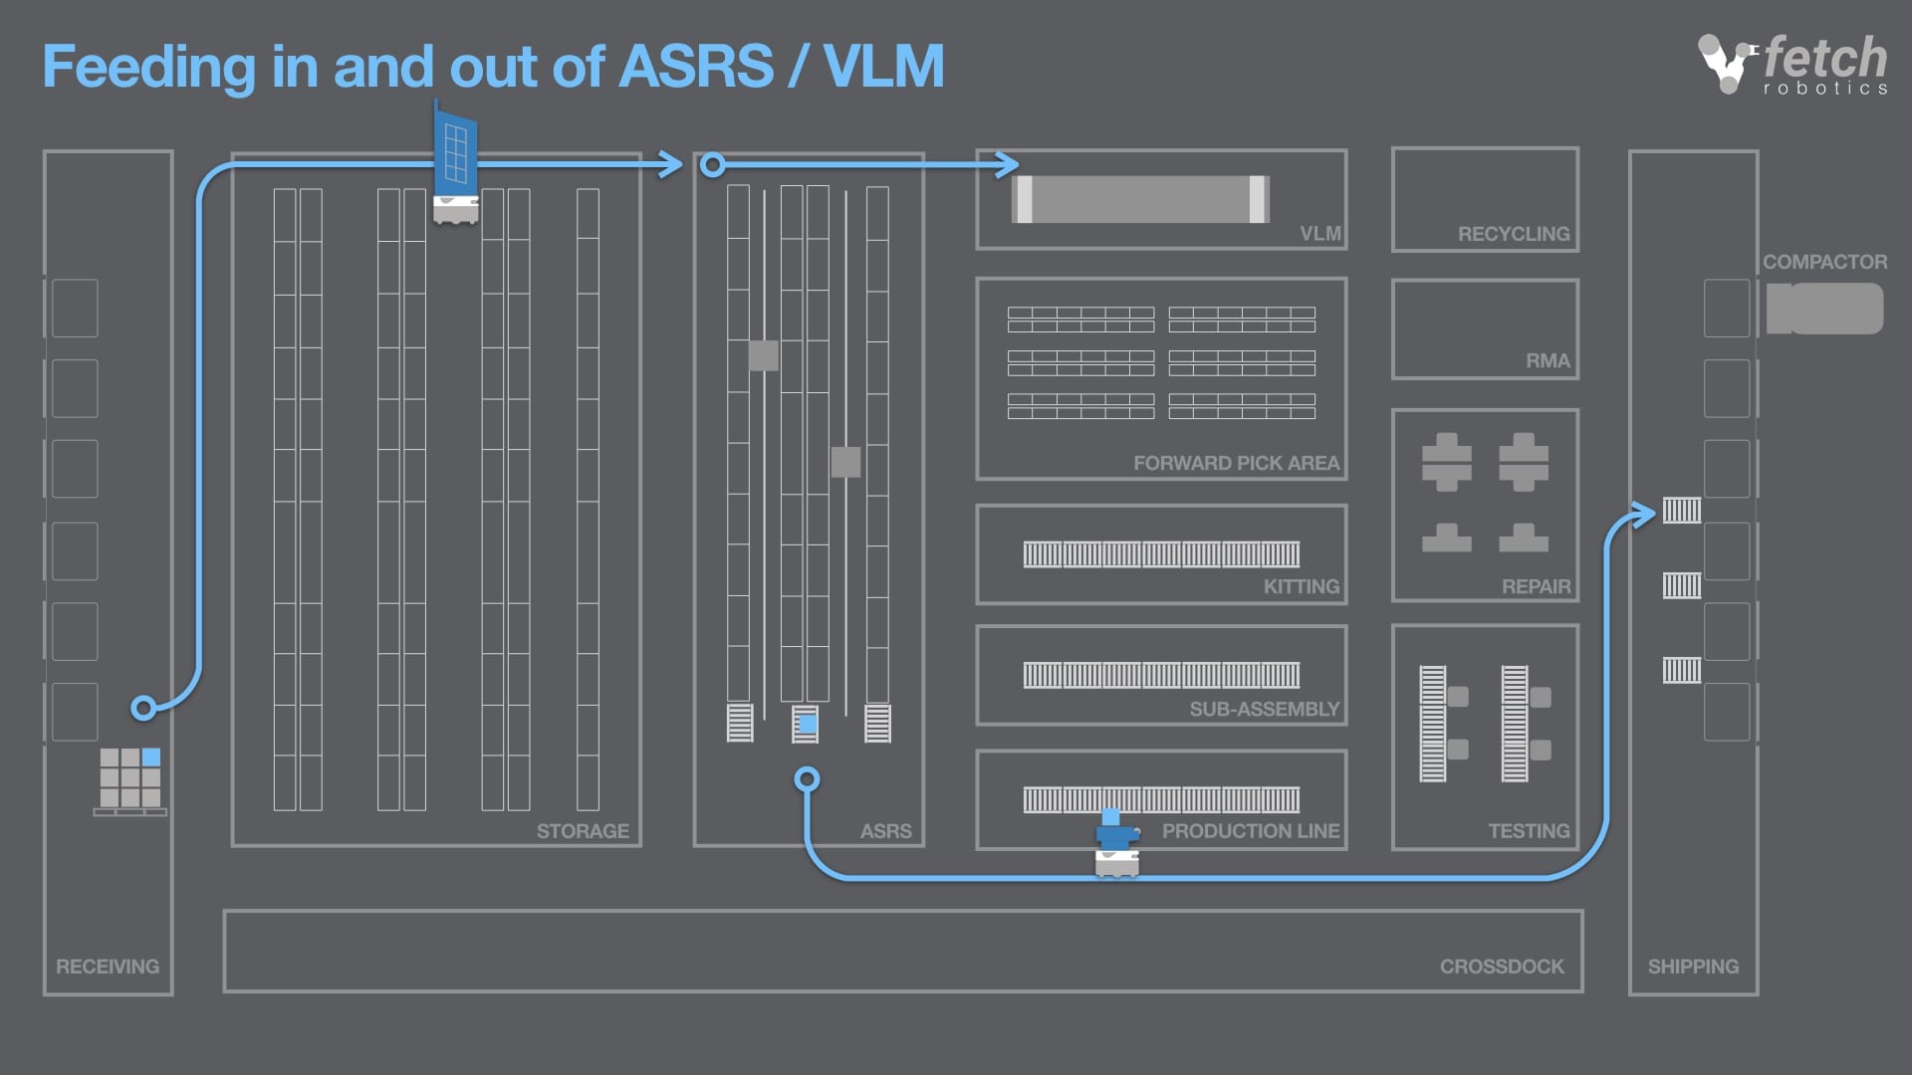
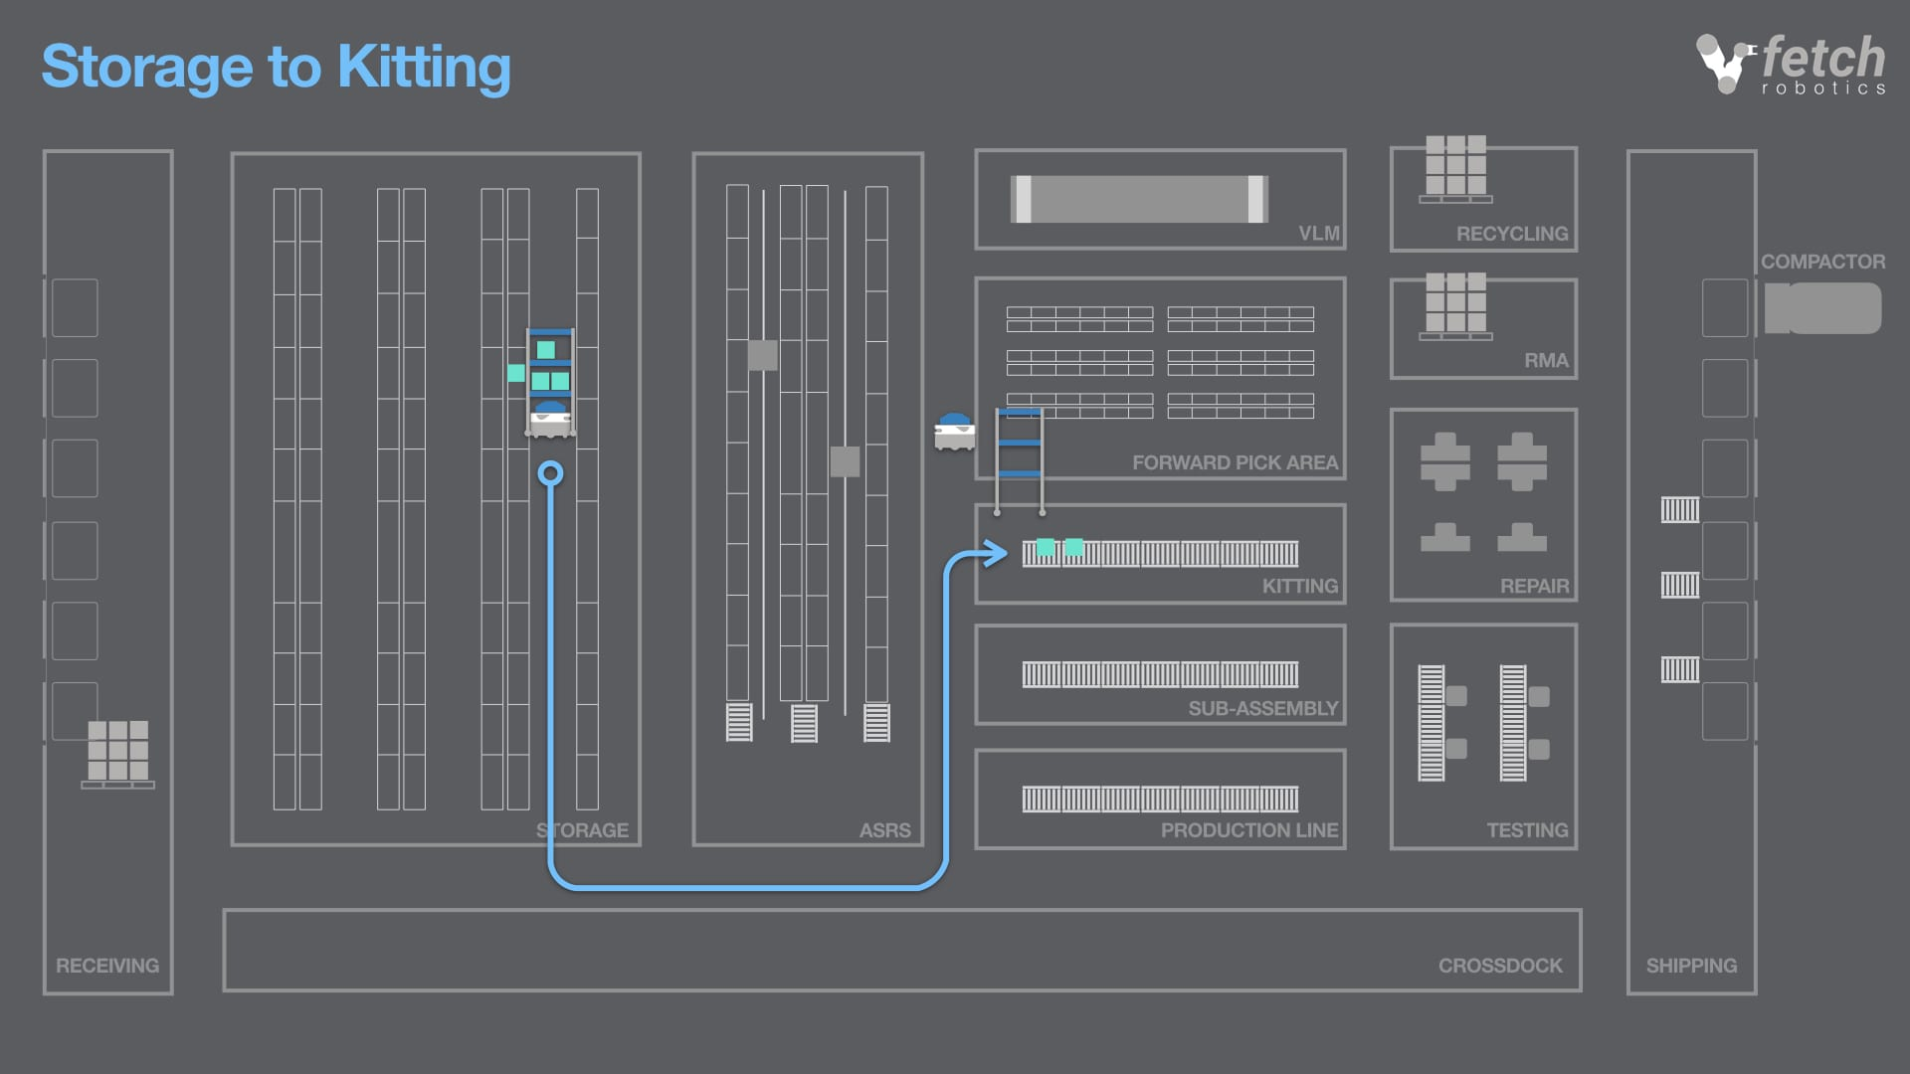
Page

