Slide 1

Nickel Price Predicion
By LSTM

Slide 2
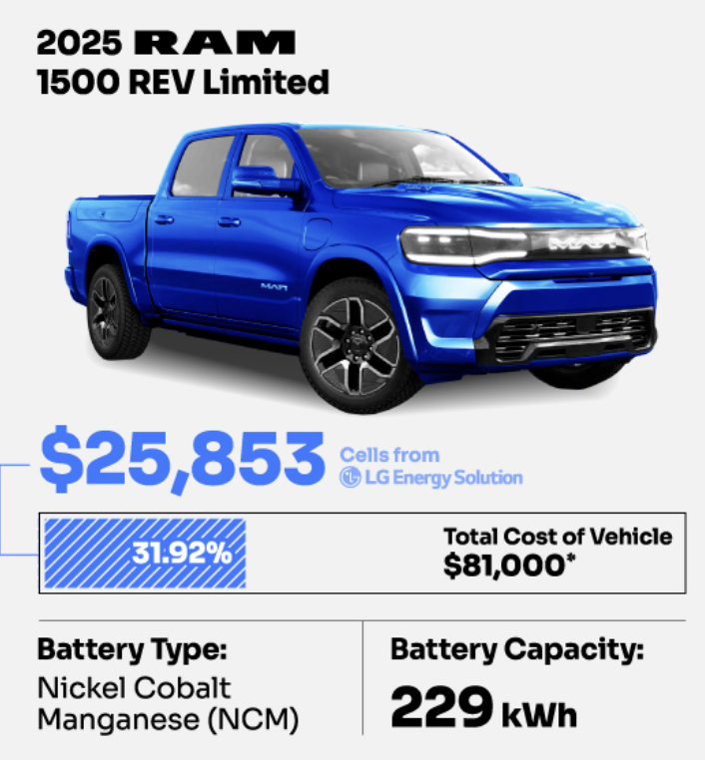

Background and Problem Definition
Battery packs make up over 30% of EV costs and rely mainly on nickel.
Rising nickel prices greatly cut EV profit margins.

Slide 3

Background and Problem Definition
an accurate nickel price prediction model can aid purchasing decisions and
cost management strategies for manufacturers.

Slide 4

Background and Problem Definition
Why Nickel? Cobalt / Lithium / Manganese Market are new.
NOT ENOUGH DATA TO TRAIN THE MODEL.

Slide 5
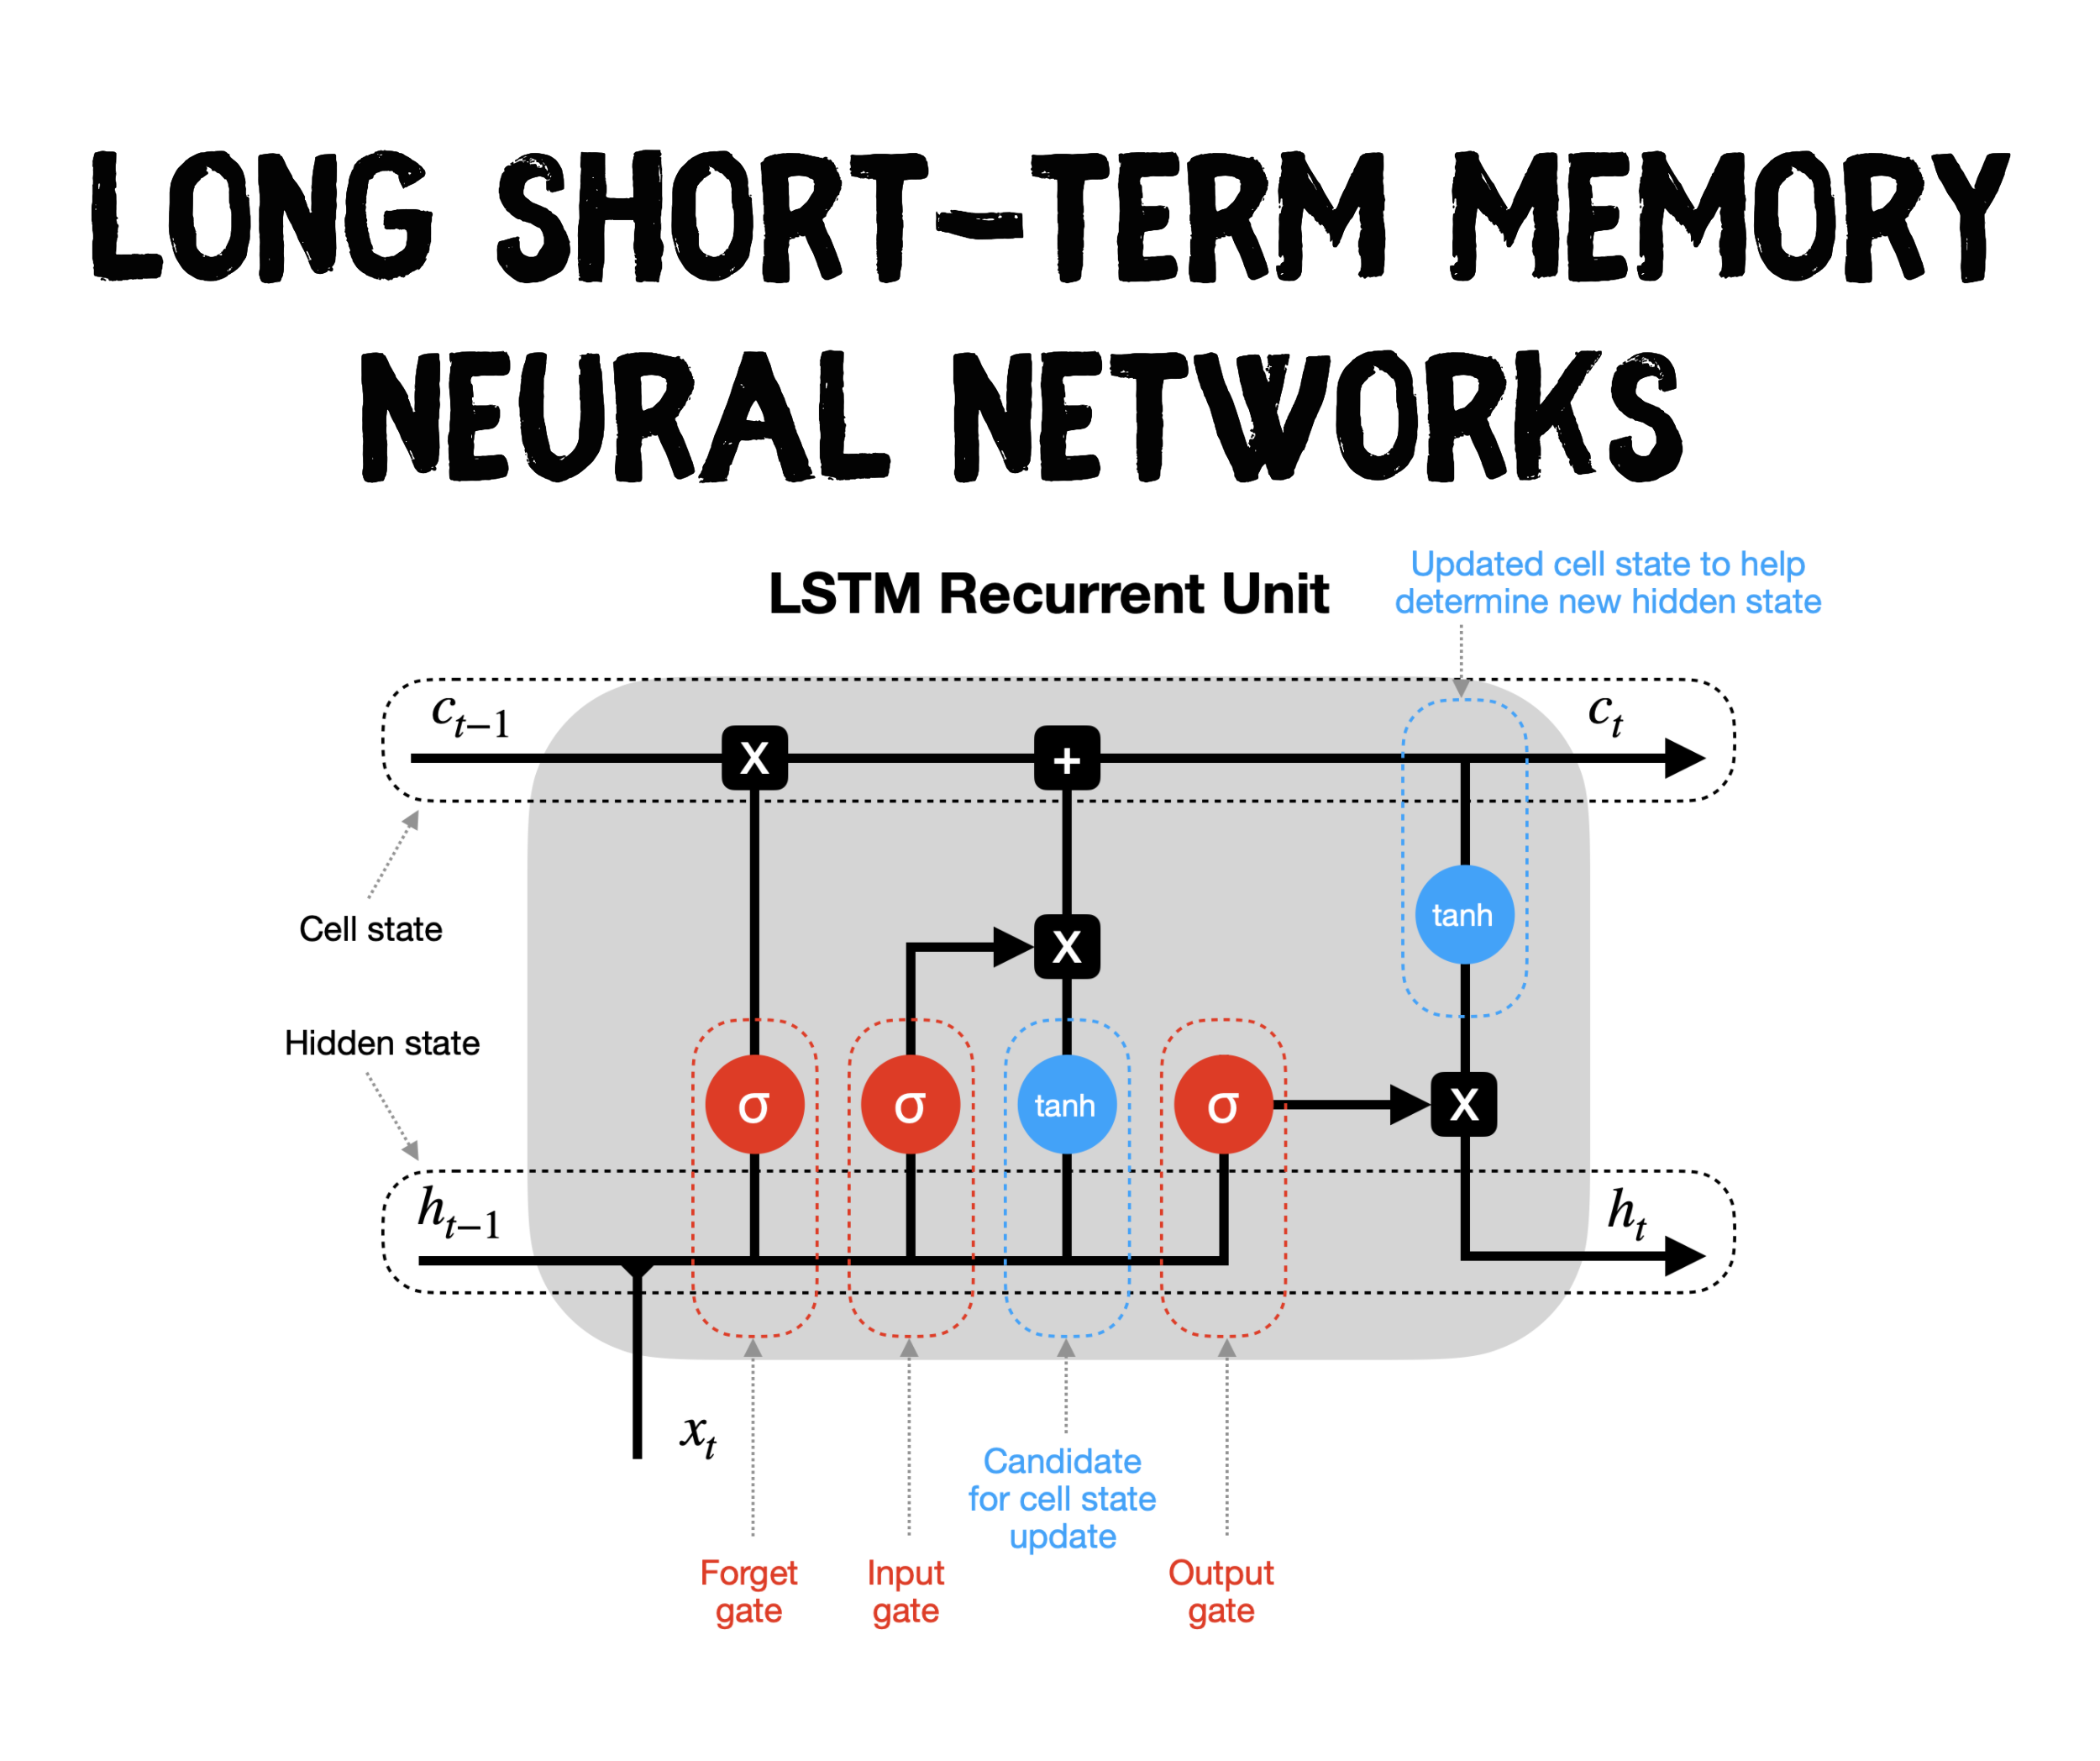
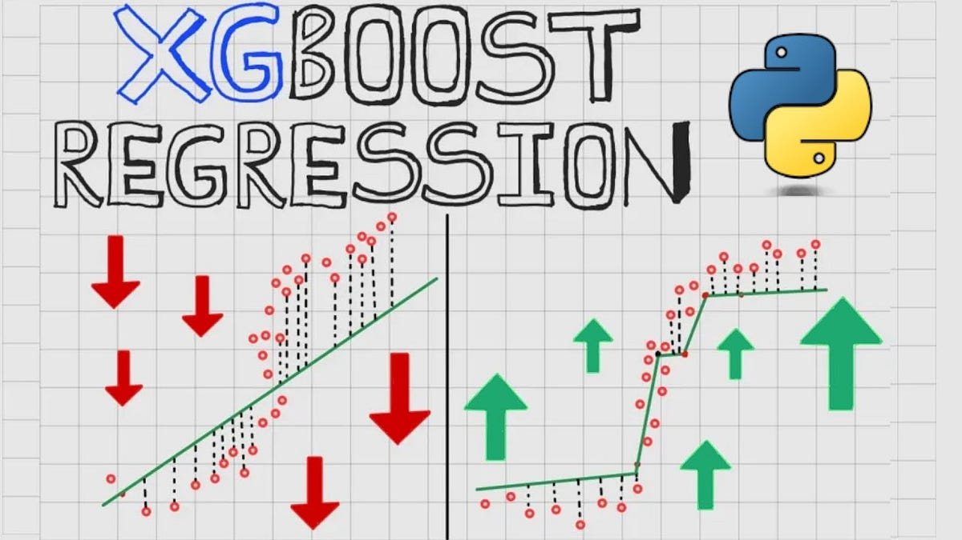
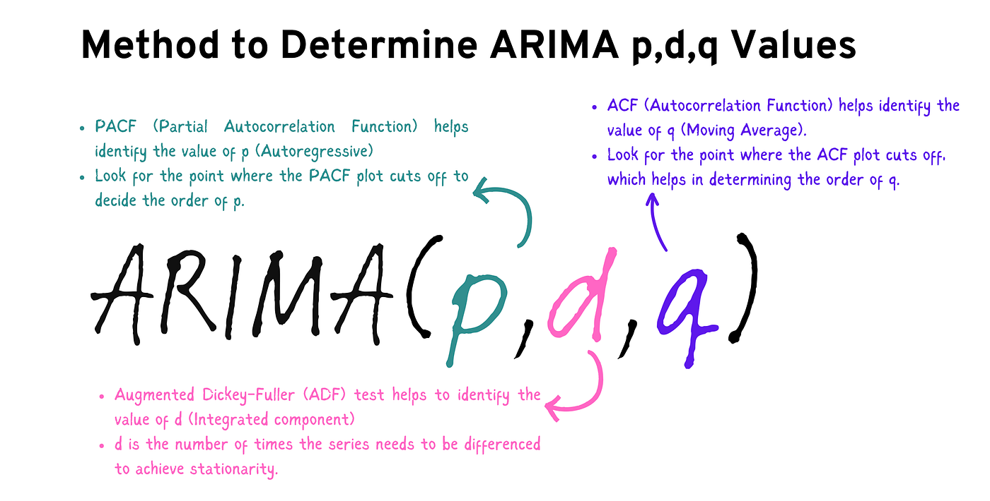
Research Question
Can LSTM model predict monthly nickel prices using historical economic indicators?

Slide 6
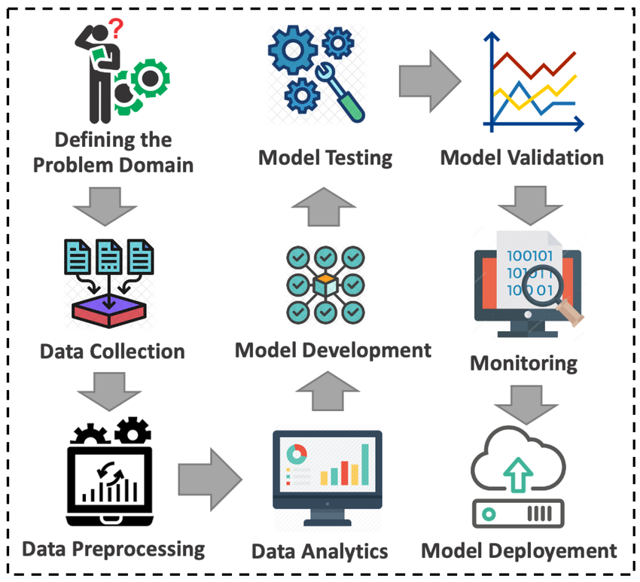


Methodology
Feature Engineering
RSME, MAE, MAPE

Slide 7

Data Collection
Kaggle doesn’t have related dataset. Collected data from FRED and TRENDFORCE

Slide 8

Data Preprocessing
Nickel Price
USD Index
Consumer Price Index
China Manufacturing PMI
MERGED
Industrial Production Index
DGS10 - Treasury Rate
Crude Oil Price
Collected each features individually, then MERGED BY DATE

Slide 9
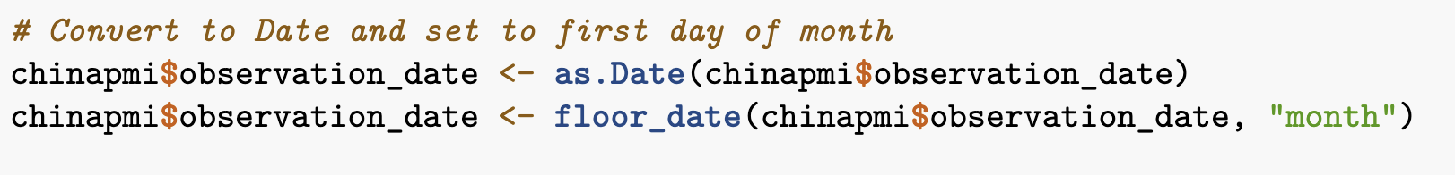
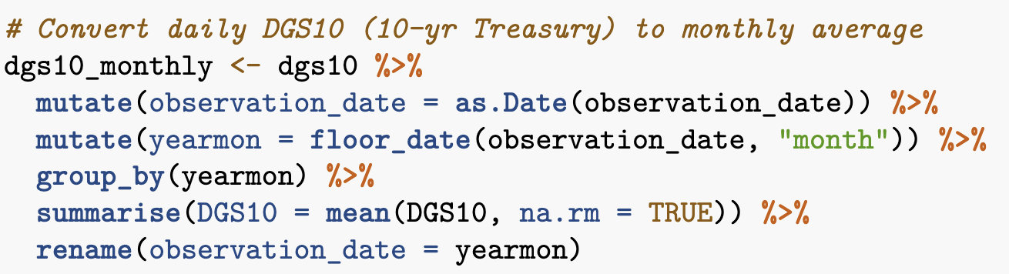
Data Preprocessing
China Manufacturing PMI
DGS10 - Treasury Rate
China Manufacturing PMI had different format. DGS10 was yearly data.

Slide 10
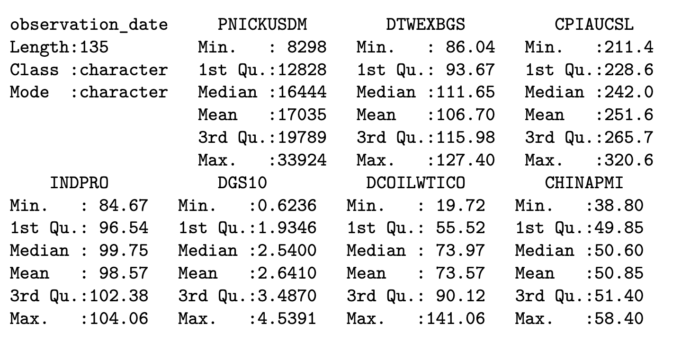
Data Preprocessing
Merged
Successfully Merged. No Missing Values.

Slide 11
Feature Engineering – Lag Variables
Lag1
Nickel Price
Lag3
Lag Variables : Price Momentum (Up, Down, or Stable?)

Slide 12
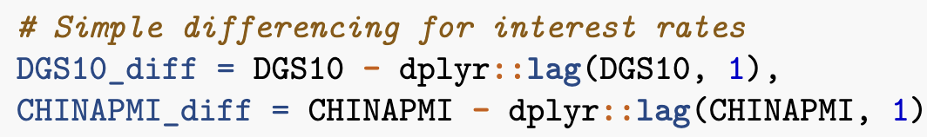
Feature Engineering – Stationary Transformations
CHINAPMI
DGS10
Differencing: Difference between months
Let the model learn Changes NOT TRENDS

Slide 13

Feature Engineering – Scaling
Scaling = Standardization
Standardization: All features on same scale → Fair importance

Slide 14
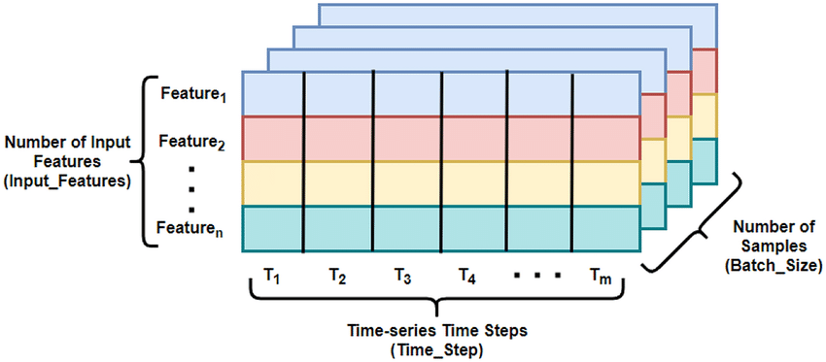
Feature Engineering – Creating Sequence
create sequences where each input consists of the past 24 months of data
to predict the next month's nickel price change.

Slide 15
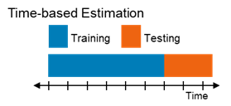
Model Development – Data Split
First 80% of sequence = Training Set
Remaining = Testing Set

Slide 16
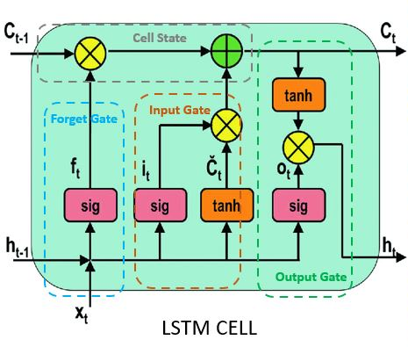
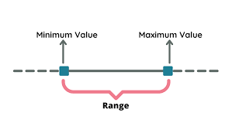
Model Development – Build
...
32 Units
Input: 24 months × 8 features LSTM: 32 units → Learn time patterns
Dropout: 20% → Prevent overfitting Output: 1 value → Next month's price change

Slide 17

Model Development – Model Training
Max 300 epochs (stop early if no improvement) Batch size 48 (update weights every 48 samples)
Early stopping (patience 20) → Prevent overfitting Monitor validation loss → Save best model

Slide 18
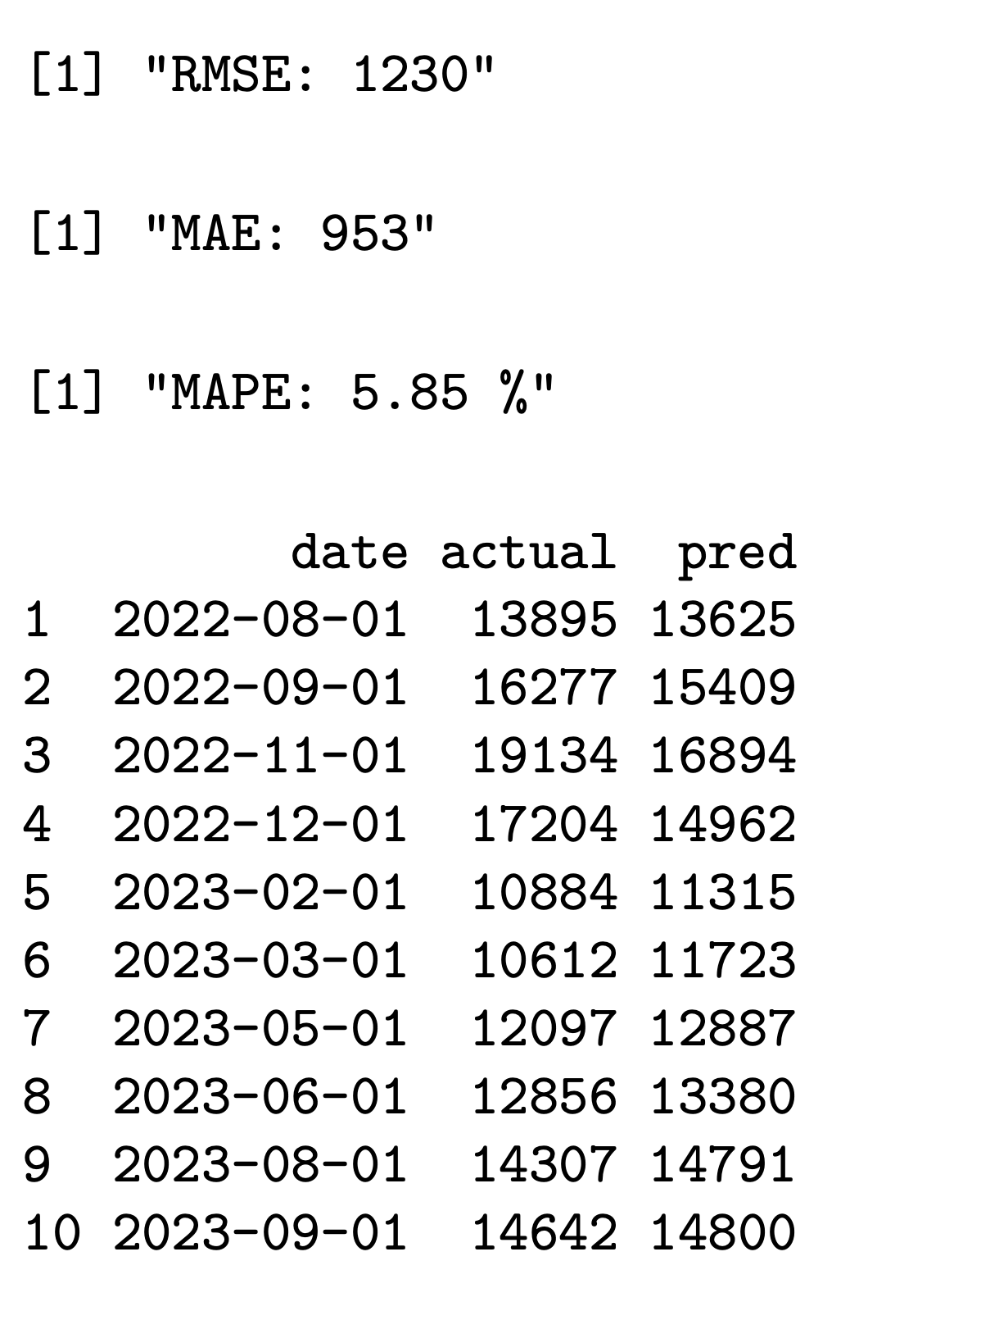
Model Validation
RMSE (Root Mean Squared Error): Average prediction error in dollars
MAE (Mean Absolute Error): Average Absolute Error in dollars
MAPE (Mean Absolute Percentage Error): Average Error in %

Slide 19
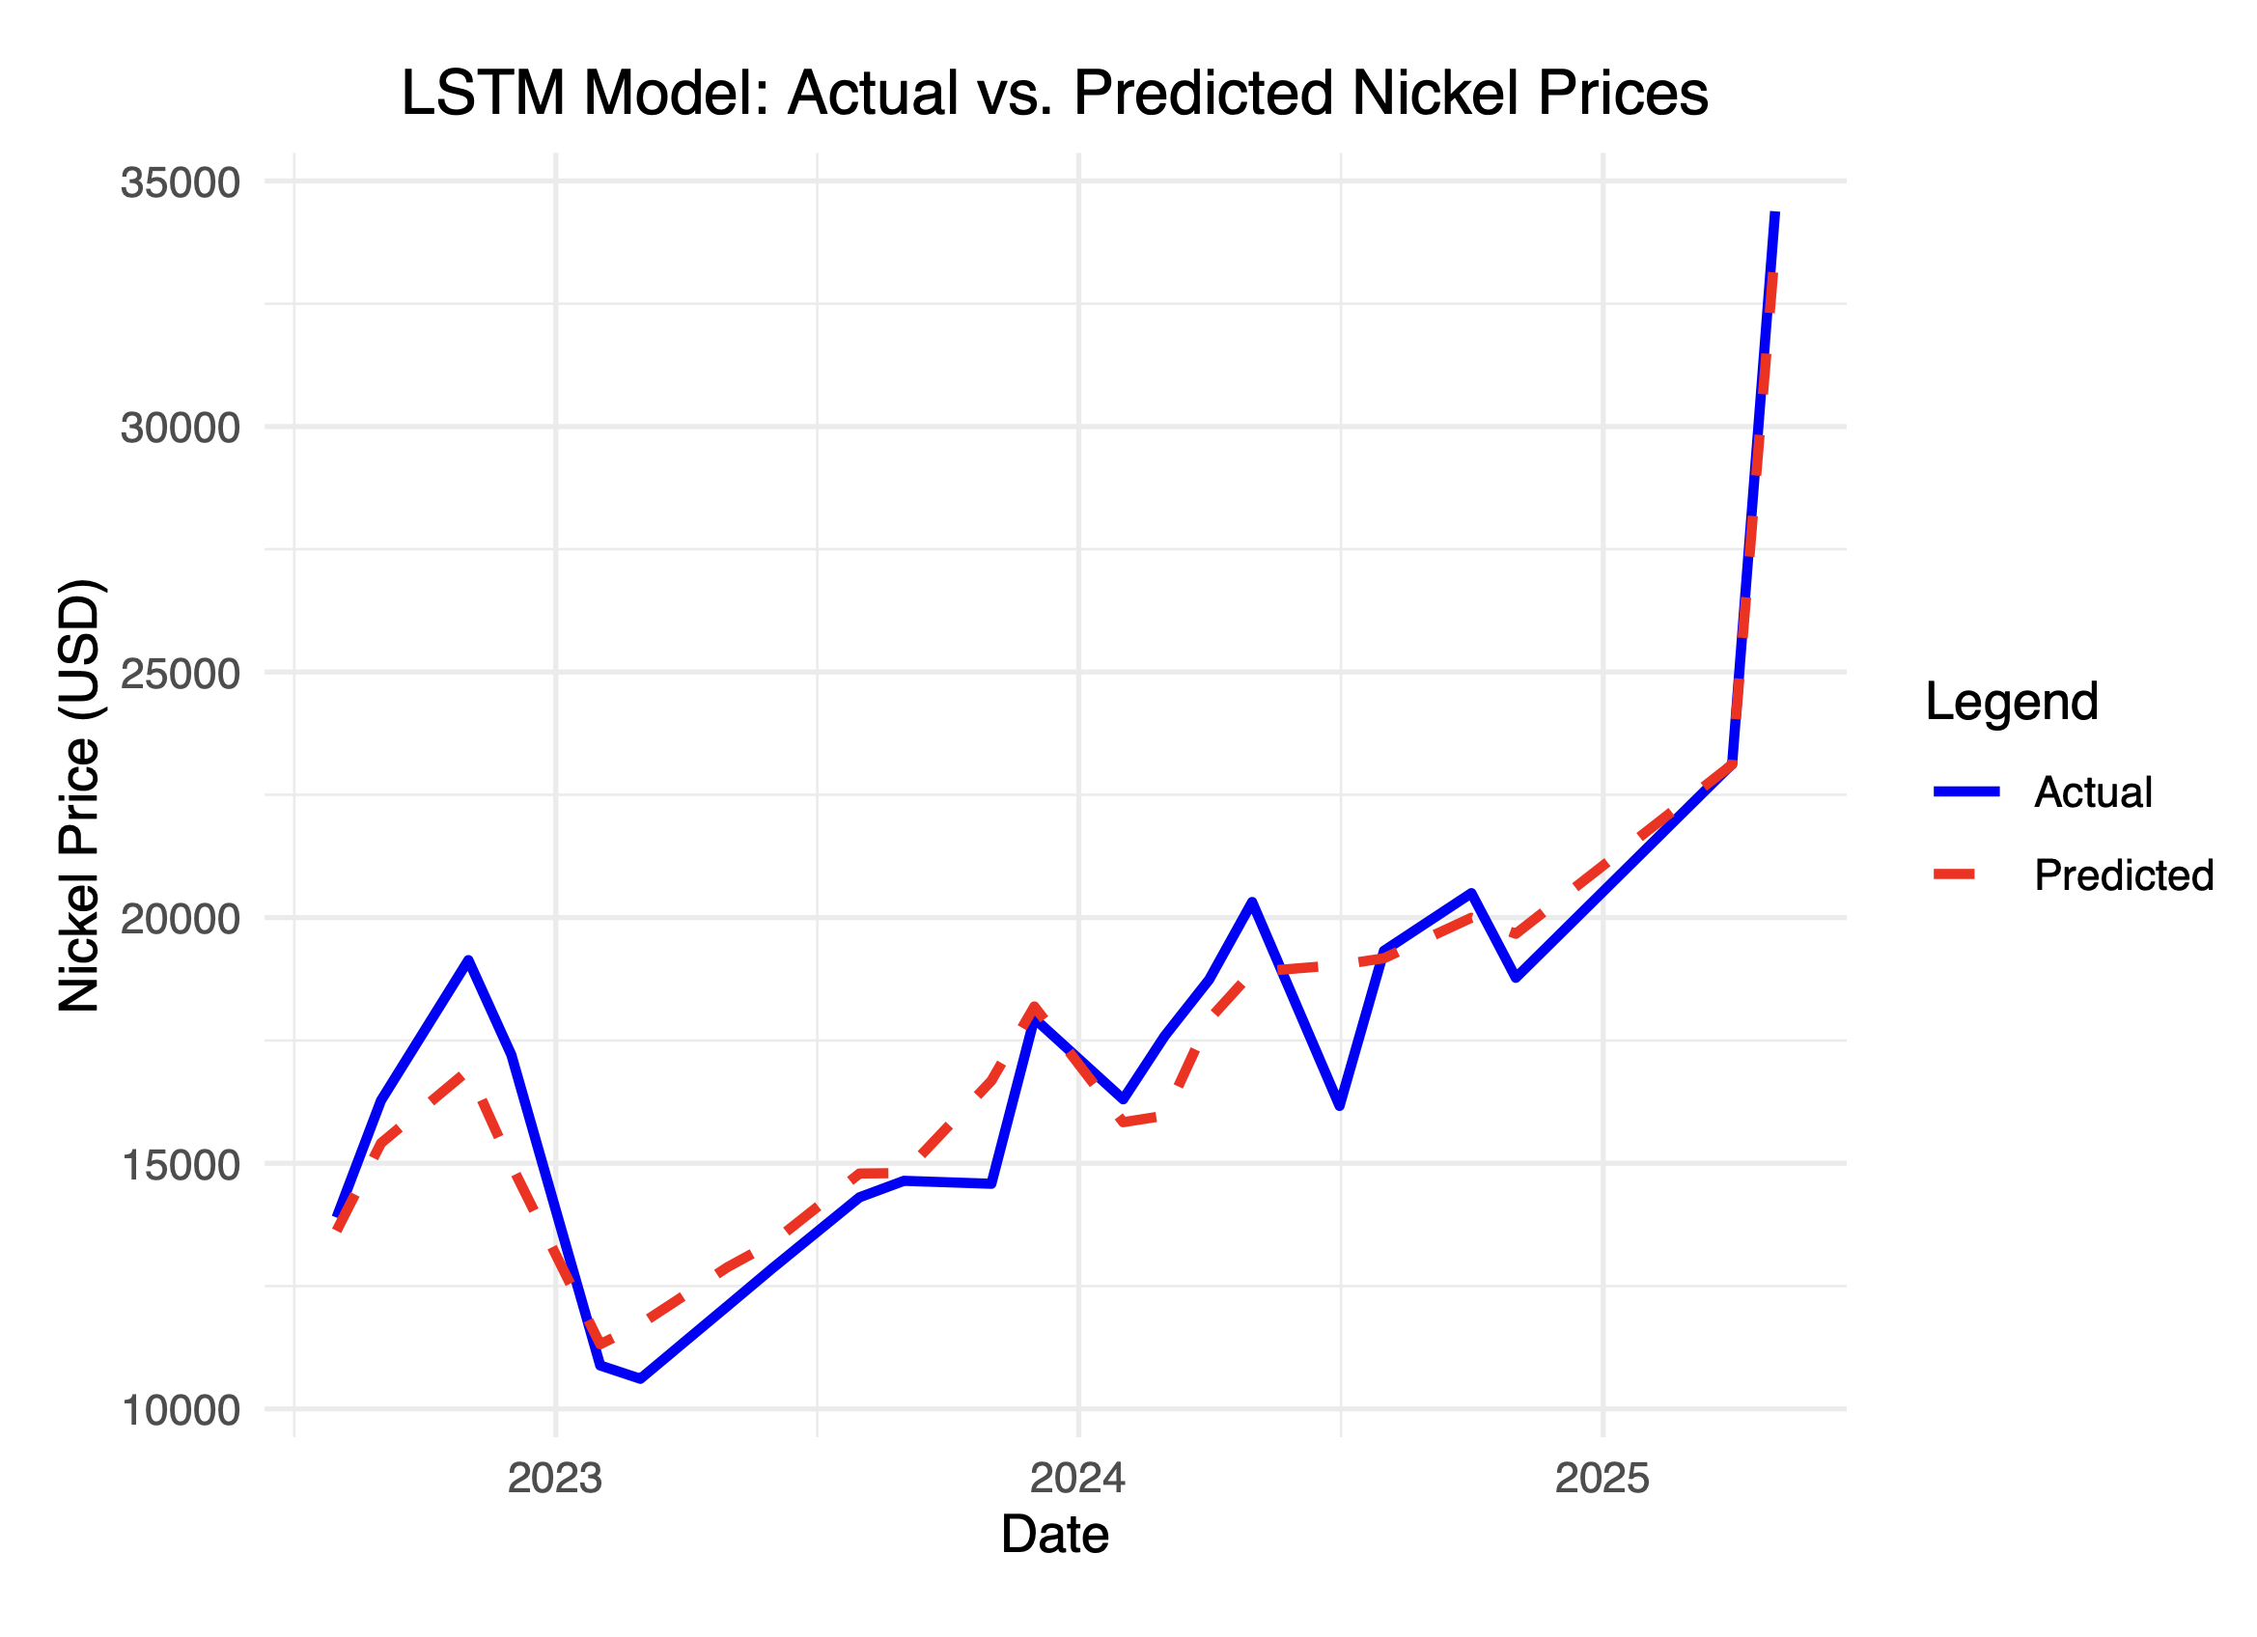
Model Validation - Visualization
Tariff?

Slide 20
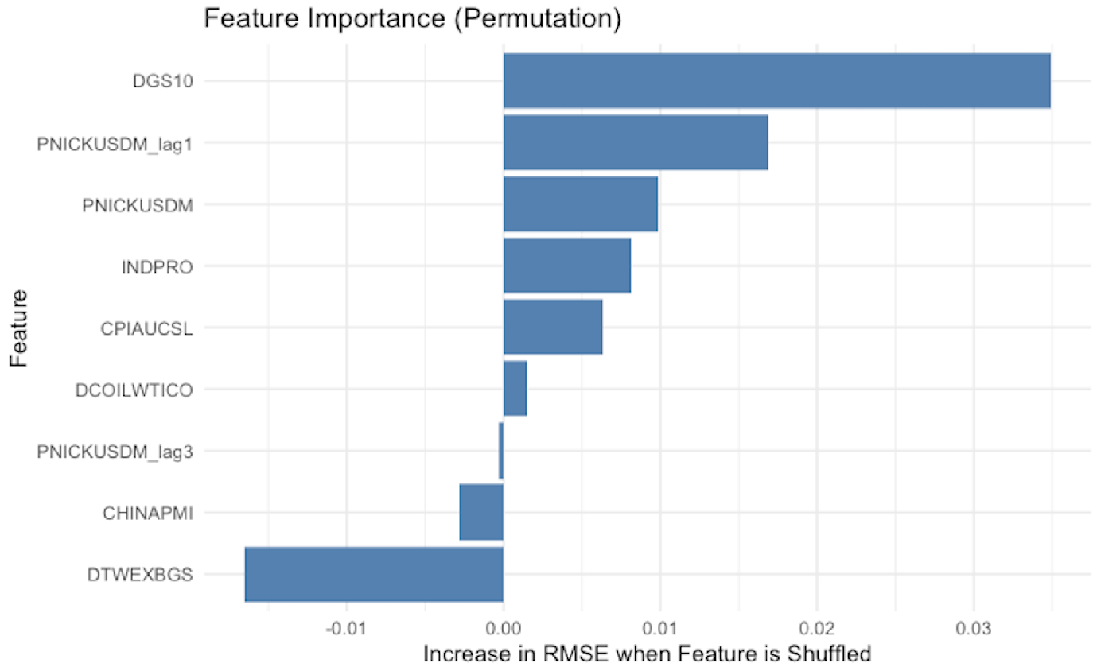
Model Validation – Feature Importance

Slide 21
Conclusion
Model Performance:
MAPE of 6-7% (best: 5.85%) This represents an average prediction error of approximately 6-7% relative to actual nickel prices
Limitation:
The model's performance could be affected by sudden market shocks or unprecedented events (Tariff)
This model provides a practical tool for manufacturers to anticipate nickel price movements and make informed purchasing decisions, potentially reducing cost volatility in EV production.

