Slide 1

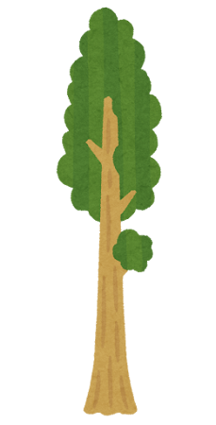
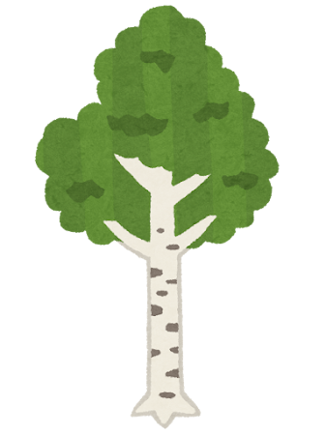
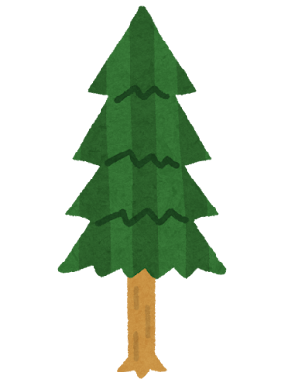
Welcome to Quantitative Field Ecology!
GES 408/608 Fall 2026

Slide 2
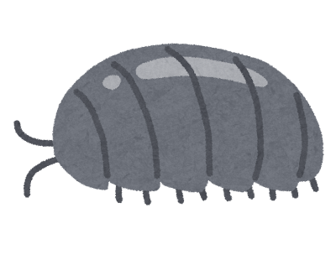
Meet Your Instructor
My name is Anna!
I’m excited to teach this course – I’m going to try to make it as fun and informative as possible for you all!
Need to get in contact? Email me: amother1@umbc.edu
I’m a PhD student studying leaf litter breakdown, macroinvertebrate traits, and urbanization.
In my free time, I love arts and crafts, reading, and Animal Crossing.
Notes:
Now meet each other! It’s a small class, take a couple of minutes and have everyone introduce themselves (name)

Slide 3

Syllabus Information
Office hours are 2:15-3 on Tuesdays (after class) and by appointment – send an email
Assignments – please turn things in on time!
Grading: see next slide/syllabus
Use of AI – policy in the syllabus
Attendance – please be here!
Notes:
My office hours are 2:15-3 on Tuesdays after class, or you can make an appointment with me!
Assignments – I will be as clear as possible about when assignments are due, with verbal and written reminders. It is your responsibility to turn things in on time. If something comes up, please endeavor to email me before rather than after something is due.
Take a look at the grading schema together
Please read the AI statement in the syllabus!!! TLDR, you can use it for some things, but not others. Do not copy and paste directly from AI into work that you submit, and do not use it to interpret the results of a study. AI is a tool, and should be used accordingly – it’s there to help you, not to do things for you. If you use AI in any way on an assignment, please add a statement saying what you used it for.
You are expected to attend all of the lecture and lab sections of this course, unless I tell you otherwise! If I have to cancel class I will let you know ASAP, or if there are optional attendance days I will let you know about those as well. Otherwise, you’re expected to be here. If you miss more than half of class meetings, you cannot pass.
Pause for questions

Slide 4
Grading Schema
 | Undergraduate | Graduate
Exercises | 50% | 40%
Exam I | 20% | 20%
Exam II | 20% | 20%
Final Project | 10% | 10%
Literature Review | --- | 10%

Slide 5
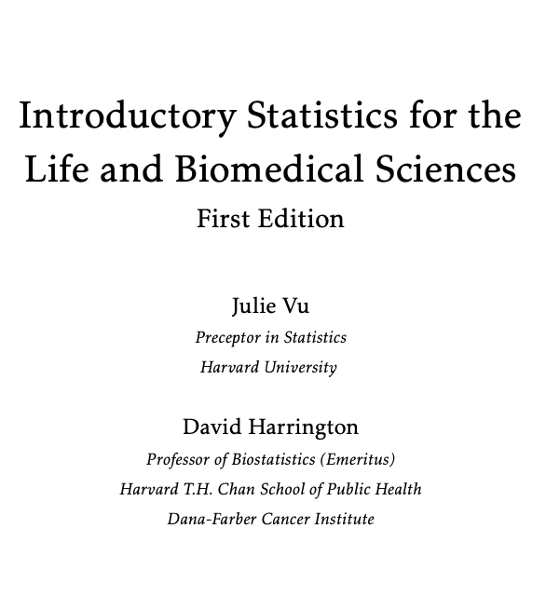
Our Textbook
Free!
Instructions for access are on BlackBoard
If you need to read something from it or if there are ever required problems, I will make it very clear. Mostly this is an optional resource to help you!

Slide 6
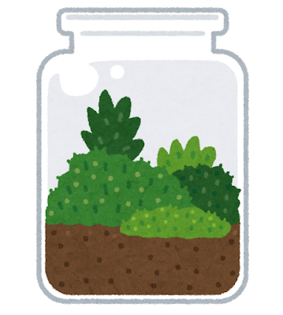
What is ecology?
Take 2 minutes to talk with those around you!
Notes:
Have everyone discuss with neighbors ~ 2 min, have a couple groups share out

Slide 7
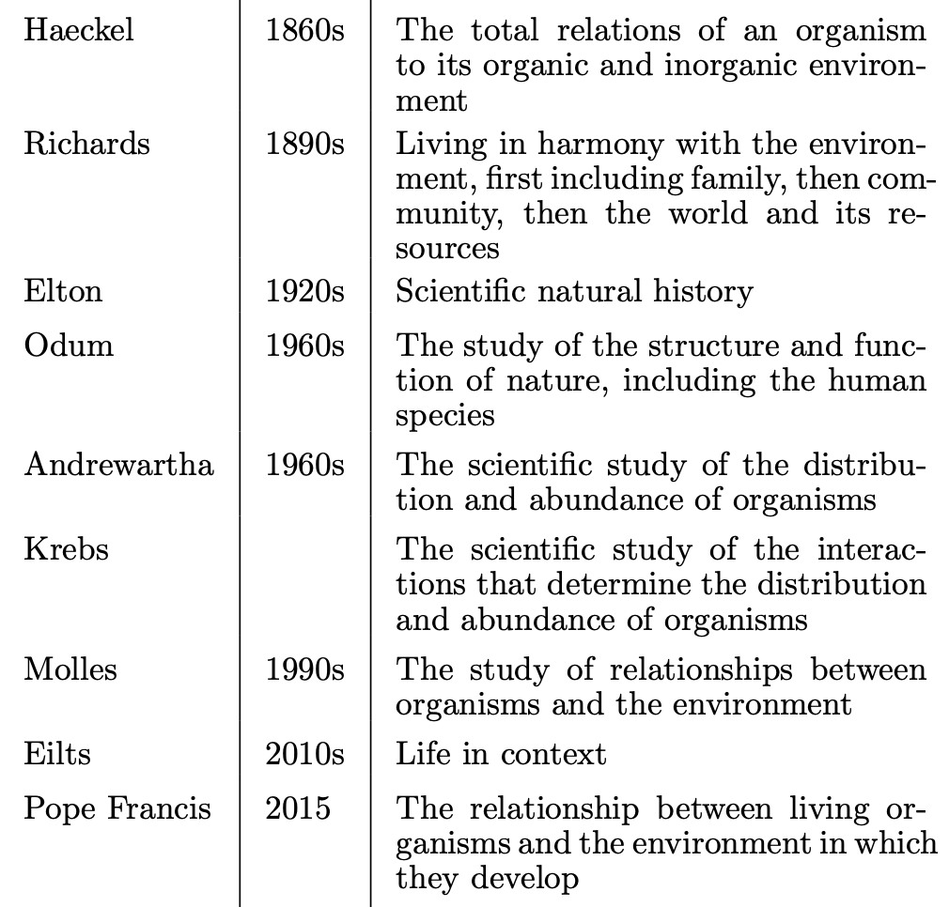
Ecology is….
the study of the interactions among organisms, and between organisms and their environment
Notes:
Table from Lehman, Loburg, and Clark 2019
Haeckel coined ecology and did a lot of good work on invertebrate anatomy but was also super racist

Slide 8
Questions in Ecology
Ecologists work by asking questions.
“What” questions drive initial discovery!
Other questions focus on a mechanism or function: “How?”
Mechanistic questions are more difficult, but necessary as they explain how the world works.
Notes:
Some what questions: (ASK)
What are the different kinds of trees in the forest?
What does the raccoon eat?
What are the times of year when a plant produces fruit?
Some how questions: (ASK)
How do the leaves of oak trees turn color in the fall?
Physiological mechanisms
How does the female wolf spider choose a mate?
Ask about male-female communication

Slide 9
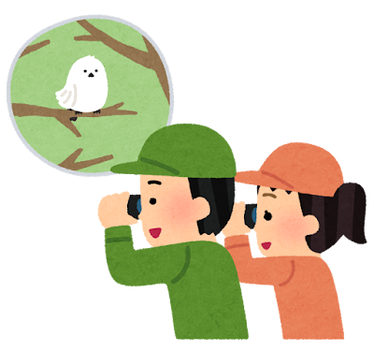
Questioning Nature
When we question nature, we OBSERVE!
Distinguish pattern from chaos: the natural world is diverse, complex, and interconnected.
  The natural world is dynamic, but also stable and self-replenishing.
  Issues of disturbance and how communities respond to change
The natural world is organized by physical and biological processes – we can find patterns.
Notes:
After second bullet:
Do all trees do the same thing, at the same rate?
Why does a spider place its web in a certain location over another?

Slide 10

Questioning Nature
Patterns have two sources of predictability:
Reliance on observation
  Predictions made by extrapolating previous observations to new but similar situations
Understanding the mechanism
  Knowing the form and function of animals and plants allow us to predict what types of animals would exist in unexplored habitat
Notes:
Empirically observed patterns often precede causative principles that generated that pattern

Slide 11
Questioning Nature
Patterns can be understood in terms of evolution by natural selection
  Variety in form and function in a species
  Nature “selects” for those traits that lead to successful reproduction
  This is how adaptation occurs
  Selection favors traits that give organisms an advantage in nature

Slide 12
Perception in Ecology
Our mode of existence influences our perspective of time and space!
Perception of distance is different for us than a housefly
A few decades are a lifetime for us, while a redwood tree exists for centuries
Notes:
This is just something to think about while you’re asking questions

Slide 13
Natural history and human impacts
Natural history forms the basis of ecological inquiry
Describes the activity, characteristics and role of an organism in the environment
Often, our curiosity about an animal or plant drives our mode of inquiry
Nature is affected by human activity (Issues of disturbance?)
Incidence of forest fire
Habitat simplification

Slide 14

Scientific Method
5 Steps:
Observe some aspect of the natural world
Invent a tentative description, called a hypothesis, that is consistent with what you have observed
Use the hypothesis to make predictions
Test those predictions by experiments or further observations and modify the hypothesis in the light of your results
Repeat steps 3 and 4 until there are no discrepancies between theory and experiment and/or observation

Slide 15
Scientific Method Example
You have a bowling ball and a feather, Which one will hit the ground first if both are dropped from the same height at the same time?
Hypothesis: "I believe that the bowling ball will hit the ground before the feather if I drop them both from the same height at the same time.”
Drop the bowling ball and the feather a number of times, collecting data by keeping track of which item hit the ground first each time. After dropping the ball and the feather 5 times, sum up the number of times each item hit the ground first.
Finally, after demonstrating that the ball hit first each of the five times, the person could conclude that their hypothesis appears correct, the bowling ball DOES hit the ground first!!
So, often data is collected to test a hypothesis, and the analysis of the data is used to prove or disprove the theory.

Slide 16
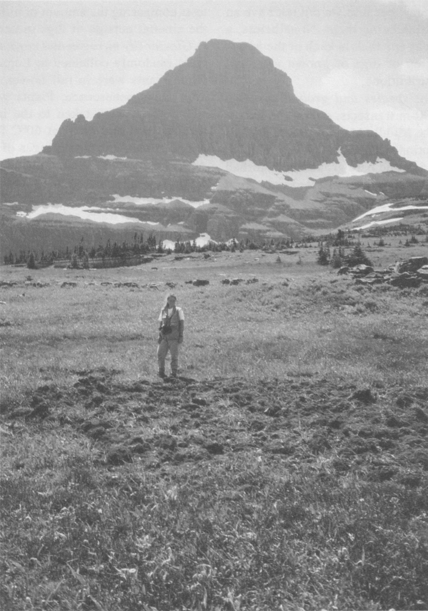
Tardiff and Stanford 1998
Please get into 3 groups!
15 minutes to read/skim paper and discuss with classmates
Questions we will talk about are on next slide – each group will get two questions to discuss, and then share out with the class!

Slide 17
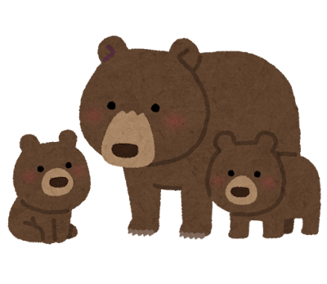
Tardiff and Stanford 1998 Discussion
What pattern were they observing prior to doing the experiment?
What were the hypotheses?
How did they test them?
What was their control?
What was their conclusion?
What did they suggest should be incorporated in future studies of this nature?
Notes:
Organisms modify ecosystems via disturbance, post-herbivory sometimes nitrogen in the soil can decrease but burrowing can increase soil nitrogen – grizzly digging could affect soil nitrogen and plant revegetation. Bears regularly dig for glacier lily bulbs!
Explicitly stated in abstract (overall) and at the end of the introduction (specific predictions)
Had 3 separate meadows, mapped where bear digs were. Used ion exchange resin bags to determine soil nitrogen, randomly collected lily bulbs, counted seeds,
Undisturbed meadow around the digs, did their experimental dig (ion exchange bags placed in future disturbed and undisturbed areas first, then disturbed and tested again the same way)
Digs had more soil nitrogen, glacier lilies in digs had more nitrogen, digs had more seeds, and experimental digs also had more soil nitrogen
Cross site comparisons to meadows without any bear digs to see if they house plant species with higher c/n ratios and even less soil nitrogen

Slide 18
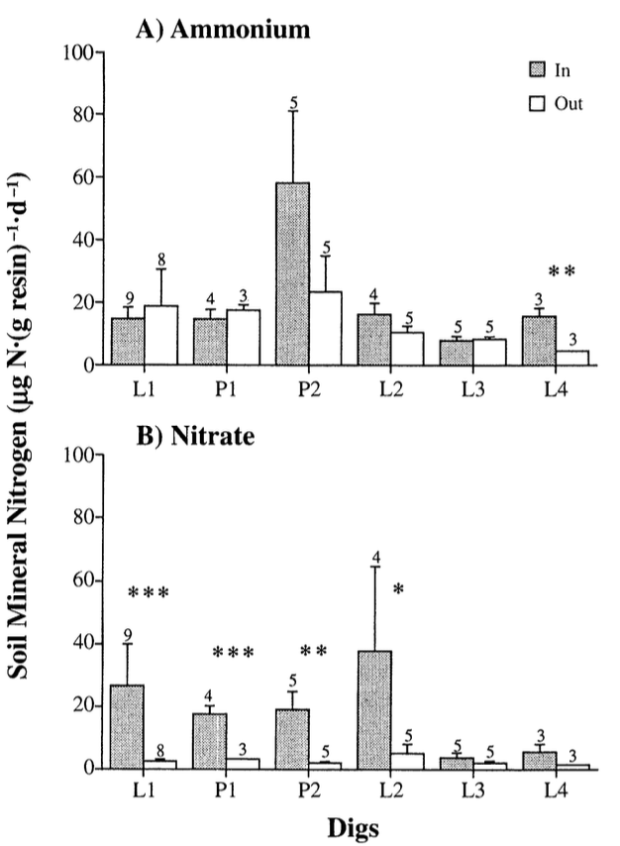
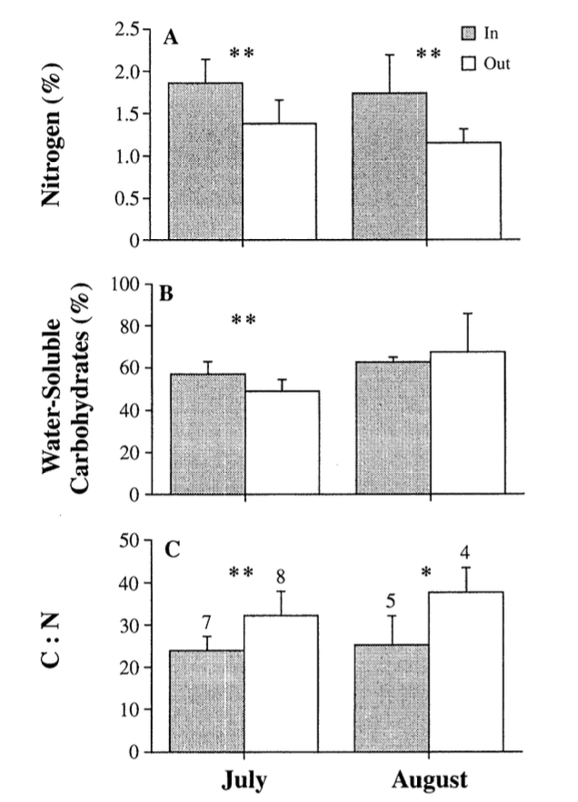
Notes:
Left is the soil nitrogen, you can see its higher inside the digs than outside,
Right is glacier lily nitrogen, you can see its higher inside the digs than outside

Slide 19
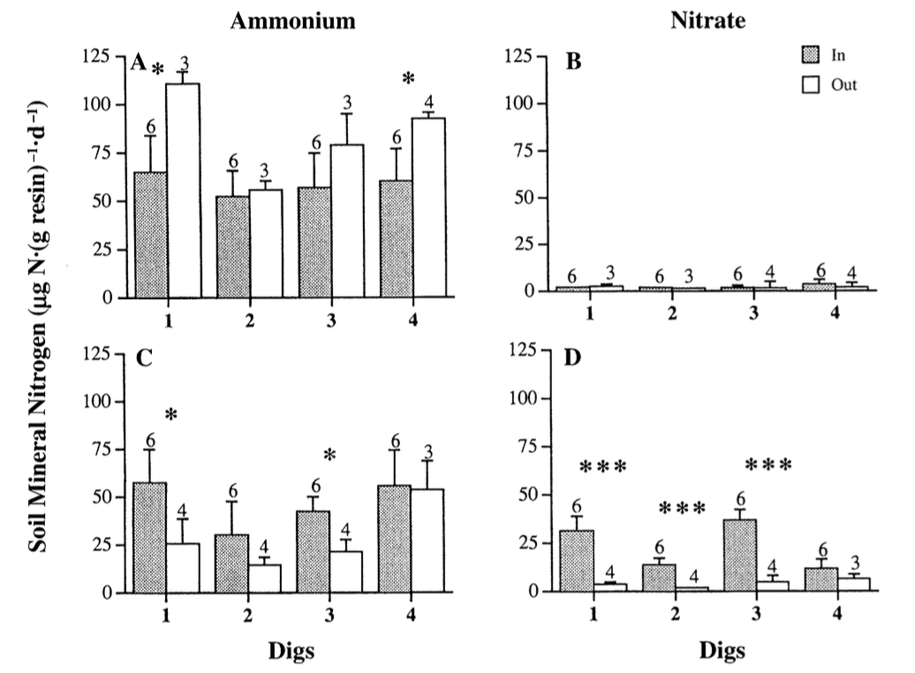
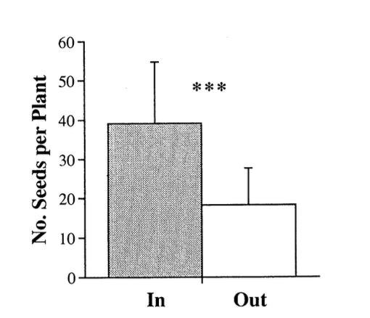
Notes:
Left is seeds per plant, inside digs had more
Right is experimental digs, before is up top and after is the bottom two. You can see that afterwards, the inside dig sites had more nitrogen.

Slide 20
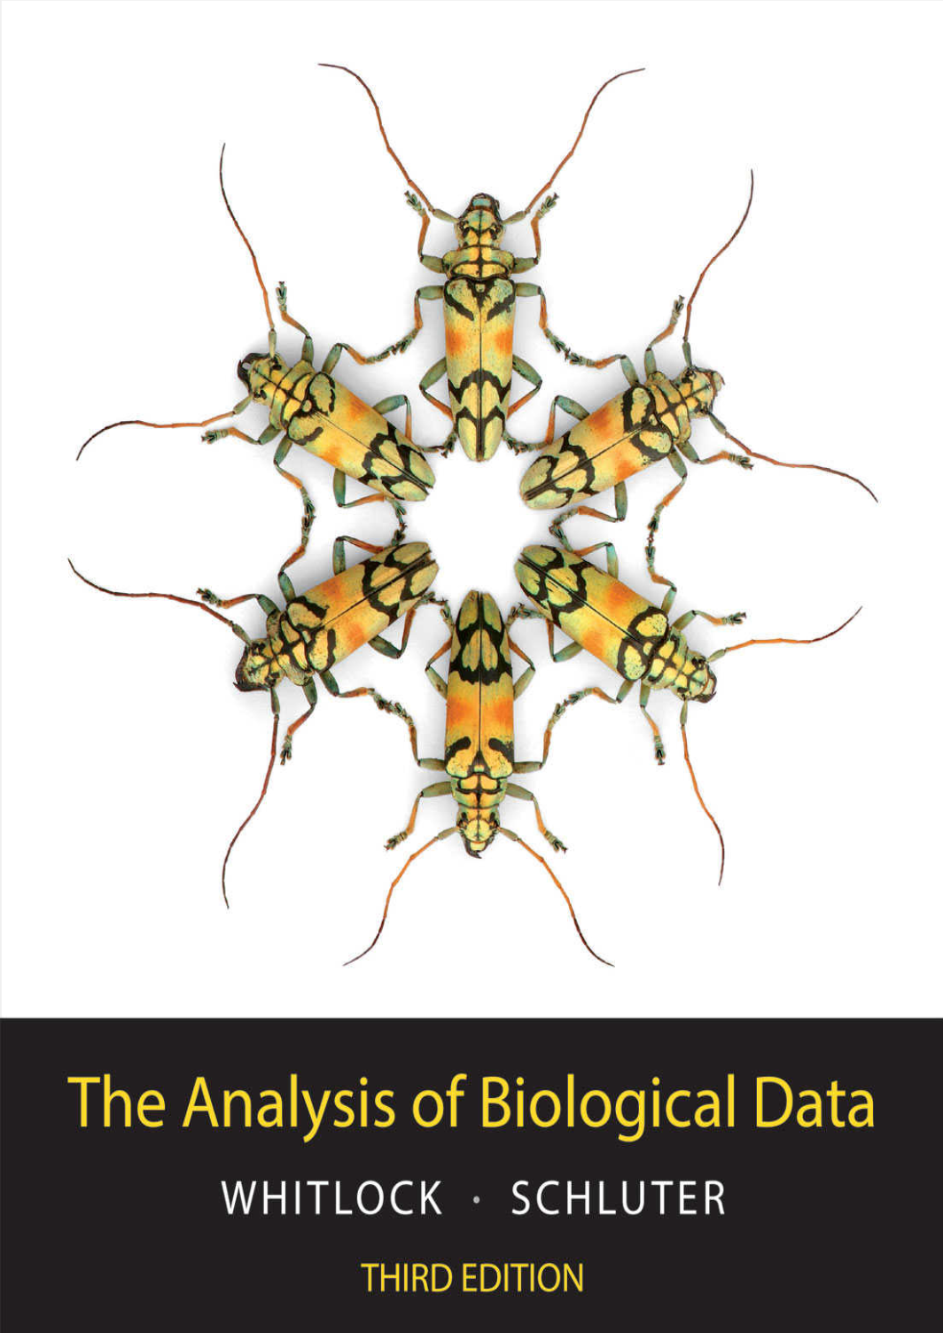
What is statistics?
“Statistics is the study of methods to describe and measure aspects of nature from samples. Crucially, statistics gives us tools to quantify the uncertainty of these measures—that is, statistics makes it possible to determine the likely magnitude of a measure’s departure from the truth.”

Slide 21
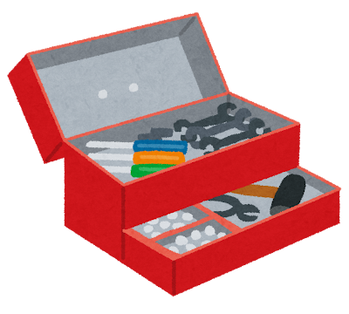
Statistics is a toolbox. I am going to give you some tools – not a finished house!

Slide 22
JASP and R
R is a programming language, free and open source.
  Not a stats program or a GUI
JASP is a stats program built off of R
  Also free and open source
We will mostly be using JASP in this course, but I will teach you the very basics of how to use R!

Slide 23
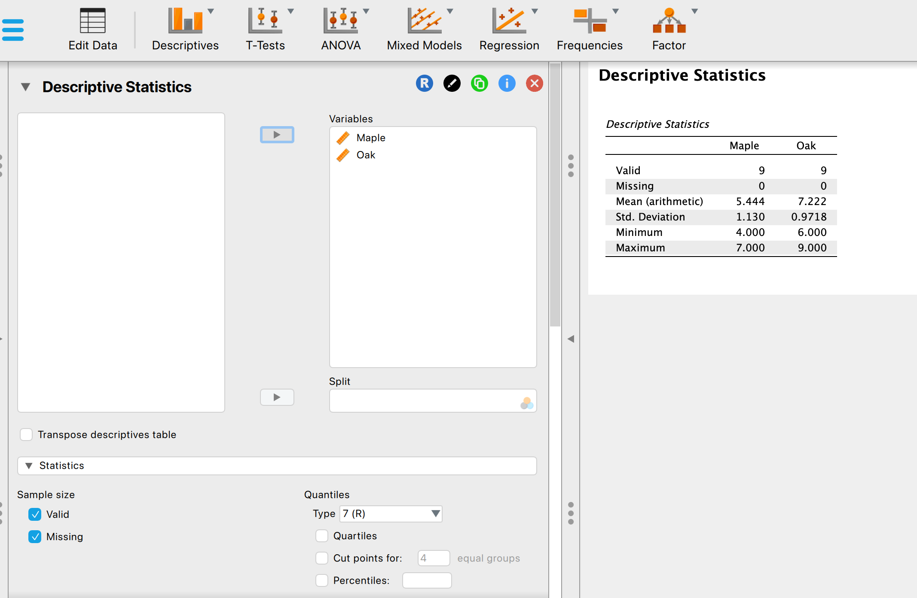
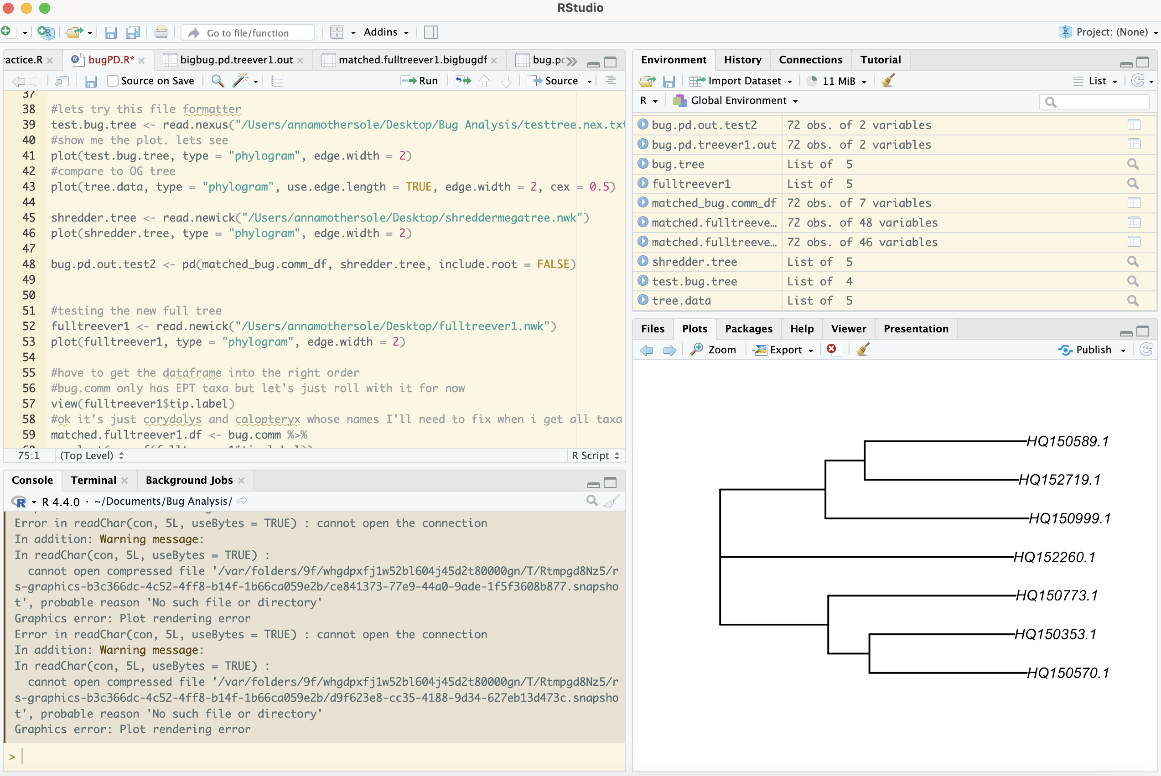
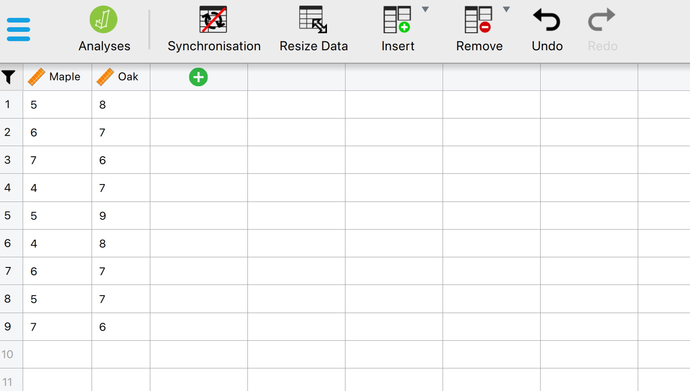
JASP and R

Slide 24
Homework for Thursday
Download JASP and make sure you can open it on your laptop!
Notes:
Guess what JASP stands for LOL… Jeffrey’s Amazing Statistics Program in recognition of the pioneer of Bayesian inference Sir Harold Jeffreys.

Slide 25
There is a pre-course survey I’d like you to take!
Anonymous, optional, no effect on grade, etc.
Link to the google form is on Blackboard!
This is to get to know all of you a bit better in the context of the course.

