Slide 1
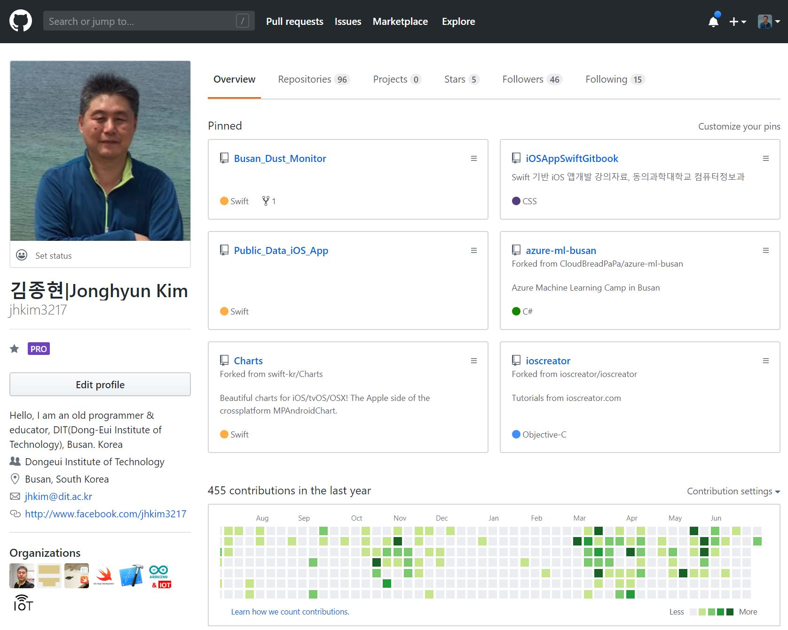

Slide 2
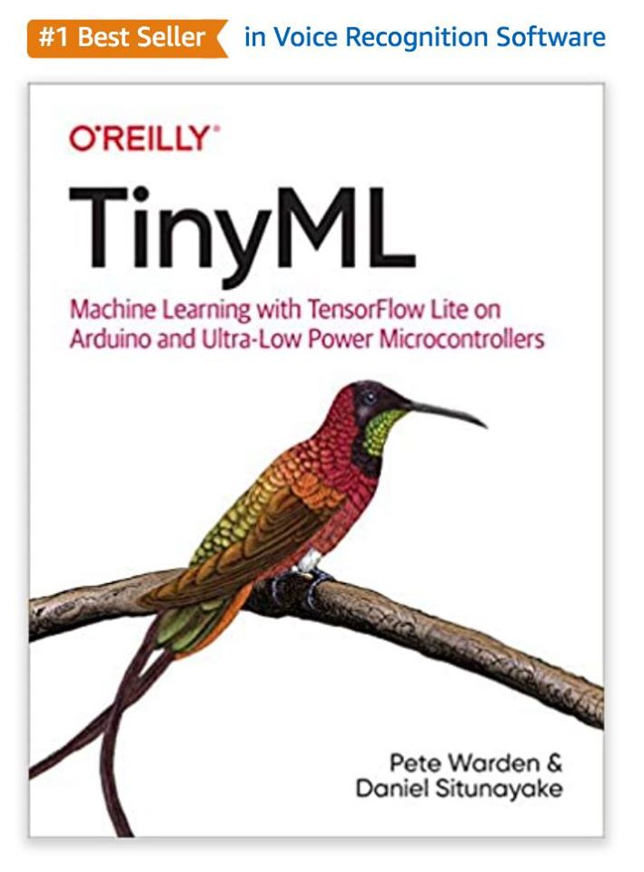
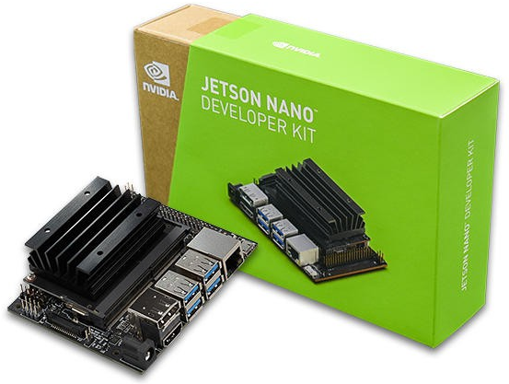
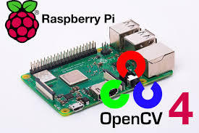
Edge AI : IoT + AI

Slide 3
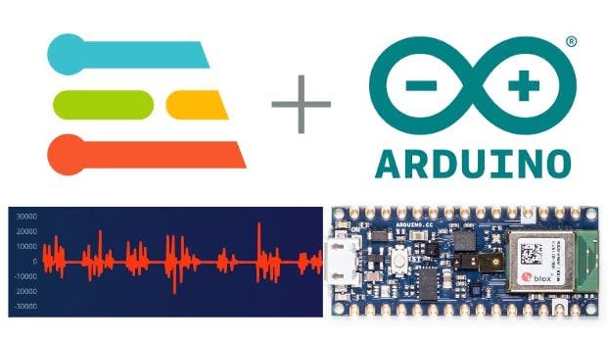
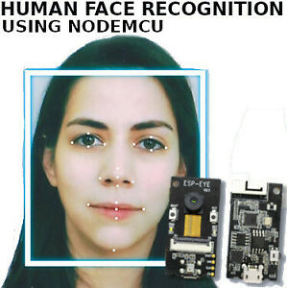
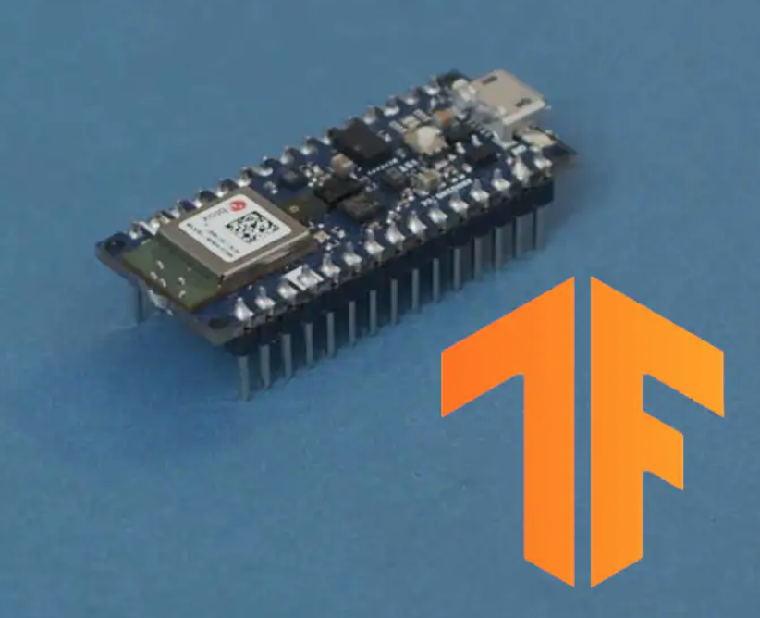

Slide 4
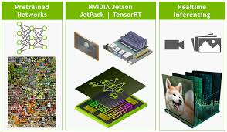
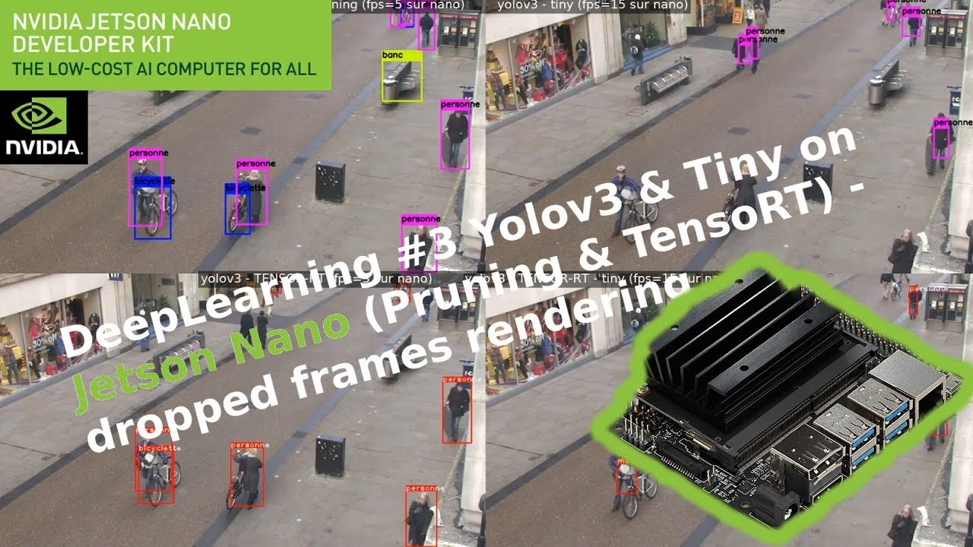
on-device AI Board
http://bitly.kr/mo9ltGbXkDd

Slide 5
2020 IoT + AI 학생 프로젝트(진행 중)
Deep Mask
Transfer Learning
TensorFlow2.0, Open-cv, Python3, NVIDA Jetson nano
Deep Health Trainer
Google’s Teachable Machine, TensorFlow.js
AI Sign Language Communication System
Google’s Teachable Machine, TensorFlow.js

Slide 6
2020-1 학기 수업
IoT 클라우드 서비스 개발
Azure IoT Hub
AWS IoT Core
Google’s Firebase
교안(PPT) : https://github.com/IoT-Lab-02/Lec-IoT-Cloud-PPT
수업 동영상(YouTube) : http://bitly.kr/7b7TY1s5Zmr

Slide 7
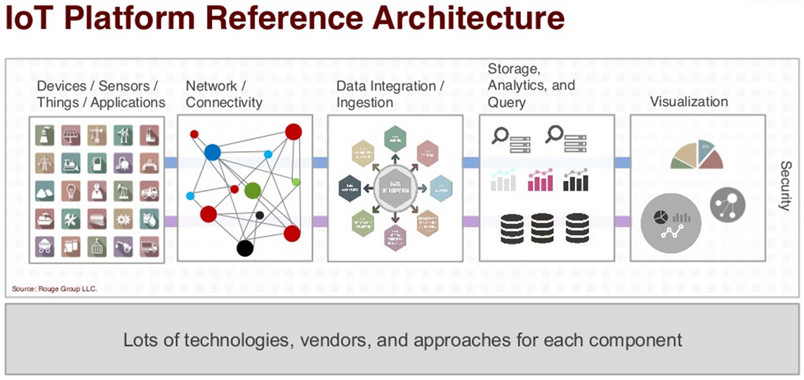
IoT Cloud Platform Landscape
https://www.postscapes.com/internet-of-things-platforms/

