Slide 1
Factor Analysis – What Determines Patient Satisfaction?
2019120256 JungHyun Kim
STAT401 (Multivariate Statistical Analysis)

Slide 2

Motivation
Measuring Customer Satisfaction is important in business context.
More satisfied customer leads to sustainablility in the health care.

Slide 3
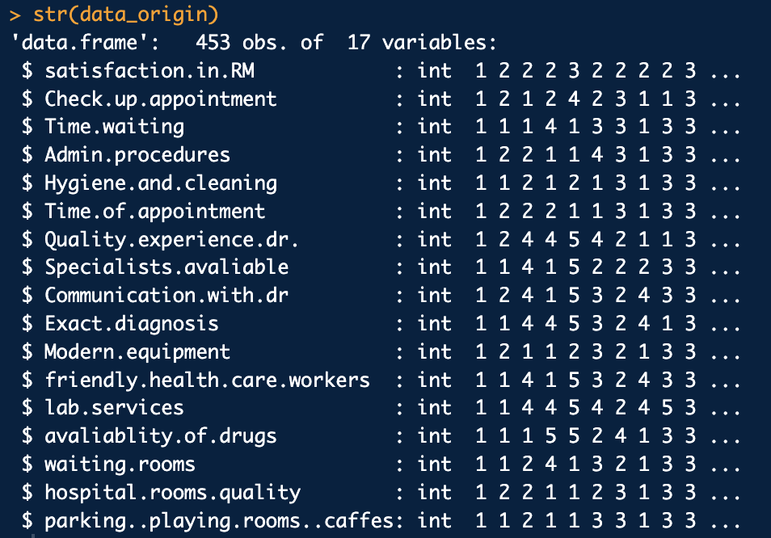
About DataSet
Conduct Online Survey n = 453 with 17 Questions
Satisfaction in Hospital (1~3 Scale)
Q1: Check up appointment / Q2: Time waiting
Q3: Admin procedures / Q4: Hygiene and cleaning
Q5: Time of appointment / Q6: Quality/experience
Q7: Dr. Specialists available / Q8: Communication with Dr.
Q9: Exact diagnosis / Q10: Modern equipment
Q11: Friendly health care workers / Q12: Lab services
Q13: Availability of drugs / Q14: Waiting rooms
Q15: Hospital rooms / Q16: Quality parking, playing rooms, cafes

Slide 4

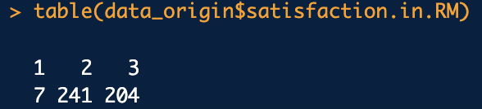
About DataSet
Check NA data
1 Missing Row with NA data
Check Unsatisfied Customers
1: Satisfied, 2: Unsatisfied, 3: Partly Satisfied
Consider “Unsatisfied” Patients to check the reasons for unsatisfaction

Slide 5
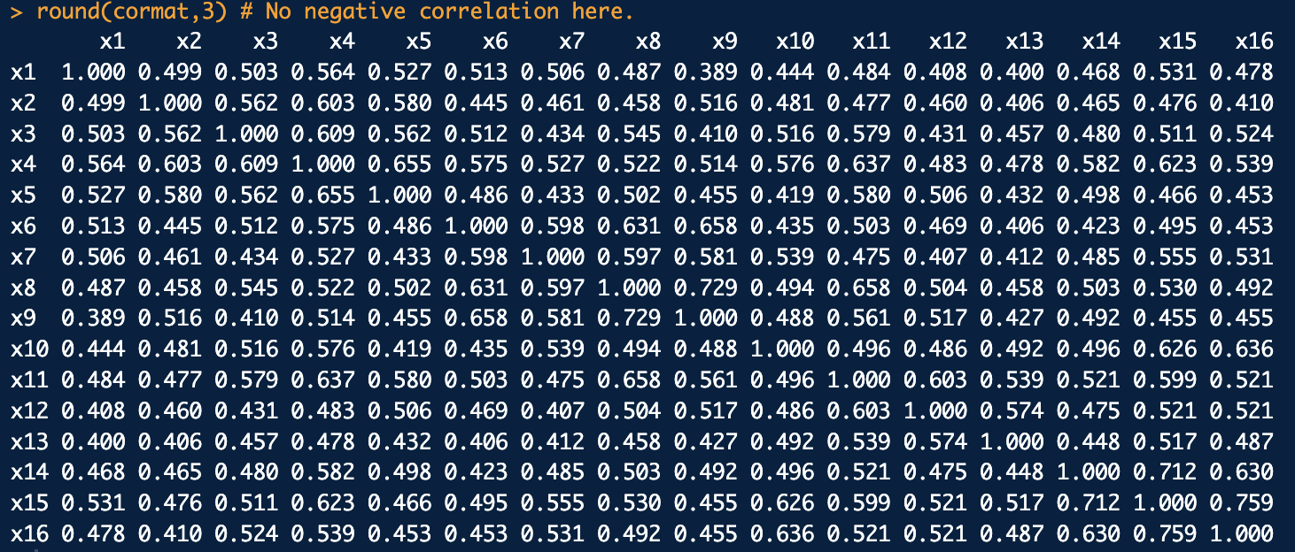
About DataSet
Check Correlation Matrix
No Negative Correlation and No High Correlation given.

Slide 6
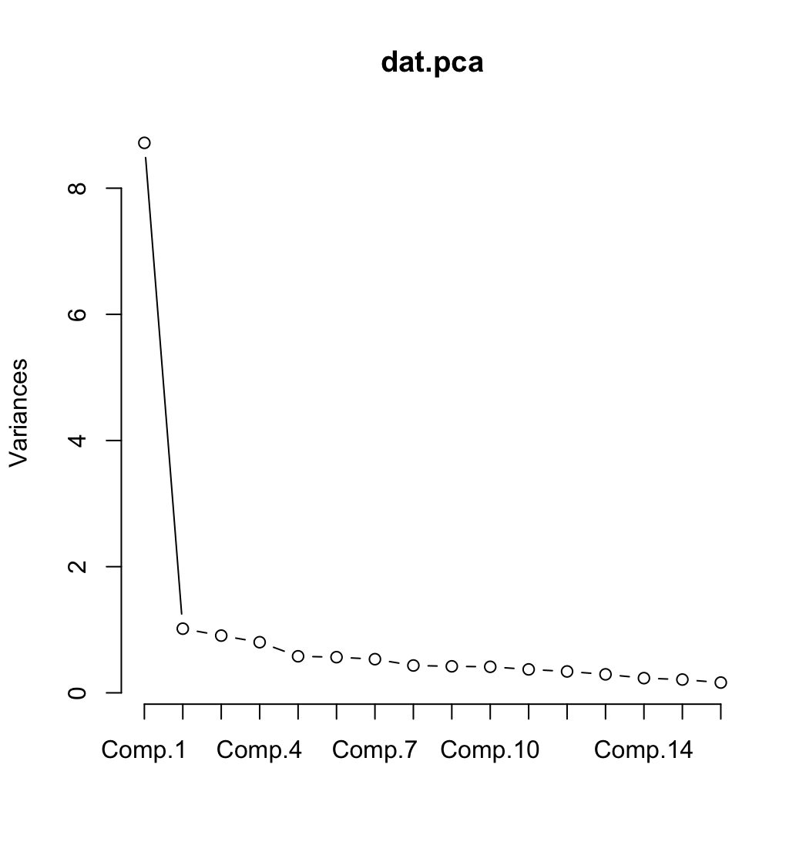
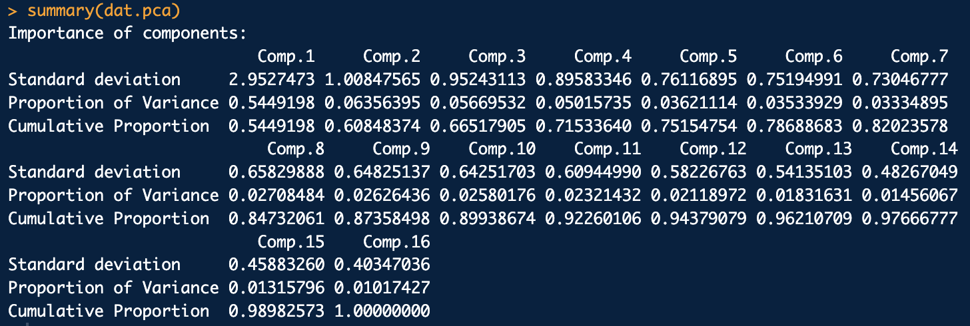
Principal Factor Method
Conduct PC Method to choose number of factors (p =4)
Rule 1. Kaiser’s Rule => Choose p = 2
Rule 2. Cumulative Proportion => Choose p = 4
Rule 3. Scree Plot => Choose p = 4

Slide 7
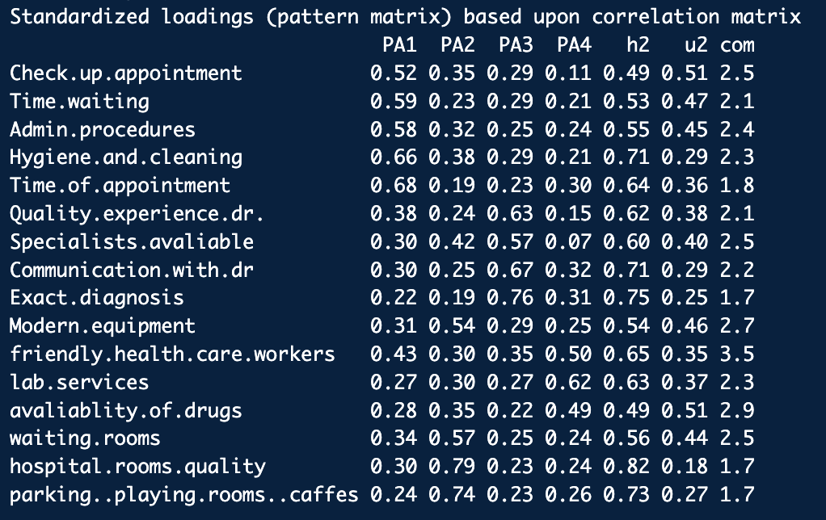
Principal Factor Method
Conduct Principal Factor Method with Varimax

Slide 8
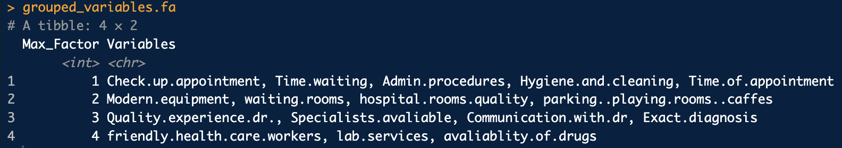
Principal Factor Method
Assume Simple Structure
F1 (Management) : Check Appointment, Waiting, Admin, Cleaning, Time of Appointment
F2 (Rooms) : Modern, Waiting Room, Hospital Room, Parking/Playing Rooms
F3 (Doctor) : Quality of Doctor, Specialists, Communication with doctor, Exact Diagnosis
F4 (Service) : Friendly Health Care, Lab Services, Available of Drugs

Slide 9
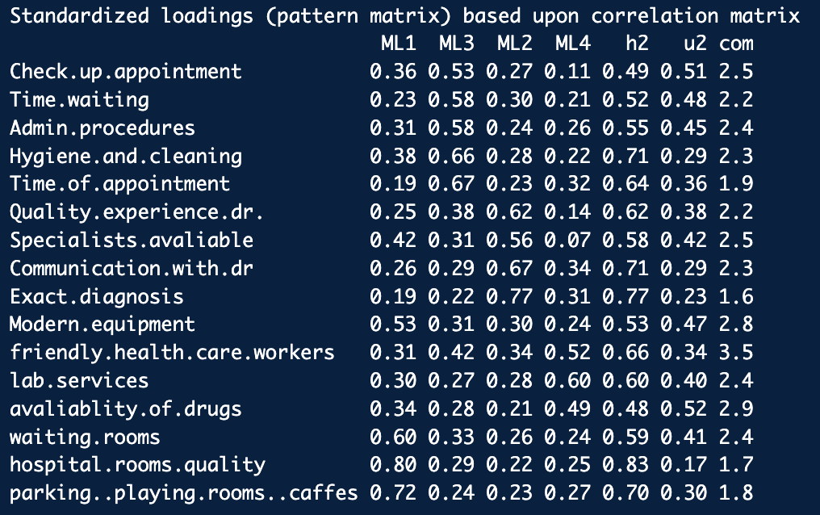
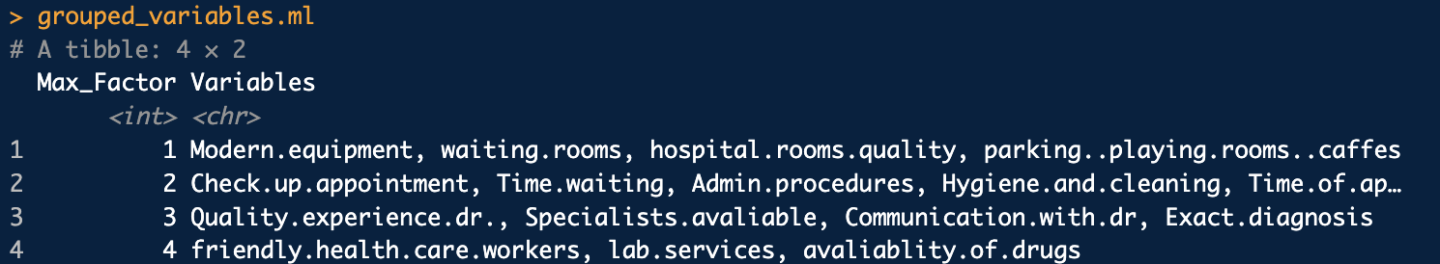
Maximum Likelihood Method
Conduct Maximum Likelihood Method with same factors p = 4,
Gives same result with principal factor method with Simple Structure!

Slide 10
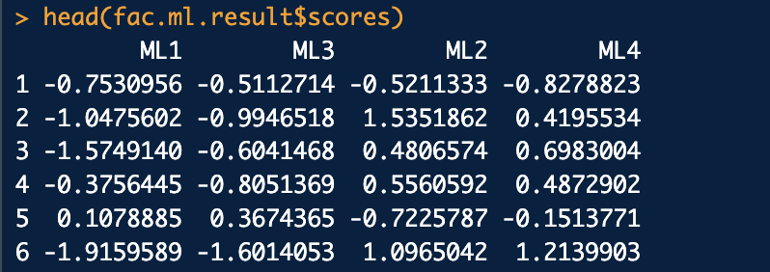
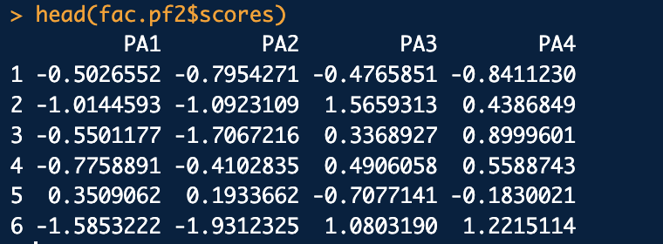
Further Application
We can consider Factor scores for further Analysis
If Demographic Information is given, we can compare results in terms of Factor Scores
Also, we can check that the mean is close to 0, variance is close 1 , which fits the theory.

Slide 11
Interpretation

