Slide 1
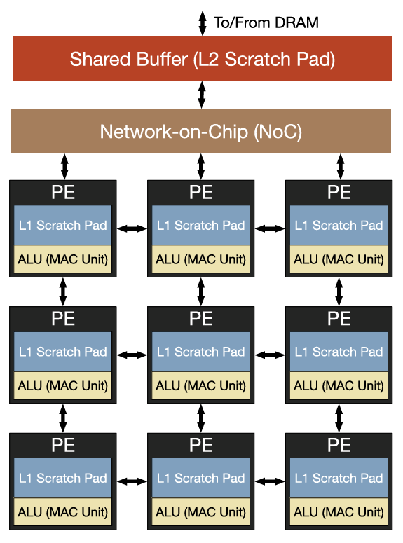
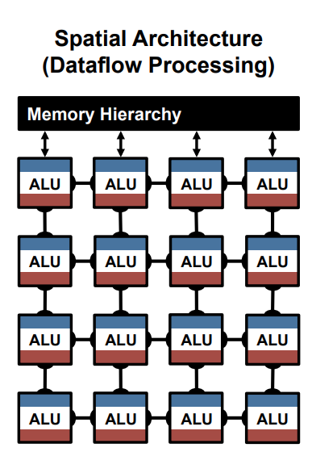
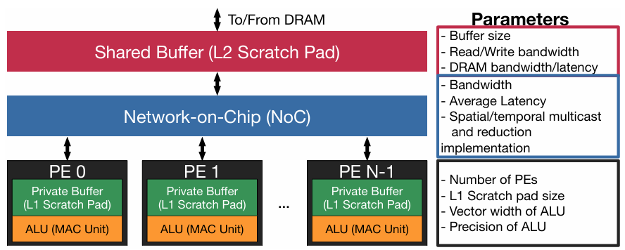
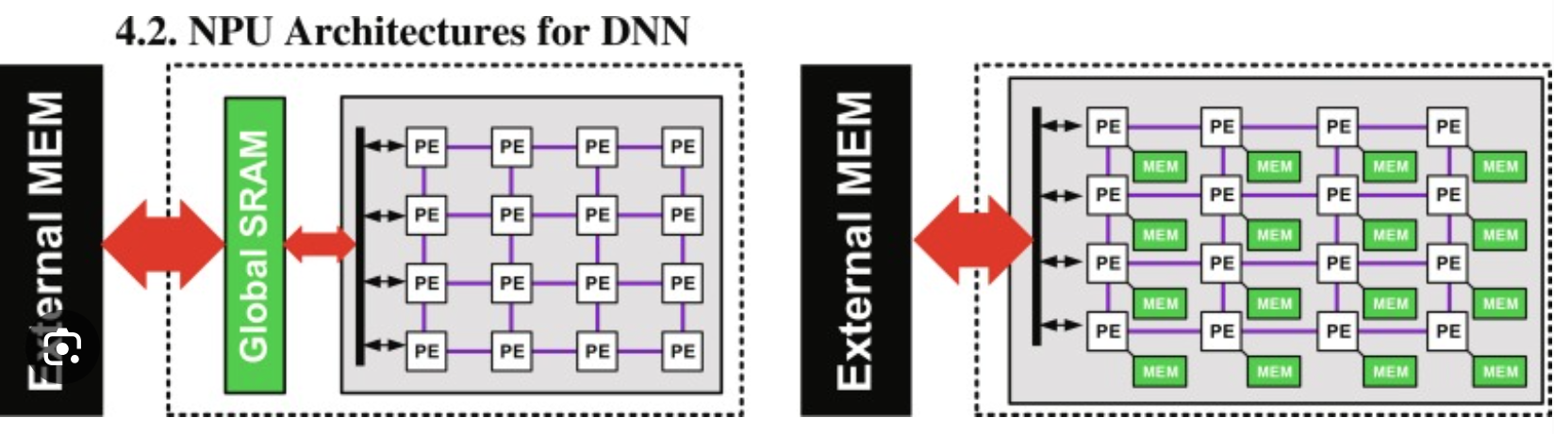




Fig 1. Spatial NPU Architecture
Memory Hierarchy
(Off-chip Memory & On-chip Global Buffer)
Network-on-Chip
(NoC)
PE
PE
PE
Local Scratchpad Memory
Local Scratchpad Memory
$$⋯$$
Local Scratchpad Memory
ALU
(MAC array)
ALU
(MAC array)
ALU
(MAC array)
PE
PE
PE
Local Scratchpad Memory
Local Scratchpad Memory
$$⋯$$
Local Scratchpad Memory
ALU
(MAC array)
ALU
(MAC array)
ALU
(MAC array)
$$⋯$$
$$⋯$$
$$⋯$$
$$⋯$$
PE
PE
PE
Local Scratchpad Memory
Local Scratchpad Memory
$$⋯$$
Local Scratchpad Memory
ALU
(MAC array)
ALU
(MAC array)
ALU
(MAC array)

Slide 2
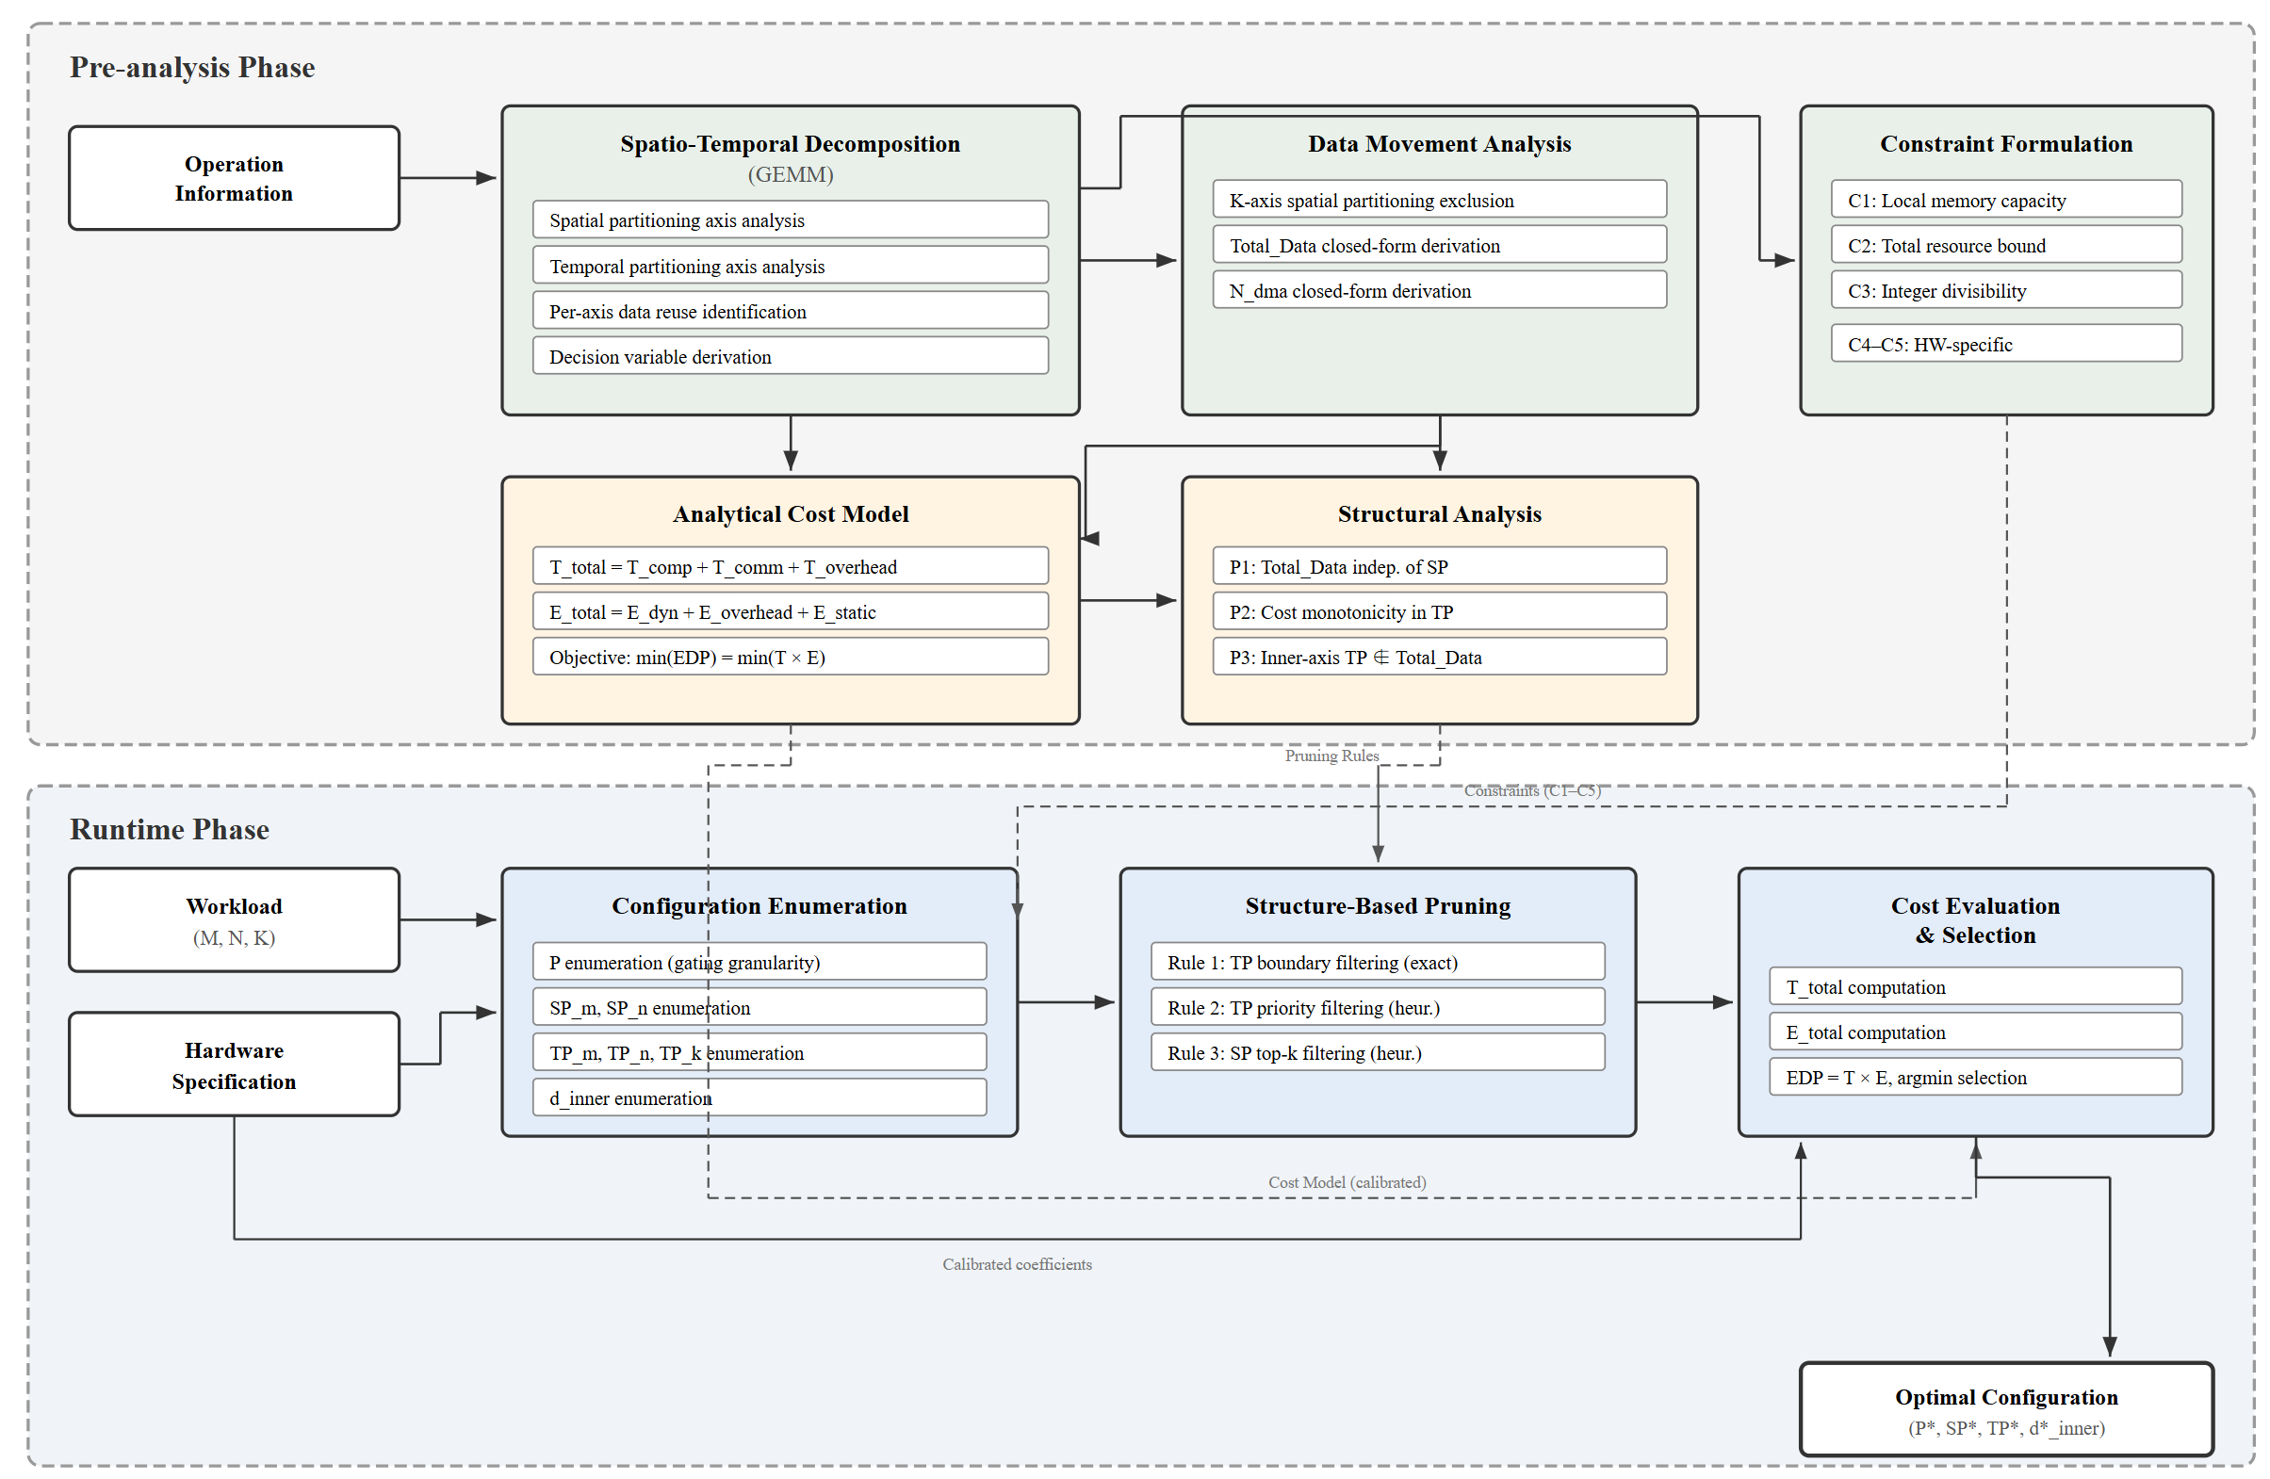
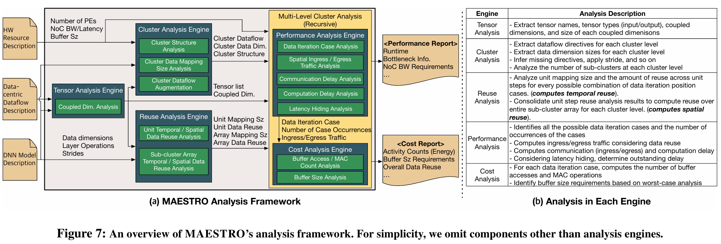

Fig 2. Framework
STAR-Map
Analysis Phase
Spatio-Temporal Decomposition
Data Movement Analysis
Analytical Cost Model
Spatial Partitioning Analysis
Data Transfer Volume Analysis
Performance Model Formulation
Operation
Information
(GEMM)
Temporal Partitioning Analysis
DMA Descriptor Count Analysis
Energy Model Formulation
Temporal Loop Order Analysis
Decision Variable Derivation
Data Movement Expressions
Cost Structure
Structural Analysis
Constraint Formulation
Cost
Models
Decision
Variables
Cost Structure Analysis
Generic Constraint Definition
Structural Property Extraction
Runtime Phase
Generic Constraints
Structural Properties
Configuration Generation
Structure-Based Pruning
Cost Evaluation & Selection
GEMM
Workload
(M, N, K)
HW-specific Constraint Definition
Pruning Rule Derivation
Cost Function Evaluation
EDP-optimal
Configuration
Configuration Space Construction
Search Space Reduction
EDP-optimal Selection
Feasible Candidate Generation
Candidate
Configurations
Pruned
Candidates
Hardware
Specification

Slide 3







Fig 3. Spatial Partitioning
PEs
Spatial Reuse
(Multicast)
K
N
N
M
A0
K
B0
M
C0
PE3
A3
B0
→
C3
A1
C1
PE2
A2
B0
→
C2
$$SP_{m}$$
$$×$$
=
A2
C2
PE1
A1
B0
→
C1
A3
C3
PE0
A0
B0
→
C0
Matrix A (M, K)
Matrix B (K, N)
Matrix C (M, N)
1
Time Step
$$SP_{n}$$
(a)
PEs
Spatial Reuse
(Multicast)
K
N
N
M
A0
K
B0
B1
B2
B3
M
C0
C1
C2
C3
PE3
A0
B3
→
C3
PE2
A0
B2
→
C2
$$×$$
=
PE1
A0
B1
→
C1
PE0
A0
B0
→
C0
Matrix A (M, K)
Matrix B (K, N)
Matrix C (M, N)
1
Time Step
(b)
$$SP_{k}$$
C3
PEs
K
N
K
N
C2
No Spatial Reuse !
M
A0
A1
A2
A3
K
B0
M
C1
PE3
C0
A3
B3
→
C3
B1
PE2
A2
B2
→
C2
$$×$$
=
+ Reduction
B2
PE1
A1
B1
→
C1
$$SP_{k}$$
B3
PE0
A0
B0
→
C0
Matrix A (M, K)
Matrix B (K, N)
Matrix C (M, N)
1
Time Step
(c)

Slide 4




Fig 4. Temporal Partitioning
PEs
Temporal Reuse
(Local Memory)
K
N
N
M
A0
K
B0
M
C0
A1
C1
A0
A1
A2
A3
$$TP_{m}$$
$$×$$
=
PE0
B0
B0
B0
B0
A2
C2
→
→
→
→
A3
C3
C0
C1
C2
C3
Matrix A (M, K)
Matrix B (K, N)
Matrix C (M, N)
1
2
3
4
Time Step
$$TP_{n}$$
(a)
PEs
Temporal Reuse
(Local Memory)
K
N
N
M
A0
K
B0
B1
B2
B3
M
C0
C1
C2
C3
A0
A0
A0
A0
$$×$$
=
PE0
B0
B1
B2
B3
→
→
→
→
C0
C1
C2
C3
Matrix A (M, K)
Matrix B (K, N)
Matrix C (M, N)
1
2
3
4
Time Step
(b)
$$TP_{k}$$
PEs
Temporal Reuse
(Local Memory)
K
N
N
M
A0
A1
A2
A3
K
B0
M
C0
↓
C1
↓
C2
↓
C3
A0
A1
A2
A3
B1
B0
B1
B2
B3
$$×$$
=
PE0
C0
C1
C2
B2
→
$$TP_{k}$$
→
→
→
B3
C0
C1
C2
C3
Matrix A (M, K)
Matrix B (K, N)
Matrix C (M, N)
1
2
3
4
Time Step
(c)

