Slide 1
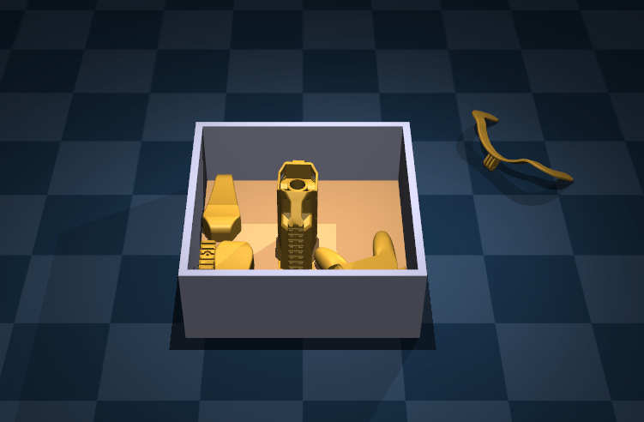
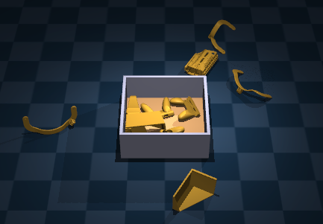
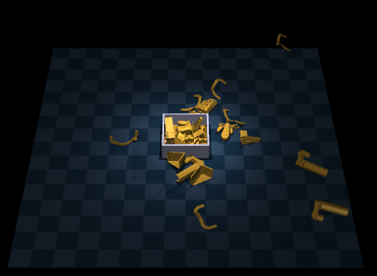
Scene_10
Scene_20
Scene_50
PPO (5-OBJ STATE)
Baseline证明纯PPO有改进的余地

