Slide 1
An example
Nothing much to say.

Slide 2
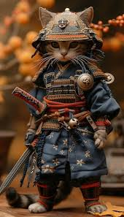
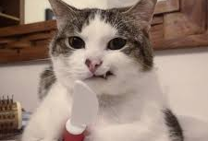
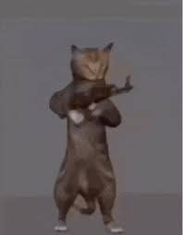
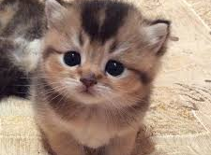
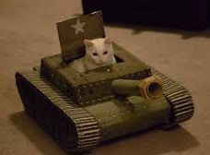
If cats were to take over the world, what would they use as weapons?
Knife
Gun
Tank
The Art of War by Sun Tzu
Adorable appearance
🤔…

