Slide 1
An example
There's nothing much to say.

Slide 2
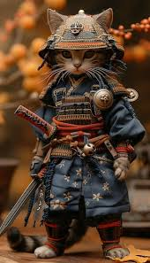
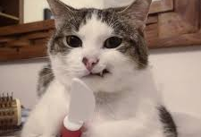
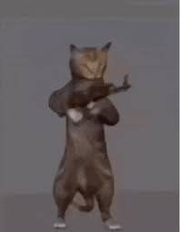
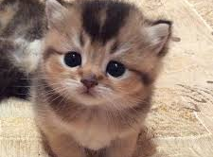
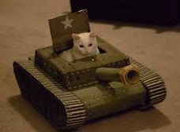
If cats want to take over the world, what weapons would they use?
Knife
Gun
Tank
The Art of War
Adorable appearance
🤔…

