Slide 1
An example
There's nothing to say.

Slide 2
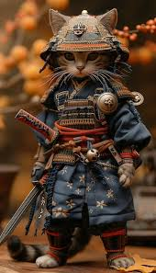
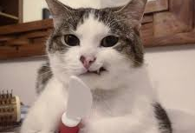
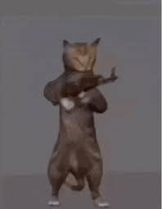
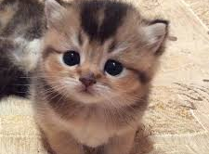
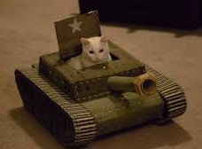
If cats were to conquer the world, what would they use as their weapons?
Knife
Gun
Tank
The Art of War by Sunzi
Lovely exterior
🤔…

