Slide 1
An example
There's nothing much to say.

Slide 2
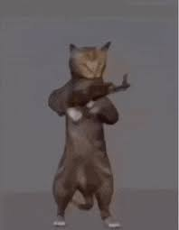
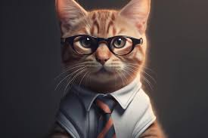
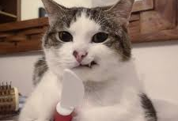
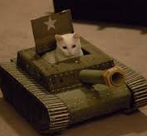
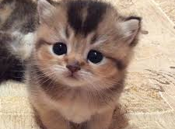
If cats were to take over the world, what would they use as their weapon?
Knife
Gun
Tank
Wisdom
Adorable Appearance
🤔

