Slide 1
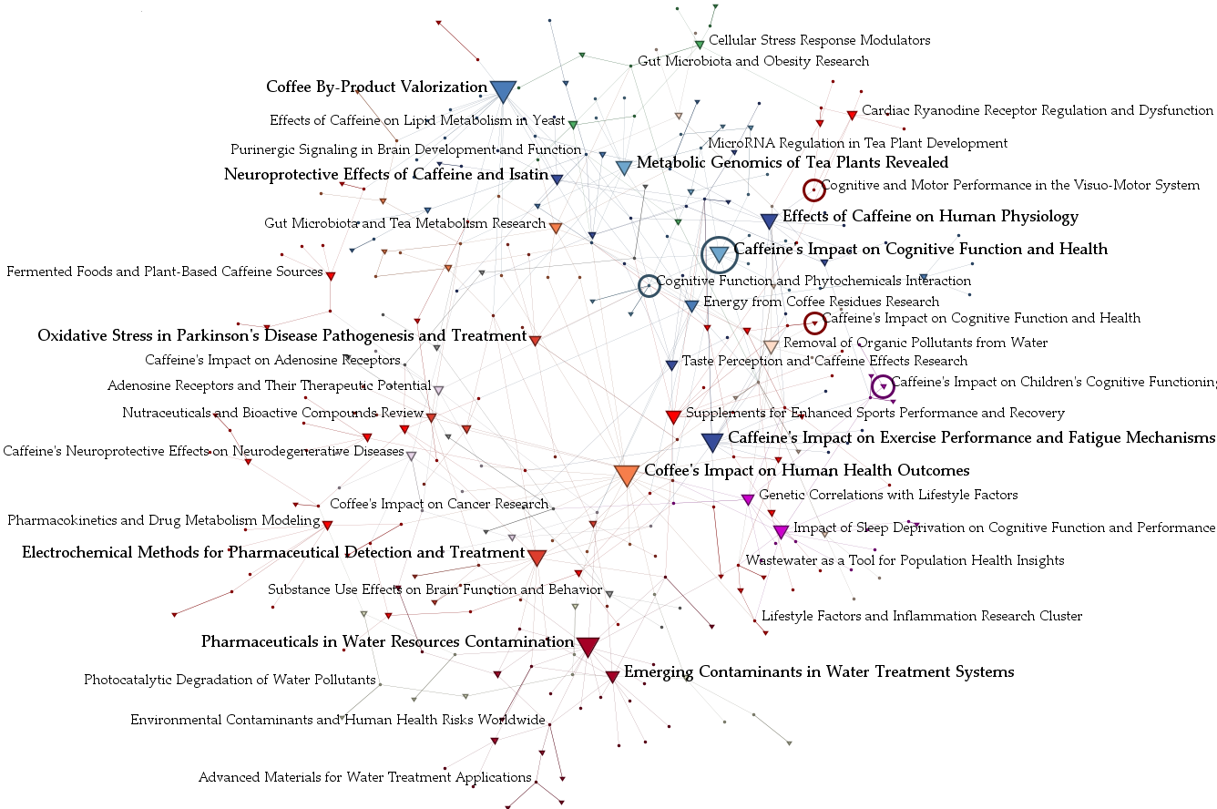
Metabolic
Genomics
Effects of Caffeine on Human Physiology
Caffeine’s Impact on
Cognition
Bioactive
Compounds
Caffeine’s Impact
on Health &
Human Performance
Pharmacokinetics &
Drug Metabolism
Population Health &
Pharmaceutical Contamination

