Slide 1
Informative Title Here
Joe Snuffy
Netanomics
17 December 2024

Slide 2
Slide Title: Analysis Context
Example Text and Graphic

Slide 3
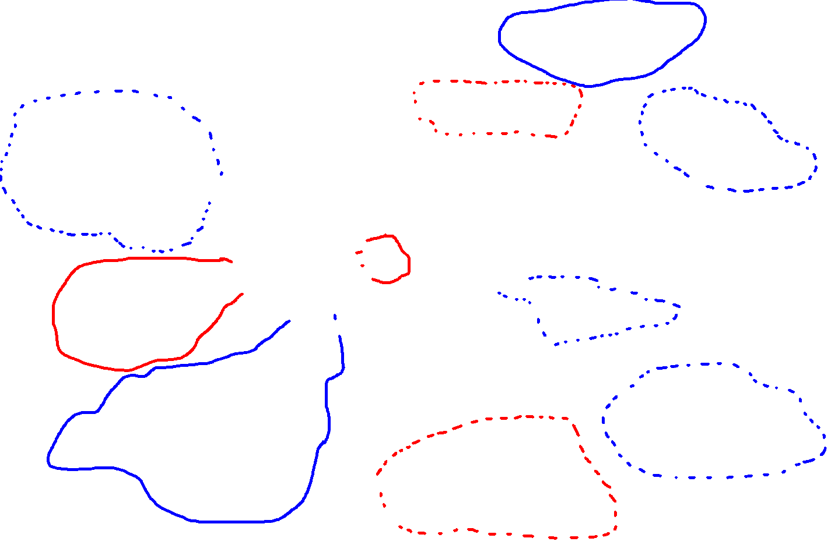
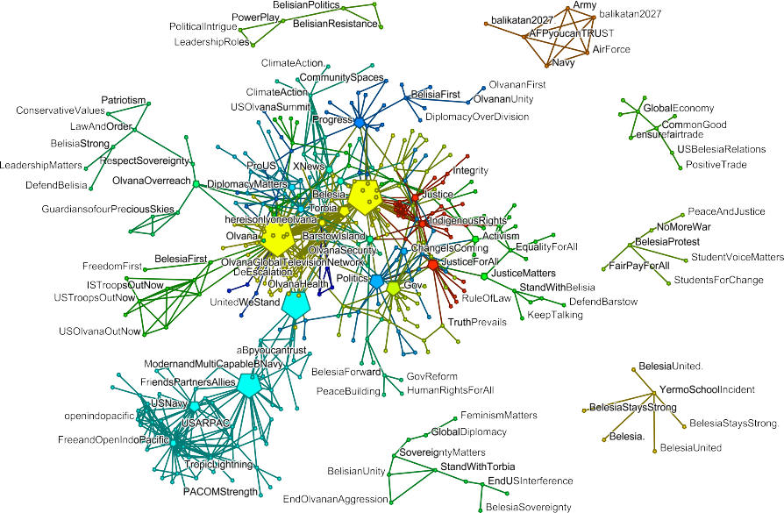
Example Slide: Topic Oriented Communities

