Slide 1
STUDENT ADMISSION PREDICTION USING XGBOOST
AI-Powered Machine Learning Application
Technologies:
Python | Pandas | NumPy | Scikit-learn | XGBoost | Streamlit
Presented by:
Jahnavi R.

Slide 2
Abstract
Student admission decisions depend on several academic and application-related factors.
This project develops a machine learning system to predict a student's Chance of Admit.
The model uses XGBoost Regression to learn patterns from historical graduate admission data.
Input features include GRE Score, TOEFL Score, University Rating, SOP, LOR, CGPA, and Research experience.
The trained model is deployed using Streamlit for real-time prediction.
The application provides an estimated admission probability through a simple and user-friendly interface.

Slide 3
Introduction
Admission to graduate programs depends on multiple academic and profile-related factors.
Manually estimating admission chances can be difficult because several variables influence the outcome.
Machine Learning can identify relationships between historical student data and admission outcomes.
This project applies XGBoost, a powerful gradient boosting algorithm, to predict admission chances.
A Streamlit application allows users to enter student details and receive an estimated admission probability.

Slide 4
Problem Statement
Develop an AI-powered Student Admission Prediction system using XGBoost Regression that analyzes student profile information and predicts the estimated Chance of Admit.

Slide 5
Objectives
Develop an end-to-end Machine Learning solution for admission prediction.
Perform data preprocessing and exploratory data analysis.
Identify relevant features affecting admission chances.
Train an XGBoost Regression model.
Evaluate model performance using appropriate regression metrics.
Save and reuse the trained model for prediction.
Develop an interactive Streamlit application.
Provide real-time admission probability predictions through a clean interface.

Slide 6
Dataset Description
Dataset: Graduate Admission Dataset
Input Features:
Feature | Description
GRE Score | Graduate Record Examination score
TOEFL Score | TOEFL examination score
University Rating | University rating
SOP | Statement of Purpose rating
LOR | Letter of Recommendation rating
CGPA | Undergraduate CGPA
Research | Research experience
Target Variable:
Chance of Admit
Dataset Type
Structured tabular data
Supervised Machine Learning
Regression problem
Dataset Source: Graduate Admission dataset provided for the project.

Slide 7
Data Preprocessing
The following preprocessing steps were performed:
Loaded the dataset using Pandas.
Inspected the dataset structure and feature types.
Selected relevant input features.
Defined Chance of Admit as the target variable.
Prepared the data for Machine Learning.
Split the dataset into training and testing data.
Prepared the features in the same order required by the trained model.

Slide 8
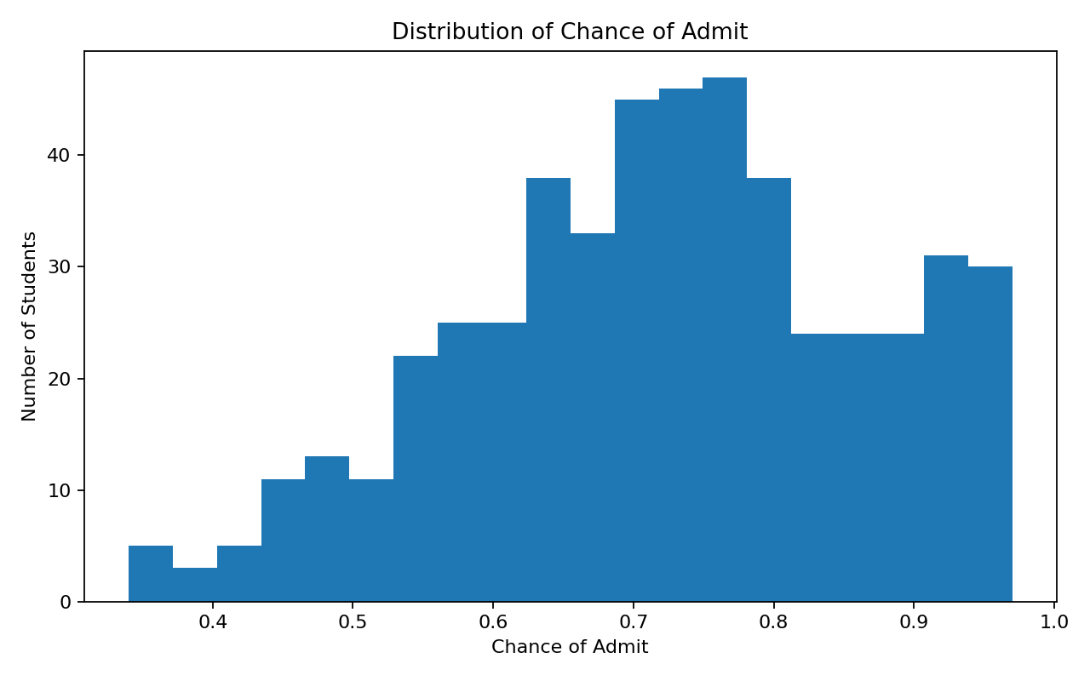
Exploratory Data Analysis
EDA was performed to understand:
Distribution of student academic scores.
Relationship between features and admission chances.
CGPA and admission probability patterns.
GRE and TOEFL score distributions.
Impact of research experience.
Overall characteristics of the dataset.
EDA Techniques
Descriptive statistics
Distribution analysis
Feature relationship analysis
Data visualization
Actual vs Predicted visualization

Slide 9
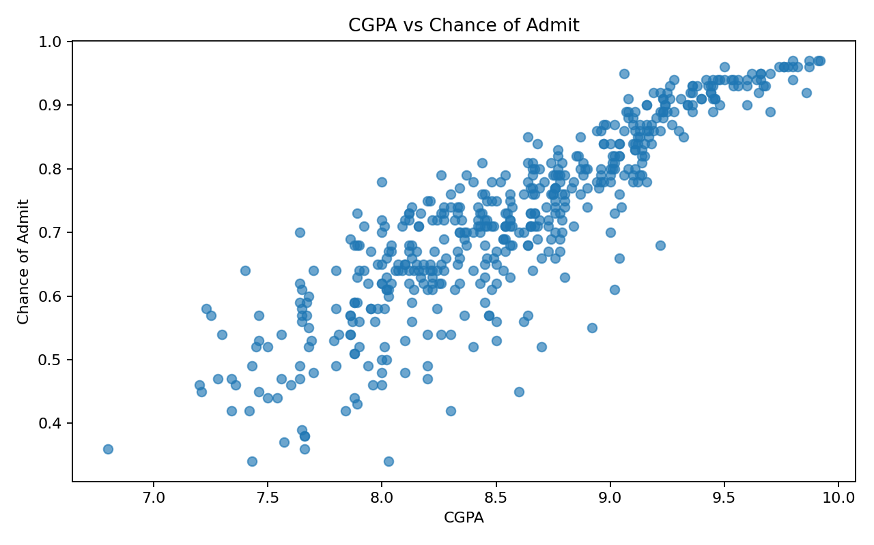
CGPA vs Admission Chance

Slide 10
Model Training
Training Process
Prepared input features and target variable.
Divided the dataset into training and testing sets.
Created an XGBoost Regression model.
Tuned important model hyperparameters.
Trained the model using the training data.
Evaluated predictions on evaluation data.
Saved the trained model using Joblib.

Slide 11
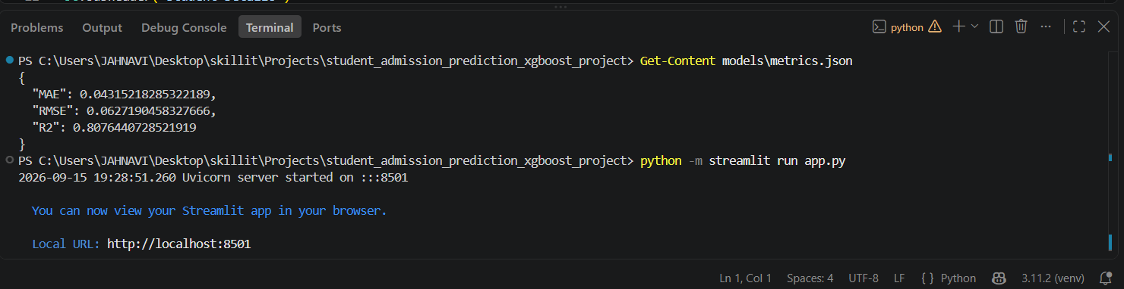
Model Evaluation
Metrics Used:
Mean Absolute Error (MAE)
Root Mean Squared Error (RMSE)
R² Score
Metric | Score
MAE | 0.04315
RMSE | 0.06272
R² Score | 0.80764

Slide 12
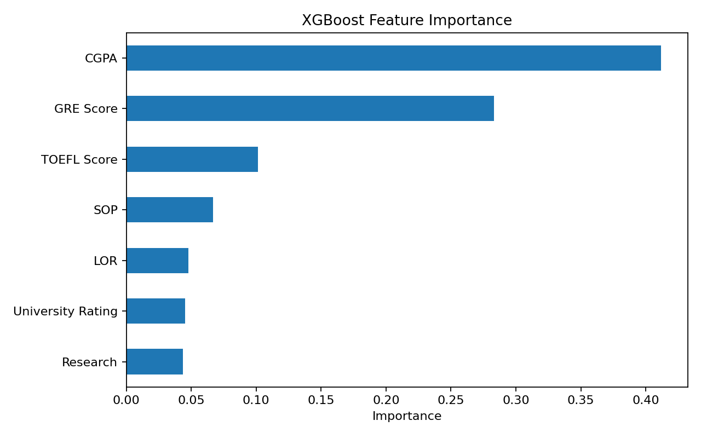
Feature Importance

Slide 13
Streamlit Application
Application Development
The trained XGBoost model was integrated into a Streamlit application.
Application Features
Clean and user-friendly interface.
Interactive student input controls.
GRE Score input.
TOEFL Score input.
University Rating input.
SOP Rating input.
LOR Rating input.
CGPA input.
Research Experience selection.
Real-time admission probability prediction.
Model performance displayed in the application.

Slide 14
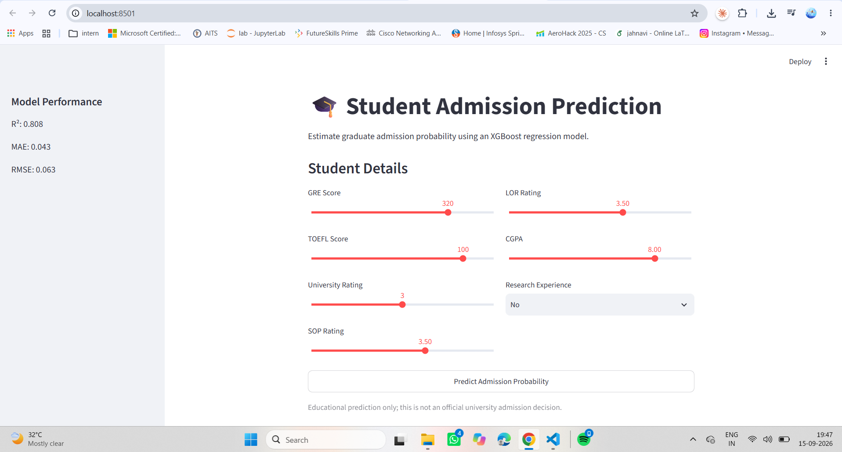
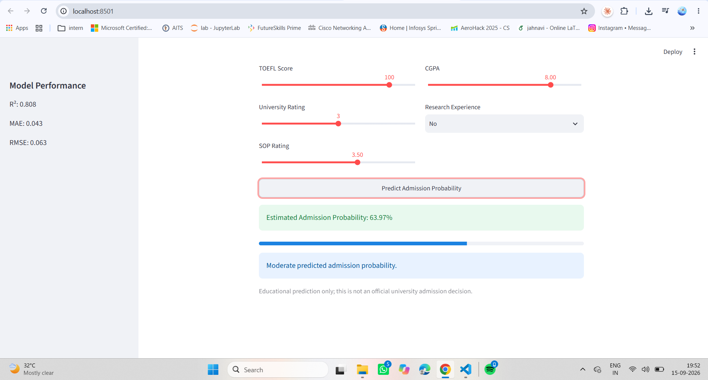
Screenshot 1: Student Admission Prediction interface.
Screenshot 2: Prediction result.

Slide 15
Conclusion & Limitations
Limitations
Depends on the quality of the training dataset.
Uses a limited number of admission-related features.
Predictions are estimates, not official admission decisions.
Conclusion
Developed an XGBoost-based admission prediction system.
Achieved an R² score of 0.8076.
Successfully deployed the model using Streamlit for real-time predictions

