Slide 1
Student Admission Prediction using XGBoost
End-to-end Machine Learning + Streamlit
Target: Chance of Admit
Algorithm: XGBoost Regressor

Slide 2
Problem Statement
Estimate admission probability from academic/profile attributes.
Provide real-time prediction through a web application.
Treat Chance of Admit as regression.

Slide 3
Dataset
500 records
7 input features + 1 target
GRE, TOEFL, University Rating, SOP, LOR, CGPA, Research

Slide 4
Data Preprocessing
Remove index/identifier columns
Clean column names
Validate numeric fields
Handle missing values
80:20 train-test split

Slide 5
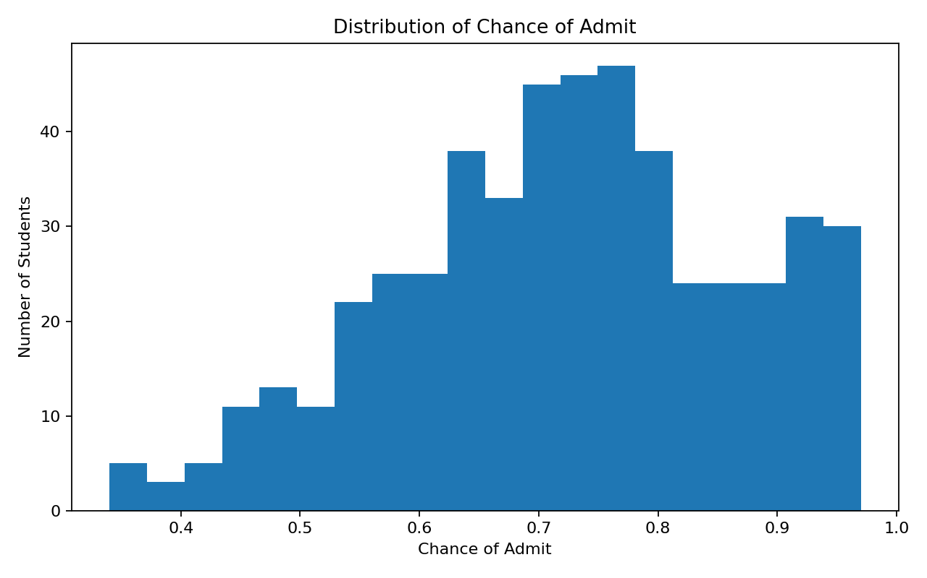
Exploratory Data Analysis

Slide 6
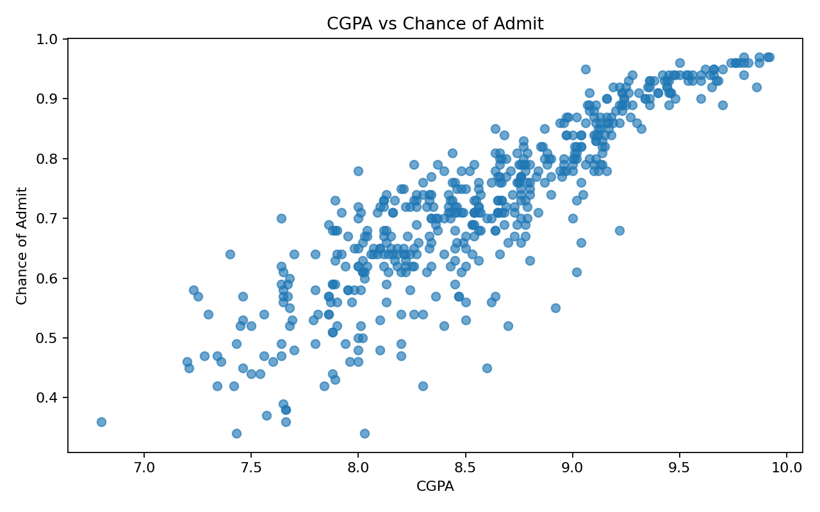
CGPA vs Admission Chance

Slide 7
XGBoost Model
XGBoost Regressor
5-fold cross-validation
Hyperparameter tuning

Slide 8
Model Performance
MAE: 0.0427
RMSE: 0.0628
R²: 0.8071

Slide 9
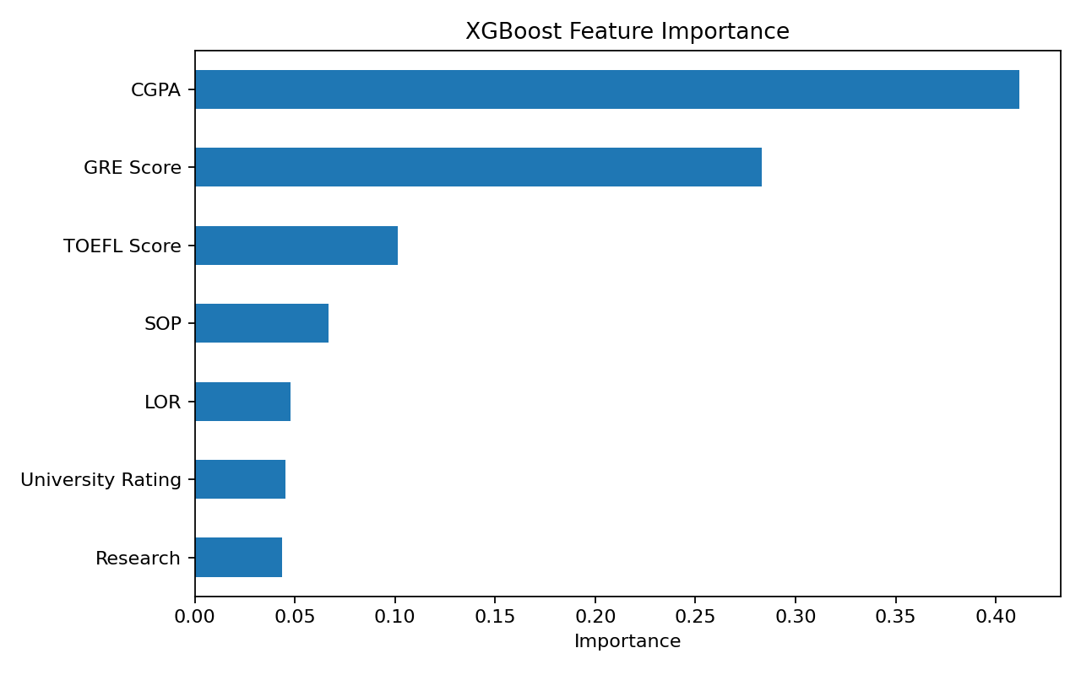
Feature Importance

Slide 10
Streamlit Application
Interactive academic inputs
One-click prediction
Percentage output
High / moderate / lower interpretation

Slide 11
Conclusion & Limitations
Complete ML lifecycle implemented.
Educational prediction tool.
Not an official admissions decision.
Performance depends on historical data.

