Slide 1
A Comparison of Hashing Techniques using Spell Checking
Jonathan Nguyen, Justin Kirschner, Yi Qiu, Rahul Ramakrishan

Slide 2
Overview
Why Hash Tables
Components of a Hash Table
Hash Functions
Collision Methods
Our Experiments
Conclusion
Notes:
To give an overview of this presentation, we will be going over why Hash tables are important, the different components of hash tables, the experiments we ran, and what we were able to conclude.

Slide 3
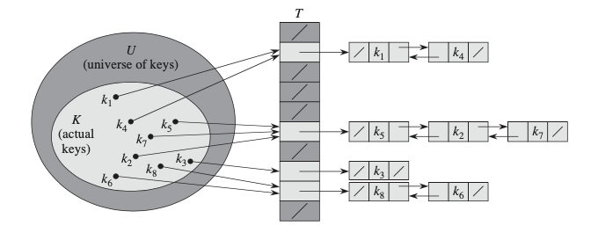
Motivation
Hash Tables
Most commonly used to implement in-memory tables
Improves searching efficiency, O(1)
Each key value mapped to unique index (ideally)
Can be implemented when a finite set of keys is known
Notes:
Hash tables are most commonly used for implementing in-memory tables to improve searching efficiency with the trade-off of using more memory to increase speed. The average time to search has O(1) complexity.
If a set of keys are finite and known in advance, a hash table can be implemented where each key is mapped to a unique index, where no two keys will hash to the same value

Slide 4
Components
There are two components to a hash table:
Hash Functions - Comprised of a hash code and a compression function.
Easy and fast to compute
Collision Methods - reduce keys from having the same indices [5].
Notes:
Hash Tables have two components, a hash function and a collision method
The hash function should be easy and fast to compute and is comprised of a hash code and compression function
The purpose of the hash function is spread the keys uniformly across the table
The collision methods are strategies used to reduce keys from having the same indices

Slide 5
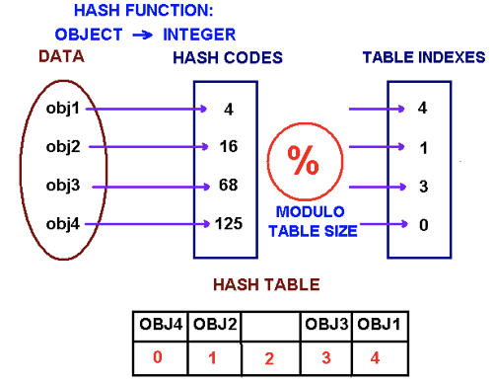
Hash Codes
Used to map the key to an integer value
Doesn’t necessarily have to be in the table’s range
Bad codes could lead to Collisions
For example: the strings “stop”, “spot” and “tops” could lead to the same hash code
Different types of Hash Codes:
Polynomial
Additive
Cyclic
Notes:
Hash codes are used to map the key to an integer value with values not necessarily being in range of the table
There are good encodings and bad ones, with the bad ones ignoring letter order
For example, words like stop spot and tops could potentially lead to the same hash code
We will be exploring three different types of hash codes, polynomial, additive, and cyclic hash.

Slide 6
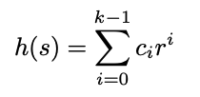
Polynomial Hash Code
Polynomial Hash Codes
Considers letter order
Example:
Consider r = 2
A B C
65 66 67
h(“ABC”) = (65*2⁰) + (66*2¹) + (67*2²) = 461
B A C
h(“BAC”) = (66*2⁰) + (65*2¹) + (67*2²) = 444
Notes:
The polynomial hash is an efficient encoder that takes into account a strings position
It does this by taking the ASCII value of character, multiplying it by a constant value of r, and raising it to the ith position in the string
It will then do the summation of this operation for all characters in the string
In the example, using r =2, and the ASCII values of ABC being 65, 66 and 67 we can see how the two combinations of characters lead to unique hash codes

Slide 7
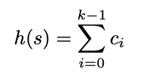
Additive Hash Code
Additive Hash Codes
Does not consider letter order
Example:
A B C
65 66 67
h(“ABC”) = 65 + 66 + 67 = 198
B A C
h(“BAC”) = 66 + 65 + 67 = 198
Notes:
The additive hash is considered a poor encoder it does not consider the letter order, which will lead to some words having the same hash code.
In the example, with the ASCII values of ABC being 65, 66 and 67 we can see how the two combinations of characters lead to the same hash codes which results in more collisions

Slide 8
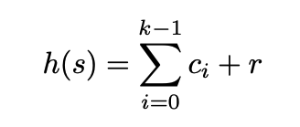
Cyclic Shift Hash Codes
Cyclic Shift Hash Codes
Variant of polynomial hash code
Common shift values are 5, 6, 7, 9, and 13
Here ‘r’ is the partial sum.
r = (h(k) << shift | h(k) >>> (32 - shift))
Notes:
The cyclic shift hash is a variant of the polynomial hash with common shift values of 5, 6, 7, 9, and 13
It will take the current hash code, shift it by x number of bits to left and right then do the OR operation. Afterwards it will add the ASCII value of character.
It will take the sum of this operation for all characters in the string

Slide 9
Cyclic Shift Hash Code
Example Shifting by 1:
h(“AB”) = 0
A = 1000001₂ = 65
B = 1000010₂ = 66
First iteration:
h(“AB”) = 0
Shifting h(“AB”) by 1 = 0
h(“AB”) = 0 + 65 = 65
Second iteration:
h(“AB”) = 1000001₂ = 65
Shifting h(“AB”) by 1 = 10000010₂ = 130
h(“AB”) = 130 + 66 = 196
Notes:
In this example we will be doing a cyclic shift of 1. We will initialize the hashcode to 0 and have the ASCII values of A and B
In the first iteration it will take the current hash code initialized to 0 and shift it by 1 which will result in the hash code still being 0. After it will add the ASCII value of A which will result in the hash code being 65.
In the second iteration, it takes the current hash code of 65 and shifts it bitwise by 1 to the left which results in a value of 130. It will then add the ASCII value of B.
The final hash code of “AB” will then be 196.

Slide 10
Compression Functions
Maps the hash codes to indices of the hash table [5].
Different Types of Compression Functions:
Multiplication
Division
Multiply Add Divide
Notes:
Compression functions are needed to map the hash codes to indices in the hash table
We will be exploring three different types of compression functions, multiplication, division,and multiply add and divide

Slide 11
Multiplication
index(k) = ⌊m(kA mod 1)⌋
where kA = kA - ⌊kA⌋,
m = 2^{p} for some integer p,
0< A < 1
Example:
Assume p =2 and A = 0.5
h(“ABC”) = 461, from polynomial hash
index(461) = ⌊2²((461(0.5) - ⌊461(0.5)⌋) mod 1)⌋
= ⌊2²((230.5 - ⌊230.5⌋) mod 1)⌋
= ⌊2²((230.5 - 230) mod 1)⌋
= ⌊2²(0.5)⌋
= ⌊4(0.5)⌋
= 2
Notes:
The multiplication function contains two steps
The first step is to multiply the hash code k by a constant A which is in a range of 0 and 1
The second step is to extract the fractional part of kA, multiply value of m and take the floor of that value
In the example, we will be computing the index with the polynomial hash for the string ABC. We will assume p = 2 and A = 0.5. From the multiplication function you can see that it generates an index value of 2 for the string ABC.
In order to generate unique index values, it is suggested to use larger values of p and the inverse of the golden ratio for A, which is approximately 0.618
(IF STALLMAN ASKS)
Golden ratio is considered a number of divine proportions as the number shows up in a number of places and ancient Greeks used this to design buildings. Its also recommended by Knuth

Slide 12
Division
index(k) = k mod m
where k is the hash code,
m is a prime number chosen
More unique prime number, the better results
Example:
Assume m = 13
h(“ABC”) = 461, from polynomial hash
index(461) = 461 mod 13
= 6
Notes:
The division function computes the hash value as the remainder of the hash code after being divided by a prime number
This function is able to generate good results when the prime number is not too close to the exact power of 2
In the example, we will be computing the index with the polynomial hash for the string ABC. We will assume m = 13 and do the mod function on the hash code. Index 6 will be generated to store string ABC.

Slide 13
Multiply Add Divide (MAD)
index(k) = ((ak + b) mod p) mod m
where m is the size of the hash table,
p is a prime number larger than m,
k is the hash code,
a and b are constant values chosen at random from [0, p - 1] with a > 0
Example:
Assume m = 10, p = 13, a = 2, b = 4
h(“ABC”) = 461, from polynomial hash
index(461) = ((2*461 + 4) mod 13) mod 10
= ((926) mod 13) mod 10
= (3) mod 10
= 3
Notes:
The multiply add divide is a combination of multiplication and division functions
M will be size of the table, p is a prime number larger than m, k is the hash code, a and b are constants that are values from 0 to p - 1
In the example, we will be computing the index with the polynomial hash for the string ABC. We will assume m = 10, p = 13, a =2, and b =4. As you can see, index 3 will be generated to store the string ABC

Slide 14
Collision Resolution Methods
Reduce when two keys are hashed at the same index in the table.
Collision when one key is hashed to same indices
Different Types of Collision methods:
Separate Chaining
Linear probing
Coalesced Chaining
Notes:
Collision methods are implemented in order to reduce when two keys are hashed at the same index of the table.
A collision occurs when more than one key is hashed to the same index. Collisions are bound to occur as no hash table is perfect but there are ways we may reduce these collisions [2].
We will be exploring three different types of collision methods
Separate Chaining
Linear Probing
Coalesced Chaining

Slide 15
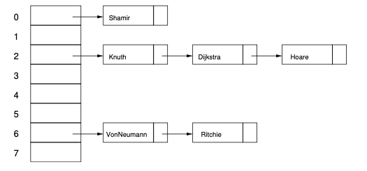
Collision Resolution Methods
Separate Chaining
Array of linked lists
Keys that are hashed to the same location being in the same list.
Notes:
Separate Chaining is a collision method that is an array of linked lists with all keys that are hashed to the same location being in the same list [5].
If there already exists a key at an index, it will be added to the front of the linked list.
As you can see from the image below, index 6 would have one collision as Von Neumann and Ritchie have the same index.

Slide 16
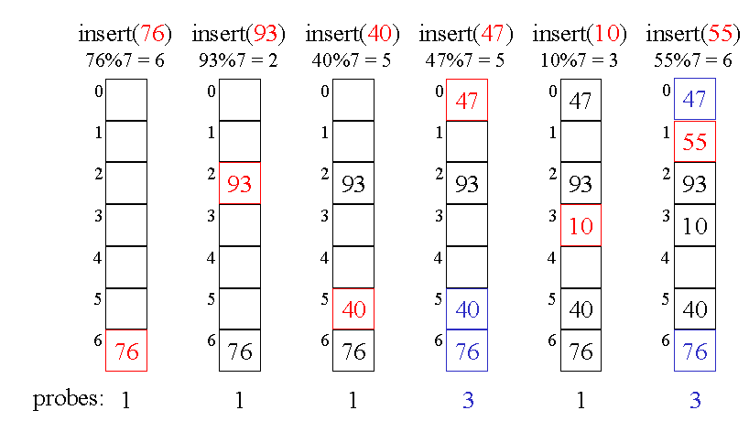
Collision Resolution Methods
Linear Probing
Probes in consecutive locations which means that we are treating the list as a circular list.
Image courtesy: Department of Computer Science, University of Washington
Notes:
Linear Probing is a collision method that probes in consecutive locations which means that we are treating the list as a circular list [2].
As you can see in the example for insert(47), its index is 5 from the hash function but there already exists a value so it moves down to index 6. Which also has a value in it, so it moves to the top of the list where index 0 is empty and inserts 47.

Slide 17
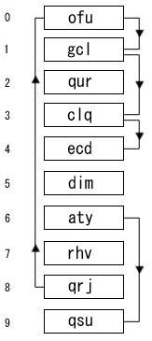
Collision Resolution Methods
Coalesced Chaining
Combination of separate chaining and open addressing.
Open Addressing(Linear Probing) to find the next position that is open.
Separate Chaining links colliding keys through pointers
Notes:
Coalesced Chaining is a combination of separate chaining and open addressing.
It uses Open Addressing to find the next position that is open if there is a collision and it uses Separate Chaining by linking colliding keys through pointers [3].
For example, suppose we want to enter ‘ecd’ into the table and get the index value of 8. But that slot is filled, so you move on to the value that its pointing to, i.e index 0. We continue this till we get an empty slot at index 4. This resulted in 4 collisions.

Slide 18
Experiment Data
This dictionary contains 25,000 root words.
Input text files will not just contain root words, we will need to do some text preprocessing [6]:
If word ends in -ing, remove -ing and add -e
If word ends in -s, -es, -ly or -ed, remove -s, -es, -ly, -ed
If word ends in -ies, remove -ies and add -y
If word ends in -es or -ed, remove -s or -d
Notes:
For our experiment, we will be utilizing a dictionary that has approximately 25,000 root words. (CMU). About 15% of all words that are currently used in the English language account for 99% of all English written text.
Inputs:
We will be using texts of various sizes to test our spell checker. But since these files do not only contain root words we will need to do some text preprocessing such as:
If word ends in -ing, remove -ing and add -e
If word ends in -s, -es, -ly or -ed, remove -s, -es, -ly, -ed
If word ends in -ies, remove -ies and add -y
If word ends in -es or -ed, remove -s or -d

Slide 19
Experiment Description
We evaluate various hash schemes on the basis of correctness and efficiency.
Metrics used:
Average number of probes
Run Time
Load Factor - percentage of the table that is full
Four hypotheses will be tested
Notes:
We will be using various hashing schemas comprised of the different components discussed.
Hypothesis 1 deals with relationship between load factor and average number of probes and run time. Hypotheses 2 and 3 compares the performance of different hash codes and collision methods respectively. Hypothesis 4 talks about the effect of compression functions on the performance.

Slide 20
Hypothesis 1
Hypothesis:
A smaller load factor, i.e. the table is not full, will result in lower probe average and faster run time.
How we will test:
Polynomial hash code, multiplication compression function, and separate chaining.
Changing the size of the hash table.
Notes:
For our first hypothesis we will be testing if a smaller load factor, the table is not full, resulting in a lower probe average and faster run time
We will test this by using a constant polynomial hash code, multiplication compression function and separate chaining
We will be changing the size of our hash table

Slide 21
Hypothesis 1
Results:
Text File Size | Hash Table Size | Load Factor | Average Probes | Run Time (10th of a second)
25000 | 25000 | 0.60 | 2.03 | 0.54
25000 | 50000 | 0.37 | 1.74 | 0.47
25000 | 75000 | 0.26 | 1.60 | 0.38
25000 | 100000 | 0.20 | 1.54 | 0.35
Notes:
As you can see from our results, as we increased the separate chaining list by 25,000 the load factor was also decreasing. Analyzing further, we can see that there is an association between load factor, average number of probes, and runtime. With the lower the load factor, the lower the number of probes and runtime.

Slide 22
Hypothesis 2
Hypothesis:
Cyclic shift hash code and polynomial hash code will have significantly lower number of probes and run times compared to additive hash code.
How we will test it:
Multiply-add-divide compression function
Separate chaining, with a table size of 50,000.
Interchange the hash code
Across 2 input files
Notes:
For our second hypothesis we are expecting the cyclic hash and the polynomial hash to perform significantly better than the the additive hash. We will be testing this hypothesis by using the multiply add and divide compression function and a separate chaining collision method. We will then interchange the hash code to see how it performs.

Slide 23
Hypothesis 2
Results:
Text File Size | Hash Code | Average Probes | Run Time (10th of a second)
25,000 | Cyclic | 1.23 | 0.31
25,000 | Polynomial | 1.77 | 0.40
25,000 | Additive | 19.64 | 0.56
510,000 | Cyclic | 1.14 | 1.03
510,000 | Polynomial | 1.63 | 1.28
510,000 | Additive | 21.13 | 3.79
Notes:
Analyzing the results, we can see that there is an association between hash codes, number of probes, and run time.
Polynomial and cyclic shift hash codes performed significantly better than the additive hash code.
There was an association for run time but the differences were not as significant as we were expecting.

Slide 24
Hypothesis 3
Hypothesis:
Separate Chaining and Coalesced Chaining collision methods will generate a lower probe average and run time compared to Linear Probing.
How we will test:
Fix hash code and compression function, change collision methods
Cyclic shift hash code and the multiplication compression function.
The collision methods will have a hash table size of 50,000 and the size of the text file will have 510,000 words.
Notes:
The third hypothesis compares the three collision methods we’re considering in terms of run time
We will test this hypothesis by keeping the hash code and compression function constant and changing the collision methods
The hash code used is the cyclic shift hash code and the compression function used is the multiplication function.

Slide 25
Hypothesis 3
Results:
Compression Method | Average Probes | Run Time (10th of a second)
Separate Chaining | 1.11 | 1.42
Coalesced Chaining | 1.20 | 3.23
Linear Probing | 537.46 | 1949.70
Notes:
Analyzing the results, we can conclude that our hypothesis was verified that separate chaining and coalesced chaining was able to generate a lower average probe count and run time.
You can see that the results from linear probing performed significantly worse with an average probe count of 537 and a run time of 1,950 10ths of a second
The explanation is that Separate Chaining and Coalesced Chaining use additional space to track the pointer of the next available slot, but linear probing calculates the slot during look up process.

Slide 26
Hypothesis 4
Hypothesis:
The performance across the different hash codes will remain the same regardless of which compression function is used.
How we will test:
Text file size 510,000
Separate Chaining with hash table size or 50,000
Combinations of hash codes and compression functions
Notes:
For the fourth hypothesis, we compare the performance of the different hash codes with each compression function to test if there is a relationship between the two. We think that the performance would not be affected by the compression function.
In order to test this, we will use a consistent collision resolution method, Separate Chaining, and then test 9 different combinations of hash codes and compression functions
# For further explanation if asked
The performance of the experiments regarding number of probes and execution time will depend only on the hash code used and not the compression function. The performance patterns across the different hash codes will remain the same regardless of which compression function is used.

Slide 27
Hypothesis 4
Results:
Compression Function | Hash Code | Average Probes | Run Time (10th of a second)
Multiplication | Cyclic | 1.11 | 1.11
Multiplication | Polynomial | 1.60 | 1.63
Multiplication | Additive | 21.13 | 3.40
MAD | Cyclic | 1.14 | 0.89
MAD | Polynomial | 1.63 | 1.59
MAD | Additive | 21.13 | 3.57
Division | Cyclic | 1.08 | 1.03
Division | Polynomial | 1.56 | 1.62
Division | Additive | 21.13 | 3.92
Notes:
Analyzing the results, we can see that no matter which compression function we tested the results were the same for each hash code.
The differences in probes and runtime were insignificant when comparing each hash code across different compression functions.

Slide 28
Conclusion
Improved performance for lower load factors when using a unique hash function and separate chaining
Unique hash code provides better performance (Average Number of Probes & Runtime)
Additive code performs worse than cyclic and polynomial codes
Linear Probing has the worst performance of the three collision resolution methods.
Notes:
From our first hypothesis we can conclude that the lower the load factor, the better performance of our hash table when an efficient hash function was used with separate chaining.
We can also conclude that a hash table performs as well as its hash code. If it does not consider a characters position to create the hash code, it tends to perform poorly.
Lastly, the worst case scenario for linear probing requires the lookup function to iterate through the entire hash table if the word does not exist in the hash table which results it performing poorly.

Slide 29
References
Jiang, Hao, and Sian-Jheng Lin. IEEE Xplore Full-Text PDF: ieeexplore.ieee.org/stamp/stamp.jsp?arnumber=9004567.
Leiserson C. Rivest R. Stein C. Cormen, T. Introduction to Algorithms, Third Edition. MIT Press, 2009.
Singh, Nikhil. “Coalesced Hashing.” GeeksforGeeks, 5 Nov. 2019, www.geeksforgeeks.org/coalesced-hashing/.
Tang, Daisy. CS240: Data Structures & Algorithms I, www.cpp.edu/~ftang/courses/CS240/lectures/hashing.htm.
Weiss, Stewart. Hashing and Hash Tables, www.compsci.hunter.cuny.edu/~sweiss/course_materials/csci335/lecture_notes/chapter05.pdf.
Lab 3 - Hash Table Spell Checking, www.andrew.cmu.edu/course/15-200/s06/applications/labs/lab3/.

Slide 30
Questions

