Slide 1
Team P16: [Question Pair Classification]
Members: ADARSH PURI (apuri3)
EMILY TRACEY (etracey)
KOUSHIK SHANKAR (kshanka2)
JONATHAN NGUYEN (jhnguye4) (Fall’ 2020)

Slide 2
What is it?
Quora is a website with over 300 million monthly users, where they can ask or answer questions. With such a large community, similar questions are going to be asked which may cause users to spend more time to find their answers. Which leads us to our goal in “Quora Question Pairs Classification.”
id | qid1 | qid2 | question1 | question2 | duplicate
0 | 1 | 2 | How can I be a good geologist? | What should I do to be a great geologist? | 1
1 | 3 | 4 | What is web application? | What is the web application framework? | 0
2 | 5 | 6 | Is there a cure for cancer? | Why is the cure for cancer so elusive? | 0

Slide 3
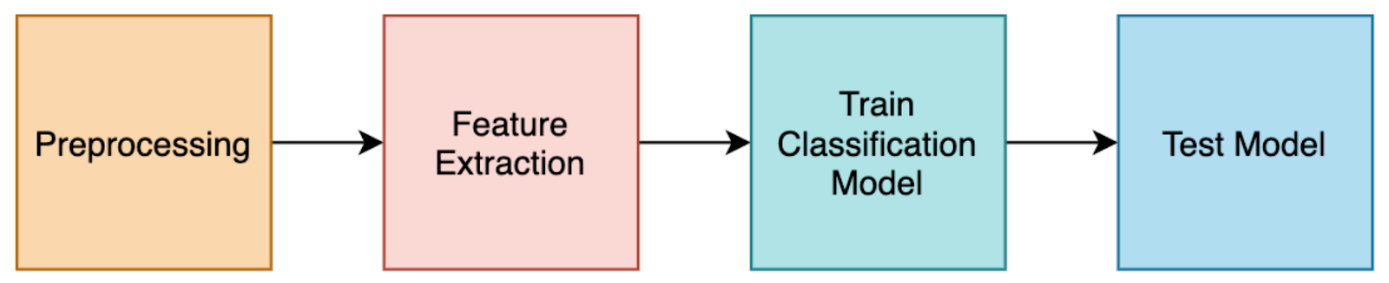
Our Goal
Our goal is to combine different strategies Machine Learning and Deep Learning to discover not only the best technique, but also gain insight concerning the importance of preprocessing and benefits of different feature extraction techniques in relation to duplicate question detection.
Plan Of Action

Slide 4
Dataset Text Preprocessing
The dataset for this project will be taken from the open dataset provided by Kaggle, at “Quora Question Pairs Classification”. This dataset consists of questions that come in pairs and a ground truths table that is taken to be “informed”.
The training data set has 405,290 question pairs with 149,263 duplicates and 255,027 non duplicates.
We are splitting the data as 80% to train, 10% validation and rest 10% to test our models.
Data Preprocessing is an essential step when analyzing data.
We applied following cleaning techniques:
Removal of excess punctuation and specials characters,
Converting numeric terms to words,
Keeping case consistent (lower case).
In addition, we removed the stop words as they don’t add any knowledgeable information when evaluating the models.
Preprocessing before Training DeepNets:
Tokenize data
Convert Text data to sequences

Slide 5
Feature Extraction
Bag of Words method extract the features from text documents and is represented as the bag (multiset) of its words, disregarding grammar and even word order but keeping multiplicity.
Word2Vec uses a neural network model to learn word associations from a large corpus of text. Once trained, such a model can detect synonymous words or suggest additional words for a partial sentence.
GloVe focuses on words co-occurrences over the whole corpus. Its embeddings relate to the probabilities that two words appear together. [2]
Term frequency–inverse document frequency, is a numerical statistic that is intended to reflect how important a word is to a document in a collection or corpus.

Slide 6
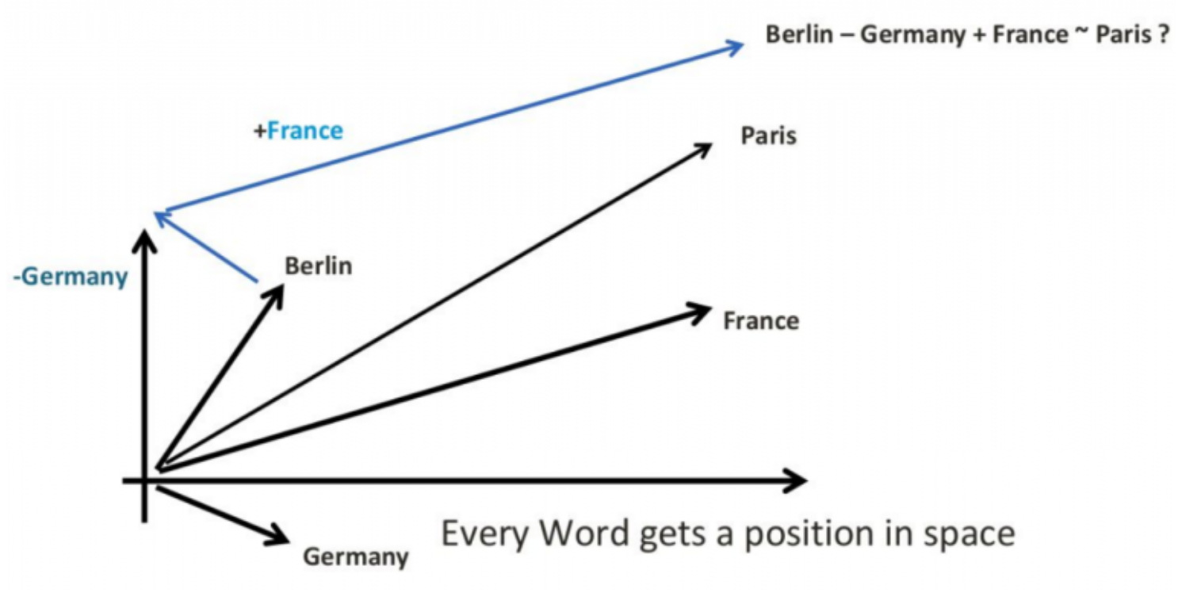
Word2vec Bag of Word GloVe
Raw Text
Features →
it is a puppy and it is extremely cute
Word Feature Matrix
Context →
Bag of words
Feature Context matrix
Words →
Features →
It | 2
they | 0
puppy | 1
and | 1
cat | 0
………. | …….
Context →
Word Context
Co-occurrence matrix
Words →

Slide 7
Classification Techniques
We chose the following classification models, to analyze the performance and accuracy:
Bayesian classification addresses the classification problem by learning the distribution of instances given different class values.
XGBoost is a scalable Machine Learning system for tree boosting that has been widely recognized in a number of ML and data mining challenges.[4]
Logistic regression is used to describe data and to explain the relationship between one dependent binary variable and one or more nominal, ordinal, interval or ratio-level independent variables.
Long Short-Term Memory (LSTM), is a recurrent neural network capable of learning order dependence in sequence prediction problems.[3]
Time Distributed CNN (TD-CNN), is a a type of CNN that applies the same layer to several inputs to produce on output per input in time.[2]
The Concatenated Model are used in addition to LSTM and TD-CNN with a simple 1D CNN Layer followed by batch normalization and dropout and activation (RELU).

Slide 8
Experiment-Models
Bag of Words + Multinomial Bayes
Bag of Words + n-grams + Multinomial Bayes
Bag of Words + XGBoost
Bag of Words + n-grams + Logistic Regression
TF-IDF + n-grams + Logistic Regression
Word2vec Embeddings + LSTM (Type MODEL 1A)
GloVe Embeddings + LSTM (Type MODEL 1B)
Word2vec Embeddings + (TD-CNN+ 1D CNN) (Type MODEL 2A)
GloVe Embeddings +TD-CNN (Type MODEL 2B)
Word2vec Embeddings + (LSTM+TD-CNN+CNN) (Type MODEL 3A)
GloVe Embeddings + (LSTM+TD-CNN+CNN) (Type MODEL 3B)

Slide 9
Framework for Machine Learning Models
Predictions
Multinomial Baysian / Logistic regression / XGBoost
Concatenated Input (question_1+question_2)
Bag of Words/ TF-IDF
Feature Extraction
Feature Extraction
question_1
question_2
is_duplicate (Ground Truth)

Slide 10
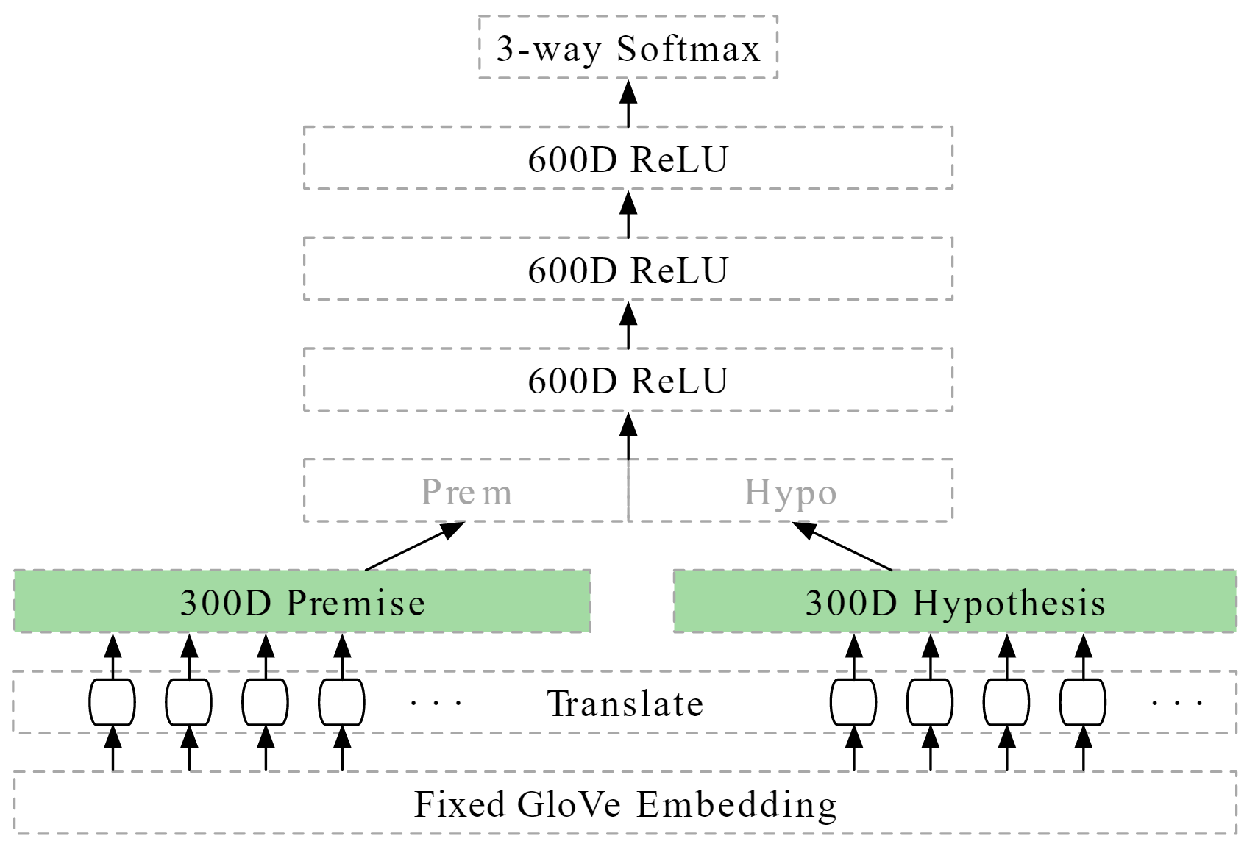
Embedding Layers
Basis of Deep Learning Model[3]
Simple Layer
Converts Indexes to Vector, e.g. word count to word vectors: [[4],[20]] → [[0.15,0.1],[0.4,-0.2]]
Used Transfer Learning to initialize weights via:
Word2Vec (Google’s Corpus)
GloVe (Stanford’s Corpus)
Parameters Learned:
MODEL | TRAINABLE PARAMETERS | Non-Trainable Parameters | Total parameters
MODEL 2A | 1,182,717 | 114,723,000 | 115,905,717
MODEL 2B | 1,178,817 | 114,720,600 | 115,899,417
MODEL 3A | 2,806,317 | 172,082,400 | 174,888,717
MODEL 3B | 60,159,417 | 114,720,600 | 174,880,017

Slide 11
Predictions
Predictions
Output Layer Sigmoid Activation
Output Layer Sigmoid Activation
MODEL 1A & 1B
Batch normalization + PRELU + Dropout
Batch normalization + PRELU + Dropout
.....................................
.....................................
Batch normalization + PRELU + Dropout
Batch normalization + PRELU + Dropout
Concatenated Layer
Concatenated Layer
LSTM
LSTM
MODEL 2A & 2B
TD-CNN+Lambda
TD-CNN+Lambda
Embeddings
Embeddings
Embeddings
Embeddings
question_1
question_2
question_1
question_2

Slide 12
Predictions
Output Layer Sigmoid Activation
MODEL 2A & 2B
Batch normalization + PRELU + Dropout
.....................................
Batch normalization + PRELU + Dropout
Concatenated Layer (LSTM_q1, LSTM_q2, TD-CNN_q1, TD_CNN_q2, 1D-CNN_q1, 1D-CNN_q2
Dropout + BN
Dropout + BN
RELU
RELU
LSTM
LSTM
Globalmaxpooling
Globalmaxpooling
TD-CNN+Lambda
TD-CNN+Lambda
1D-CNN
1D-CNN
Embeddings
Embeddings
Embeddings
Embeddings
Embeddings
Embeddings
question_1
question_2
question_1
question_2
question_1
question_2

Slide 13
Results : Quora’s (Text Corpus + Model ) (Benchmark)
Model | Test Accuracy
Quora’s Model: “LSTM with concatenation” | 0.87
Bag of Words + Multinomial Bayes | 0.73
Bag of Words + n-grams + Multinomial Bayes | 0.78
Bag of Words + XGBoost | 0.78
Bag of Words + n-grams + Logistic Regression | 0.80
TF-IDF + n-grams + Logistic Regression | 0.78
Word2vec Embeddings + LSTM (MODEL 1A) | 0.82
GloVe Embeddings + LSTM (MODEL 1B) | 0.63
Word2vec Embeddings + (TD-CNN + 1D-CNN) (MODEL 2A) | 0.82
GloVe Embeddings + (TD-CNN + 1D-CNN) (MODEL 2B) | 0.82
Word2vec Embeddings + (LSTM + TD-CNN + 1D-CNN) (MODEL 3A) | 0.83
GloVe Embeddings + (LSTM + TD-CNN + 1D-CNN) (MODEL 3B) | 0.69

Slide 14
Conclusion
Word2vec Embedding + (LSTM + TD-CNN + 1D-CNN) gave the best performance with an accuracy on test data of 83% and train data of 98.8%.
Combining layers of models generally lead to better accuracy.
LSTM works better on Word2vec Embedding compared to GloVe.
Simple Models can still perform well:
Logistic regression can be used if there is time and GPU constraints.
Feature extraction play a vital role in the classification scheme, a simple model with efficient data preprocessing and feature extraction can still boost the results.

Slide 15
References
[1] Jeffrey Pennington, Richard Socher, and Christopher D. Manning. "GloVe: Global Vectors for Word Representation," in Proceedings of the 2014 Conference on Empirical Methods In Natural Language Processing (EMNLP 2014), October 2014.
[2] https://medium.com/smileinnovation/how-to-work-with-time-distributed-data-in-a-neural-network-b8b39aa4ce00
[3] Keras-snli Model: https://github.com/Smerity/keras_snli
[4] Tianqi Chen, Carlos Guestrin (2016) XGBoost: A Scalable Tree Boosting System
Similar Previous Work:
Wei Emma Zhang, Quan Z. Sheng, Jey Han Lau, Ermyas Abebe, and Wenjie Ruan. 2018. DuplicateDetection in Programming Question Answering Communities. ACM Trans. Internet Technol. 18, 3, Article 37(May 2017), 21 pages.
Mamdouh Farouk (2019) Measuring Sentences Similarity: A Survey

