Slide 1



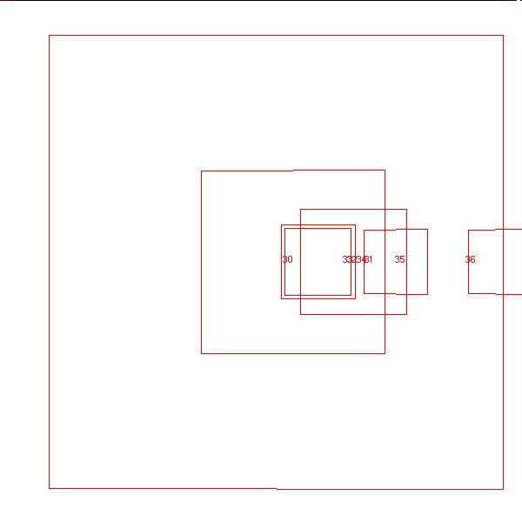
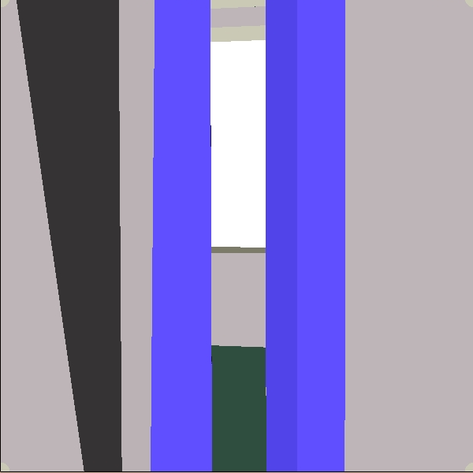
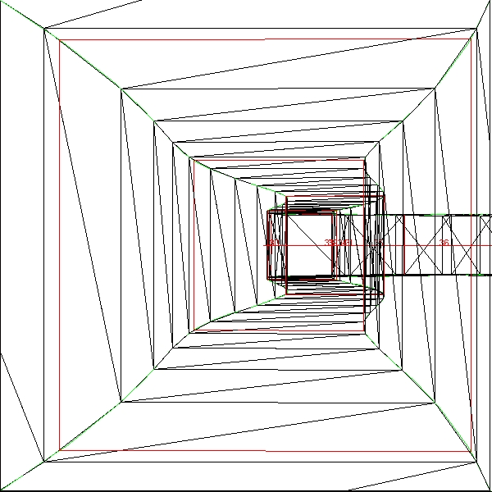
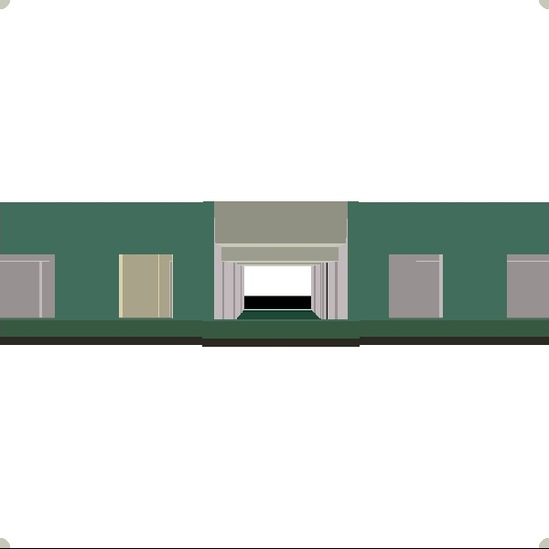
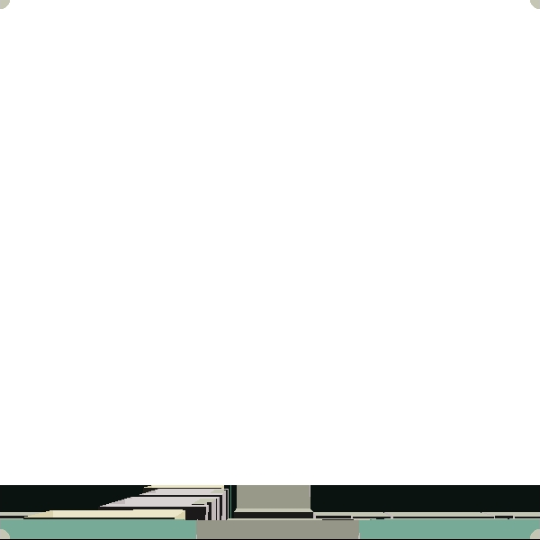
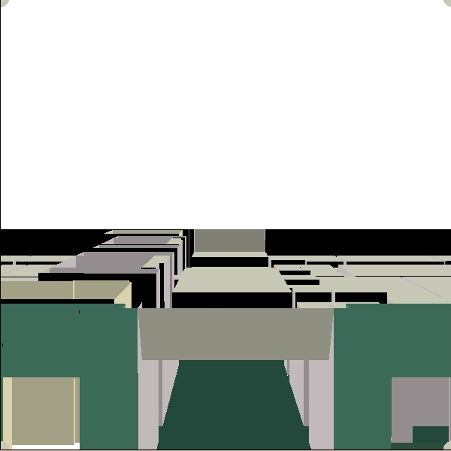
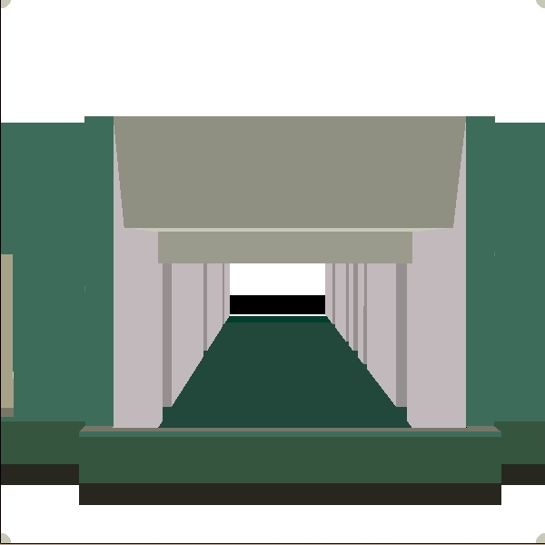
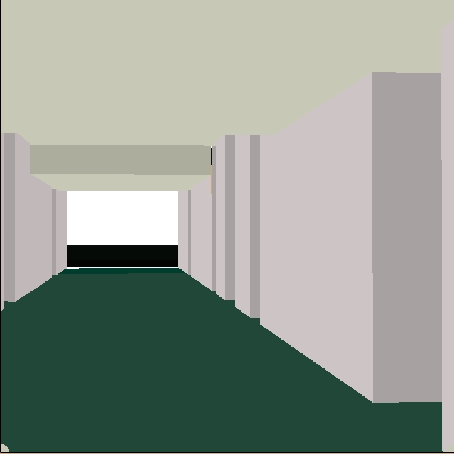
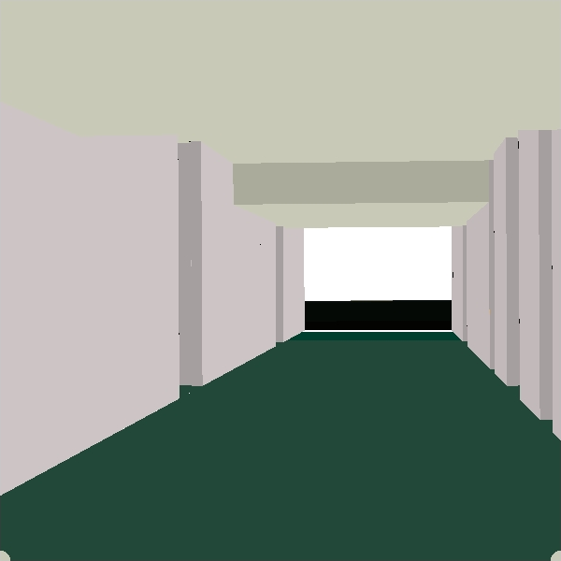
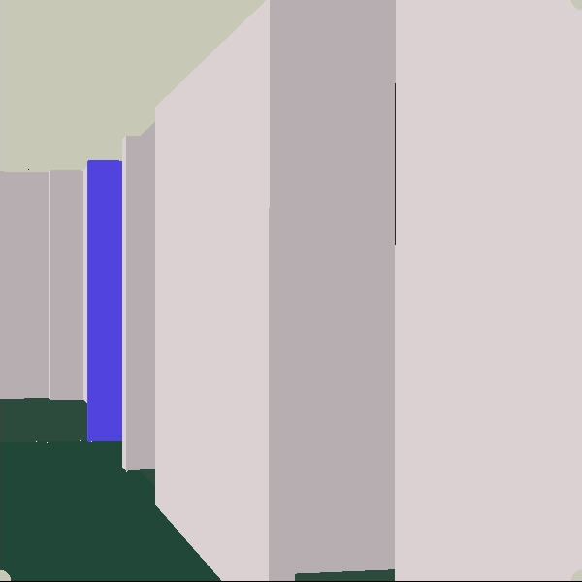
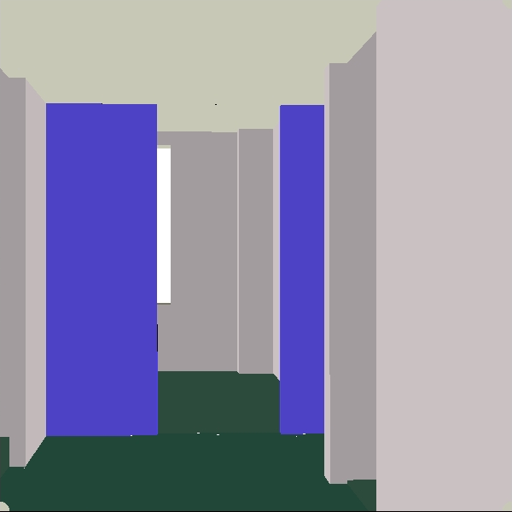
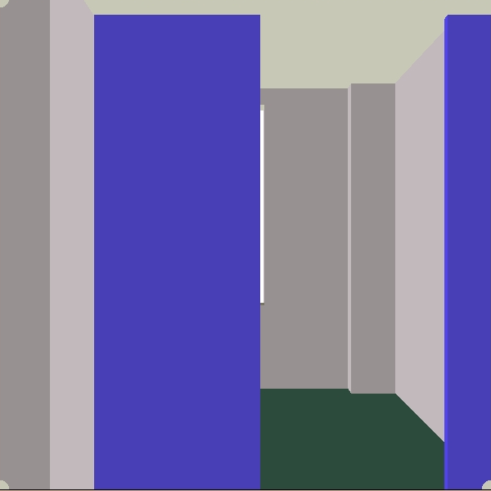
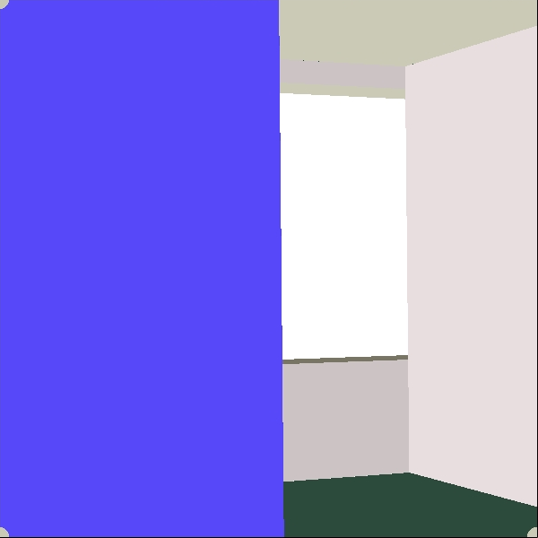
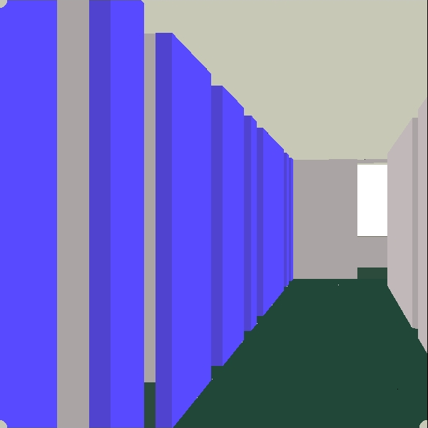
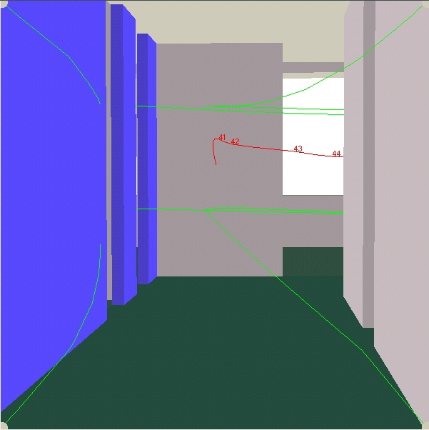
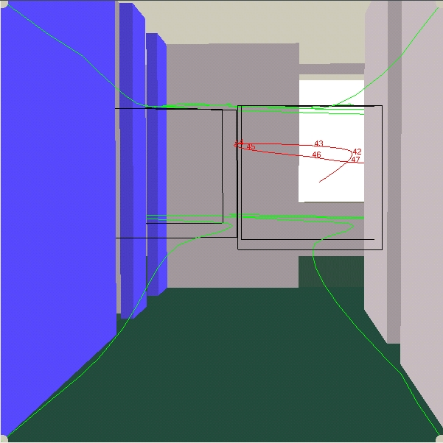
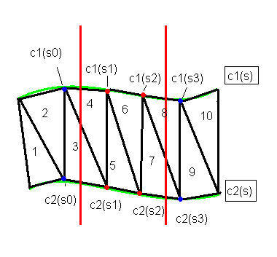
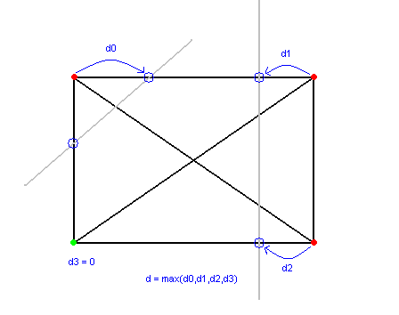
Ross Ptacek
Computer and Information Sciences
University of Alabama at Birmingham
rptacek@uab.edu
John K. Johnstone
Computer and Information Sciences
University of Alabama at Birmingham
jj@cis.uab.edu
Controlling the entire path of a virtual camera
The work of both authors was partially supported by the NSF under grant CCR-0203586.
Creating a path
Introduction
Keyframes
Camera model and collision detection
Tracking the corners
Swept volume of the near quadrilateral
In computer animation, the path of a virtual camera through the scene is often controlled interactively. However, it is also reasonable to define the desired camera path by some keyframes that the camera must pass through. This is a reasonable model in an architectural walkthrough, for example, where a tour of the building is desired, which could be predefined. The keyframes can be generated automatically by a higher level motion planner, or designed by hand.
A major issue in animation is that the camera path may collide with the scene, resulting in unattractive cutthroughs. An advantage of the keyframe approach to camera control is that collisions can be detected and avoided before the motion is begun. Moreover, optimal smooth motions can be planned, both globally and locally.
Keyframes are positions and orientations that the camera is constrained to pass through.
They can be thought of as snapshots taken by the camera as it moves along the desired path.
We have to choose how the camera will transition from keyframe to keyframe.
The visible part of a scene is defined by a view frustum, a rectangular cone bounded by near and far clipping planes.
It is natural for objects to penetrate the back or sides of the view frustum, as the object moves out of our field of vision. However, objects that penetrate the near clipping plane are unnatural, creating ugly cutaways.
Camera positions are interpolated using a cubic B-spline B(t). This represents the position of the center of the near quadrilateral.
Camera orientations are interpolated using a rational quaternion spline Q(t).
  Quaternions are points on the unit sphere in 4-space.
  A B-spline is interpolated through these points, constrained to the sphere.
  A rational method is more efficient and robust.
A corner of the near quadrilateral at time t is calculated as follows:
  V = vector from the center of the near quadrilateral to a corner.
  Rotate V by Q(t), then translate by B(t).
We want to find the entire path of a corner.
Using a result from Johnstone and Williams 1995, we find a rational B-spline representing the path of each corner curve.
There are four curves representing the paths of the four corners of the near quadrilateral during the motion, which we call corner curves.
A ruled surface is lofted between adjacent corner curves.
These four lofted surfaces bound the swept volume of the near quadrilateral.
The near boundary of the view frustum is a quadrilateral in the near clipping plane, called the near quadrilateral.
We need to track the near quadrilateral as the camera moves along its path, so that we can find its collisions with the scene.
It suffices to track its four corners.
We want to detect collisions of the scene with this volume, and correct them.
Let C(t) be the parameterized near quadrilateral represented by this swept volume.
Keyframes can also be represented with quadrilaterals as shown here. Why quadrilaterals? Read on!
This figure shows a sampling of frames from a flythrough. A key step in the construction of a natural flythrough is the collision detection, and collision correction, of the near quadrilateral of the view frustum with the scene.
The near clipping plane intersects part of the scene, creating an ugly cutaway
The swept volume defined by the near quadrilateral of the view frustum.
Path Correction
Results
Detecting Collisions
Determining a New Keyframe
Determining a New Keyframe
Before
After
We find problem areas where collisions occur and push the path away from them. The path is pushed away from the collision by adding new keyframes. There are three steps, as follows.
Find intervals of the swept camera volume that intersect the scene.
Measure how deeply the near quadrilateral penetrates the scene over each interval.
Insert a new keyframe in the middle of each parameter interval.
Consider a collision interval (si,sf).
We consider the frame at the middle of the collision interval, identify the direction and depth of the collision, and use this information to define a new keyframe nearby that is hopefully collision-free.
The parameter value of the inserted keyframe is
  s_{mid} = (s_{f} – s_{i}) / 2.
The orientation of the inserted keyframe is Q(s_{mid}).
The position of the inserted keyframe is B(s_{mid}) + d * v, where
  B(s_{mid}) = position at center of interval
  d = approximate depth of intersection
  v = a vector away from the intersections
Finding v:
  Intersect the four line segments from the center of C(s_{mid}) to the vertices of this near quadrilateral with the scene.
  If a line segment intersects the scene, classify the associated vertex “good”, otherwise “bad”.
  v is the normalized sum of vectors from the center of C(s_{mid}) to each good corner.
Finding d:
  For each bad vertex of C(s_{mid}), intersect the two adjacent edges of the near quadrilateral and record the distance to the closest intersection on each edge.
  Define the vertex depth to be the maximum of these two distances.
  Define d to be the maximum of these vertex depths.
This extra keyframe may still intersect some scene geometry, in which case we will have to repeat the procedure.
Multiple keyframes may have to be inserted over an interval to completely fix it.
Green lines: Corner curves
Red line: B(t)
Numbers indicate keyframes
Black quadrilaterals indicate the near quadrilateral collision intervals in the original path.
Finding Collision Intervals
Sample the swept surface to triangles T_{p}.
Annotate each triangle of T_{p} with a parameter value from C(t).
Each collision interval is found by binary search with respect to the parameters, at both ends of the interval.
This gives us a series of parameter intervals over which there is continuously a collision.
We add a new keyframe in the center of each collision interval, as described below.
Once this keyframe has been added, the interval is rescanned to make sure that the new path is collision-free. If necessary, additional keyframes are recursively added over the interval.
Typically fewer than three iterations are required.
The corner curves (represented in green) show the camera running into the wall ahead.
After collision correction, the corner curves avoid the wall, while still interpolating the user-specified keyframes.
The correction took two iterations to completely correct this segment, as the first iteration fixed the original collision but introduced a new one.
We tested the algorithm on the U.C. Berkeley Walkthrough Group’s Soda Hall WALKTHRU Model.
The entire algorithm has been implemented in C++.
Each collision interval took at most 3 iterations to correct.
The black rectangle is the near quadrilateral C(s_{mid}). The grey lines represent pieces of scene geometry that intersect the quadrilateral. Lines are intersected to determine good (green) and bad (red) vertices.
References and Acknowledgments
The parameter finding algorithm. Red lines represent the true beginning and end of the collision. The triangles are triangles from one side of C(t). The number indicates order when sorted by parameter value of C(t).
J.K. Johnstone and J.P. Williams (1995) A Rational Model of the Surface Swept by a Curve. Computer Graphics Forum 14(3), 77–88.
We thank the U.C. Berkeley Walkthrough Group for the U.C. Berkeley Soda Hall WALKTHRU Model.

