Slide 1
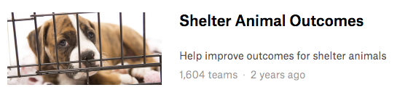
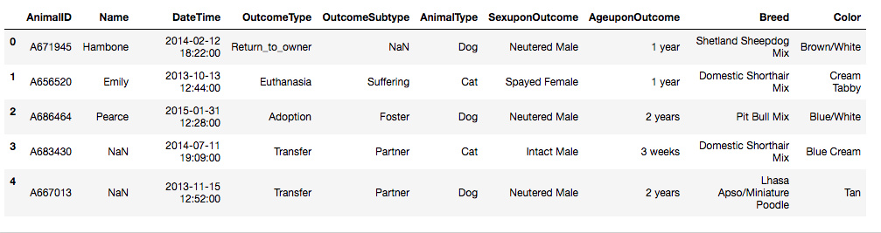
John Hoerr
I526 SP18 Final Project
https://www.kaggle.com/c/shelter-animal-outcomes
Notes:
Hi, my name is John Hoerr, and this is my presentation of my I526 Final Project.
The goal of my project was to model and predict the outcomes of shelter animals. According to the American Society for the Prevention of Cruelty to Animals, approximately 6.5 million animals enter shelters every year. I propose to improve adoption rates by modeling and classifying animal outcomes using a combination of observable and historical features. This model can be used by shelter staff to allocate resources in a way that maximizes their adoption goals.
My inspiration and data source for this project is the Kaggle competition, Shelter Animal Outcomes. The data set includes approximately 27,000 unique animals in the Austin, TX area from October 2013 to March 2016. [TRANSITION] The input features include the animal’s age, sex, reproductive status, and breed, as well as visual characteristics such as coloring and coat pattern. [TRANSITION] The outputs included the classification of the animal outcome -- whether it was adopted or euthanized, among others – and often the reason for the animal entering the shelter.

Slide 2
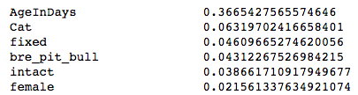
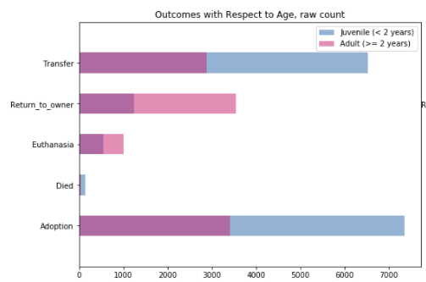
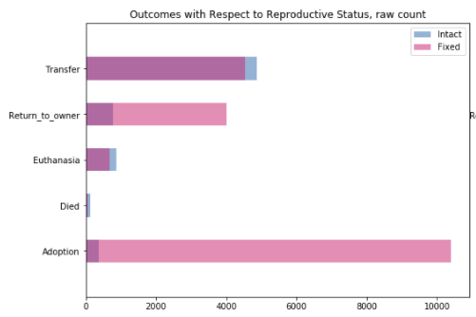
Feature Importance vs
Exploratory Data Analysis
John Hoerr, I526 SP18 Final Project
Notes:
Exploratory data analysis indicated that features such as age and reproductive status would play a strong role in determining outcomes. [TRANSITION] This analysis was later confirmed by observations of feature importance. The few available input features were engineered primarily for normalization. Ages were converted to days, discrete labels such as dog/cat, male/female, fixed/intact were isolated, and breeds, colors, and coat patterns were distilled to their dominant values.

Slide 3
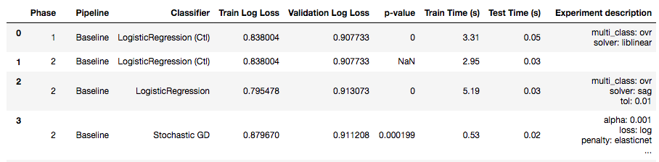
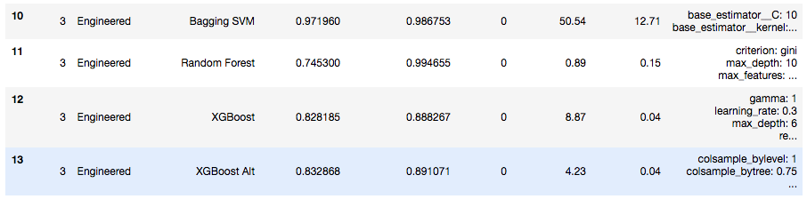
Results
John Hoerr, I526 SP18 Final Project
Notes:
Log-loss scoring was selected to align with the Kaggle’s scoring metric. This type of scoring does best with probabilistic, non-binary classification, so a grid search was conducted using a range of classifiers that supported probabilistic classification. These included LogisticRegression (Softmax), Support Vector Classifier, Random Forest, and XGradientBoost. The best model achieved a log-loss score of ~0.87 with the engineered feature set and the X Gradient Boost classifier, narrowly outperforming our baseline Softmax with the raw features. Neither model ultimately proved any more accurate than guessing. I think one reason for this poor accuracy is that the contextual information that would inform an animal’s outcome (such as being sick or a runaway) was included as an output of the dataset, and I was thus left to model outcomes based purely on physical features.

Slide 4
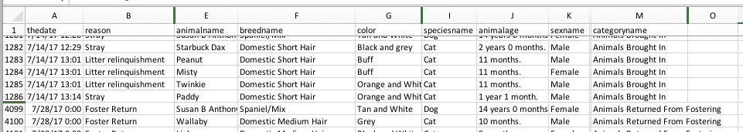
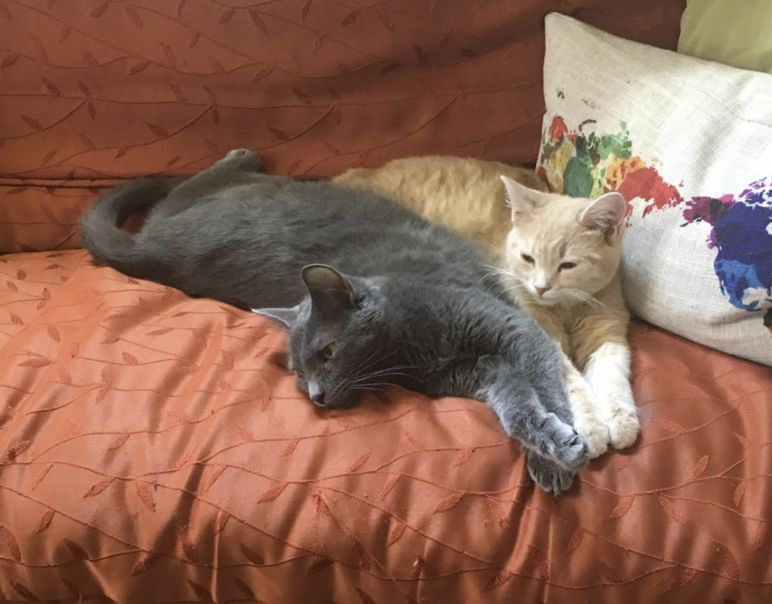
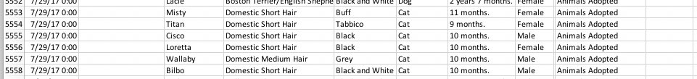
Bloomington Animal Care and Control Adopted Animals
https://data.bloomington.in.gov/dataset/adopted-animals
John Hoerr, I526 SP18 Final Project
Notes:
By request the city of Bloomington recently released our local shelter data which includes richer context for the animals entry into the shelter as well as the outcome. [TRANSITION] I will be revisiting this problem over the summer with the Bloomington data and sharing the results with the city.

Slide 5
John Hoerr, I526 SP18 Final Project

