Slide 1
Cooperative agents using planning
Jordan Hoffmann, Zack Krolikowski, Dylan Pautler
4/11/2021

Slide 2
Cooperative agents using planning
Hieratical Planning Or Goal Oriented Action Planning
Demo
How it works
Farther Work

Slide 3
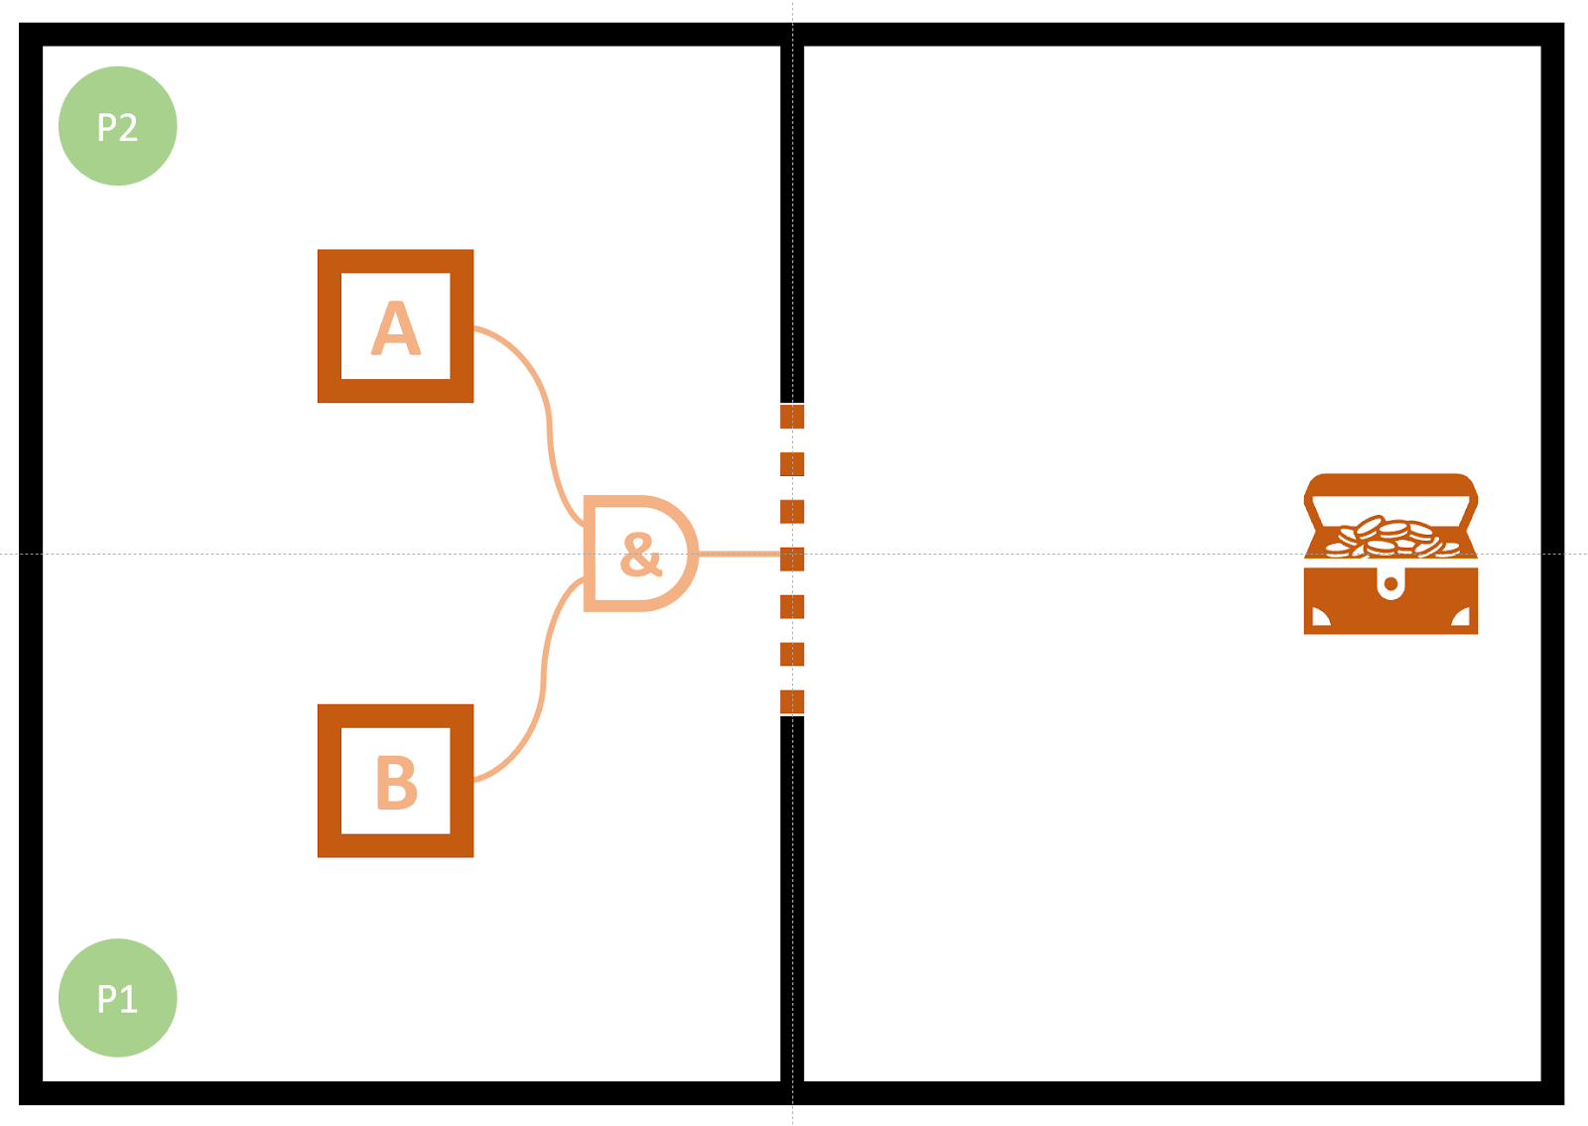
What we expect from our Demo
Notes:
Planning takes a lot of time so, demo needs to be short to account for planning pragmming lenght

Slide 4
The basic of Hierarchical task networks
Forward Planning
Hierarchical/Decomposition
Operators

Slide 5
Pros of using Hieratical Planning
Reacts very well to stimulus
Operators enable generic code
Better control

Slide 6
Cons of using Hieratical Planning
No way to set an end goal
They react to the environment, rather than plan
Parents depend on children
Notes:
1. Because HTNs are forward searching there is no way to set an end goal. They just respond to the everntment and don’t care what will happen

Slide 7
The basics of GOAP
Sequence of actions based on the world
Plans start the at end and backfills

Slide 8
Pros of using GOAP
They can complete goals
Independent tasks, making all tasks decoupled

Slide 9
Cons of using GOAP
Bad at planning relative to its effect to on the world
Most tasks are non invertible
Notes:
Because of backtracking it is hard to keep track of its affects on the world and can become unaccreted after planning a couple of tasks. It Has to assume the world state now is what it will be when it reaches the end because it has to track backwards. Might have to make guess about the starting state of a task

Slide 10
Why we picked GOAP
Can set a goal
Easier to code

Slide 11
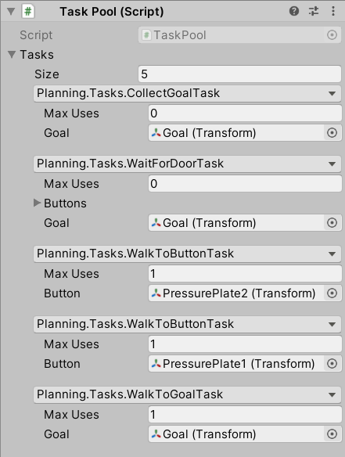
All the possible tasks in our demo

Slide 12
How agents perform tasks
Parts of a task
Preconditions
Effects
Operation
Weight
Parts of Operation
Init
Update
Exit
IsComplete
Notes:
Operation borrowed from HTN

Slide 13
The algorithm agents use to plan
WorldStack = Current State Of World
GoalsStack = End Goal
TasksStack = null
While all goals are not complete:
task = Get Best Task
If no valid tasks
Mark top of TasksStack as unusable
Pop all stacks and continue
TasksStack.push(task)
WordStack.push(World state after tasks)
GoalsStack.push(all unmet preconditions)

Slide 14
How to get the best task
Lowest weighted task
Unmet preconditions
Number of goals left uncompleted

Slide 15
Possible ways to improve our planning
Find a way to get invertible tasks consistently
A-Star vs Depth first

Slide 16
Questions/Comments

Slide 17
Presentation Name (don’t use “Agenda” or “Overview”)
Section 1
Section 2
Section 3
Section 4

Slide 18
Sentence that explains the point
Minimize your use of text
Use bullets sparingly (better to just say it)
Minimize the “noise” on each slide
No one wants to read your presentation
Use “effective redundancy” and let your slides add value in addition to what you say

Slide 19
Changing the highlight color
←This is a bullet point
To change the highlight color of the title or bullets
Select the lines
Click the bullet drop down in the Home tab
Select “Bullets and Numbering”
Click the Color drop down and choose a color
It’s better to go into the Master slide and change the color there if it’s for all slides in the presentation
View->Slide Master

Slide 20
Don’t let the audience read ahead
Add polish with a Fade for each point
To add a Fade animation
Put the cursor anywhere in the text
Go to the Animations tab
Click Fade
To reorder animations
Go to Animations tab and select Animation Pane
Drag and drop to reorder
Use the drop down to change when it happens

Slide 21
“Home->New Slide” drop down has choices
There are many New Slide drop down versions
Section (optional footer)
Indented Content (optional footer)
Content (optional footer)
Split Content (optional footer)
Blank page (optional footer)
Note: You can always hide the footer
Click on a blank part of the background
Right click and choose “Format Background”
Check the “Hide Background” checkbox

Slide 22
Checklist for editing slides
Is the formatting of the slides consistent?
Is the text large enough to read?
Is each slide aesthetically pleasing?
Is there too much stuff on each slide?
Is there anything annoying that should be removed?
Is there enough interesting stuff?
Are the slides adding value?

Slide 23


Get rid of noise, decoration, and chart junk
The title should explain the point of the slide
Candidate Applications
The number of candidates dropped
over the last six years
Candidate Applications Per Year
500
456
400
385
300
Applications
200
155
100
94
1985
1990
1995
2000
2005
1985
1993
1998
2008
23

Slide 24
Make your PowerPoints better
Use less ink
No chart junk
No gifs
No crowding
No walls of text
No decoration/background
Use one highlight color
Sentences as titles – So What?
Allow your slides to breathe
Fewer bullets or no bullets
Text appears as you talk about it
Interesting and relevant images
Aesthetically balance your slides
Consistency between all slides

Slide 25
Make your Delivery better
Figure out your key message
Practice, practice, practice
Adapt to your audience
Empathize with the audience
Give a performance
Involve the audience
Show up early and test
Extinguish idiosyncrasies
Use repetition to make it stick
Be a storyteller
Vary your pacing and pitch
Show your excitement
End strong – stick the landing
Tell them what to remember

