Slide 1

An Analysis Into Video Game Popularity
By Jason Hoffmeier

Slide 2
The Question: Which Games Tend to be the most popular?
Hundreds of Games are designed yearly.
Some are remembered for years to come, others are forgotten.
Regardless of popularity, all can be found at the right source

Slide 3
Goal(s) & Objective(s)
Measure, collect and go through a high level of video game data on Metacritic.
Through the data analyzed, produce conclusions, and further questions for future analysis.

Slide 4
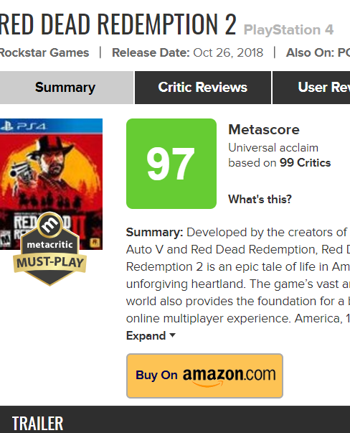
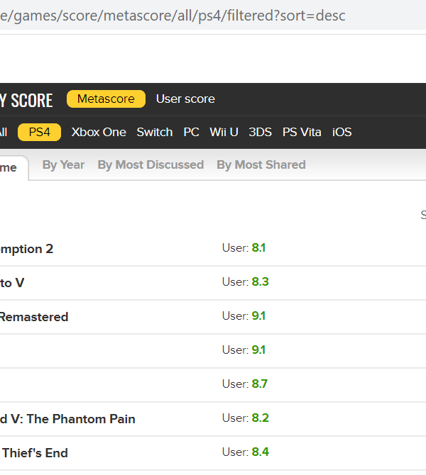
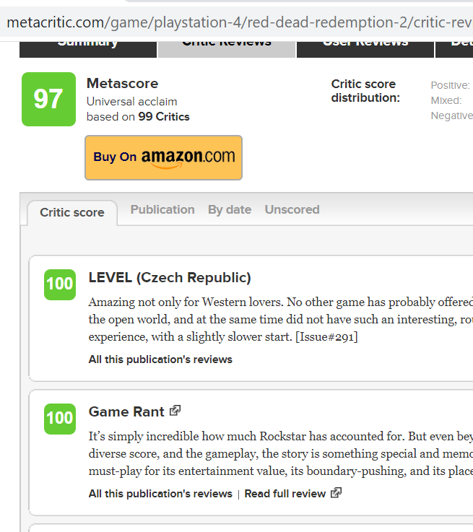




Scraped site

Slide 5
Areas of data analyzed to understand popularity.
Developer
Release Date
Genres
Critic Reviews
Critic names, and separate scores
User grade

Slide 6
Critic and User appeal to all 1,600+ games
A web scrape was done to all PlayStation 4 games that have ever come out.
In doing so, two primary independent variables were marked to allow for further analysis: Metacritic scores, and User critic scores.

Slide 7
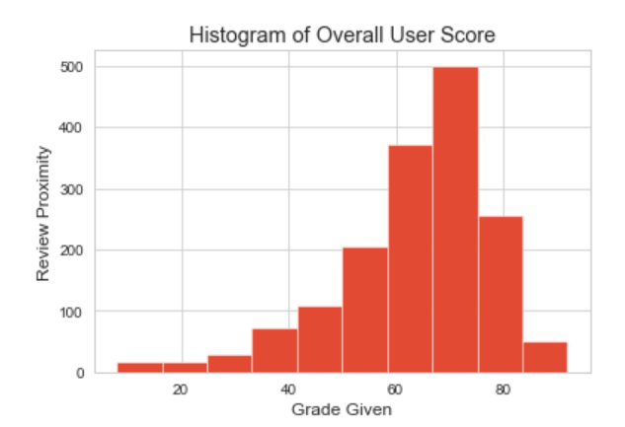
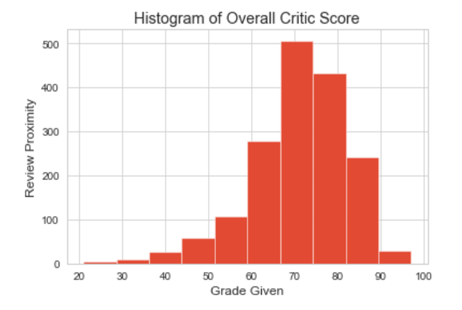
Full analysis on Critics and Users

Slide 8
Based on the data shown deeper review was made:
Based on the distribution that the data has shown, where can we define deeper correlation?
In this case the area of analysis that was dug into were Video Game Genres.

Slide 9
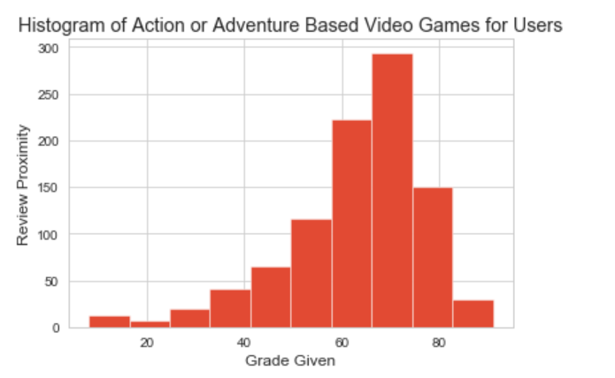
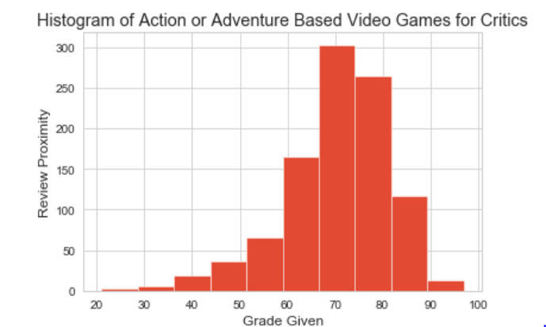
Action or Adventure

Slide 10
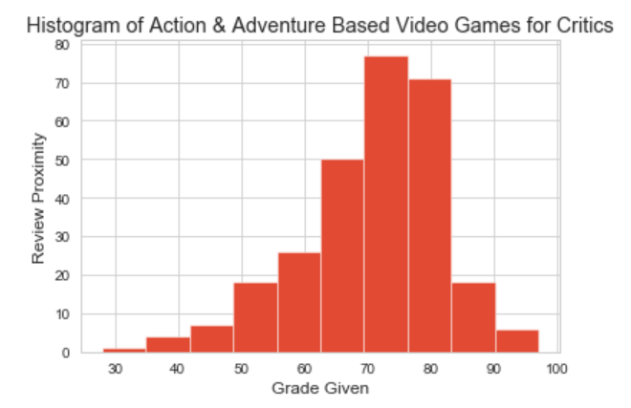
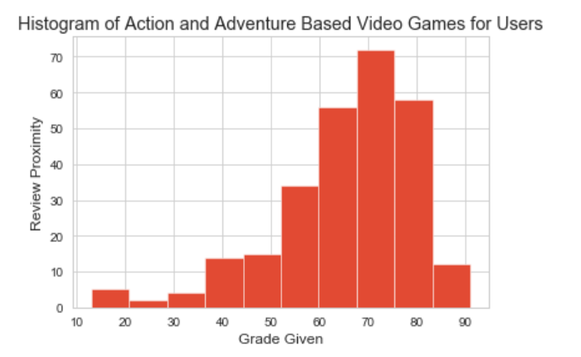
Action & Adventure

Slide 11
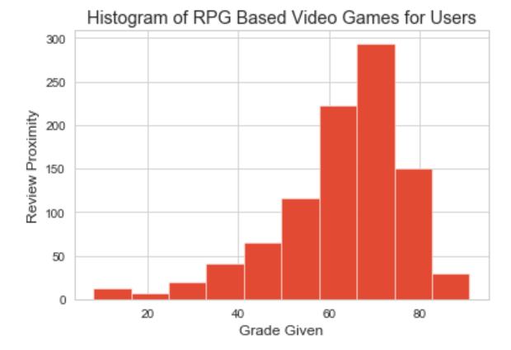
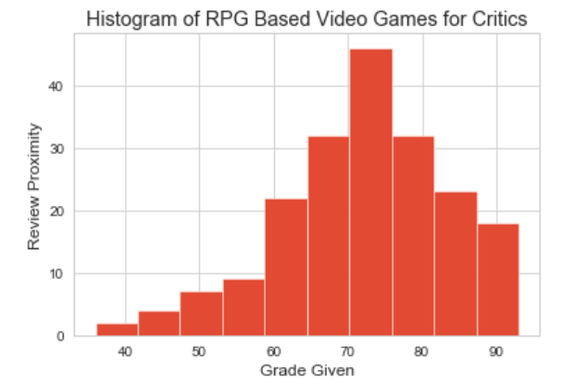
RPG

Slide 12
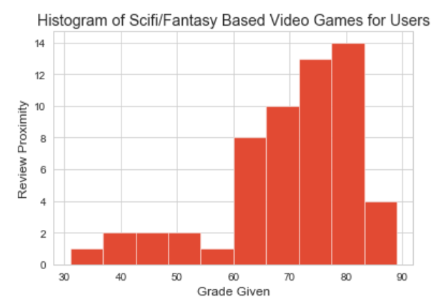
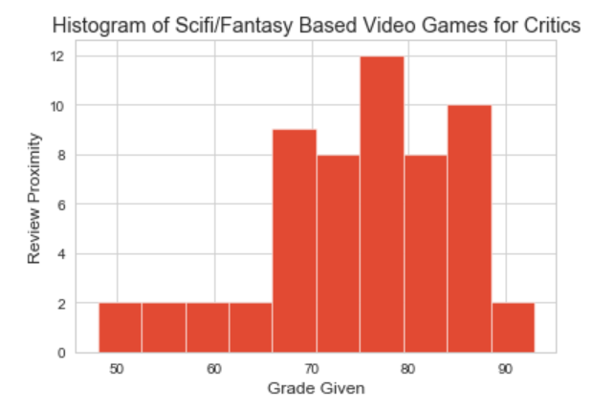
SciFi/Fantasy

Slide 13
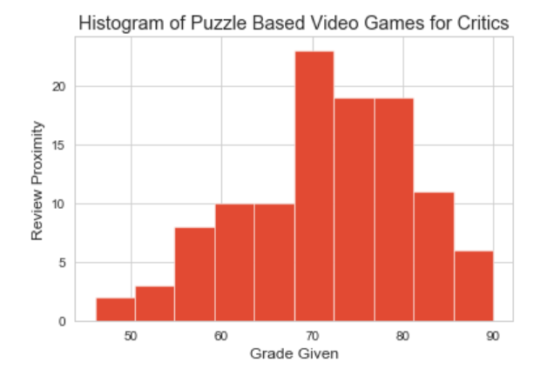
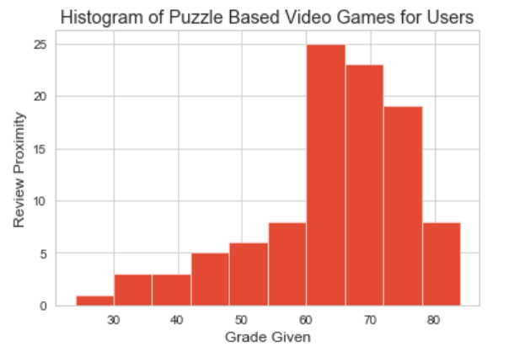
Puzzle/Strategy

Slide 14
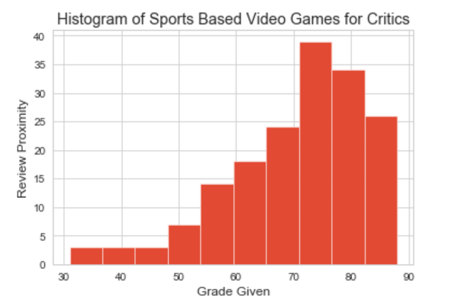
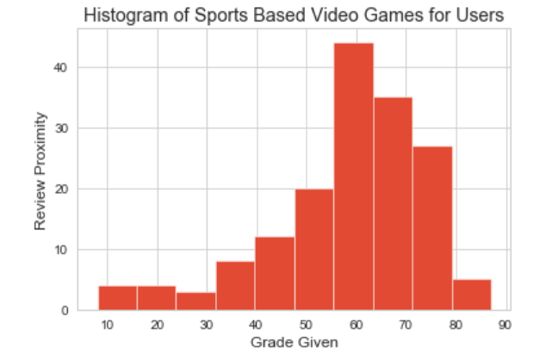
Sports

Slide 15
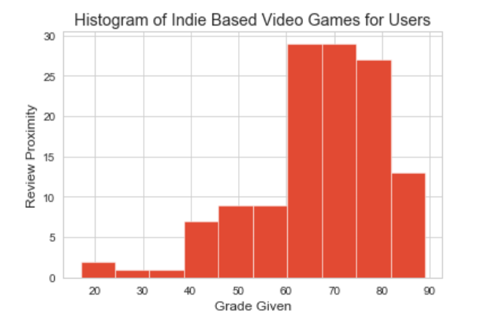
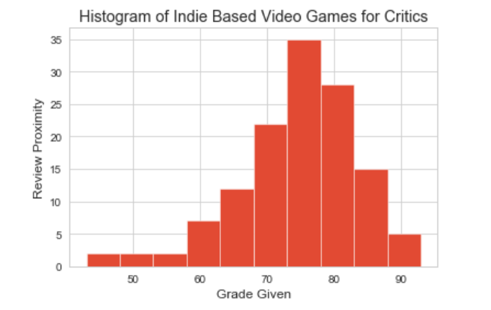
Indie

Slide 16
Correlation shows to be rather consistent:
according to what was shown above, it seems that there is relatively steady balance with Metacritic and User critic reviews.
To dig in deeper however, further analysis was done with the critics of video game genres (there was not enough time to scrape and analyze user score data)

Slide 17
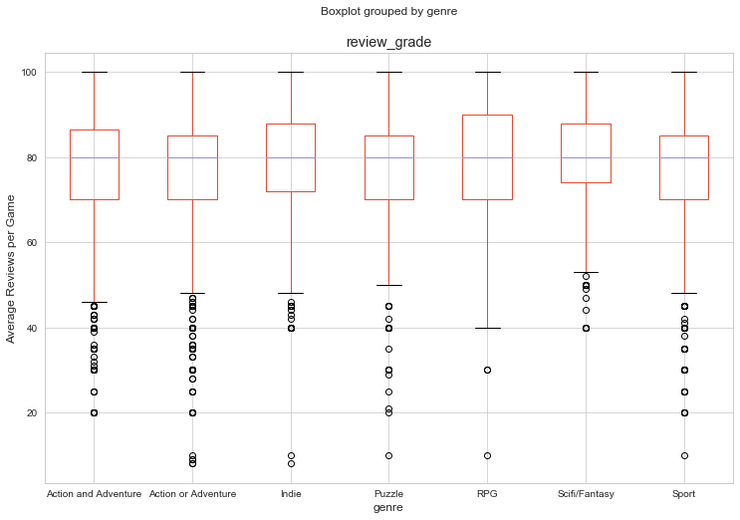
Average genre critic ratings:
-The Boxplot shows the average review per critic
-Based on what the data shows us, several outliers exist per genre.
-This could mean that most video games tend to have a relatively solid review with critics.

Slide 18
REVIEW TOTALITY

Slide 19
The totality data for each genre with critics was analyzed.
The genre reviews show a steady review status, but does that mean they are all reviewed equally?
Further analysis was done to look at the total amount of reviews that were done for each genre in video games.

Slide 20
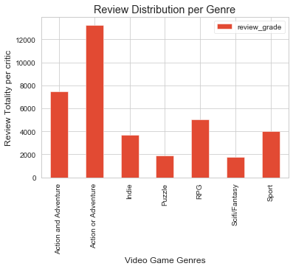
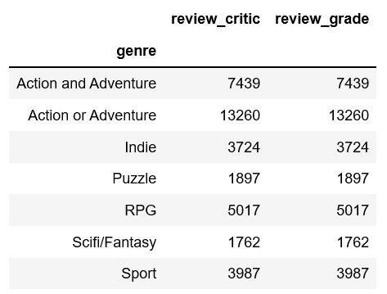
Review Distribution
This data shows the number of reviews done for each video game per genre.
It can be determined that Action/Adventure games tend to have the strongest amount of reviews.

Slide 21
NUMBER OF REVIEWS DONE BY EACH REVIEWER

Slide 22
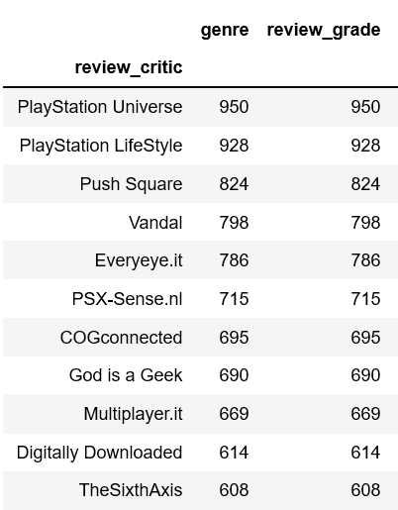
Popularity of Review Critics
I was curious to look deeper into which review critics review the most games.
It was interesting to see how much variance exists between review critics.
In the future, I would scrape and analyze data relative to the most popular review critics to see what common trends they have with their analysis.

Slide 23
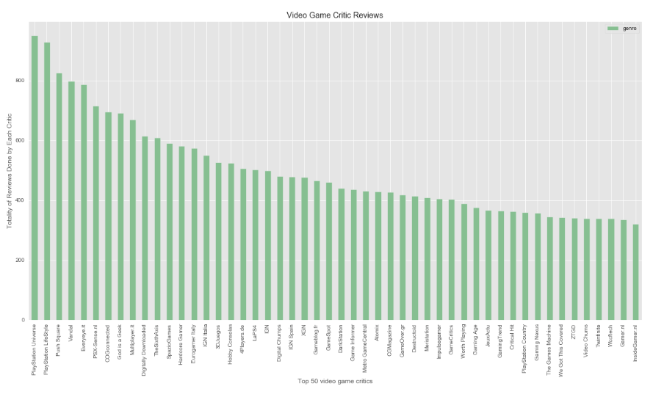

Slide 24
Conclusion
There is an abundance of criticism that exists for all video games, good and bad.
Action and Adventure appear to have the highest amount of popularity for both users and critics alike (although that can be scraped and analyzed further).
Most games tend to score rather well (averaging around 75-80 by critics)
Further analysis to investigate: Review critic popularity.

Slide 25

THANKS! Questions?

