Slide 1
Communication and teamwork topics
For CSE 3902
By: Matt Boggus

Slide 2
Class policies on teamwork
Everyone should be doing roughly the same amount of work each sprint and should not be doing all of their work the day before a deadline
Grading plan and syllabus have additional details
Ideally everyone should be able to design the parts of the system they are responsible for implementing, but since the pieces must fit together you need to agree on how to handle conflicts
By team consensus / vote
By the choice of team leader(s)
Peer evaluation forms at the end of Sprints 2-6
See class website for example
Talk to the instructor privately if serious problems occur mid-sprint

Slide 3
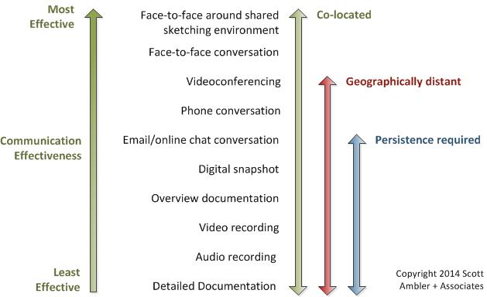
Communication on Agile teams
Image from http://www.agilemodeling.com/essays/communication.htm

Slide 4
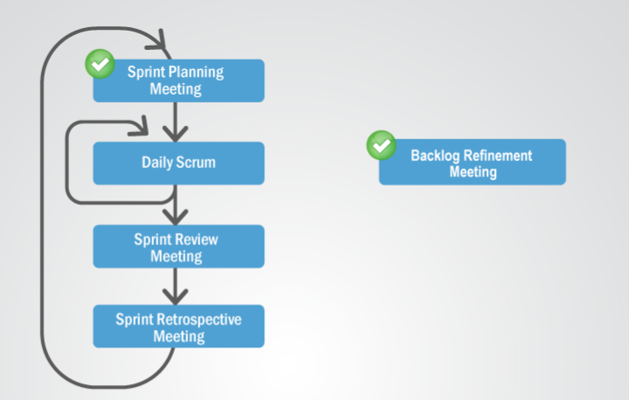
Communication on Agile teams Possible meeting structure
Image from http://scrumtrainingseries.com/DailyScrumMeeting/DailyScrumMeeting.htm

Slide 5
Communication on Agile teams Daily SCRUM / Stand-up meetings
Every team member answers the following three questions (assuming meetings occur daily)
What did I accomplish yesterday?
What will I do today?
What obstacles are impeding my progress?

Slide 6
Conflict resolution styles
Avoidance
One party ignores the conflict
Yielding
One party allows the other to determine the outcome
Competitive
The “strongest” party wins
Assertiveness, arguments, insults, etc.
Do not use this approach in this class
Cooperation
Communicate to find a solution acceptable to both parties
This method is encouraged
Conciliation
Communicate to find a solution both parties at least can agree to
Resort to this if cooperation fails

Slide 7
Conflict resolution tips
Practice active listening
Listener restates or paraphrases what they have heard in their own words, to confirm what they have heard and moreover, to confirm the understanding of both parties
Manage your emotions
To an extent, this is a skill you can learn and practice
Isn’t brought up much in science and engineering classes, so you may have to deal with others with low knowledge/experience on this topic
Agree on a conflict resolution strategy BEFORE conflict occurs
Voting, leaders choose, etc.

