Slide 1
Introduction to software design patterns
For CSE 3902
By: Matt Boggus

Slide 2

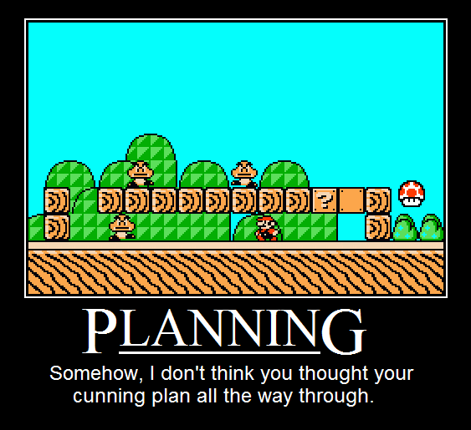
Why Design?
Objects and Systems
Processes
http://ipostr.com/pic-275-Planning

Slide 3
Patterns
“Each pattern describes a problem which occurs over and over again in our environment, and then describes the core of the solution to that problem, in such a way that you can use this solution a million times over, without ever doing it the same way twice”
Christopher Alexander

Slide 4
Design Pattern
“A design pattern names, abstracts, and identifies key aspects of a common design structure that makes it useful for creating a reusable object-oriented design.”
Gang of Four (Design Patterns: Elements of Reusable Object-Oriented Software)

Slide 5
Why use design patterns?
Solve commonly occurring problems using existing well known and tested approaches
More efficient communication
"Let's use an ADAPTER.“ compared to…
"How about a superclass with a getTemperature method and then subclass that with classes that reference instances of the vendor-supplied classes for...."

Slide 6
Four essential elements to a Pattern
Pattern Name
Having a concise, meaningful name for a pattern improves communication among developers
Problem
What is the problem and context where we would use this pattern?
What are the conditions that must be met before this pattern should be used?
Solution
A description of the elements that make up the design pattern
Emphasizes their relationships, responsibilities and collaborations
Not a concrete design or implementation; rather an abstract description
Consequences
The pros and cons of using the pattern
Includes impacts on reusability, portability, extensibility

Slide 7
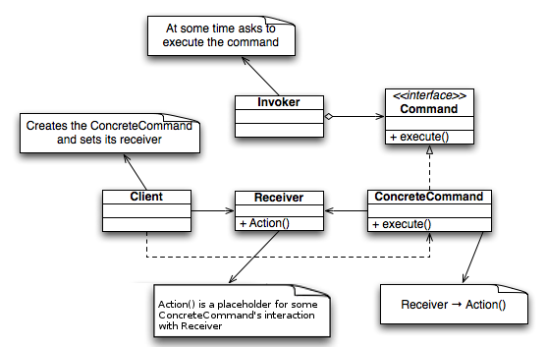
UML Notation
http://en.wikipedia.org/wiki/File:Command_Design_Pattern_Class_Diagram.png
Design patterns in UML paper

Slide 8
Downsides
Many design patterns only make sense in an object oriented system
Do not use a pattern just because you can http://c2.com/cgi/wiki?GoldenHammer
Avoid anti-patterns!

