Slide 1



Try-With-Resources in Java
Josh Holland
Notes:
Hi, I’m Josh, and today I will be discussing the use of try-with-resources in Java.

Slide 2
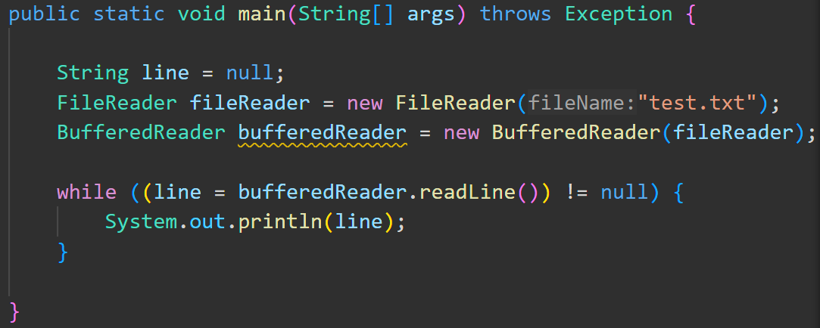
Working with resources in java
Notes:
Let me start by briefly talking about using resources in Java.
Here we are using the FileReader and BufferedReader classes to read through a text file line by line.
This code relies on a text file named “test.txt” being present. But what happens if the file is missing?
That’s right, it could throw an exception. So what should we do?

Slide 3
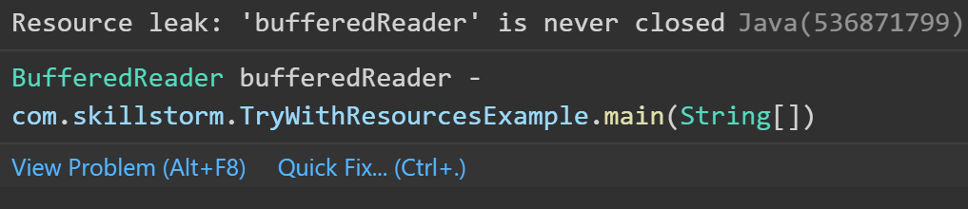
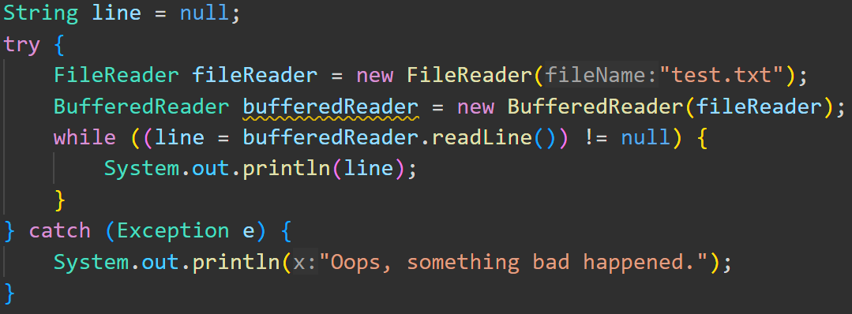
Working with resources in java
Notes:
We can place our code in a try/catch block.
Now, if for some reason, the file isn’t where we expect it, instead of an exception halting our program abruptly, we can “fail gently” by instead printing something to the screen to indicate that there was a problem.
But what else did I forget?
***click***
Ah, that’s right. I never closed the file in my code. This causes a resource leak!

Slide 4
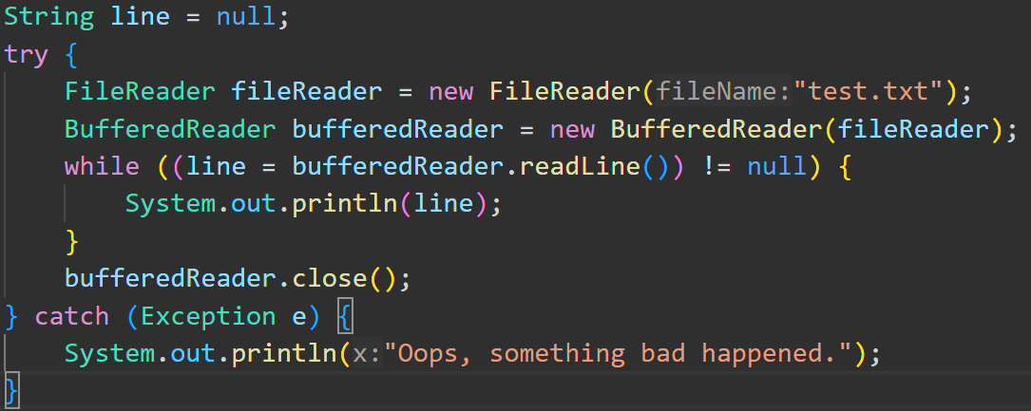
Working with resources in java
Notes:
Now, I could just add a statement to close my file just after the while loop, but if an exception is thrown before that line, it will never get executed, and our file will never be closed!
The next line of thought may lead us to also close the file in the catch block, just in case there was an exception, but that would be duplicating code, and bad practice.
Before Java 7, what you WOULD do is close the file in the finally block.

Slide 5
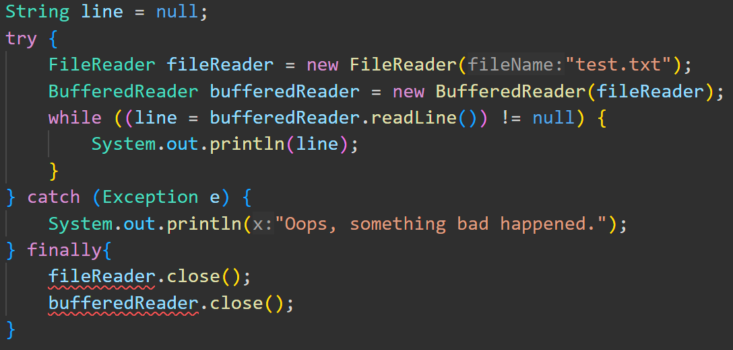
Working with resources in java
Notes:
Since the finally block ALWAYS executes regardless of whether an exception was thrown, in older versions of Java, it was common practice to use the finally block to close resources.
This right here is how that would look, but since I’m using Java 8, my IDE is flagging it because my resource objects are actually out of the scope of the finally block.
This code is also starting to get a little cumbersome, and there is STILL the possibility of a resource leak if the print line and close methods BOTH throw exceptions!
So what do we do instead in modern versions of Java? We use Try-With-Resources!

Slide 6
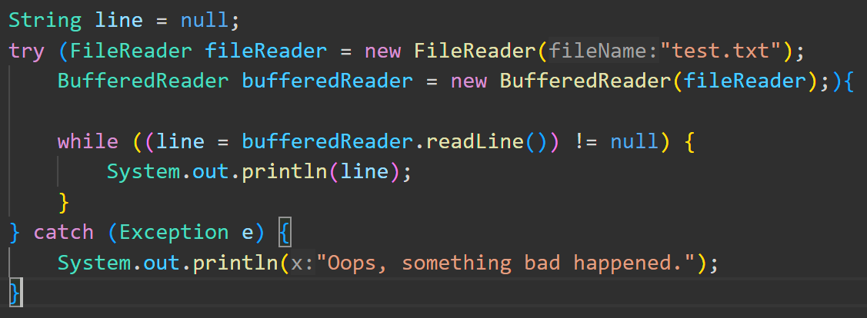
Try-with-resources
Notes:
With this feature, the Developers of Java have given us a more efficient and less error-prone way to handle resources.
First, we hand the resources inside parenthesis when we start a try catch block.
Now, our resources will be available in the scope of both the try, catch and finally blocks while they’re needed, and Java will automatically close them afterward for us!
This is really convenient, and makes our code more concise and easy to read. Plus, we don’t have to worry about forgetting to close our resources.
We can also still use the catch and finally blocks if needed. The resources will be automatically closed before the catch or finally block is run.
This feature is available in Java 7 and later, and possible for any resources that implement the java.lang.AutoCloseable interface.

Slide 7
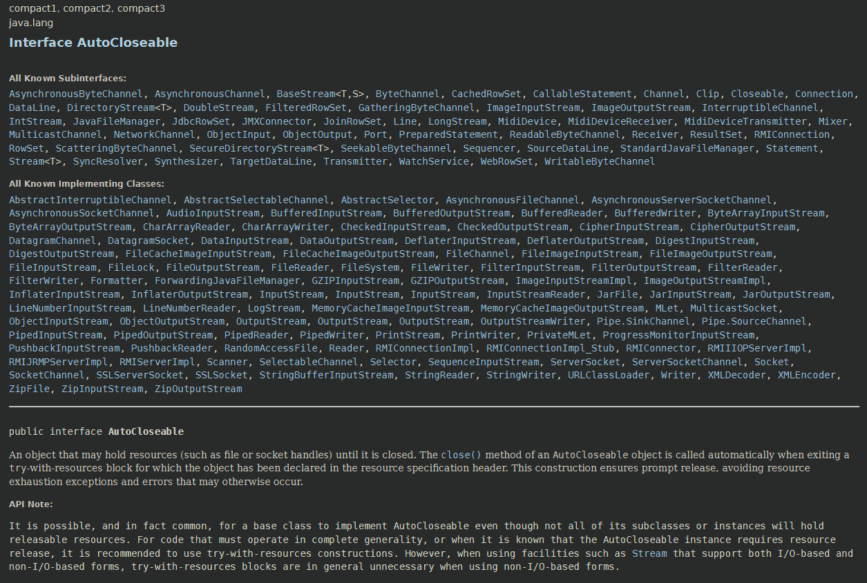
Try-With-Resources
Notes:
As you can see here, there are a lot of resources that are Auto-Closeable. So, in the future, when you’re working with external files, databases, network connections, etc., try-with-resources will be there to help.

Slide 8

THANK YOU FOR LISTENING!
APPLAUSE

