Slide 1

Switch Statements in Java
Joshua Holland

Slide 2
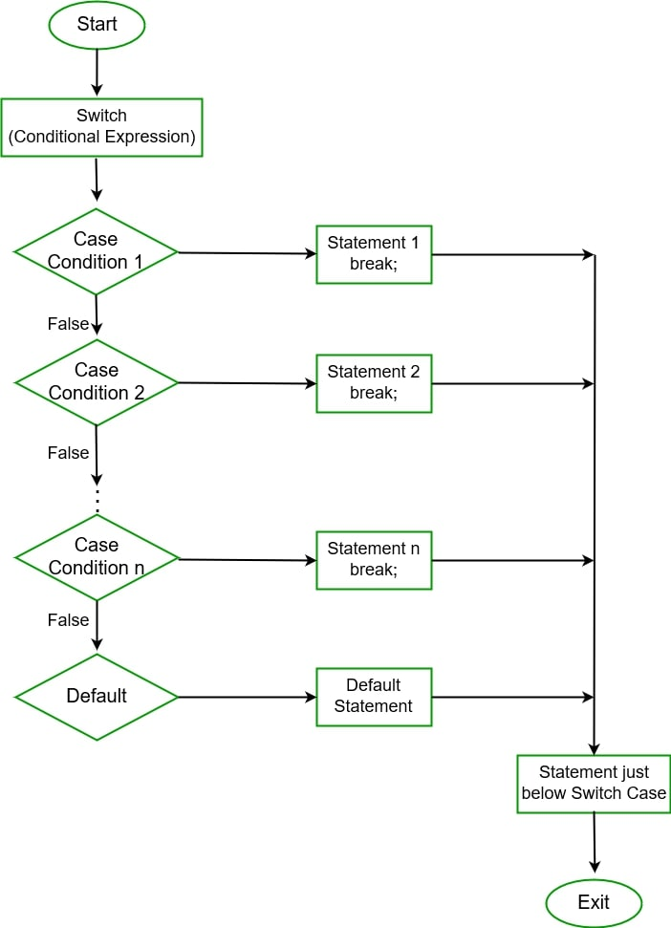
What is a switch statement?
Logic statement similar to if/else
Evaluates equality of case values with expression
Expression can be any of the following data types:
Byte
Short
Char
Int
String

Slide 3
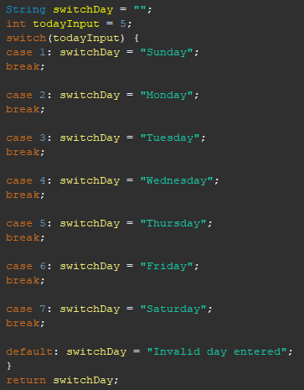
What is a switch statement?
Logic statement similar to if/else
Evaluates equality of case values with expression
Expression can be any of the following primitive data types:
Byte
Short
Char
int

Slide 4

Rules to remember for switch statements
No duplicate case values

Slide 5

Rules to remember for switch statements
No duplicate case values
Case value must match the data type of the variable in the switch

Slide 6
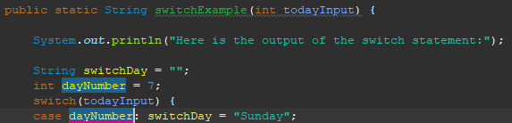
Rules to remember for switch statements
No duplicate case values
Case value must match the data type of the variable in the switch
Case value must be constant or literal. No variables.

Slide 7
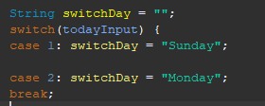
Rules to remember for switch statements
No duplicate case values
Case value must match the data type of the variable in the switch
Case value must be constant or literal. No variables.
The break statement is used inside the switch to terminate the sequence.

Slide 8
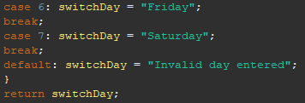
Rules to remember for switch statements
No duplicate case values
Case value must match the data type of the variable in the switch
Case value must be constant or literal. No variables.
The break statement is used inside the switch to terminate the sequence.
The default statement is optional. If not at the end, it's recommended to include a break statement after.

Slide 9
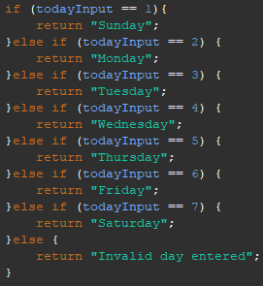
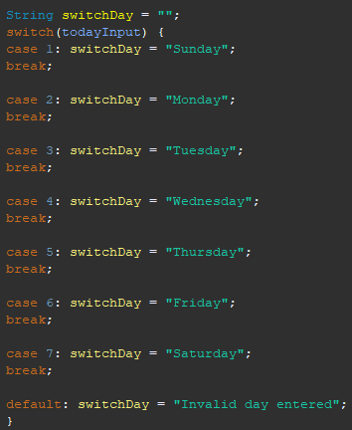
Why use a switch statement?
More readable and organized code
Avoid long chains of if-else-if statements
Improve the performance by reducing the number of comparisons needed to find the matching case

