Slide 1
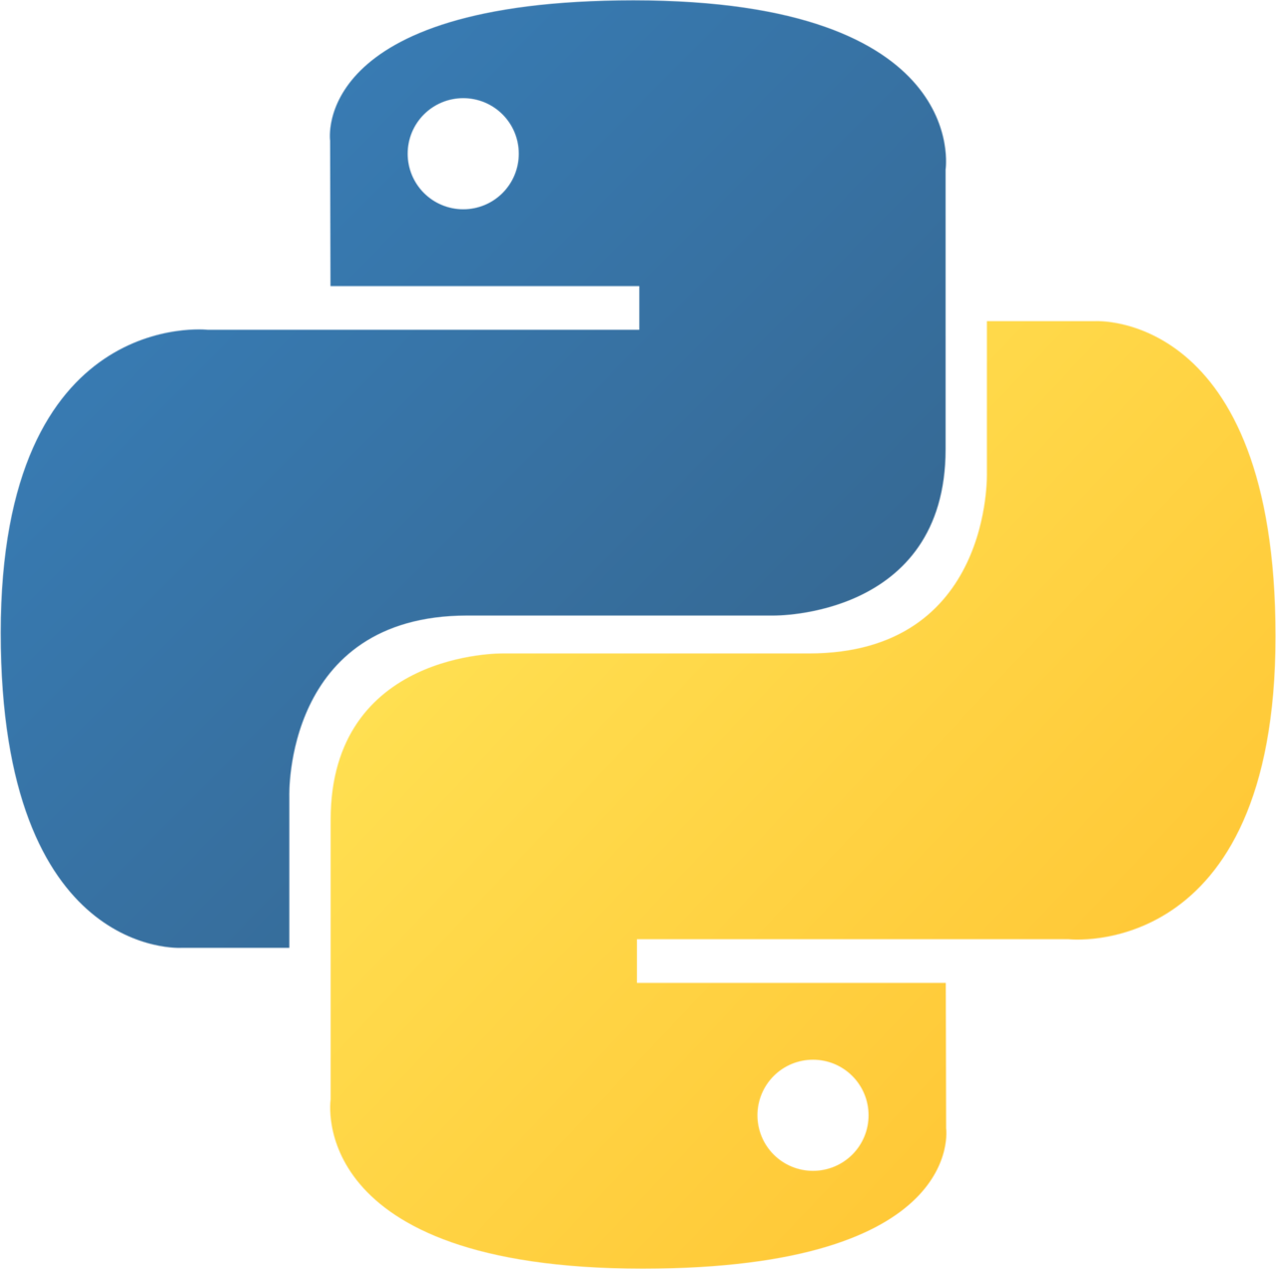

Java Vs. Python Programming
Joshua Holland

Slide 2

Python
High-level object-oriented interpreted language
Dynamically typed
Created in 1991 by Guido Van Rossum
Huge amount of library support
Syntax focuses on readability

Slide 3

Java
Uses the JVM (Java Virtual Machine) to run source code
High-level, object-oriented compiled language
Created in 1995 by James Gosling at Sun Microsystems
Statically Typed
Similar syntax to C-based languages
Platform-independent (WORA – Write Once Run Anywhere)

Slide 4





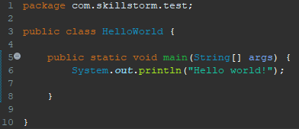

JAVA
PYTHON
Compiled, Statically Typed
Key Features
Interpreted, Dynamically Typed
Verbose, Complex, Rigid
Syntax
Simple, Concise, Expressive
Faster (Compilation, Static Typing)
Speed
Slower (interpreting, types)
Robust standard and enterprise libraries
Libraries
Rich set built-in/3rd party modules
Reliable automated refactoring due to typing
Legacy
Rapid Deployment, popular for DevOps

Slide 5
Conclusion
Both have their own strengths and weaknesses
Looking for simplicity/rapid deployment? You might want to use Python.
Looking for speed, portability or enterprise applications? You might want to go with Java.
Personal preference!

