Slide 1



Try-With-Resources in Java
Josh Holland
Notes:
Hi, I’m Josh, and today I will be discussing the use of try-with-resources in Java.

Slide 2
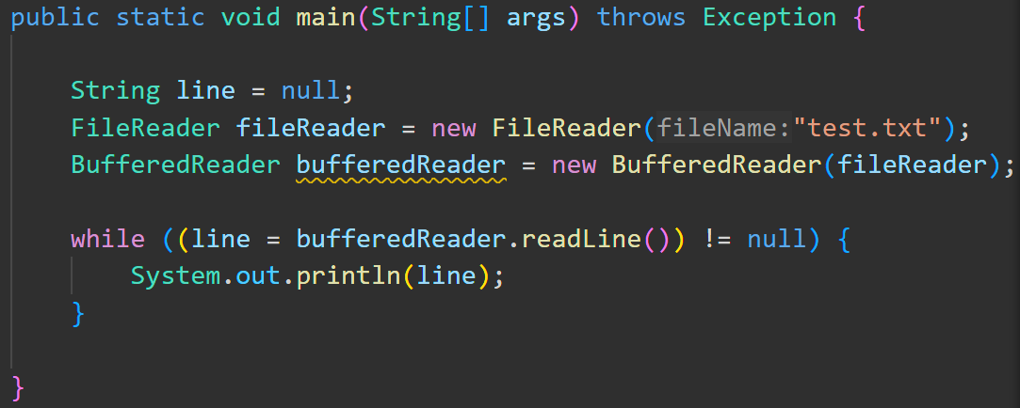
Working with resources in java
Notes:
Let me start by briefly talking about using resources in Java.
Here we are using the FileReader and BufferedReader classes to read through a text file line by line.
This code relies on a text file named “test.txt” being present. But what happens if the file is missing?
That’s right, it could throw an exception. So what should we do?

Slide 3
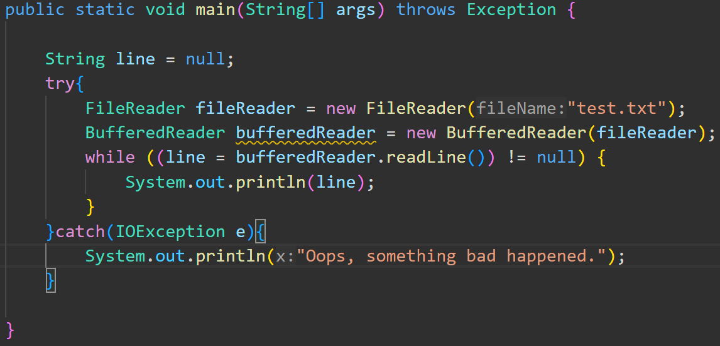
Working with resources in java
Notes:
We can place our code in a try/catch block.
Now, if for some reason, the file isn’t where we expect it, instead of an exception halting our program abruptly, we can “fail gently” by instead printing something to the screen to indicate that there was a problem.
But what else did I forget?

Slide 4
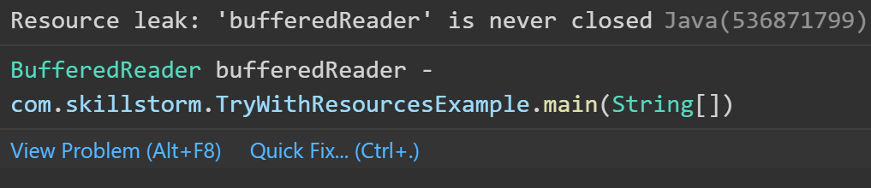
Working with resources in java
Notes:
Ah, that’s right. I never closed the file in my code. This causes a resource leak!
Now, I could just add a statement to close my file just after the while loop, but if an exception is thrown, the file still won’t be closed.
The next line of thought would lead you to maybe also close the file in the catch block, but that would be duplicating code, and bad practice.

Slide 5
Working with resources in java
Notes:
Before Java 7, what you WOULD do is close the file in the finally block.

Slide 6
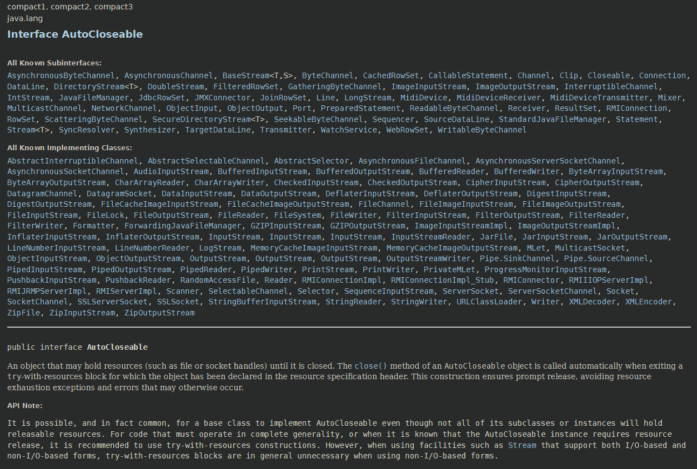
Try-With-Resources

