Slide 1
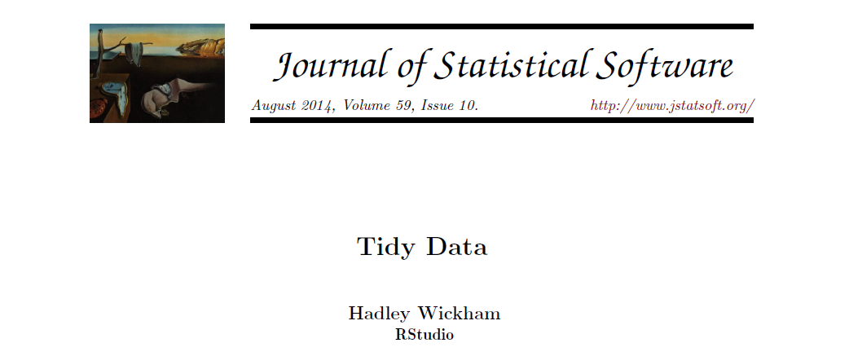
Happy families are all alike; every unhappy family is unhappy in its own way. Leo Tolstoy Like families, tidy datasets are all alike but every messy dataset is messy in its own way.

Slide 2
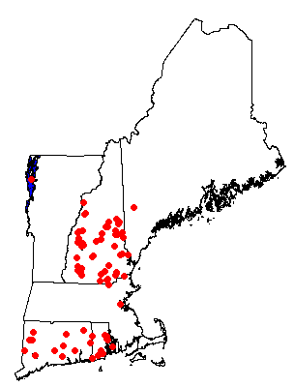
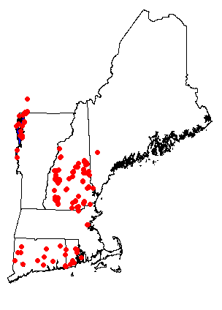
Cyano Monitoring 2014
75 Waterbodies
227 Locations

Slide 3
Number of Observations
4728 observations
1035 for Beagle/Unfrozen/Unfiltered

Slide 4
Number of Waterbodies by Organization

Slide 5
Samples by Depth

Slide 6
Samples by Method

Slide 7
Samples by Units

Slide 8
Data Report Available
https://github.com/willbmisled/Reg1Cyano/blob/master/Data2014/Data2014.md
Data Available in CSV format
What is CSV Format?

Slide 9
Next Steps
QA/QC
Compare aggregated data to the raw data
Validate locations
Redefine Locations and Lakes
Create Wide Format Views for Analysis
Add missing data
Add Ancillary Data
Phone App

