Slide 1
Computational ecology approaches to understanding cyanobacteria: It's just ecology but with more computers!
Jeff Hollister, Stephen Shivers, Sophie Fournier, and Betty Kreakie

Slide 2
Partners and collaborators
ACESD Computational Ecology
Me
Betty Kreakie
Stephen Shivers
Sophie Fournier
Alums: Farnaz Nojavan, Bryan Milstead
Anne Kuhn
ACESD
Jonathan Serbst
Steve Rego
Barbara Sherman
???
EPA Region 1
Hilary Snook
Katrina Kipp
EPA Region 7
Steve Krabbe
Chris Taylor
Laura Webb
Steve Baker
Gary Welker
Elsewhere in ORD
Ann Vega
Jake Beaulieu
Blake Schaeffer
Jay Christensen
Betsy Hilborn
Elsewhere in EPA
Shelly Thawley
David Smith
???
USGS
Keith Loftin
Jennifer Graham
???
URI
Elizabeth Herron
Linda Green
Art Gold
Q Kellogg
RIDEM
Bryan Zalewsky
Jane Sawyers
Sue Kiernan
Rhode Island
Friends of Warwick Pond
Mashapaug Folks
???

Slide 3
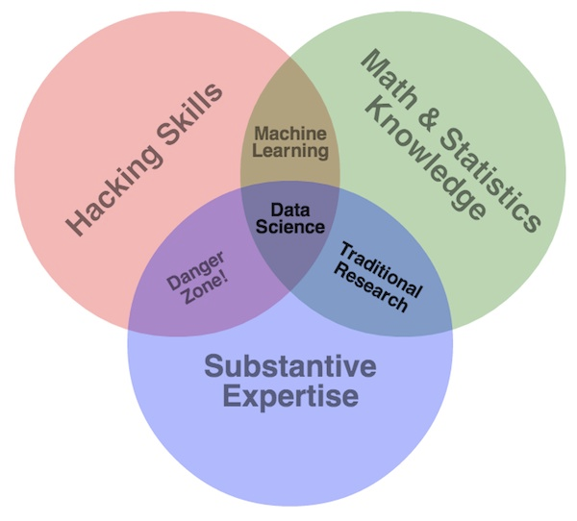
What is computational ecology?
Subset of data science
Interdisciplinary
Combines:
Programming
Mathematical/statistical methods
ecological subject-specific expertise
Drew Conway’s Data Science Venn Diagram: http://drewconway.com/zia/2013/3/26/the-data-science-venn-diagram

Slide 4
What are we doing to support computation ecology research?
Advocate
Computational/Data Intensive Research
Agency data science initiatives
Build expertise
Support other research efforts
Apply to our own research
Current focus: Freshwater ecology and HABs

Slide 5
How we do computational ecology: Past projects (cyano free)

Slide 6
How we do computational ecology: Why Cyanobacteria
Primordial ooze
They are everywhere
Problems with excess nutrients
Toxins
Hypoxia
Agency Priority
Lots we don’t know

Slide 7
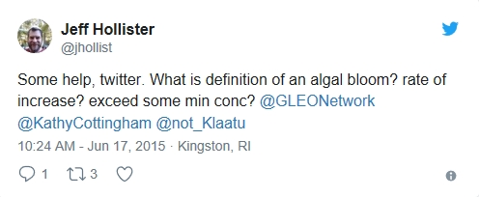
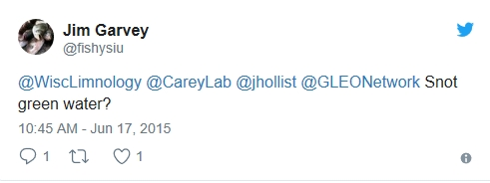
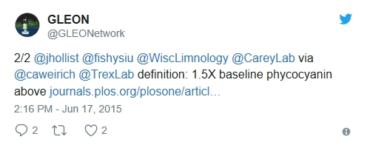
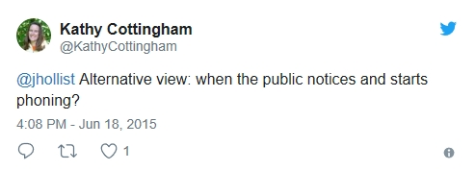
How we do computational ecology: Associations between microcystin and chlorophyll
Hollister and Kreakie. (2016). Associations between Chlorophyll a and various Microcystin-LR Health Advisory Concentrations. F1000Research
Uses NLA 2007
Empirical method to answer, “What is a bloom?”
Published at F1000Research immediately after clearance

Slide 8
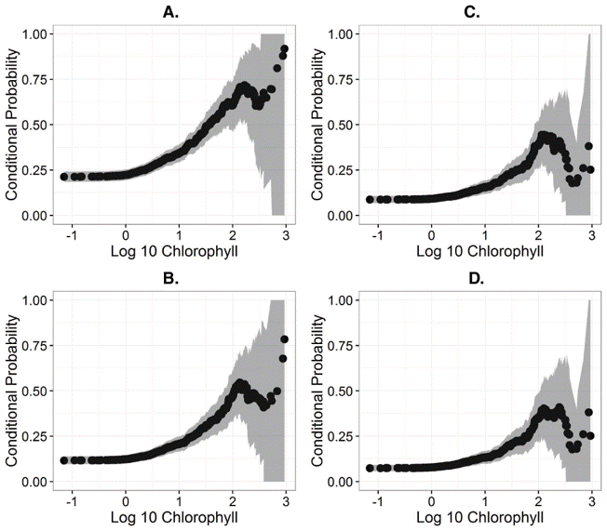
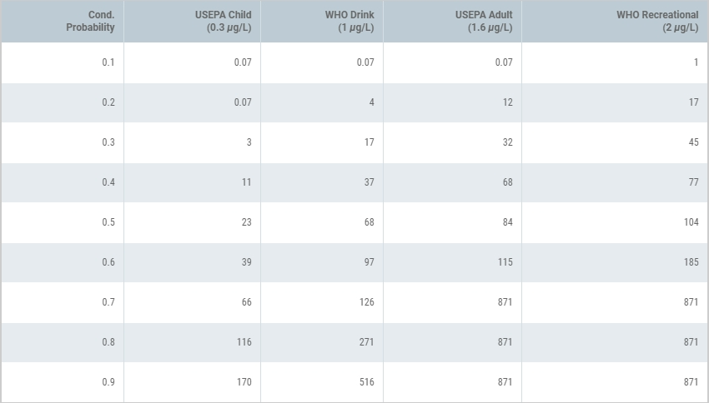
How we do computational ecology: Associations between microcystin and chlorophyll
Hollister and Kreakie. (2016). Associations between Chlorophyll a and various Microcystin-LR Health Advisory Concentrations. F1000Research
Uses NLA 2007
Empirical method to answer, “What is a bloom?”
Published at F1000Research immediately after clearance

Slide 9
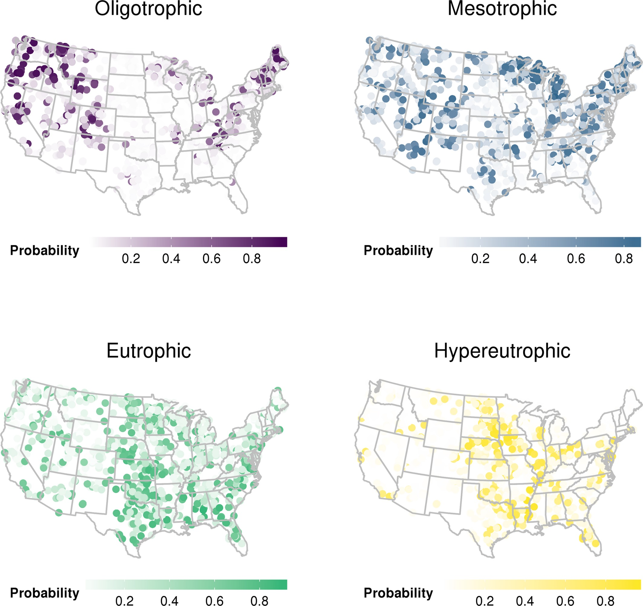
How we do computational ecology: Lake trophic state and random forests
Hollister et al. (2016). Modelling lake trophic state: a random forest approach. Ecosphere
Uses NLA 2007
Random forests to predict chlorophyll a based trophic state
After clearance, before peer-review published as a PeerJ Preprint

Slide 10
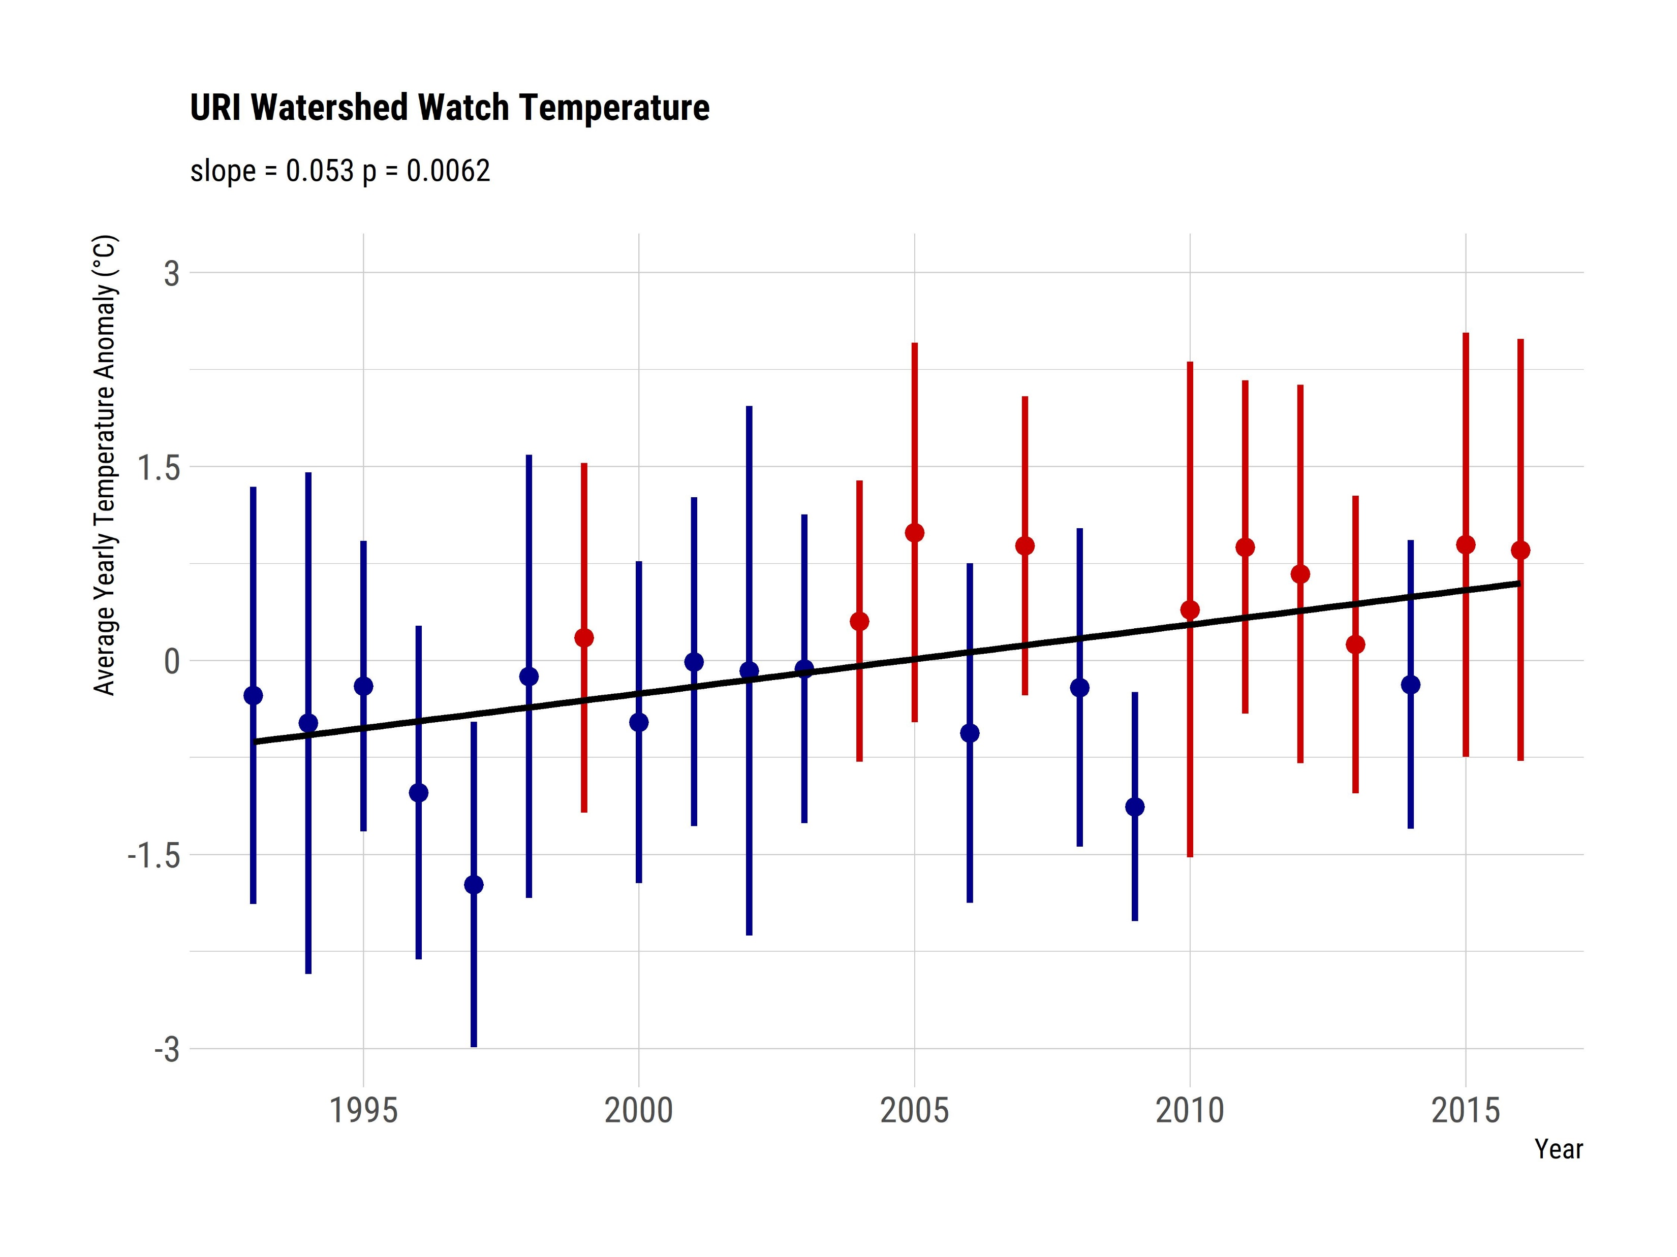
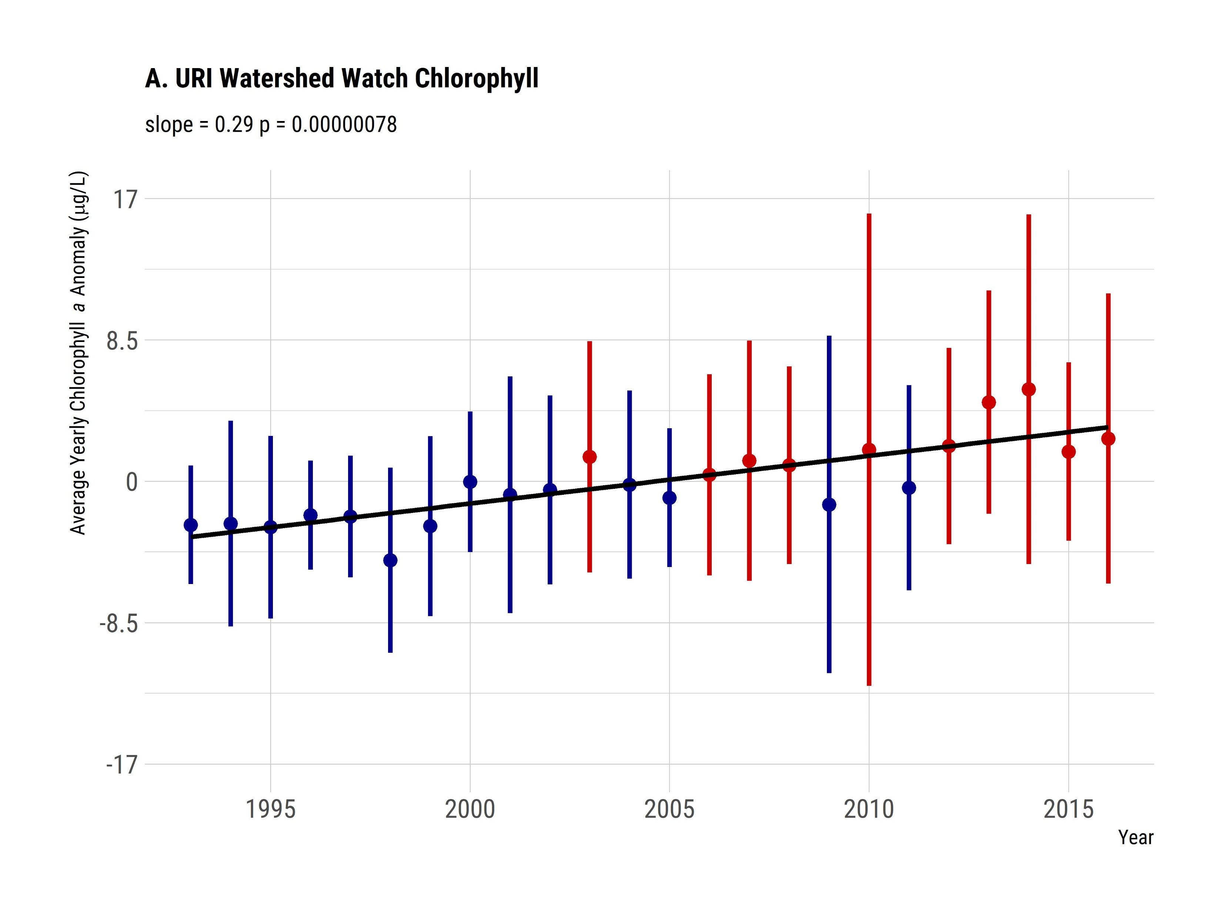
How we do computational ecology: Rhode Island water quality trends
Hollister et al. (In Review) Increasing Chlorophyll a Amid Stable Nutrient Concentrations in Rhode Island Lakes and Reservoirs. Ecosphere
What are the long term water quality trends in RI lakes and reservoirs
URI Watershed Watch and LAGOSNE
Why computational?
Big(ish) data
Develop/modified analytical methods
Open science

Slide 11
What are the limits to using existing data?

Slide 12
Stop, Shivers time…

Slide 13
Why is our Rhode Island work, computational?

Slide 14
What’s next: FLAMe and buoys

Slide 15
What’s next: CHEAP

Slide 16
What’s next: Cape Cod and Shubael’s Pond

Slide 17
What’s next: SURGE

