Slide 1
Computational ecology approaches to understanding cyanobacteria: It's just ecology but with more computers!
Jeff Hollister, Stephen Shivers, Sophie Fournier, and Betty Kreakie

Slide 2
Partners and collaborators
ACESD Computational Ecology
Me
Betty Kreakie
Stephen Shivers
Sophie Fournier
Alums: Farnaz Nojavan, Bryan Milstead
Anne Kuhn
Elsewhere in EPA
Shelly Thawley
David Smith
???
URI
Elizabeth Herron
Linda Green
Art Gold
Q Kellogg
USGS
Keith Loftin
Jennifer Graham
???
RIDEM
Bryan Zalewsky
Jane Sawyers
Sue Kiernan
EPA Region 1
Hilary Snook
Katrina Kipp
Rhode Island
Friends of Warwick Pond
Mashapaug Folks
???
EPA Region 7
Steve Krabbe
Chris Taylor
Laura Webb
Steve Baker
Gary Welker
Elsewhere in ORD
Ann Vega
Jake Beaulieu
Blake Schaeffer
Jay Christensen

Slide 3
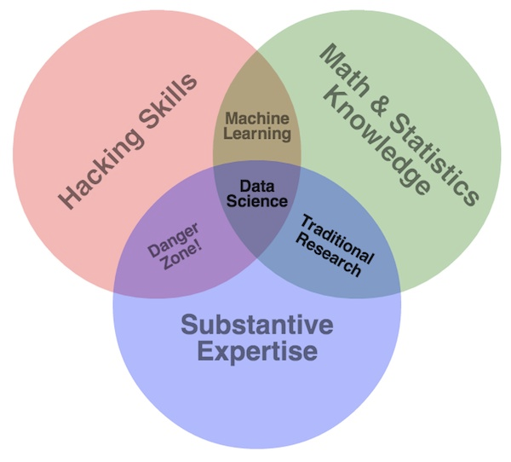
What is computational ecology?
Subset of data science
Interdisciplinary
Combines:
Programming
Mathematical/statistical methods
ecological subject-specific expertise

Slide 4
How we do computational ecology: ACESD Approach
Advance ACESD and EPA research with the use of computational and data intensive approaches
Build expertise in data science, modelling, and informatics
Integrate lab, field, and existing data to answer EPA relevant questions
Provide training for both ORD and the Agency
Support and advocate for Agency-wide data science initiatives
Current focus: Freshwater ecology and HABs

Slide 5
How we do computational ecology: Past projects (cyano free)

Slide 6
How we do computational ecology: Cyanobacteria
Why cyanos?

Slide 7
How we do computational ecology: Associations between microcystin and chlorophyll

Slide 8
How we do computational ecology: Lake trophic state and random forests

Slide 9
How we do computational ecology: Rhode Island water quality trends

Slide 10
What are the limits to using existing data?

Slide 11
Stop, Shivers time…

Slide 12
Why is our Rhode Island work, computational?

Slide 13
What’s next: FLAMe and buoys

Slide 14
What’s next: CHEAP

Slide 15
What’s next: Cape Cod and Shubael’s Pond

Slide 16
What’s next: SURGE

