Slide 1
Introduction To R
EPA’s Emerging Leaders Network 2021-02-24 Jeff Hollister, ORD/CEMM/ACESD

Slide 2
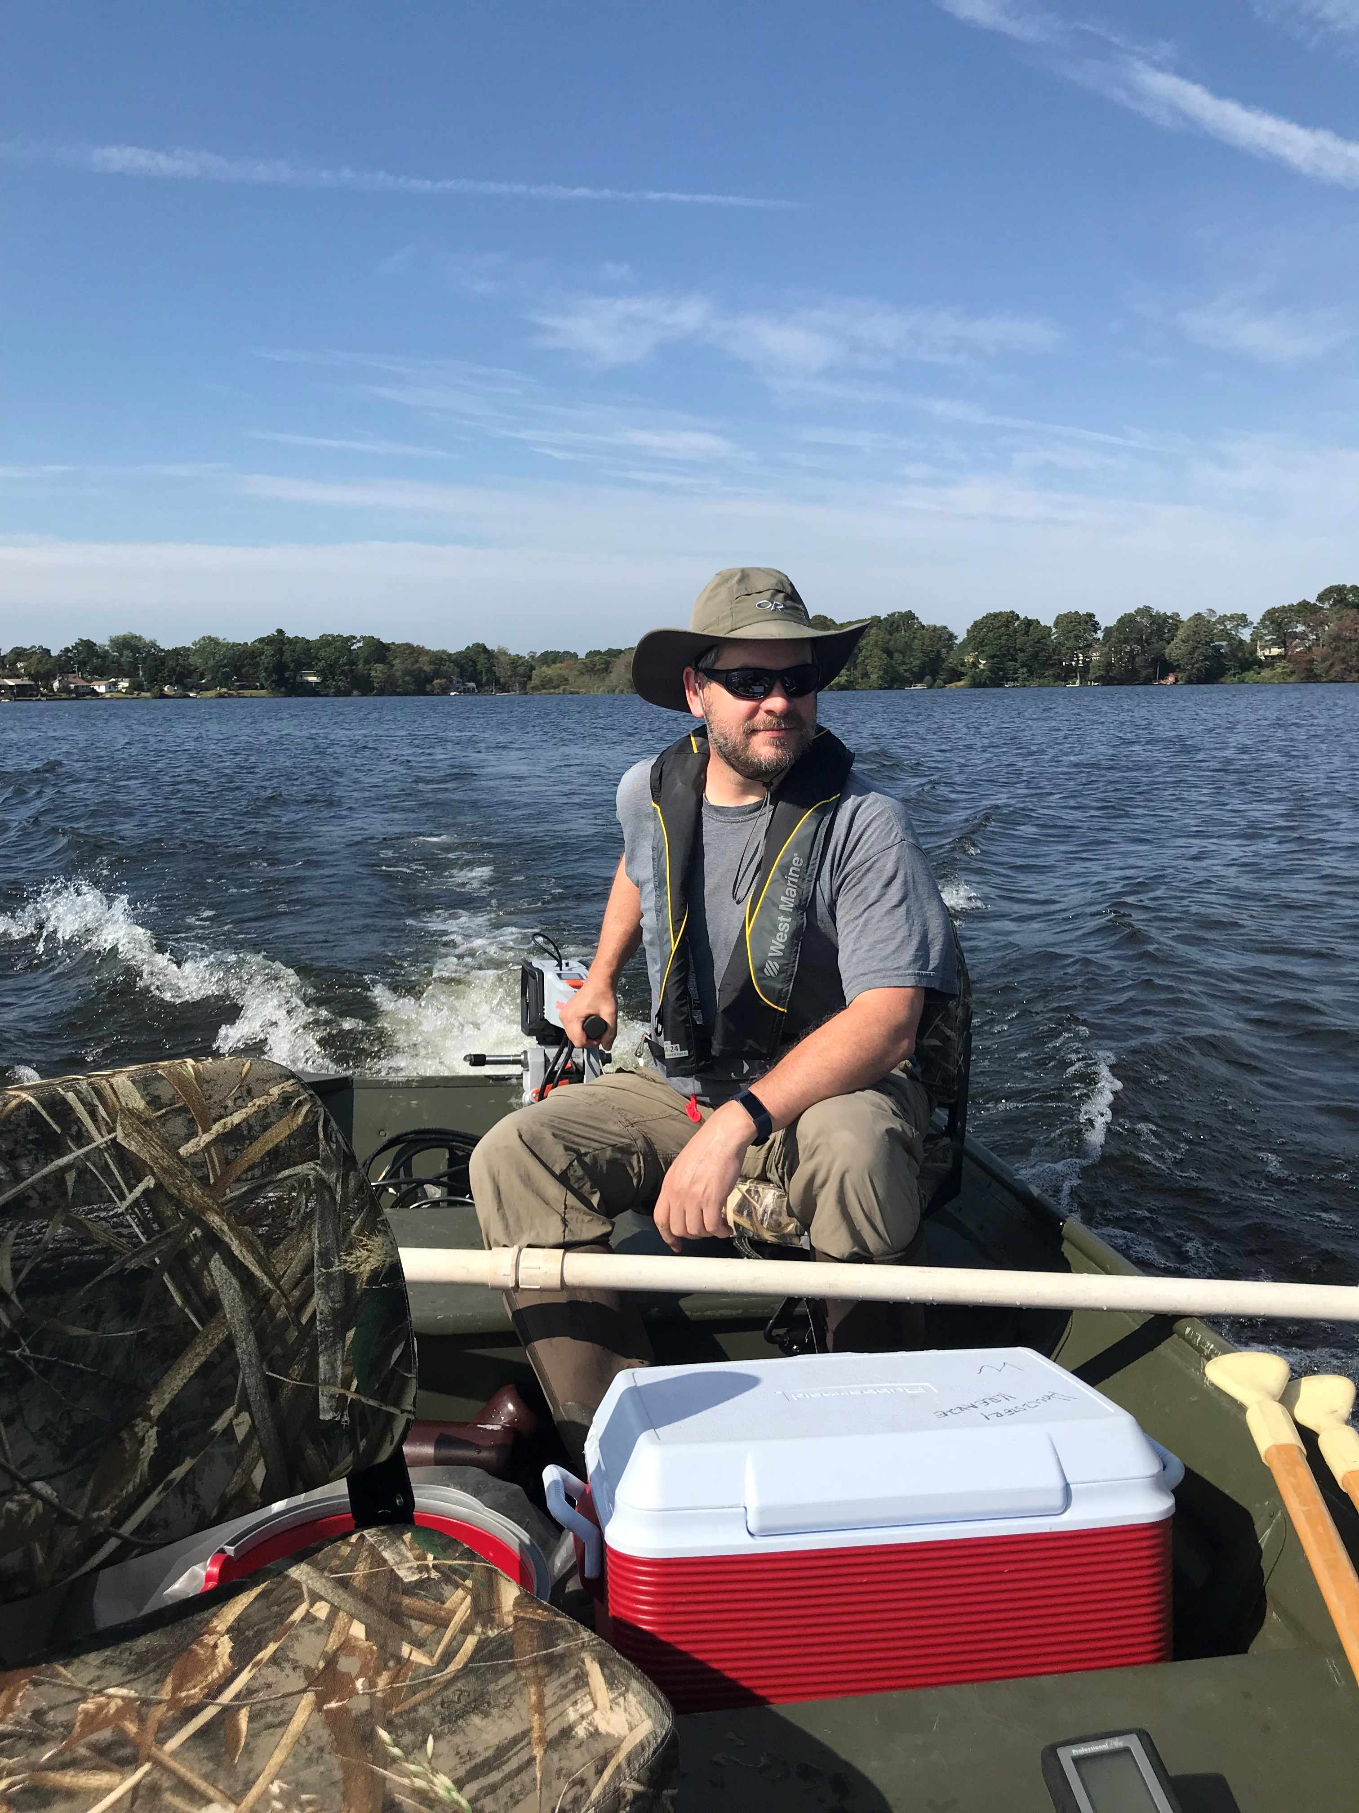
Who am I?
Landscape ecology/GIS/Lakes/Data Science
US EPA Research Ecologist since ~2006
Worked on: Forests, wetlands, gopher tortoise, estuaries, lakes, cyanobacteria, …
useR since 2000 (yikes!)
Jeff in the jon boat

Slide 3
What is R?

Slide 4
Why use R?

Slide 5
Why I use R?

Slide 6
Python vs. R

Slide 7
Python vs. & R

Slide 8
R and EPA
R Users Group
Installations

Slide 9
Base R

Slide 10
Extending Base R: Packages

Slide 11
What can you do with R?

Slide 12
Statistics

Slide 13
Geospatial/GIS

Slide 14
Documents

Slide 15
Web applications

