Slide 1
Introduction To R
EPA’s Emerging Leaders Network 2021-02-24 Jeff Hollister, ORD/CEMM/ACESD

Slide 2

Who am I?
Landscape ecology/GIS/Lakes/Data Science
US EPA Research Ecologist since ~2006
Worked on: Forests, wetlands, gopher tortoise, estuaries, lakes, cyanobacteria, …
useR since 2000 (yikes!)
Jeff in the jon boat

Slide 3

What is R?
“Free software environment for statistical computing and graphics”
Dialect of the S language
Written by Ross Ihaka and Robert Gentleman
First Release in 1993, version 1.0 in 2000
Current version 4.0.4 (aka “Lost Library Book”) released Feb 2021.
Fully functional, general purpose programming language
Excels at statistics and visualization
Why is it called “R”?

Slide 4
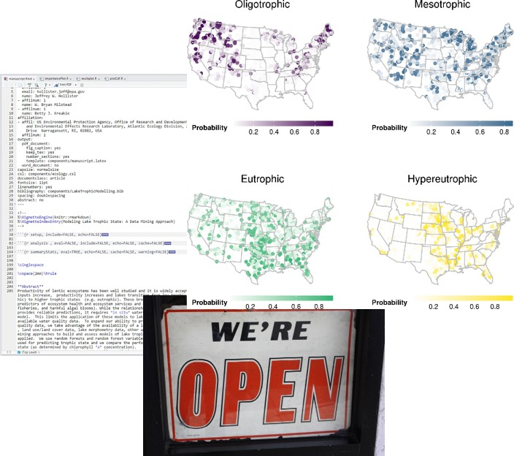
Why use R?
Free!
Statistics and Graphics
GIS/Spatial
Writing Papers
Presentations (like this one)
Develop new tools
Reproducibility
Open Science

Slide 5
Python vs. R

Slide 6
Python vs. & R

Slide 7
R and EPA
R Users Group
Installations

Slide 8
Base R

Slide 9
Extending Base R: Packages

Slide 10
What can you do with R?

Slide 11
Statistics

Slide 12
Geospatial/GIS

Slide 13
Documents

Slide 14
Web applications

Slide 15
Learn More
#rstats

